Slide 1
Energy:Past, Present, and Future
Lesson 10

Slide 2
Objectives
By the end of the lesson, the students should be able to:
Describe the major sources and uses of energy in the past, present, and future.
Identify the advantages and disadvantages of different energy sources.
Identify the environmental impact of energy use.

Slide 3


What are the different energy sources you know?

Slide 4
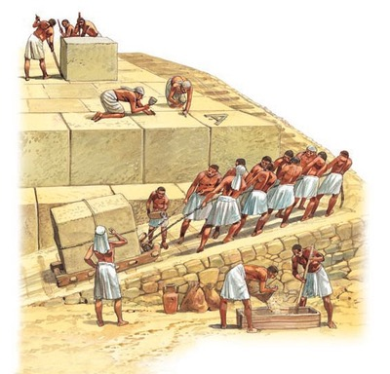
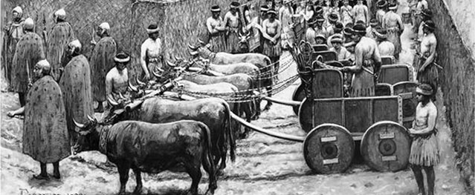
Energy-Past

Slide 5
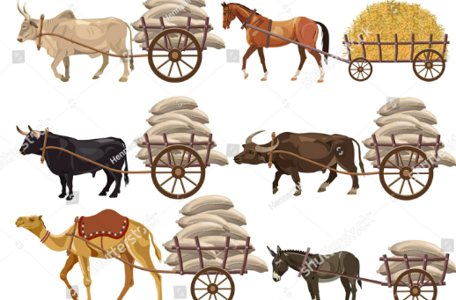
Human and Animal Power
Human Energy
  Labor-intensive tasks such as farming, building, and transportation relied on human muscle power.
Animal Energy
  Animals like oxen, horses, and donkeys were used for plowing fields, transporting goods, and even turning simple machinery like mills.

Slide 6

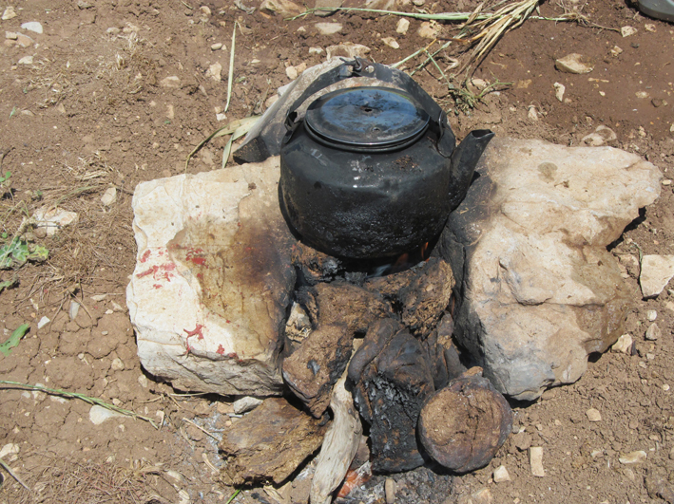
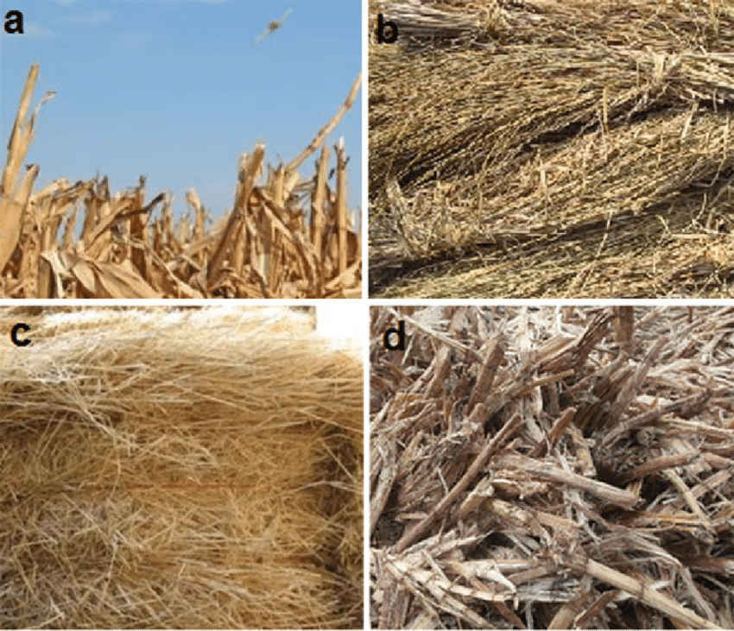
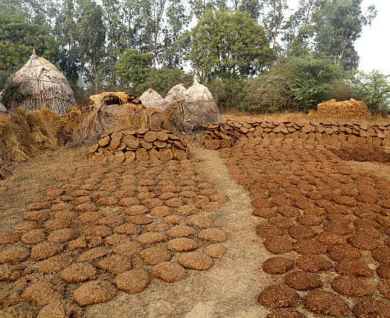
Biomass
Wood
  The primary fuel for cooking, heating, and sometimes small-scale industrial processes.
Crop Residues and Dung
  In areas with limited access to wood, agricultural residues or dried animal dung were used as fuel.

Slide 7


Wind Power
Windmills
  Used for grinding grains into flour or pumping water.
Sailing
  Wind-powered ships were essential for transportation and trade.

Slide 8
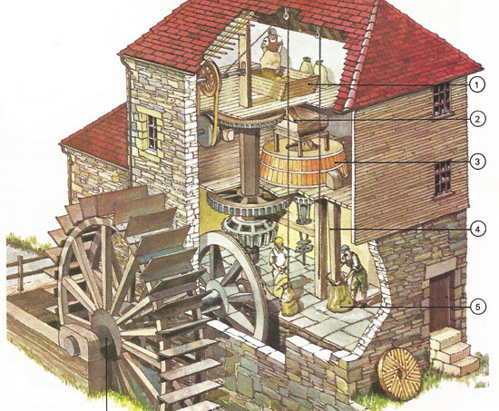
Water Power
Water Wheels
  Utilized for grinding grains, sawing wood, or powering simple industrial machines.

Slide 9

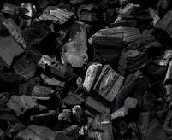
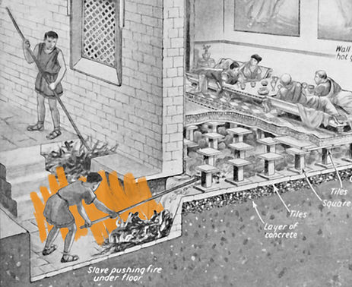
Early Use of Fossil Fuels
Coal
  In some regions, coal was used as early as the Roman period for heating and later for blacksmithing.
  It became more prominent during the Industrial Revolution.

Slide 10

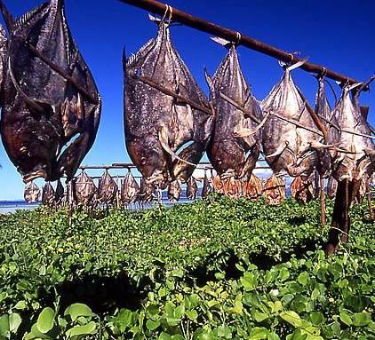

Sunlight
Direct solar energy was used for drying crops, preserving food, and warming dwellings.

Slide 11

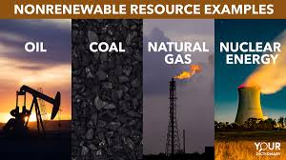
Energy: Present and Future

Slide 12
Energy sources
Non-renewable energy sources
Fossil fuels (coal, oil, natural gas)
Nuclear energy
Renewable energy sources
Solar energy
Wind energy
Hydropower
Geothermal energy
Biomass energy

Slide 13
Fossil Fuels
Fossil fuels are energy sources formed from the remains of plants and animals that lived millions of years ago. Over time, heat and pressure transformed these remains into fuels such as coal, oil (petroleum), and natural gas.
Coal: Formed from plant matter compressed over millions of years.
Oil (Petroleum): Formed from the remains of marine organisms.
Natural Gas: Primarily composed of methane, formed from the decomposition of organic matter.

Slide 14
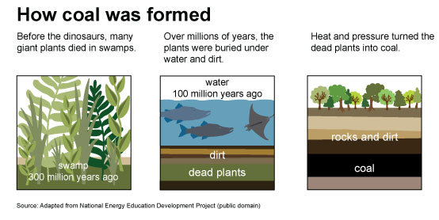

Slide 15
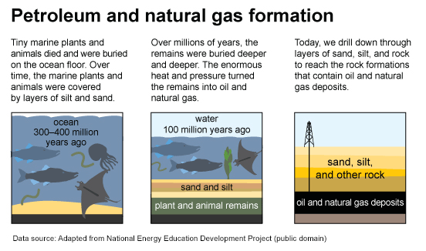

Slide 16
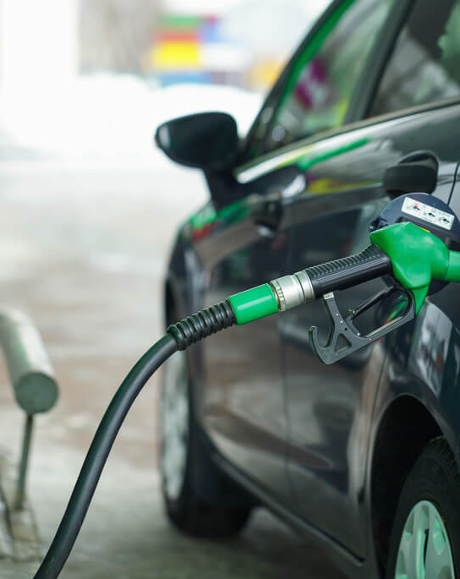
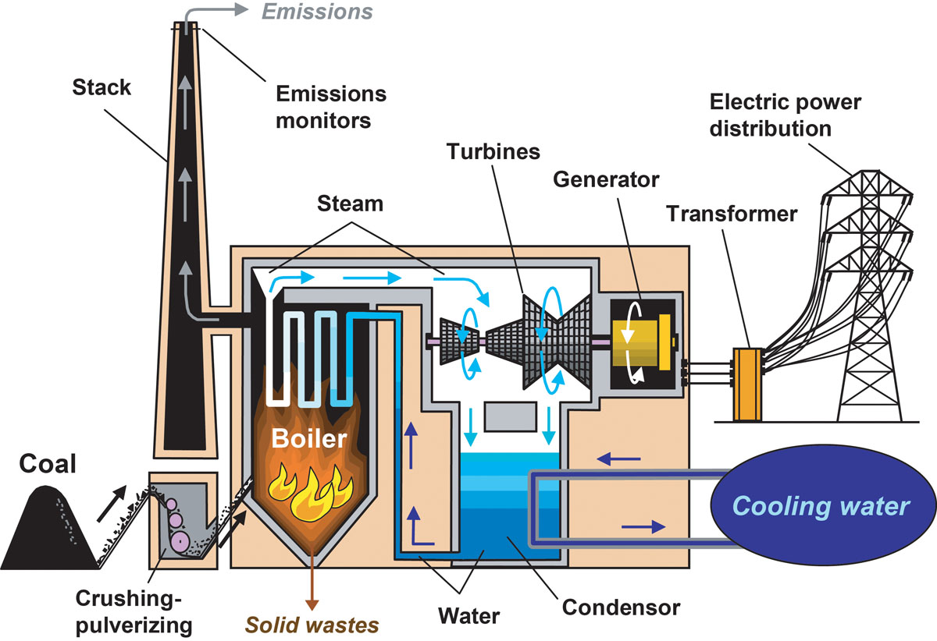

Fossil Fuels
Coal
  Used in power plants to generate electricity and in some industries for heating.
Oil (Petroleum)
  Refined into gasoline or diesel to fuel cars, airplanes, and ships.
  Used to make products like plastics and asphalt.
Natural Gas
  Used in homes for cooking and heating.
  Powers electric generators in some power plants.

Slide 17
Fossil Fuels
Advantages
Abundant and relatively inexpensive.
Produces a large amount of energy from a small amount of fuel.
Established infrastructure
Disadvantages
Contribute to air pollution and greenhouse gas emissions.
Finite resource.
Potential for accidents and spills.

Slide 18
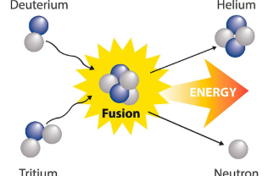
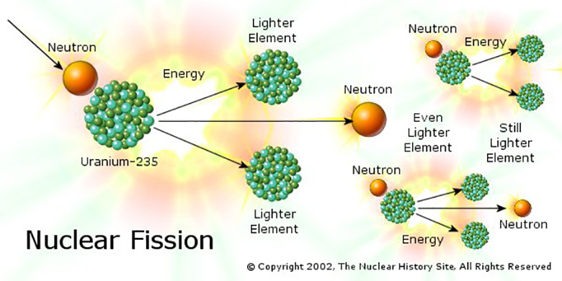
Nuclear Energy
Nuclear Energy is the energy released during nuclear reactions, either by combining (fusion) or through splitting (fission) of atomic nuclei.
It is a powerful energy source commonly used to generate electricity in nuclear power plants.

Slide 19
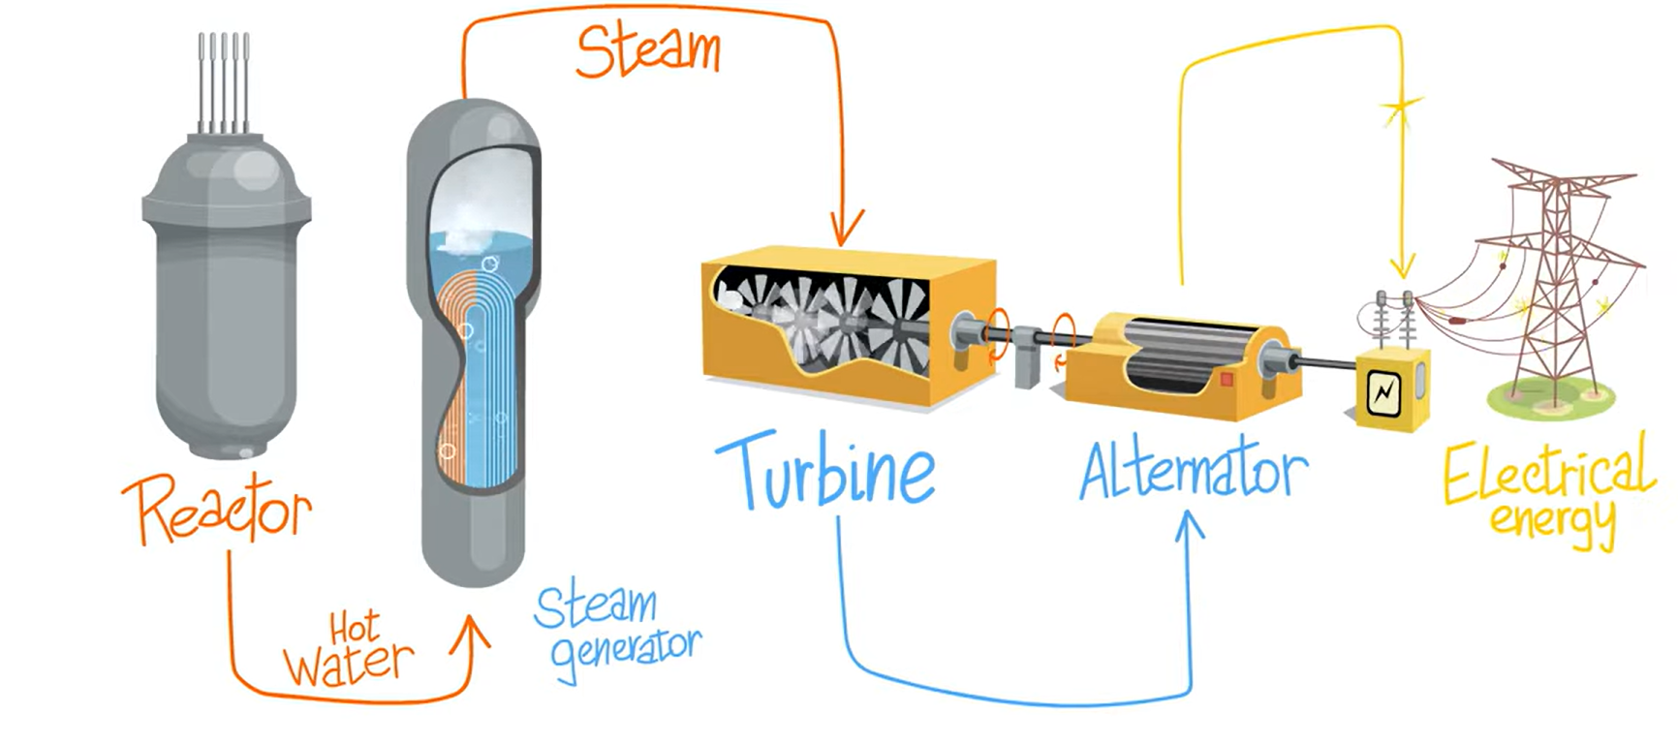
Nuclear Energy
Nuclear Fission
  The most common method in power plants.
Converting Heat to Electricity
Nuclear fission
  Atoms of uranium or plutonium are split, releasing a large amount of energy.
  This energy heats water, which turns turbines to generate electricity.
How does a nuclear power plant work?

Slide 20
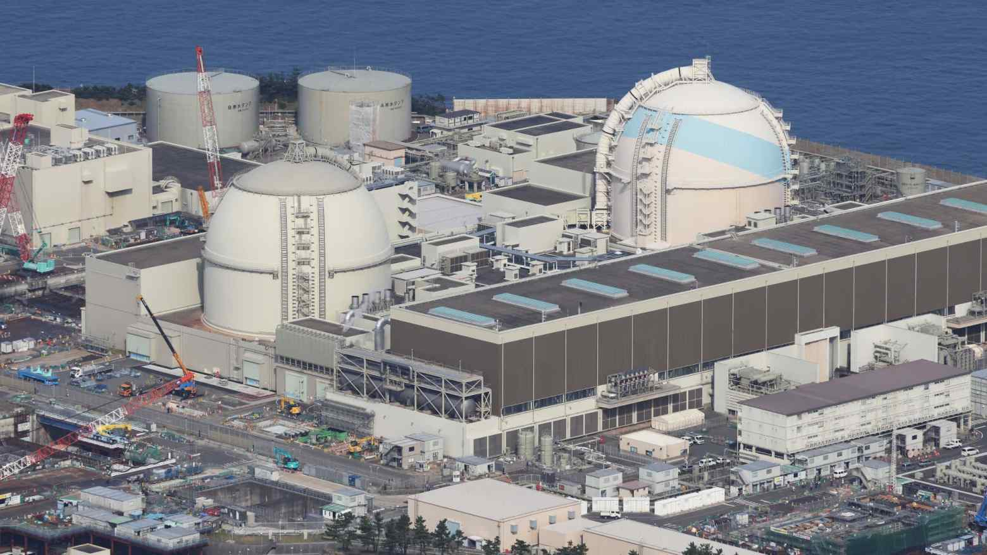
The Genkai nuclear power plant in southwestern Japan

Slide 21
Nuclear Energy
Advantages
Low greenhouse gas emissions.
Produces a large amount of energy from a small amount of fuel.
Reliable power source.
Disadvantages
Nuclear waste disposal
Risk of accidents(like Chernobyl (1986) and Fukushima (2011)).
High initial cost for building power plants

Slide 22
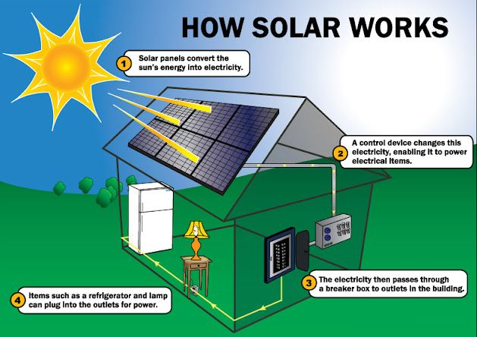
Solar Energy
Solar panels convert sunlight into electricity through photovoltaic cells.
  A photovoltaic cell (solar cell) is an electronic device that converts the energy in the solar radiation that reaches the earth in the form of light (photons) into electrical energy (electrons).
    photoelectric effect: When sunlight hits the solar cell, the energy from the photons excites the electrons in the silicon, freeing them to flow as electric current, which is then harnessed as electrical energy.

Slide 23

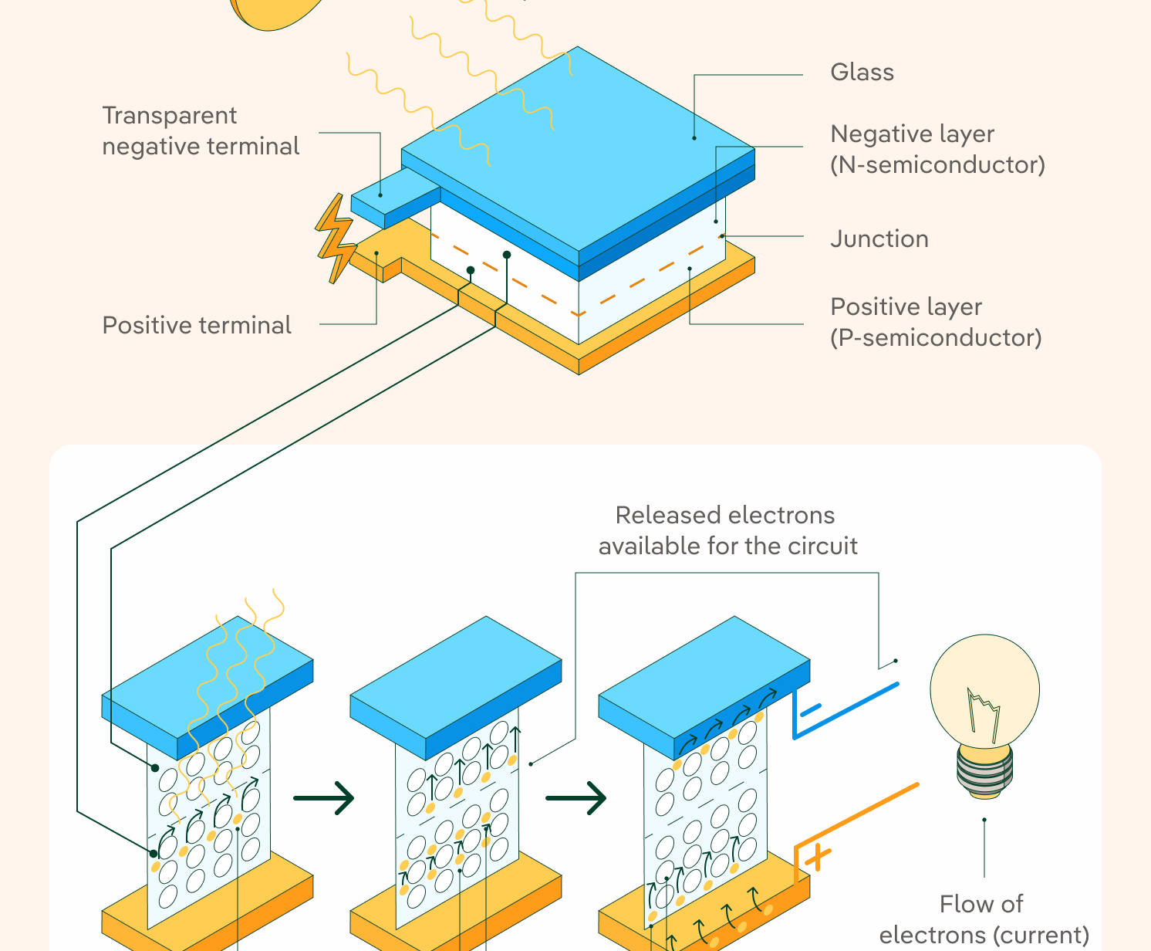
photovoltaic cell (solar cell)

Slide 24
Solar Energy
Advantages
Clean and renewable.
Reduces reliance on fossil fuels.
Can be used for both electricity and heating.
Disadvantages
Initial cost of installation
Weather-dependent
Requires large areas for efficient power generation

Slide 25
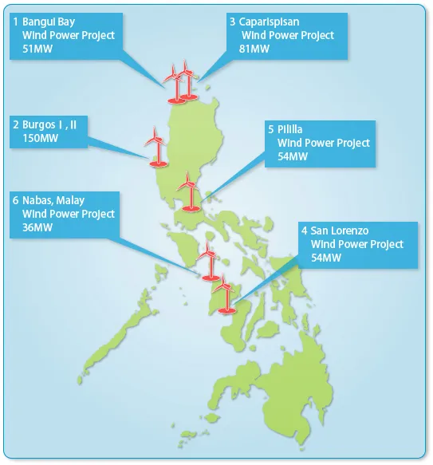
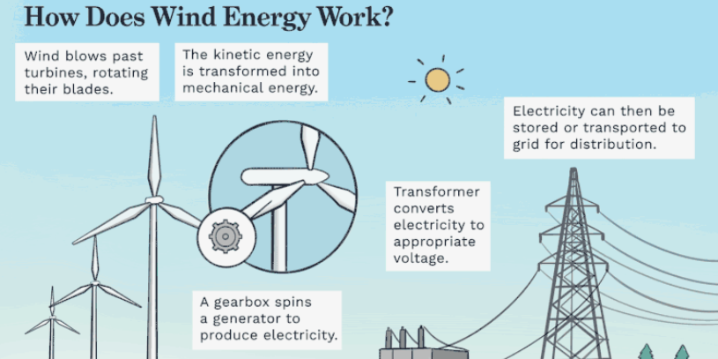
Wind Energy
Wind turbines convert the kinetic energy of wind into electricity.
  Kinetic energy is the energy an object has because of its motion.

Slide 26
Wind Energy
Advantages
Clean and renewable
Low operating costs
Minimal land use
Disadvantages
Wind speed variability
Visual impact
Noise pollution

Slide 27
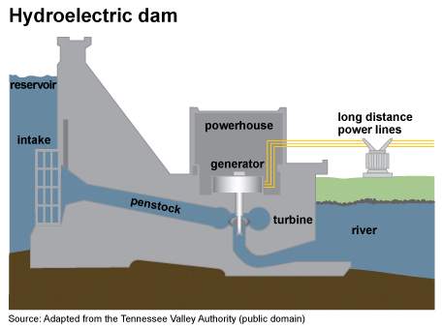
Hydropower
Dams harness the potential energy of water to generate electricity.
  Potential energy is the energy stored in an object due to its position.
Magat Hydro Plant in Luzon has a capacity of 360 MW.
Angat Hydropower Plant in Luzon has a capacity of 218 MW and supplies Manila with 90% of its fresh water.
Agus VI Hydroelectric Plant in Mindanao has a capacity of 200 MW and has been online for over 50 years.

Slide 28
Hydropower
Advantages
Reliable and consistent power source
Low greenhouse gas emissions
Multi-purpose use (e.g., irrigation, flood control)
Disadvantages
Environmental impact on ecosystems
High initial cost of dam construction
Limited availability of suitable sites

Slide 29
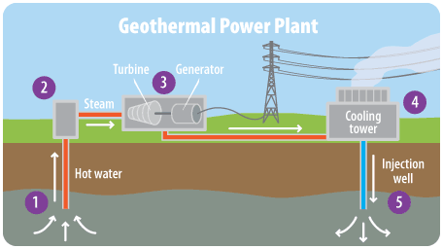
Geothermal Energy
Harnesses heat from the Earth's core to generate electricity.
  Leyte Geothermal Production Field (1,400 MW)
  Makban Geothermal Power Plant
  Tiwi Geothermal Power Plant.

Slide 30
Geothermal Energy
Advantages
Low greenhouse gas emissions
Reliable and consistent power source
Minimal land use
Disadvantages
Limited availability of suitable geothermal sites
Potential for groundwater contamination
High initial cost of installation

Slide 31
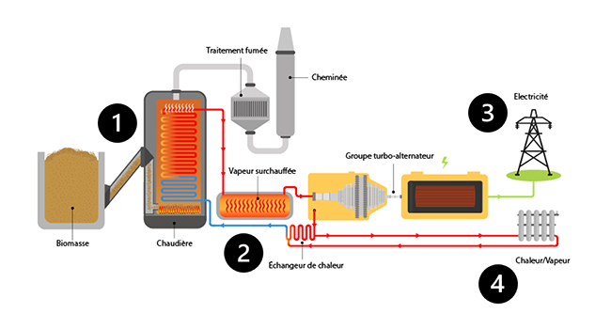
Biomass Energy
Organic matter, such as wood, agricultural waste, or animal manure, is burned to produce heat or electricity.

Slide 32
Biomass Energy
Advantages
Reduces waste
Can be carbon-neutral
Versatile fuel source
Disadvantages
Potential for air pollution
Inefficient energy conversion

Slide 33
Global Energy Challenges
A. Climate Change
Burning coal, oil, and natural gas releases greenhouse gases that contribute to global warming and climate change.
B. Energy Security
Countries need a reliable and affordable supply of energy. Dependence on imported fuel can make countries vulnerable to price changes and supply disruptions.
C. Energy Poverty
Some communities still have limited or unreliable access to electricity and clean energy.
D. Depletion of Fossil Fuels
Coal, oil, and natural gas are finite resources. They take millions of years to form and cannot be replaced quickly.

Slide 34
Cont.
E. Environmental Pollution
Energy production and consumption can contribute to:
  Air pollution
  Water pollution
  Land degradation
  Waste generation
F. Increasing Energy Demand
As population, industries, transportation, and technology grow, the demand for energy also increases.

Slide 35
The Future of Energy
Possible Future Energy Developments
Solar Energy
Solar technology can be used in homes, schools, and communities.
Electric Transportation
Electric vehicles can reduce dependence on gasoline and diesel.
Smart Energy Systems
Technology can help monitor and manage energy consumption more efficiently.

Slide 36
Sustainable Energy Practices
Turn off lights and appliances when not in use.
Use energy-efficient appliances.
Use natural light whenever possible.
Reduce unnecessary use of air-conditioning.
Walk, bike, carpool, or use public transportation when possible.
Use renewable energy when available.
Maintain electrical equipment properly.
Reduce, reuse, and recycle materials.
Plant and protect trees.
Educate others about responsible energy use.

Slide 37
The future is not simply about finding more energy. It is also about using energy more efficiently and responsibly.

Slide 38
Activity: “Energy: Then, Now, and Tomorrow”
Instructions
Form 8 groups. Each group will analyze how energy use has changed over time.
Complete the following:
Period | Main Energy Sources | How Energy Was/Is Used | Problems | Possible Solutions
Past
Present
Future

Slide 39
Rubric
Criteria | Excellent (4) | Good (3) | Fair (2) | Needs Improvement (1)
Analysis of Energy Sources | Clearly identifies appropriate energy sources for the past, present, and future | Identifies most appropriate energy sources | Identifies some energy sources but with limited explanation | Energy sources are unclear or mostly incorrect
Understanding of Energy Use | Clearly explains how energy is/was/will be used | Explains energy use with minor gaps | Gives limited explanation | Explanation is unclear or incomplete
Problems and Challenges | Clearly identifies relevant problems and challenges | Identifies relevant problems with some explanation | Identifies few problems | Problems are unclear or missing
Possible Solutions | Provides realistic and sustainable solutions | Provides appropriate solutions | Provides limited solutions | Solutions are unrealistic or missing
Group Participation & Presentation | All members participate; presentation is clear and organized | Most members participate; presentation is understandable | Some members participate; presentation needs improvement

Slide 40
Criteria | Excellent (4) | Good (3) | Fair (2) | Needs Improvement (1)
Analysis of Energy Sources | Clearly identifies appropriate energy sources for the past, present, and future | Identifies most appropriate energy sources | Identifies some energy sources but with limited explanation | Energy sources are unclear or mostly incorrect
Understanding of Energy Use | Clearly explains how energy is/was/will be used | Explains energy use with minor gaps | Gives limited explanation | Explanation is unclear or incomplete
Problems and Challenges | Clearly identifies relevant problems and challenges | Identifies relevant problems with some explanation | Identifies few problems | Problems are unclear or missing
Possible Solutions | Provides realistic and sustainable solutions | Provides appropriate solutions | Provides limited solutions | Solutions are unrealistic or missing
Group Participation & Presentation | All members participate; presentation is clear and organized | Most members participate; presentation is understandable | Some members participate; presentation needs improvement

