Slide 1
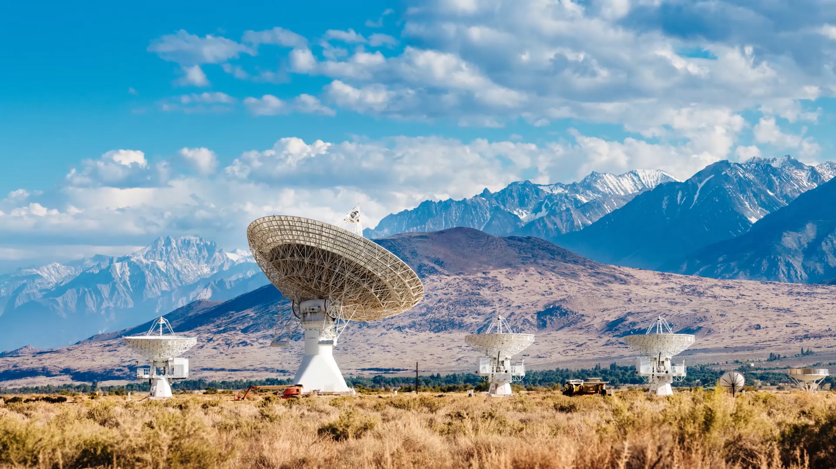
Air Quality Supervision
Lesson 7

Slide 2
Objectives
At the end of the lesson, students should be able to:
Define air and describe its composition.
Identify the major layers of the atmosphere.
Explain the importance of air to living organisms and the environment.
Describe common sources and effects of air pollution.
Explain major air-related environmental problems and their effects on humans and ecosystems.

Slide 3

Air
Air is a mixture of gases that makes up the Earth’s atmosphere.

Slide 4
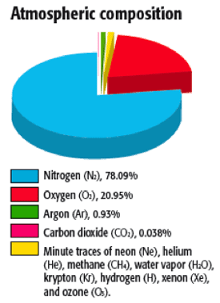

Slide 5
Composition of Air (Dry Air)
Gas | Percentage
Nitrogen (N₂) | ~78% | Needed for plant growth (nitrogen cycle). Dilute oxygen.
Oxygen (O₂) | ~21% | Essential for respiration and combustion.
Argon (Ar) | ~0.93% | Inert harmless gas.
Carbon Dioxide (CO₂) | ~0.04% | Used in photosynthesis. Helps regulate Earth’s temperature (greenhouse effect)
Other gases | Trace | Neon, helium, methane, krypton, hydrogen, xenon, ozone, etc. Plus, water vapor ( varying by humidity) and tiny solid particles like dust, pollen, and smoke.

Slide 6
Greenhouse Effect
The greenhouse effect is a natural process that warms the Earth's surface.
  When the Sun's energy reaches the Earth's atmosphere, some of it is reflected to space, and the rest is absorbed and re-radiated by greenhouse gases.
  These absorbed gases then radiate the heat back towards the Earth's surface, warming it.
  This process is essential for life on Earth, as it keeps the planet warm enough to support living organisms. Without the greenhouse effect, the Earth would be much colder.
Human activities are significantly increasing the concentration of greenhouse gases, leading to an enhanced greenhouse effect causing the planet to warm too much.

Slide 7
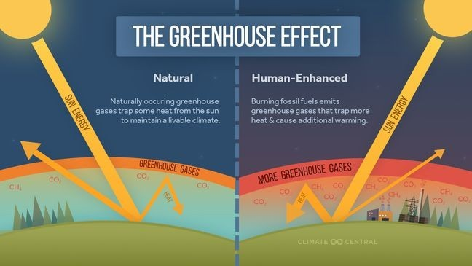

Slide 8
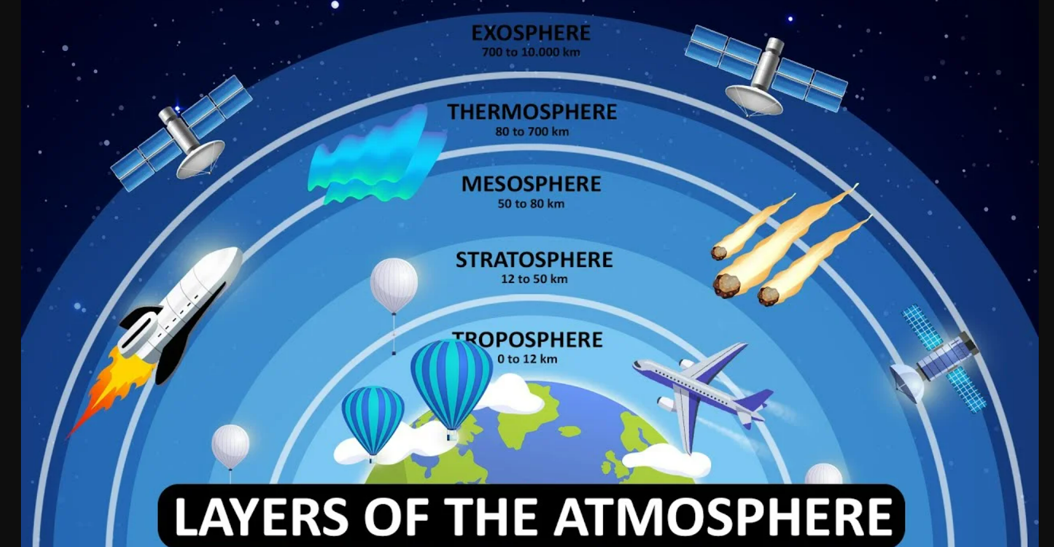

Slide 9
Layers of the Atmosphere
Layer | Key Characteristics
Troposphere | Contains most of the air and water vapor. Weather occurs here.
Stratosphere | Contains the ozone layer. Protects life from harmful UV radiation.
Mesosphere | Coldest atmospheric layer Meteors burn up here.
Thermosphere | Very high temperatures Auroras occur here. Contains the ionosphere (important for radio communication)
Exosphere | Extremely thin air. Where satellites orbit.

Slide 10
Summary (Importance of Air)
Supplies oxygen for breathing (respiration).
Provides carbon dioxide for photosynthesis.
Regulates Earth’s temperature.
  The atmosphere acts like a blanket, keeping Earth warm (greenhouse effect)
Enables weather and climate.
  Air movements create wind, storms, and weather patterns.
Protects Earth from harmful solar radiation (ozone layer).
  Ozone layer filters harmful UV radiation
Helps in pollination and seed dispersal.
Burns up most meteoroids before they hit Earth's surface.

Slide 11
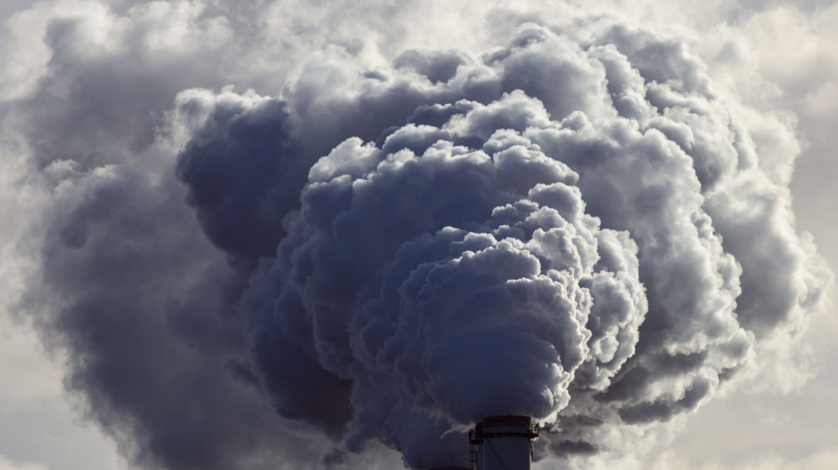
Air pollution
Topic 2

Slide 12
Air pollution
Air pollution refers to the presence of harmful or excessive quantities of substances in the air that can have adverse effects on human health, the environment, and the climate.
Pollutants are substances that contaminate the air and cause pollution.

Slide 13
Primary Pollutants
Primary Pollutants – Directly emitted into the atmosphere from sources.
  Carbon Monoxide (CO) – Produced by the incomplete combustion of fuels.
  Sulfur Dioxide (SO₂) – Emitted by burning coal and industrial processes.
  Nitrogen Oxides (NOₓ) – Released from vehicles and power plants.
  Particulate Matter (PM) – From dust, smoke, and industrial emissions.
  Volatile Organic Compounds (VOCs) – Found in vehicle emissions and solvents.

Slide 14
Secondary Pollutants
Secondary Pollutants – Formed when primary pollutants react in the atmosphere.
  Tropospheric Ozone (O₃) - formed when NOₓ and VOCs react with sunlight.
  Smog - a mixture of pollutants, including ground-level ozone and particulates.
  Acid rain - formed from SO₂ and NOₓ mixing with water vapor in the atmosphere.

Slide 15
Sources of Air Pollution
Natural Sources
  Volcanic eruptions
    emit SO₂, ash, and particulate matter.
  Wildfires
    produce CO, NOx, and particulate matter.
  Dust storms
    release fine particulate matter into the air.
  Biological decay
    releases methane and other gases.

Slide 16
Sources of Air Pollution
Human-Made Sources
  Industrial emissions
    factories release SO₂, NOₓ, and heavy metals.
  Vehicle emissions
    cars and trucks emit carbon monoxide, nitrogen oxides, and hydrocarbons.
  Burning of fossil fuels
    coal, oil, and natural gas combustion releases CO₂, SO₂, and NOₓ.
  Agricultural activities
    fertilizers and pesticides release ammonia and CH4.
  Deforestation
    reduces oxygen production and increases CO₂ levels.

Slide 17
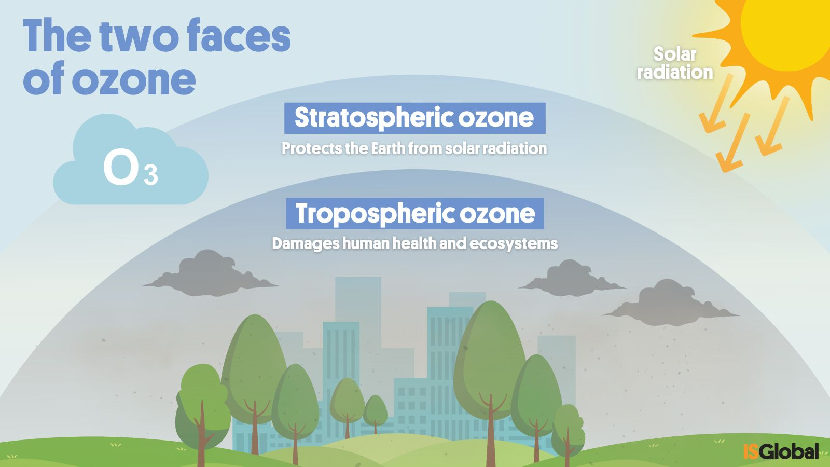
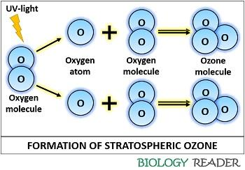
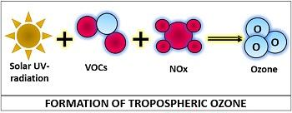

Slide 18
Air-Related Environmental Problems
Topic 3
Global Warming
Ozone Layer Depletion
Acid Rain

Slide 19
Global Warming
Global warming is the gradual increase in Earth’s average temperature due to the buildup of greenhouse gases in the atmosphere.
Key Greenhouse Gases:
  Carbon dioxide (CO₂)
  Methane (CH₄)
  Nitrous oxide (N₂O)
Causes:
  Burning of fossil fuels
  Deforestation
  Industrial activities
Effects:
  Rising sea levels
  Stronger typhoons and heat waves
  Climate change affecting agriculture and ecosystems

Slide 20
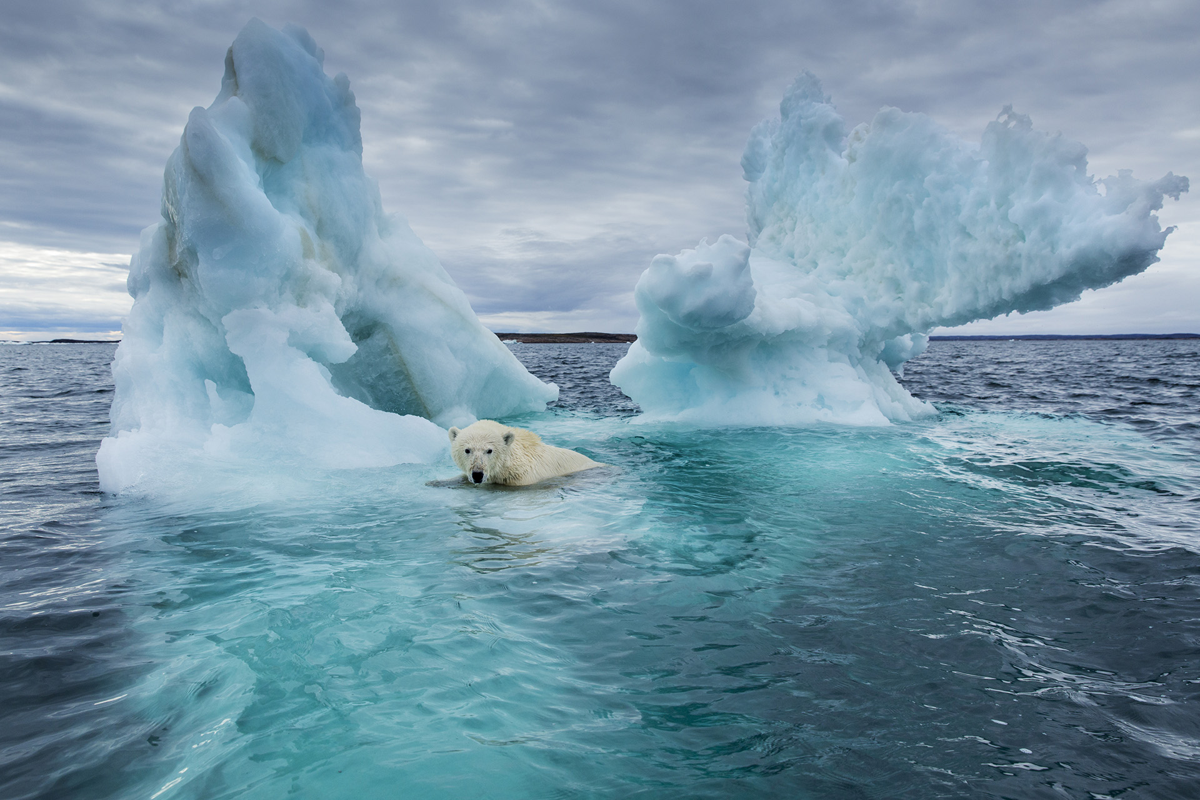
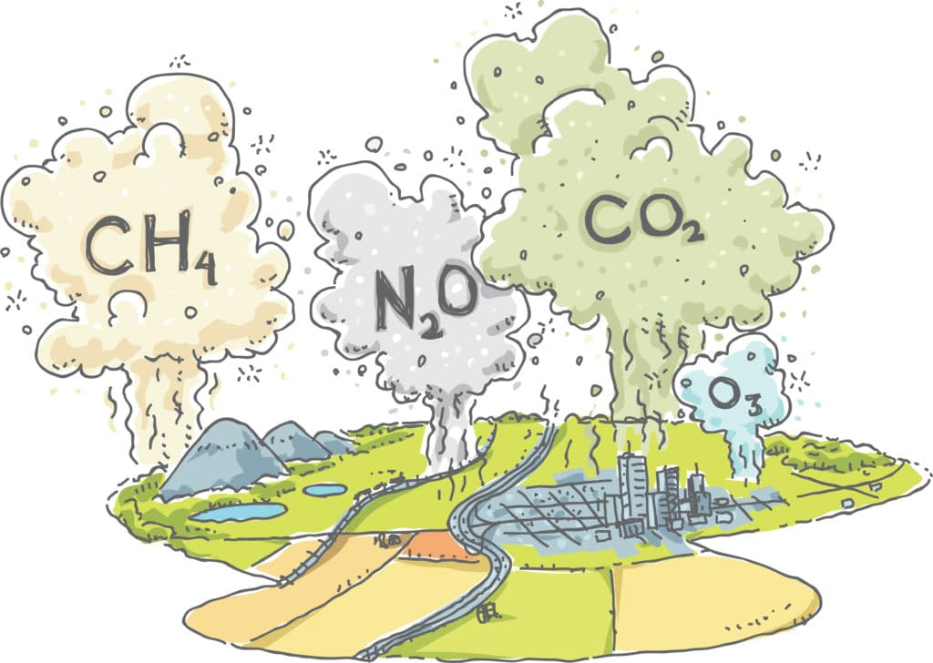
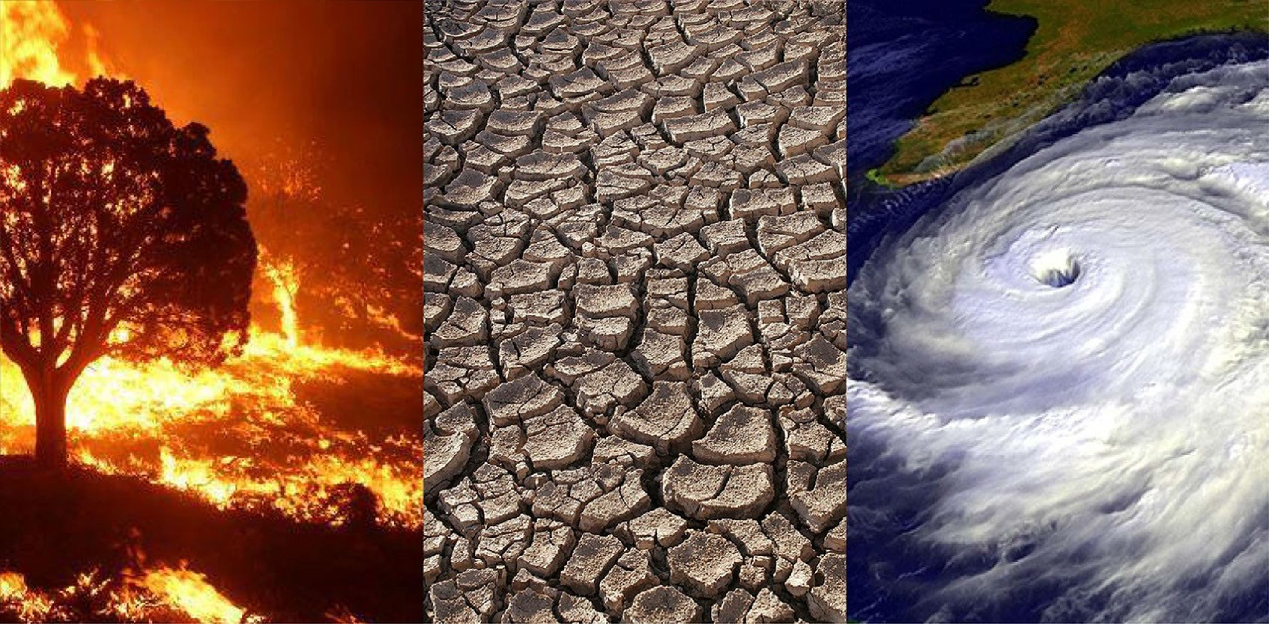

Slide 21
Ozone Layer Depletion
The ozone layer is a part of the stratosphere that protects Earth from harmful ultraviolet (UV) radiation.
Causes:
  Chlorofluorocarbons (CFCs)
  Industrial chemicals and aerosols
Effects:
  Increased skin cancer risk
  Damage to crops and marine life
  Eye problems in humans

Slide 22
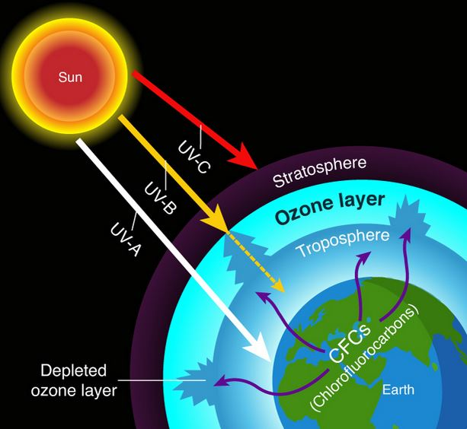

Slide 23
Acid Rain
Acid rain refers to rain, snow, or fog that contains strong acids formed from air pollutants.
Main Pollutants:
  Sulfur dioxide (SO₂)
  Nitrogen oxides (NOₓ)
Sources:
  Power plants
  Vehicle emissions
  Factory smoke
Effects:
  Damage to forests
  Fish death in lakes and rivers
  Corrosion of buildings and monuments

Slide 24
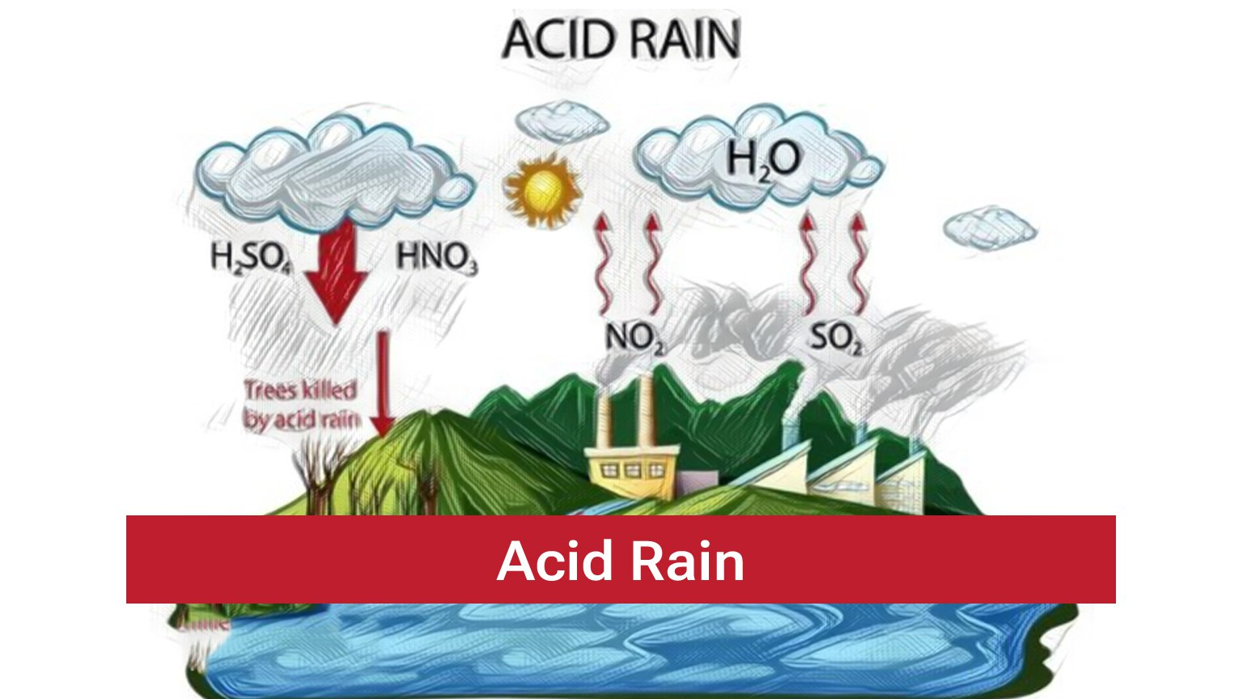

Slide 25
Air Pollution Control Methods
Topic 4
Air Pollution Control Methods are techniques and strategies used to reduce, prevent, or remove pollutants from the air.

Slide 26
A. Source Control
Prevent pollution before it enters the air.
Examples:
Using clean and renewable energy (solar, wind).
Fuel-efficient and electric vehicles.
Proper maintenance of machines and vehicles.
Reducing fossil fuel use.

Slide 27
B. Engineering and Technological Controls
Devices that remove pollutants from emissions.
Device | Function
Electrostatic Precipitator | Removes dust and smoke particles from factory exhaust
Scrubber | Uses liquid to remove SO₂ and other gases
Catalytic Converter | Reduces harmful gases from vehicle exhaust
Filters | Trap particulate matter

Slide 28
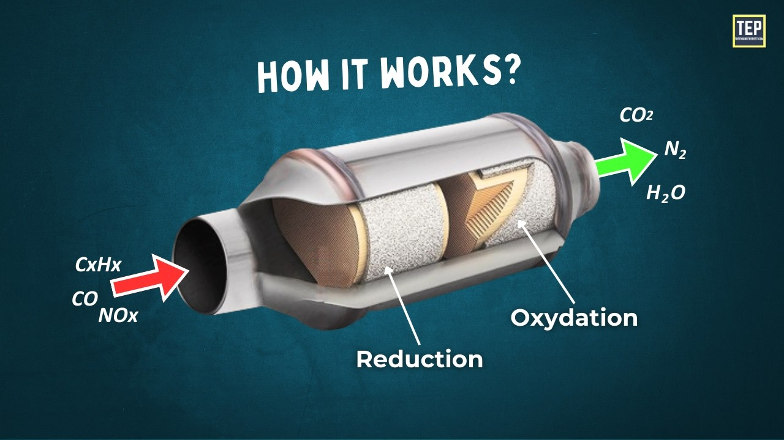
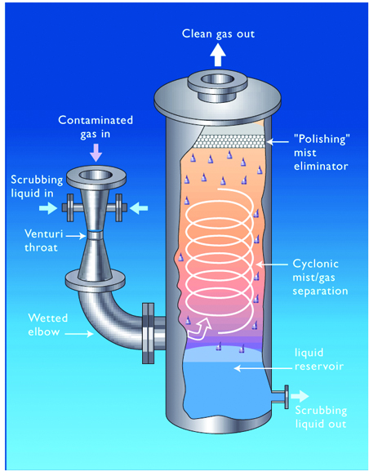
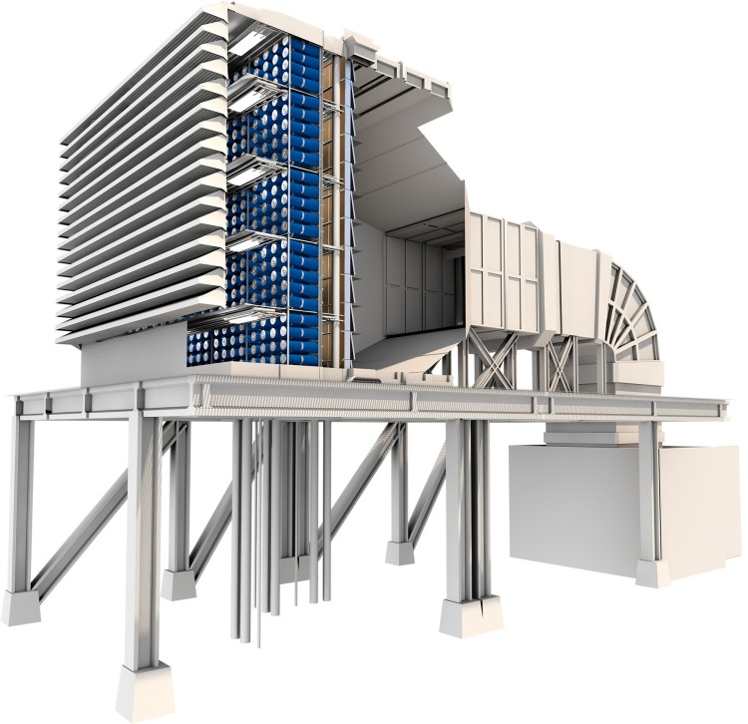
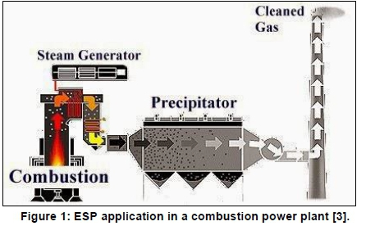

Slide 29
C. Legal and Policy Measure
Government actions to control pollution.
Examples:
Emission standards
Anti-smoke belching programs
Ban on open burning
Environmental laws (e.g., Philippine Clean Air Act – RA 8749)

Slide 30
Philippine Clean Air Act – RA 8749
The Philippine Clean Air Act of 1999 (RA 8749) is a law that aims to protect and preserve the country’s air quality by controlling air pollution from various sources. Its main goal is to ensure clean and safe air for the health and well-being of Filipinos.
Regulations:
Sets ambient air quality standards for key pollutants.
Requires emission standards for vehicles and industries.
Mandates the use of cleaner fuels and environmentally friendly technologies.

Slide 31
D. Individual and Community Actions
Everyone plays a role in keeping the air clean.
  Planting trees.
  Proper waste disposal.
  Using public transportation.
  Conserving electricity.
  Avoiding the burning of trash.

