Slide 1
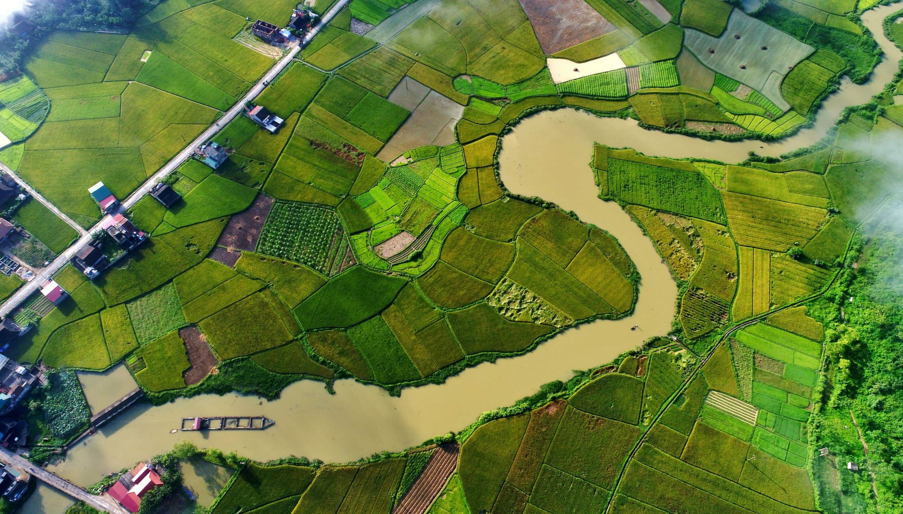
Water Resources and Land Subsidence
Lesson 8

Slide 2
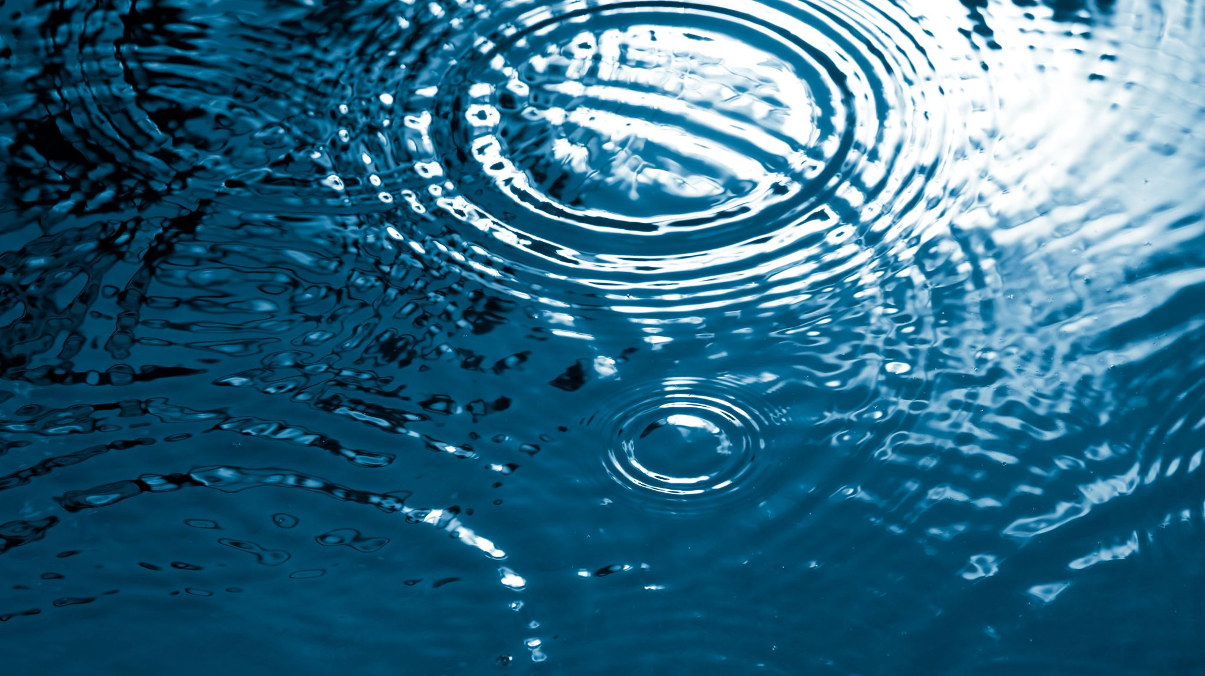
Objectives
At the end of the lesson, students should be able to:
Identify the major types and sources of water resources.
Explain common water resource issues and their effects on people and the environment.
Describe land subsidence, its causes, effects, and relationship with groundwater extraction.
Discuss sustainable strategies for managing water resources and preventing further land subsidence.

Slide 3
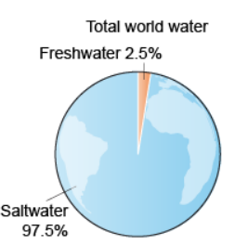
Distribution of Earth’s Water
97.5% saltwater (oceans)
2.5% freshwater
~69% glaciers
~30% groundwater
~1% surface water

Slide 4
Types of Water Use
Agricultural (70%) – irrigation for crops.
Industrial (20%) – manufacturing, energy production.
Domestic (10%) – household use (drinking, cleaning, sanitation).

Slide 5
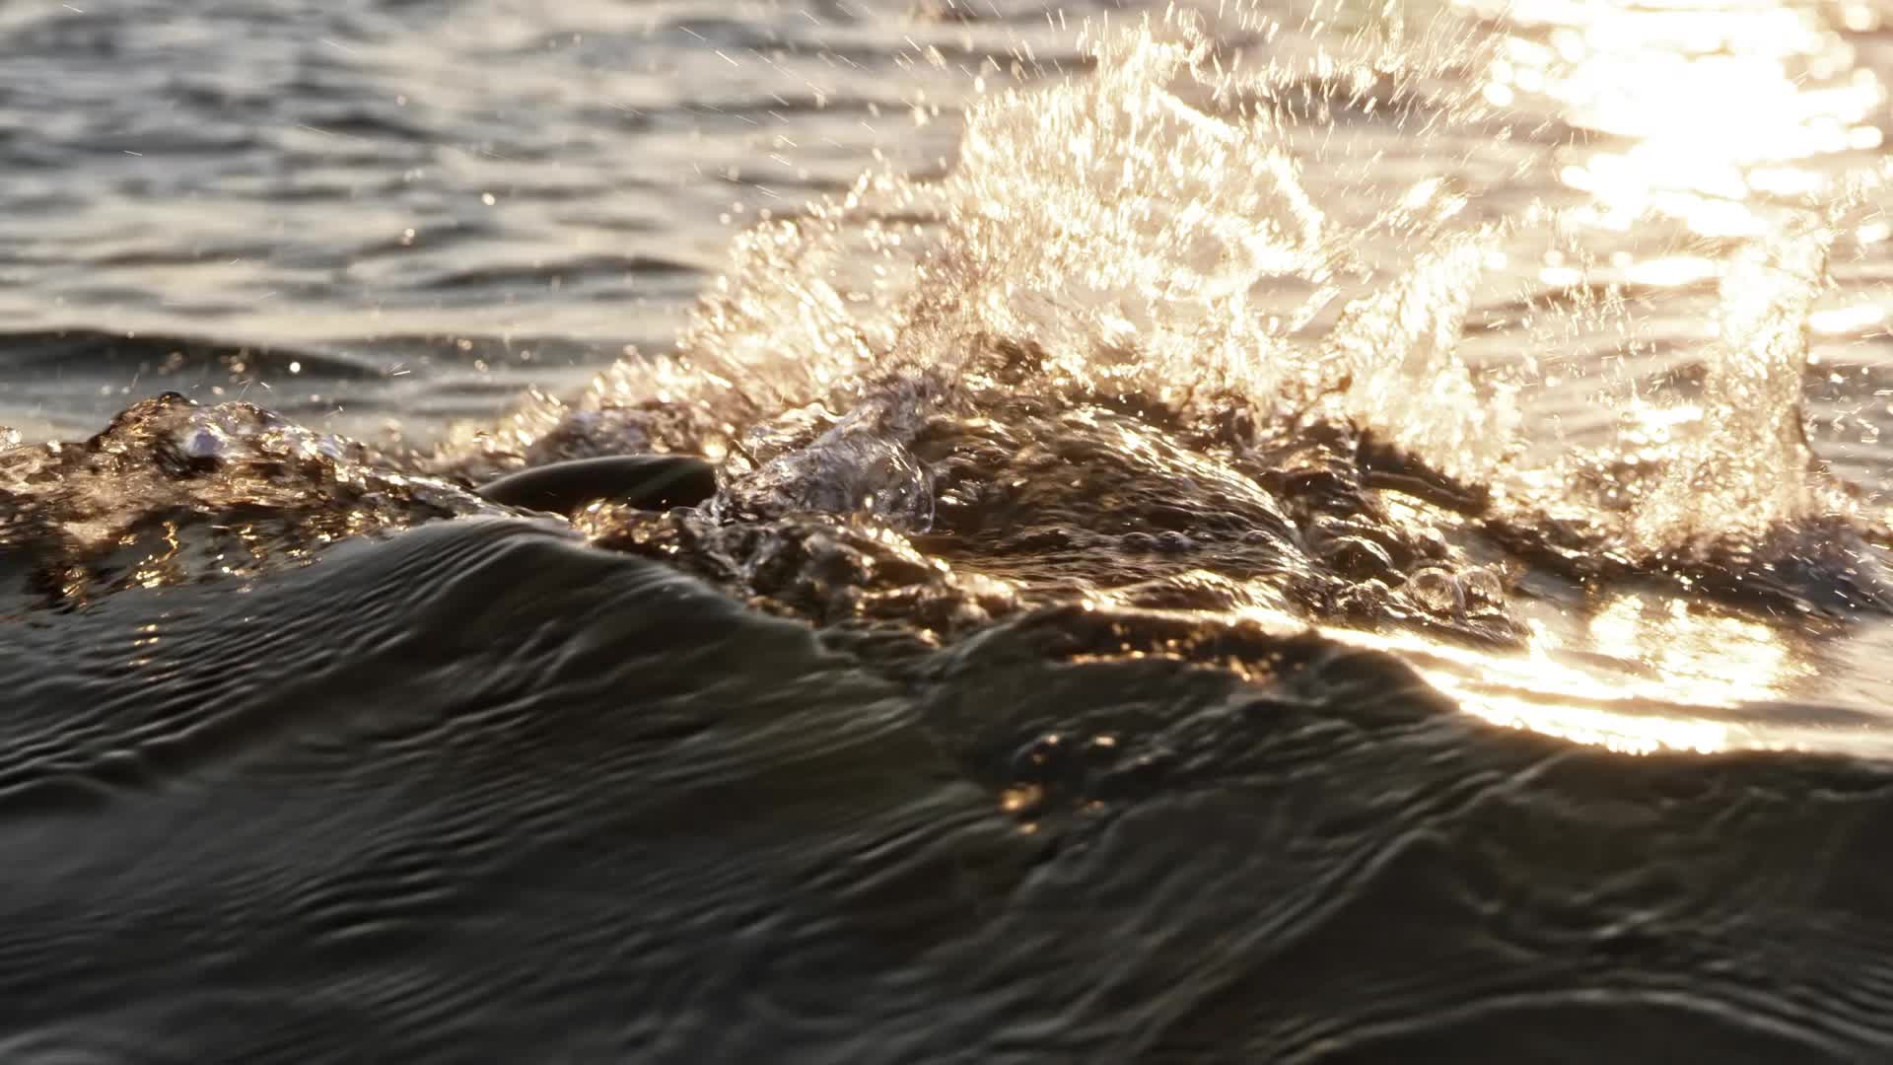
WATER RESOURCES
Water resources are sources of water that are useful or potentially useful to humans, ecosystems, agriculture, industry, and other activities.

Slide 6
Water Resource | Description | Examples | Major Uses
1. Surface water | Water found on Earth's surface. | Rivers, lakes, reservoirs, streams. | Drinking water, irrigation, industry.
2. Groundwater | Water stored beneath Earth's surface in soil and rocks. | Aquifers, wells | Drinking water, irrigation, industry.
3. Rainwater | Water collected from rainfall. | Rainwater harvesting systems. | Household use, irrigation, gardening.

Slide 7
Water Resource | Description | Examples | Major Uses
4. Glaciers and ice caps | Frozen freshwater stored as ice. | Mountain glaciers, polar ice. | Important freshwater storage
5. Wetlands | Areas where water covers or saturates the soil. | Marshes, swamps, mangroves. | Flood control, water filtration, habitat.
6. Seawater | Saltwater found in oceans and seas. | Pacific Ocean, Philippine Sea. | Fisheries, transport, desalination.
7. Atmospheric water | Water present in the atmosphere as vapor or clouds. | Water vapor, clouds. | Part of the water cycle.

Slide 8
Water Resource Issue |  | Possible Effects
1. Water scarcity | Available water is insufficient to meet demand. | Shortage of drinking and irrigation water.
2. Water pollution | Harmful substances enter water bodies. | Diseases, ecosystem damage.
3. Over-extraction | Water is removed faster than it is naturally replenished. | Declining groundwater levels.
4. Drought | Long period of unusually low rainfall. | Agricultural losses and water shortages.
5. Flooding | Excess water covers normally dry land. | Property damage, erosion, displacement.

Slide 9
WATER SCARCITY
Water scarcity occurs when the available water supply is insufficient to meet the needs of people, agriculture, industry, and ecosystems.
1. Physical water scarcity | There is not enough water available naturally. | A region experiences prolonged drought.
2. Economic water scarcity | Water may exist, but people lack adequate infrastructure or resources to access it. | A community has a water source but lacks treatment or distribution systems.

Slide 10
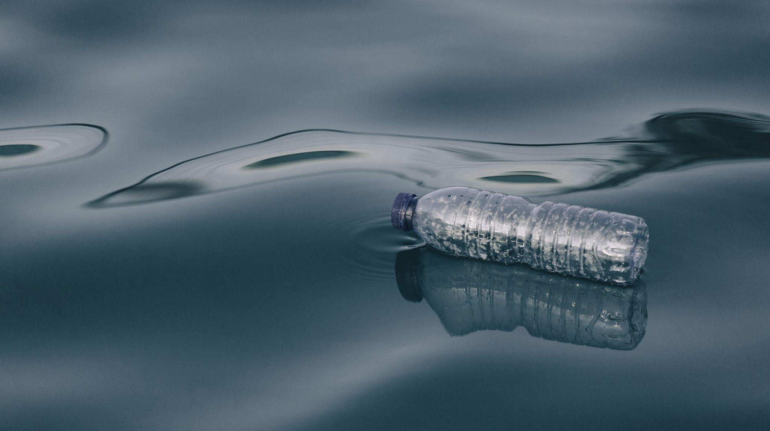
WATER POLLUTION
Water pollution occurs when harmful substances enter rivers, lakes, groundwater, oceans, or other water bodies.

Slide 11
Common Sources of Water Pollution
Source | Examples | Possible Effects
Domestic wastewater | Sewage, detergents, household waste. | Disease and oxygen depletion.
Agriculture | Fertilizers, pesticides, animal waste. | Algal blooms and contamination.
Industry | Chemicals, heavy metals, wastewater. | Toxic effects on humans and aquatic organisms.
Solid waste | Plastics, garbage. | Blocked waterways and harm to wildlife.
Mining | Sediments and chemical contaminants. | Water contamination.
Oil pollution | Oil spills and petroleum products. | Damage to marine ecosystems.

Slide 12
Example: Nutrient Pollution
Excess fertilizers containing nitrogen and phosphorus can enter waterways.
Fertilizer runoff → excess nutrients → rapid algae growth → decomposition → oxygen decreases → fish and aquatic organisms may die
This process is called eutrophication.

Slide 13
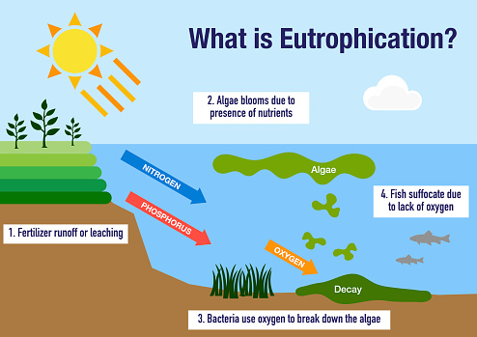

Slide 14
Water Resource Issue |  | Possible Effects
6.Saltwater intrusion | Seawater enters freshwater aquifers. | Groundwater becomes salty.
7. Deforestation | Removal of vegetation reduces infiltration and affects watersheds. | Increased runoff and erosion.
8. Climate change | Changes rainfall patterns, temperature, and extreme events. | Droughts, floods, changing water availability.
9. Urbanization | Development increases paved surfaces. | Reduced groundwater recharge and increased runoff
10. Agricultural demand | Large amounts of water may be needed for irrigation. | Increased pressure on rivers and aquifers.

Slide 15
SALTWATER INTRUSION
Saltwater intrusion occurs when seawater moves into freshwater groundwater systems, particularly in coastal areas.
Normally, freshwater in a coastal aquifer helps prevent seawater from moving inland. However, excessive groundwater pumping can lower the groundwater level.
Process
Excessive groundwater pumping → groundwater level decreases → pressure of freshwater decreases → seawater moves inland → groundwater becomes salty

Slide 16
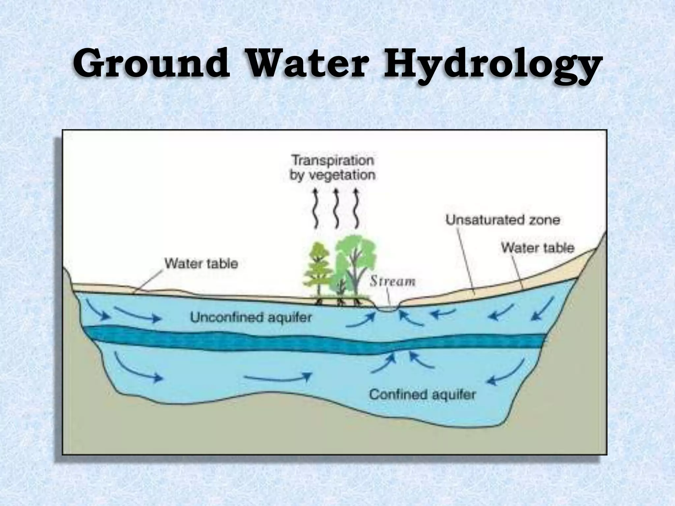
Understanding Groundwater

Slide 17
Groundwater
Groundwater is water stored below Earth's surface in the spaces and cracks within soil, sand, gravel, and rocks.
Water table: The upper level of the saturated groundwater zone.
An aquifer is a layer of permeable rock, sediment, or soil that can store and transmit groundwater.
    Unconfined - open, shallow, easily affected
    Confined - covered, deep, under pressure

Slide 18
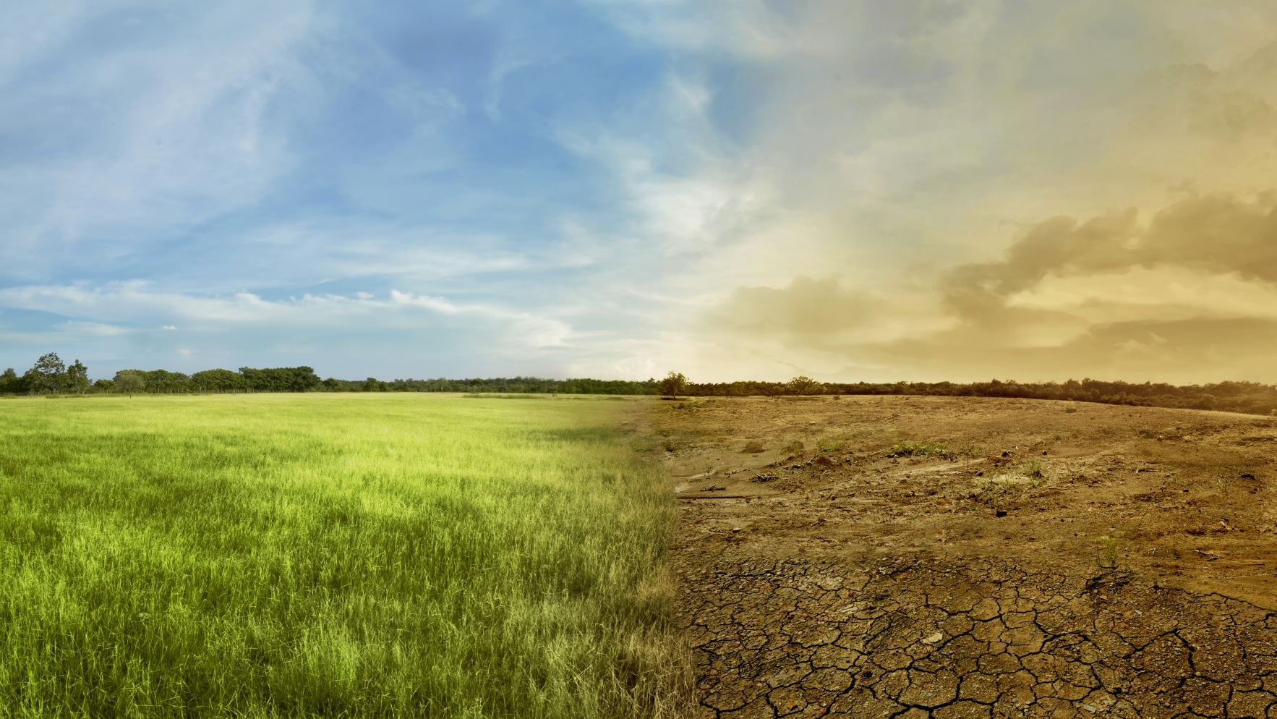
Groundwater Recharge
Groundwater recharge is the process by which water moves from the surface into the soil and eventually reaches underground aquifers, replenishing groundwater supplies. It helps maintain water availability, prevents groundwater depletion, and reduces the risk of land subsidence.
Methods:
  A. Natural Groundwater Recharge
  B. Artificial or Managed Groundwater Recharge

Slide 19
A. Natural Groundwater Recharge
 | Explanation | Example
1. Rainfall infiltration | Rainwater enters the soil and moves downward toward the groundwater system. | Rain falling on an open field.
2. River and stream infiltration | Water from rivers and streams seeps through their beds into the ground. | A river replenishing a nearby aquifer

Slide 20
B. Artificial or Managed Groundwater Recharge
Method | Explanation | Example
Recharge ponds/basins | Water is temporarily stored in shallow basins so it can slowly infiltrate into the ground. | A basin filled with collected rainwater
Percolation ponds | Ponds are specifically designed to allow water to seep downward into groundwater systems. | A community recharge pond
Recharge wells | Water is intentionally introduced into an aquifer through a properly designed well. | Treated water injected into a suitable aquifer
Rainwater harvesting | Rainwater is collected and directed to areas where it can infiltrate or be stored for later use. | Roof runoff directed toward a recharge garden
Managed aquifer recharge (MAR) | Water is intentionally managed and directed into groundwater storage for later use. | Capturing excess water during the rainy season for aquifer recharge

Slide 21
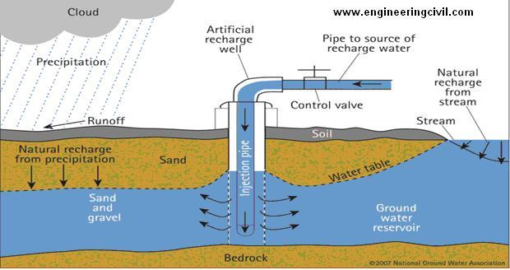

Slide 22
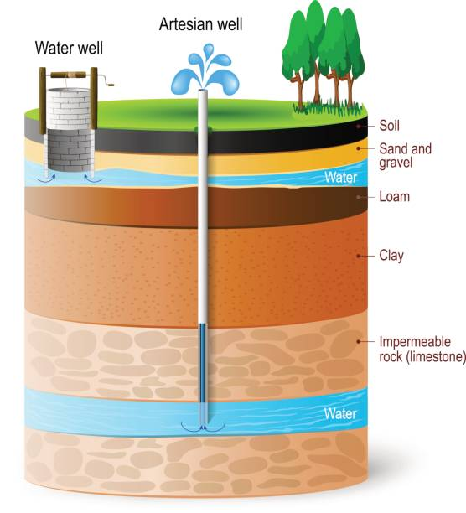
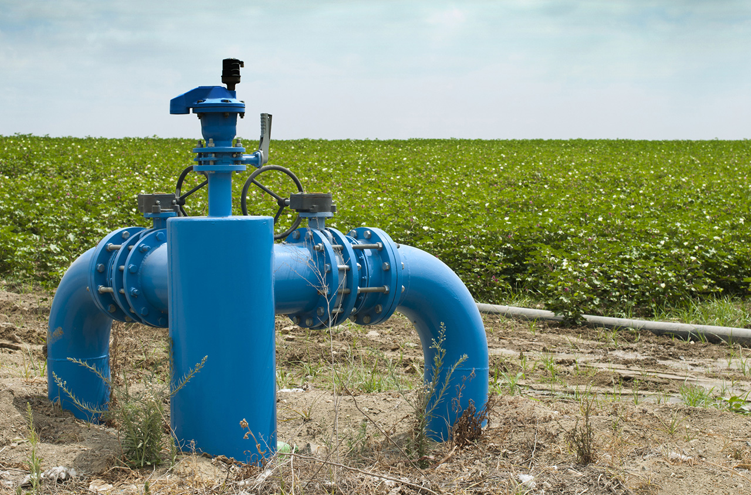
Groundwater extraction
Groundwater extraction: Removal of groundwater through wells or pumping

Slide 23
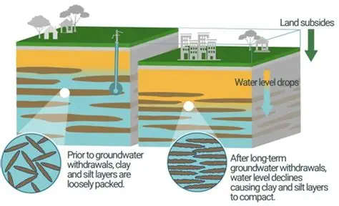
LAND SUBSIDENCE

Slide 24
Land Subsidence
Land subsidence is the gradual sinking or lowering of the Earth's land surface.
It can occur naturally, but human activities can greatly accelerate it.
Excessive groundwater extraction → groundwater level decreases → underground sediments compact → land surface sinks

Slide 25
HOW DOES GROUNDWATER EXTRACTION CAUSE LAND SUBSIDENCE?
Groundwater is often stored in spaces between particles of clay, sand, and other sediments.
When groundwater is pumped out, the water pressure that helps support these sediments decreases.
The sediments may become compressed or compacted.

Slide 26
Step-by-Step Process
Step | What Happens?
1. Groundwater is stored underground. | Water fills spaces between sediment particles.
2. Large amounts of groundwater are pumped. | The groundwater level decreases.
3. Water pressure decreases. | Sediment particles become more closely packed.
4. Sediments compact. | The underground layer becomes thinner.
5. Land surface moves downward. | The ground gradually sinks.
6. Land subsidence occurs. | Buildings, roads, drainage systems, and coastal areas may be affected.

Slide 27
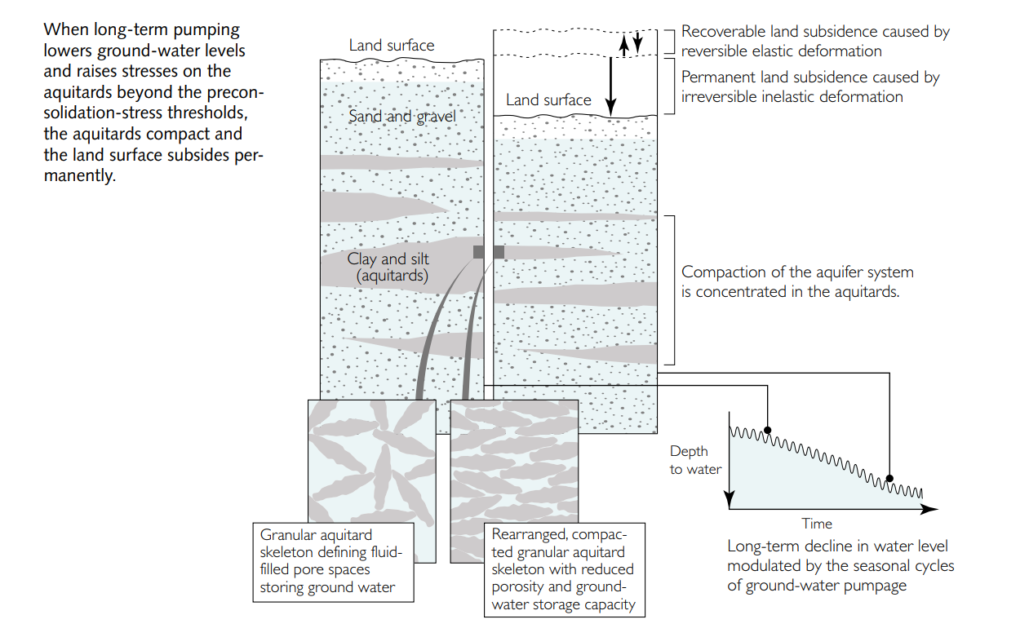

Slide 28
OTHER CAUSES OF LAND SUBSIDENCE
Cause | Explanation
Oil and gas extraction | Removal of underground fluids can reduce pressure and cause ground movement
Mining | Removal of underground materials can cause the ground to collapse or settle
Natural sediment compaction | lose sediments may naturally become compressed over time
Construction and loading | Heavy buildings and infrastructure can compress weak soils
Tectonic processes | Movement of Earth's crust can cause changes in land elevation

Slide 29
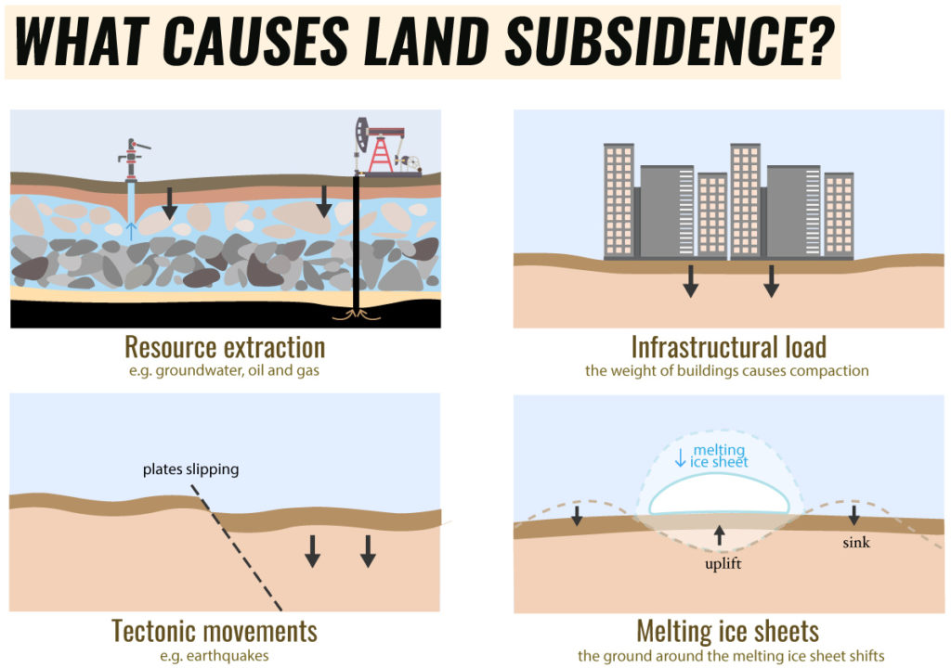

Slide 30
EFFECTS OF LAND SUBSIDENCE
Effect | Explanation
Flooding | Lower land is more easily flooded during heavy rainfall.
Coastal flooding | Subsidence can increase the relative effect of sea-level rise.
Damage to buildings | Uneven sinking can cause cracks and structural problems.
Road damage | Roads may crack, deform, or become uneven.

Slide 31
EFFECTS OF LAND SUBSIDENCE
Effect | Explanation
Drainage problems | Gravity-based drainage becomes less effective.
Damage to pipelines | Water, sewage, and gas pipelines may be stressed.
Saltwater intrusion | Lower land and altered groundwater conditions can increase coastal vulnerability.
Loss of agricultural land | Farms may become waterlogged or increasingly exposed to flooding.
Economic losses | Communities may spend more on repairs and flood protection.

Slide 32
LAND SUBSIDENCE AND CLIMATE CHANGE
Land subsidence and climate change can increase each other's impacts in vulnerable areas.
For example:
Groundwater extraction → land subsidence
At the same time:
Climate change → sea-level rise
When both occur in a coastal area:
Land sinks + sea level rises → greater relative flooding risk
This is particularly important for low-lying coastal communities and agricultural areas.

Slide 33
HOW CAN WE HELP PREVENT LAND SUBSIDENCE?
Reduce excessive groundwater pumping
Use surface water responsibly
Harvest rainwater
Improve irrigation efficiency
Protect recharge areas
Increase green spaces
Use permeable pavements
Monitor groundwater levels
Regulate deep wells
Reuse treated wastewater
Protect watersheds

Slide 34
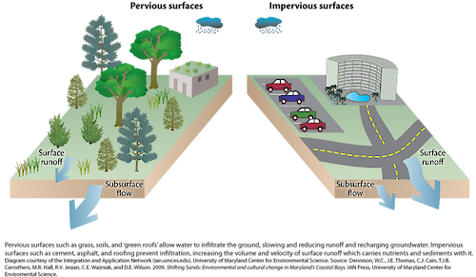
Impervious materials
Impervious materials are surfaces that do not allow water to infiltrate into the ground.
This increases the risk of:
  Urban flooding
  Flash floods, especially during heavy rainfall
Common examples: concrete, asphalt, rooftops, and paved roads.

Slide 35
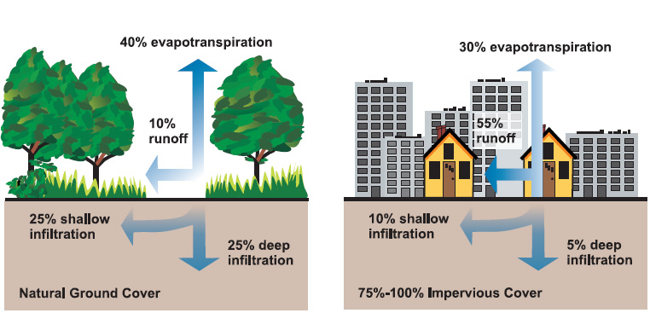

Slide 36

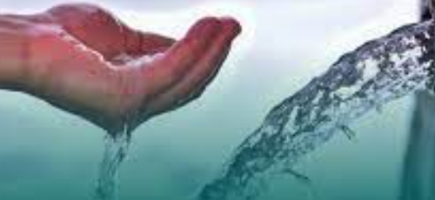
The Philippine Clean Water Act
The Philippine Clean Water Act (Republic Act No. 9275), enacted in 2004, is the country’s primary law for protecting water bodies from pollution and ensuring sustainable water resource management.
Despite its strong legal framework, implementation gaps persist.

Slide 37
Sustainable Water Management Strategies
Conservation
  Fixing leaks, efficient fixtures, and mindful use.
Protecting Water Sources
  Preventing pollution and overuse of rivers, lakes, and aquifers.
Efficient Irrigation
  Using drip or sprinkler irrigation instead of flood irrigation.
Community Action
  Rainwater harvesting, protecting watersheds.
Technology
  Desalination, wastewater recycling (Singapore’s NEWater).

Slide 38
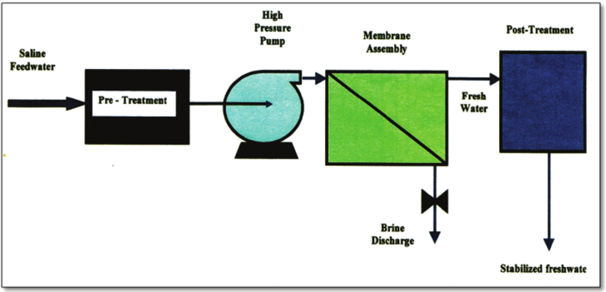
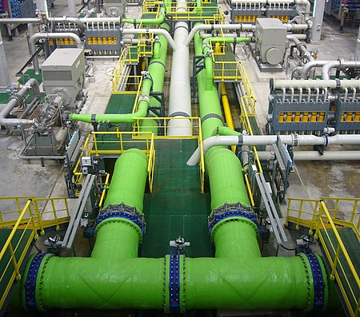
Desalination
Desalination is the process of removing salts and minerals from seawater or brackish water to produce freshwater for human use.

Slide 39
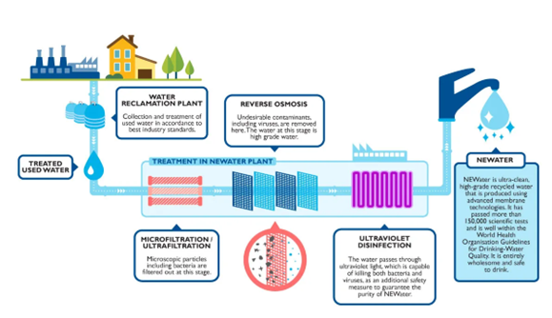
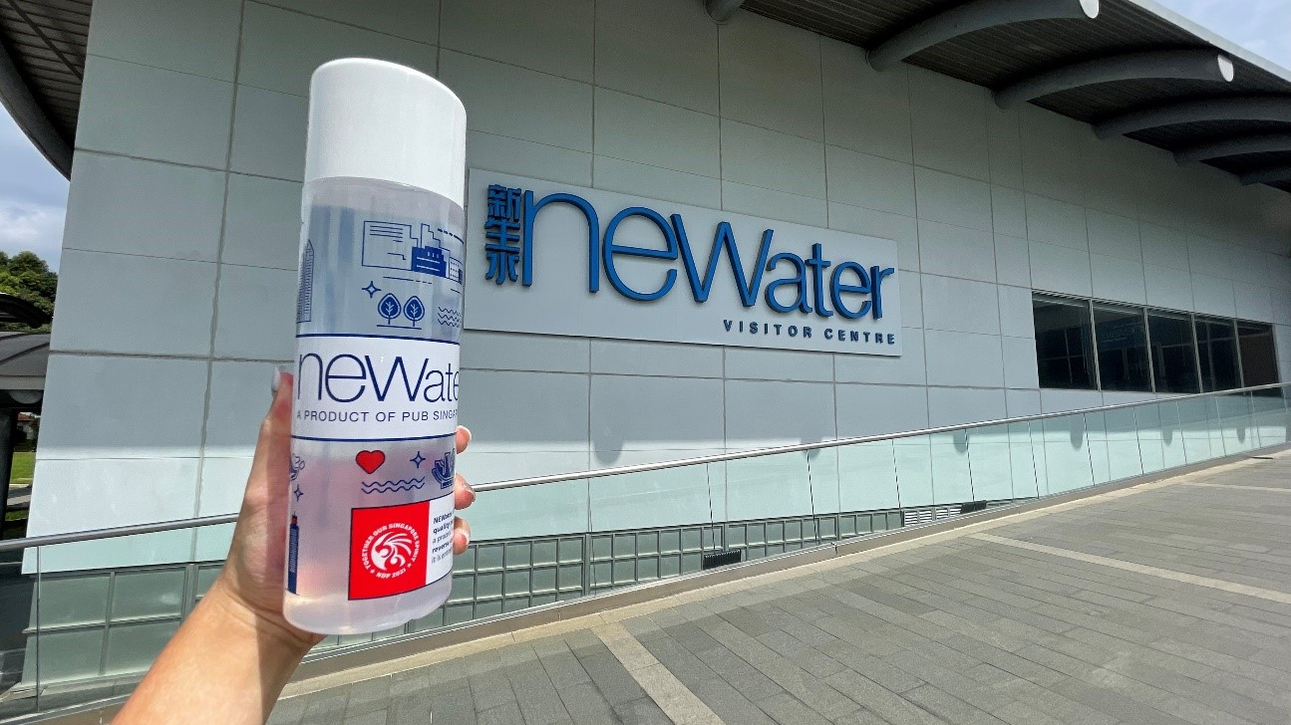
Wastewater Recycling – Singapore’s NEWater
NEWater is Singapore’s ultra-clean recycled water made from treated wastewater using microfiltration, reverse osmosis, and ultraviolet disinfection.
It is used for industrial purposes, reservoir topping (adding treated water to a reservoir to increase or maintain its water level), and even drinking after blending, providing a sustainable and reliable water source.

