Slide 1


SCRUM Pre-game
Caggiano Pasquale
Coone Alessio
Cirillo Pancrazio
De Stefano Sabatino

Slide 2

Goals
Application functionality:
The application aim is to provide to the user the possibility to draw geometrical shapes, more or less complex.
The application must provide the principal functionalities of a classic drawing program:
Changing interior or border color of shape;
Different levels of zoom
Changing shapes size;
Inserting text;
Changing shapes position;
Saving or loading a drawing;
Creation of software application for geometric drawing

Slide 3
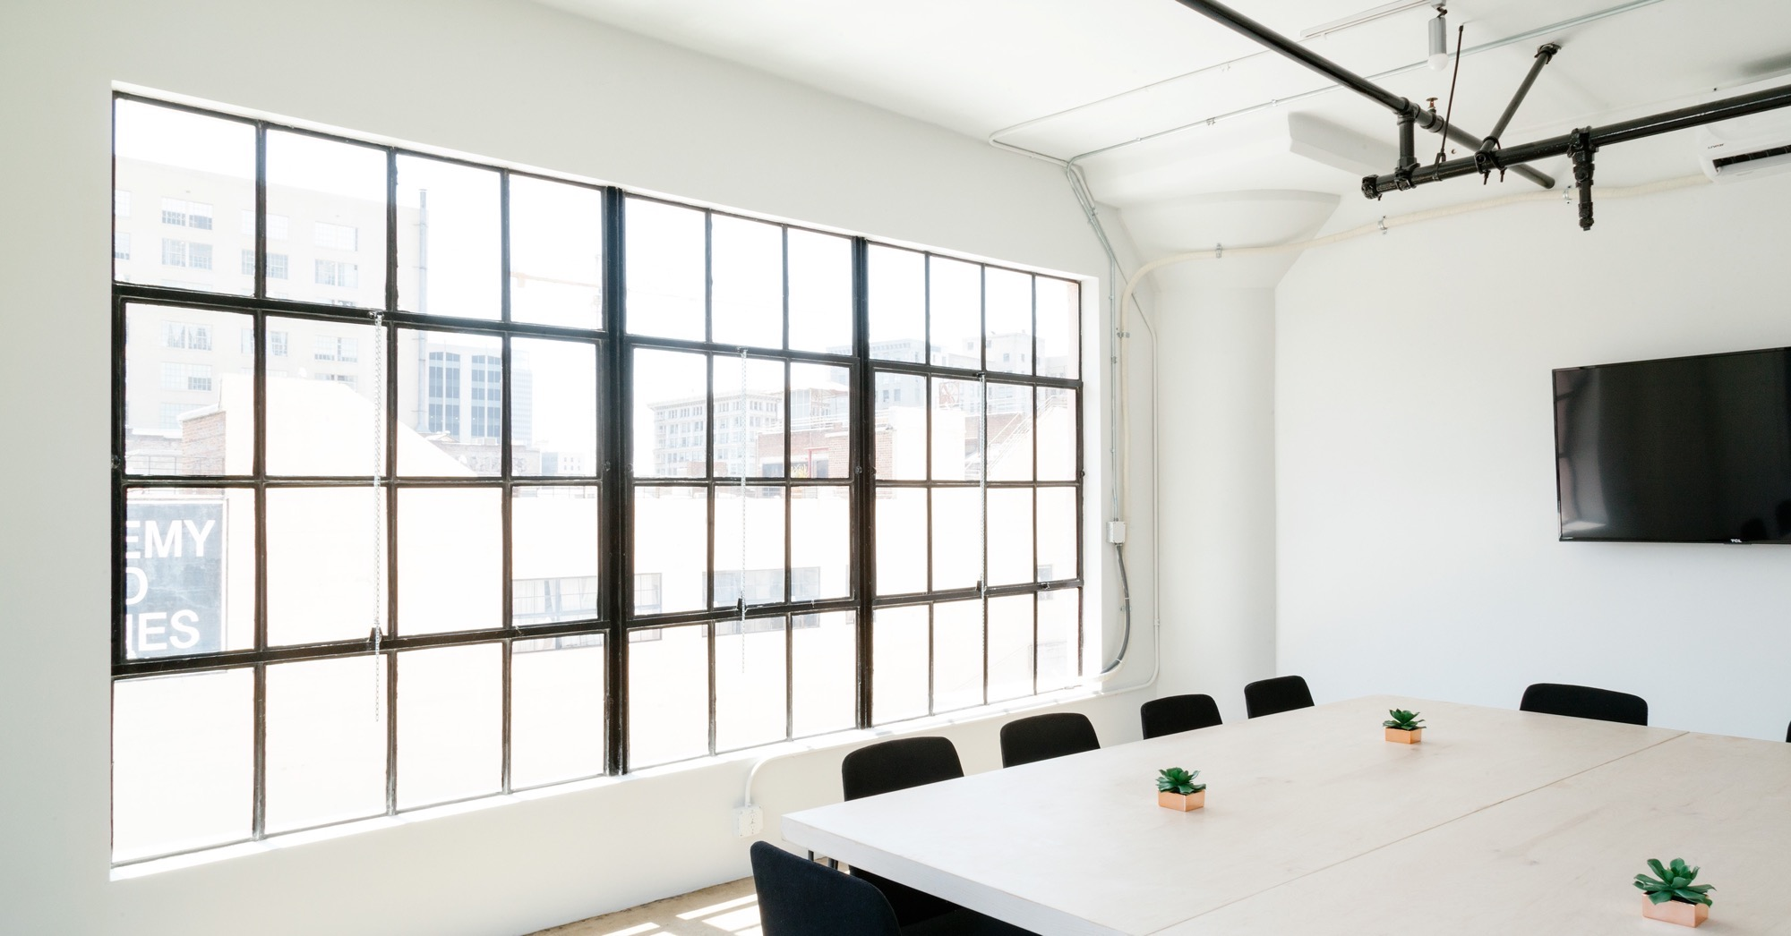
Sprint Planning e Backlog

Slide 4
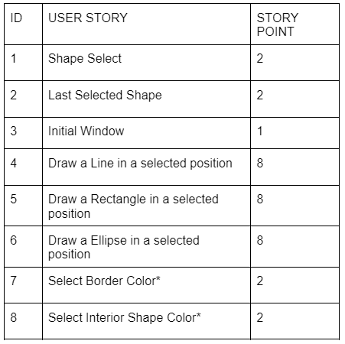

Sprint 1 - Planning
Initial estimation of project velocity:

Slide 5

Software Architecture
Description of the design pattern used

Slide 6
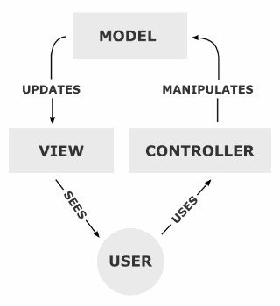
Architectural Design
For the application development will be used JavaFXML based on MVC pattern.
Model-View-Controller pattern
It is an architectural pattern widespread in Object Oriented Programming.
Separate business logic from presentation logic.
Fundamental roles:
Model 🡪 It provides useful methods to access to the application.
View 🡪 displays the data contained in the model and deals with the interaction with users.
Controller 🡪 receives commands from the user and implements them by modifying the status of the other two components.

Slide 7
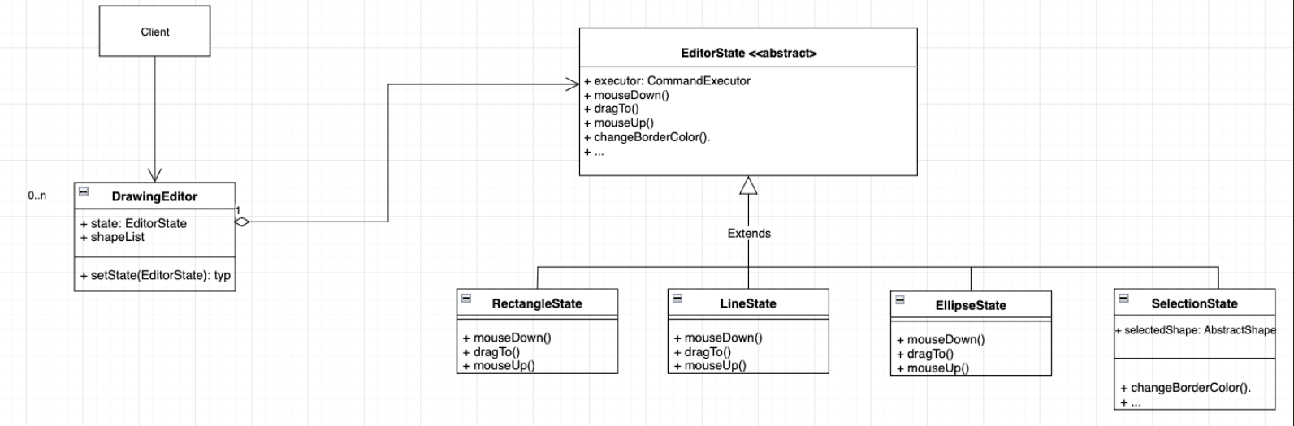
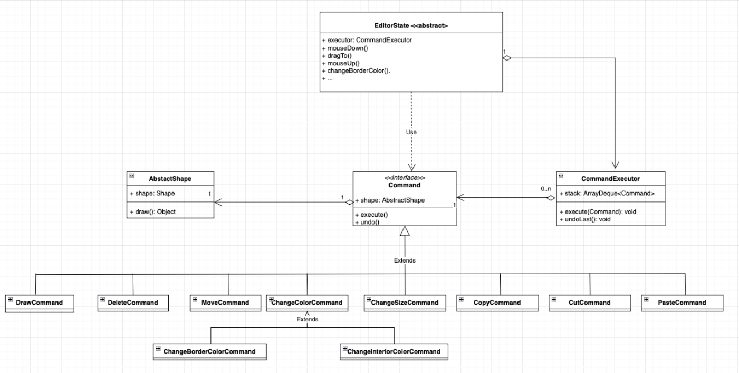
Design Pattern State:
The client works by interacting with the DrawingEditor of our application. Since we have to perform operations on different figures, whose behavior varies according to the state they are in, we decided to use the state pattern.
Design Pattern Command:
Since the user can perform different types of operations on each figure, including the Undo function, it was decided to use this type of pattern. In this way we have objects that perform the various operations, and therefore I can manipulate them in an appropriate manner.

Slide 8
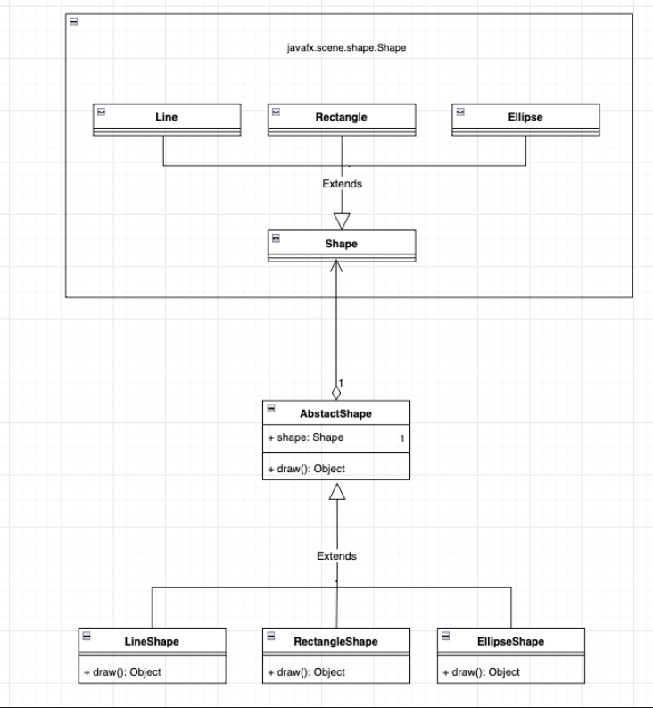
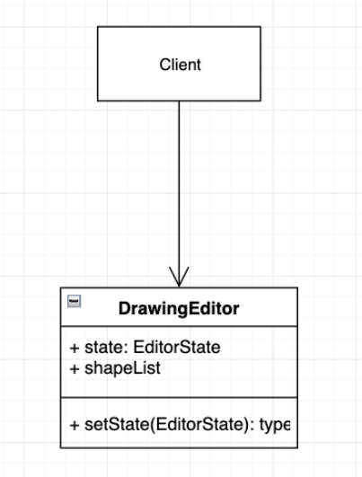
Design Pattern Adapter(Object):
The Canvas object will be used as the work plane of our application. We already have a Java library that provides all the features we need to be able to draw geometric figures or Shapes. The problem is that the Shape library is not designed to work with the Canvas. For this reason it was decided to use this pattern, in doing so we use a class that uses the interface we need and extends the functionality of the Shape class.
Design Pattern Singleton:
The Singleton pattern is used since there will need to be a single instance of the DrawingEditor which is the only object the user will operate with.

Slide 9
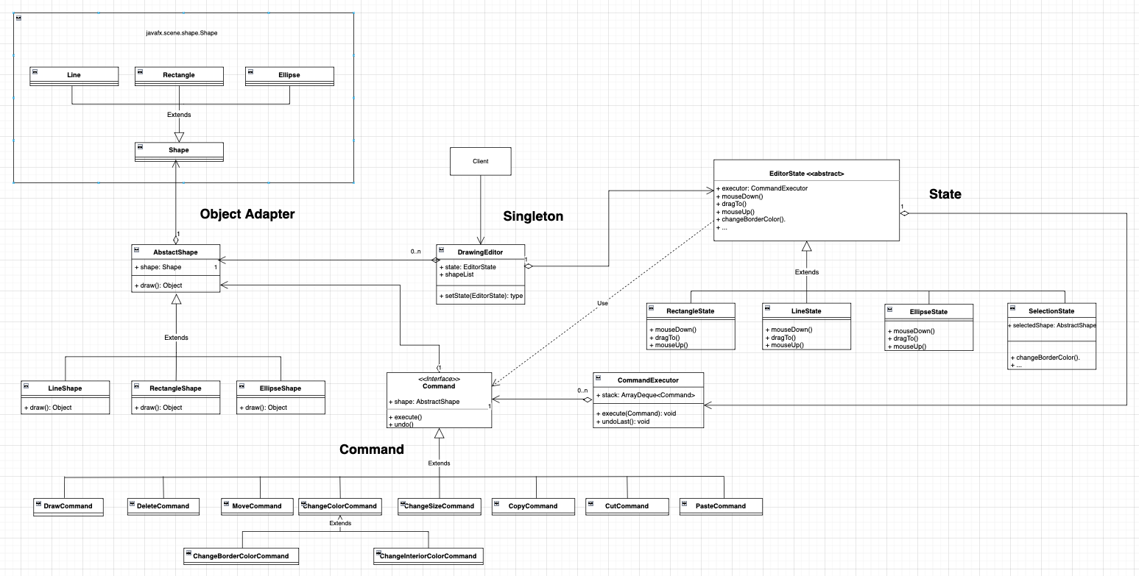

Slide 10

Thanks

