Slide 1


MyDrawingEditor Application
Caggiano Pasquale
Coone Alessio
Cirillo Pancrazio
De Stefano Sabatino

Slide 2
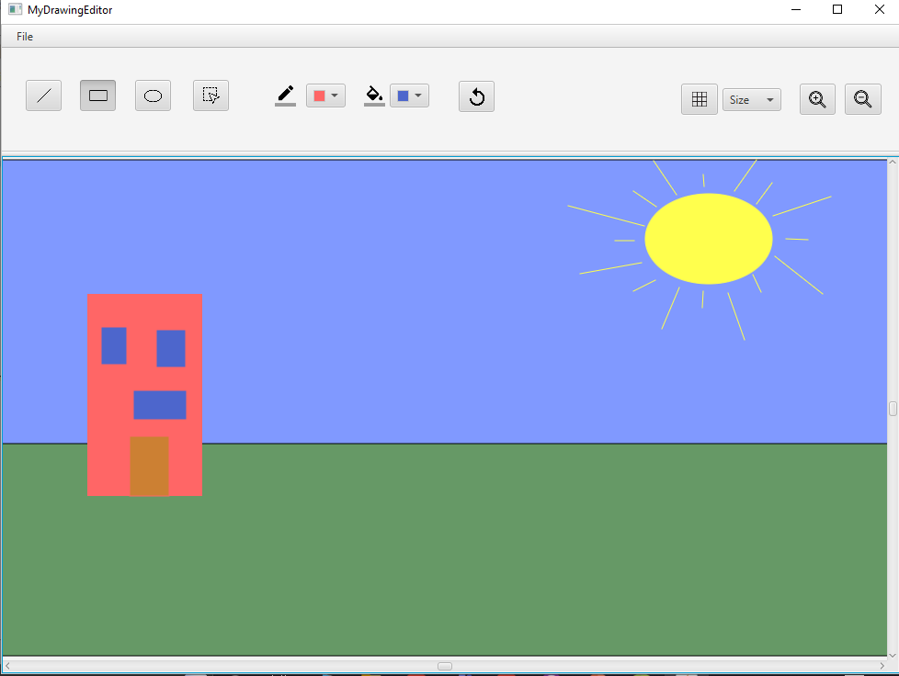
Description of the product
MVC Architecture
MyDrawingEditor functionalities:
Draw
Line, Rectangle, Ellipse
Save and load file
Change Drawing operations:
Selection, Move, Copy, Cut, Paste, Delete, Change Size, Change Border and interior color, To front, To back, Rotate and Mirror
Undo of all the operations
Zoom of the drawing
Show and hide a grid

Slide 3
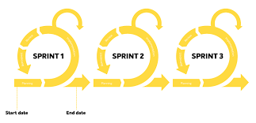
Product Development
The realization of the demo application has been divided into three sprints:
First Sprint
During the first sprint the basic functionalities have been implemented and the measured velocity was better than the estimated one. In this phase we took rash and quick decisions about the architecture of the application and the consequences of that have affected the next sprint.
Second Sprint
This sprint was mainly characterized by a refactoring phase that has allowed us to fix the architectural problems introduced in the first sprint. Due to this phase the second measured project velocity was way lower than the previous one.
Third Sprint
Thanks to the previous refactoring, during this sprint it was possible to implement user stories in an easy and speedy way. In fact the measured project velocity in this sprint was the highest measured during the entire project work.

Slide 4
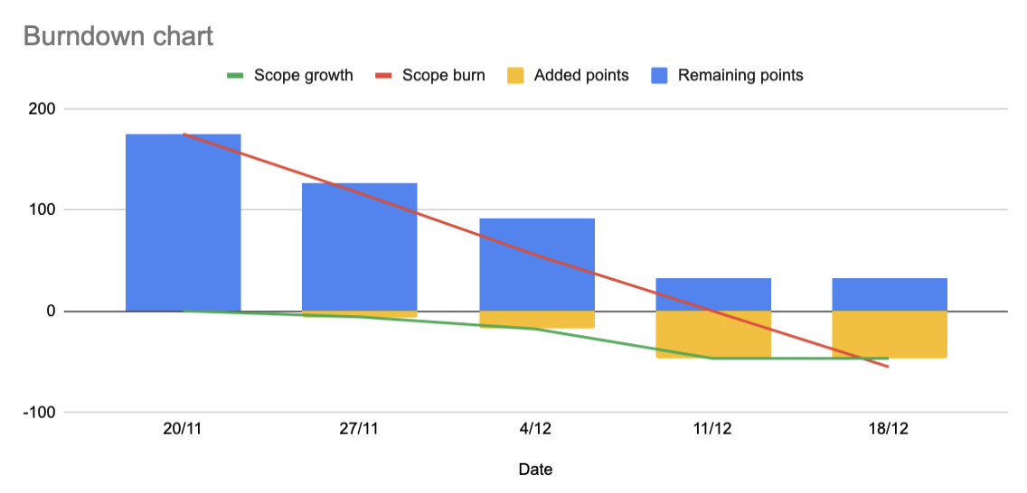
Burndown Chart

Slide 5

Scrum Process
All the sprints have been characterized by an optimal and constant communication among all the scrum members
First Sprint
During the first sprint we were not prepared about the Git usage and due to that we had several problems in sharing code and documentation. Even the planning on the Trello board was not a strong point.
Second Sprint
Learning from the previous errors, during this sprint we have understood how to share the code in a correct way and how to divide the tasks properly on the Trello board. We have also noticed that it is a lot better to add the documentation while writing the code.
Third Sprint
During the last sprint the team agreed on the fact that the work hours should be spread over different days in order to avoid an overload of constant work. All the previous problems have been minimized.

Slide 6

Thanks

