Slide 1
Logistic function

Slide 2
Function description
x = maximum investment time - baybackperiod
Risk aptitude
Agent health

Slide 3
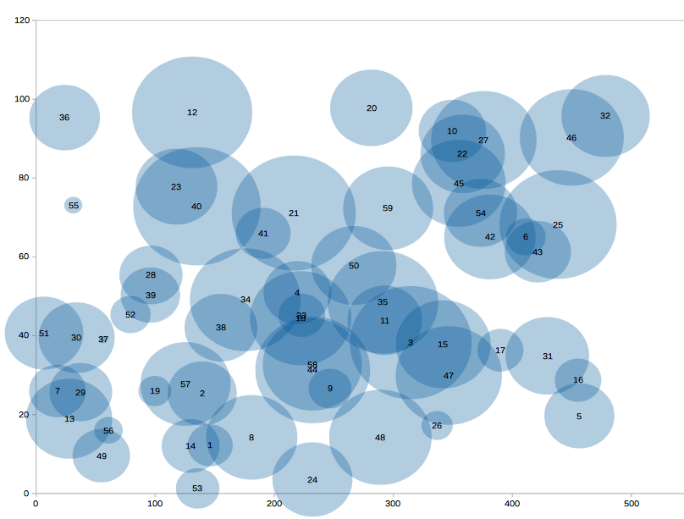
Geo Position

Slide 4
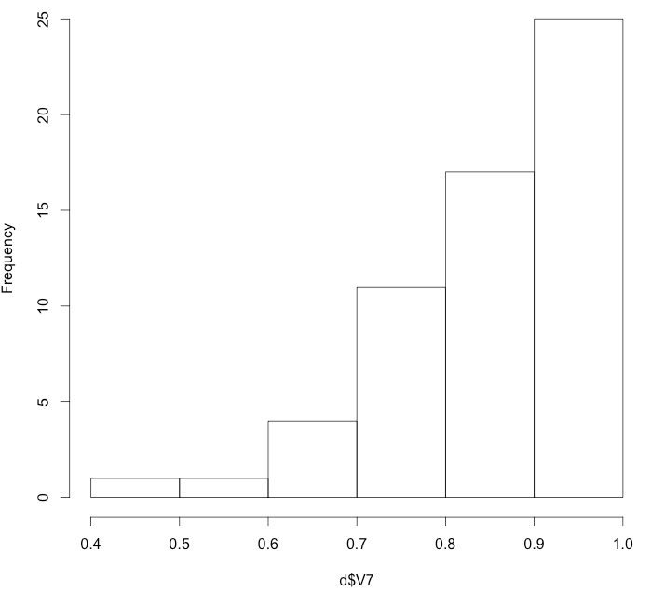
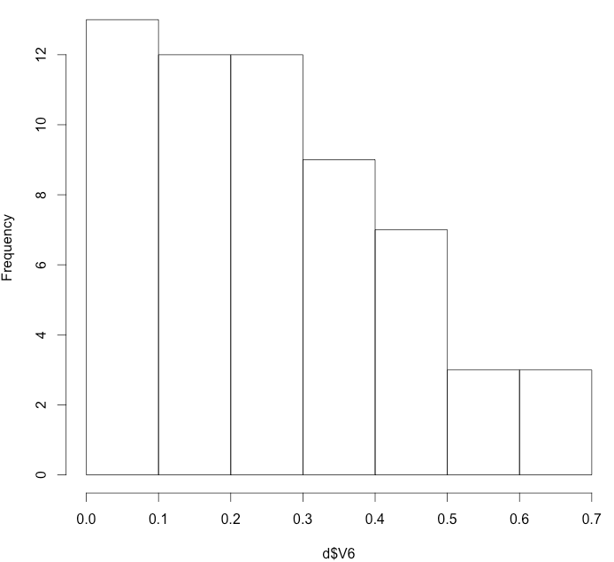
Agents
risk
health

Slide 5
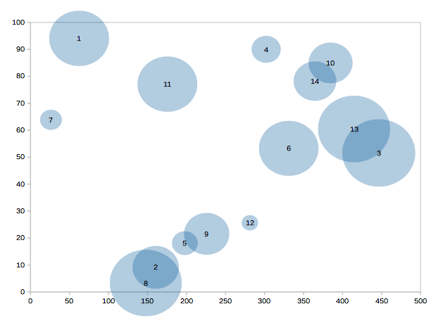
Geo (FIXED H)

Slide 6
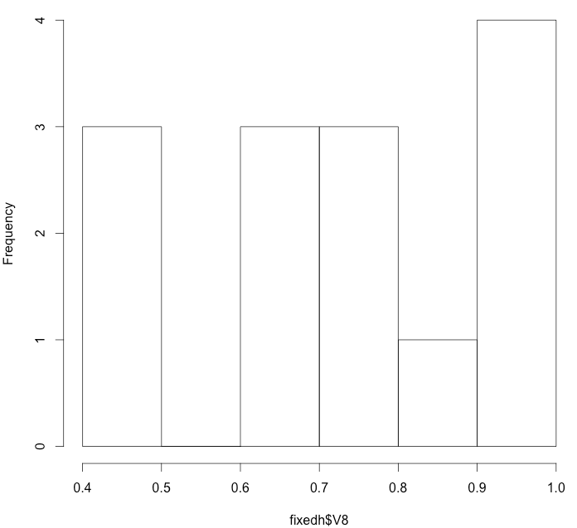
Agents Health Fixed

