Slide 1
User Quality
Perception
Compatibility
Convenience
Performance
Trustworthiness
Provider Quality
Perception
Compatibility
Functionality
Reliability

Slide 2
Convenience
CUSTOMER PERCEPTION
Performance
E-Service Quality in Use
Trustworthiness
CHARACTERISTICS
E-Service Quality in Use model
Hypothesis: This 4 e-services characteristics positively influence the user quality perception.

Slide 3
Compatibility
PROVIDER PERCEPTION
E-Service
Product Quality
Functionality
Reliability
PROPERTIES
E-Service Product Quality Model
Hypothesis: This 3 e-services properties positively influence the user quality perception.

Slide 4
DIMENSIONS
ACCESSIBILITY
USABILITY
EFFICIENCY
SECURITY

Slide 5
DIMENSIONS INFLUENCING CUSTOMER SATISFACTION
CUSTOMER SAISFACTION
H.A.
ACCESSIBILITY
H.U.
USABILITY
H.E.
EFFICIENCY
H.S.
SECURITY

Slide 6
CUSTOMER PERCEPTION
AND DIMENSIONS
H1
Convenience
ACCESSIBILITY
H2
E-Service
Quality in Use
USABILITY
Performance
H3
EFFICIENCY
H4
Trustworthiness
SECURITY

Slide 7
PROVIDER PERCEPTION
AND DIMENSIONS
H5
Compatibility
ACCESSIBILITY
H6
E-Service
Product Quality
USABILITY
Functionality
H7
EFFICIENCY
H8
Reliability
SECURITY

Slide 8
DIMENSIONS AND
KEY COMPONENTS
Fault Tolerance
Availability
Responsiveness
ACCESSIBILITY
Maturity
EFFICIENCY
Customer Service
Operability
Time behavior
Transaction Capability
Completeness
Correctness
Safety
Ease of Use
Authenticity
USABILITY
Learnability
SECURITY
Privacy
User interface aesthetics
Integrity
Confidentiality

Slide 9
DIMENSIONS AND
KEY COMPONENTS
Availability
ACCESSIBILITY
Maturity
Operability
Ease of Use
USABILITY
Learnability
User interface aesthetics
Fault Tolerance
Responsiveness
EFFICIENCY
Time behavior
Transaction Capability
Completeness
Correctness
Safety
Authenticity
SECURITY
Privacy
Integrity
Confidentiality

Slide 10
Availability
ACCESSIBILITY
Maturity
H4.8.1
Operability
H4.8.4
Ease of Use
USABILITY
Learnability
H4.8.2
DIMENSIONS, COMPONENTS
AND RELATIONSHIPS
User interface aesthetics
H4.8.3
Fault Tolerance
Responsiveness
EFFICIENCY
Time behavior
H4.8.5
Transaction Capability
Completeness
Correctness
Safety
Authenticity
SECURITY
Privacy
H4.8.6
Integrity
Key:
Confidentiality
Contributes to key component on same dimension
Contributes to key component in another dimension

Slide 11
Fault Tolerance
Availability
H4.8.3
Responsiveness
ACCESSIBILITY
Maturity
H4.8.1
Customer Service
EFFICIENCY
DIMENSIONS, COMPONENTS
AND RELATIONSHIPS
Operability
H4.8.5
H4.8.4
Time behavior
H4.8.6
Ease of Use
Transaction Capability
Learnability
H4.8.2
Completeness
Correctness
USABILITY
Safety
User interface aesthetics
Authenticity
Key:
Privacy
SECURITY
H4.8.7
Contributes to key component on same dimension
Contributes to key component in another dimension
Integrity
Confidentiality

Slide 12
Availability
Convenience
ACCESSIBILITY
Maturity
Operability
Performance
Ease of Use
USABILITY
Learnability
Trustworthiness
User interface aesthetics
Fault Tolerance
Responsiveness
Compatibility
EFFICIENCY
Customer Service
Time behavior
Transaction Capability
Completeness
Correctness
Functionality
Safety
Authenticity
Reliability
SECURITY
Privacy
Integrity
Confidentiality
COMPLETE MODEL

Slide 13
Availability
Convenience
ACCESSIBILITY
Maturity
H4.8.1
H4.6.1
Operability
E-Service
Quality
in Use
H4.8.4
Performance
Ease of Use
USABILITY
Learnability
H4.8.2
H4.6.2
User interface aesthetics
Trustworthiness
H4.8.3
Fault Tolerance
Responsiveness
Compatibility
EFFICIENCY
Customer Service
H4.6.3
H4.8.5
Time behavior
H4.8.6
Transaction Capability
E-Service
Product
Quality
Completeness
Correctness
Functionality
Safety
H4.6.4
Authenticity
Reliability
SECURITY
Privacy
H4.8.7
Key:
Integrity
Contributes to key component on same dimension
Contributes to key component in another dimension
Confidentiality
COMPLETE MODEL

Slide 14
Availability
Convenience
ACCESSIBILITY
Maturity
H4.8.1
H4.6.1
Operability
E-Service
Quality
in Use
H4.8.4
Performance
Ease of Use
Learnability
H4.8.2
USABILITY
H4.6.2
Trustworthiness
User interface aesthetics
H4.8.3
Fault Tolerance
Responsiveness
Compatibility
EFFICIENCY
Time behavior
H4.6.3
H4.8.5
Transaction Capability
E-Service
Product
Quality
Completeness
Correctness
Functionality
Safety
H4.6.4
Authenticity
Reliability
SECURITY
Privacy
Key:
H4.8.6
Integrity
Contributes to key component on same dimension
Contributes to key component in another dimension
Confidentiality
COMPLETE MODEL

Slide 15
Convenience
ACCESSIBILITY
H4.6.1
E-Service
Quality in Use
Performance
USABILITY
H4.6.2
Trustworthiness
Compatibility
EFFICIENCY
H4.6.3
E-Service
Product Quality
Functionality
H4.6.4
Reliability
SECURITY
COMPLETE MODEL

Slide 16
Availability
Convenience
ACCESSIBILITY
Maturity
H4.7.1
Operability
H4.7.4
Performance
Ease of Use
E-Service
Quality in Use
H4.7.2
USABILITY
Learnability
Trustworthiness
User interface aesthetics
H4.7.3
Fault Tolerance
DEPENDABILITY
Responsiveness
Compatibility
EFFICIENCY
Customer Service
H4.7.5
Time behavior
H4.7.6
Transaction Capability
E-Service
Product Quality
Completeness
Correctness
Functionality
Safety
Authenticity
Reliability
SECURITY
Privacy
Key:
H4.7.7
Integrity
Contributes to key component on same dimension
Contributes to key component in another dimension
Confidentiality
FOR DEPENDABILITY PURPOSES COMPLETE MODEL

Slide 17
Key:
ACCESSIBILITY
Availability
Depends on
EFFICIENCY
Fault Tolerance
E-Service
Quality in Use
Trustworthiness
Safety
SECURITY
Integrity
DEPENDABILITY
Confidentiality
FOR DEPENDABILITY PURPOSES COMPLETE MODEL

Slide 18
Key:
ACCESSIBILITY
Availability
Depends on
EFFICIENCY
Fault Tolerance
Safety
SECURITY
Integrity
DEPENDABILITY
Confidentiality
E-Service
Product Quality
Reliability
FOR DEPENDABILITY PURPOSES COMPLETE MODEL

Slide 19
Availability
Convenience
ACCESSIBILITY
Maturity
H4.7.1
Operability
H4.7.4
Performance
Ease of Use
E-Service
Quality in Use
H4.7.2
USABILITY
Learnability
Trustworthiness
User interface aesthetics
H4.7.3
Fault Tolerance
DEPENDABILITY
Responsiveness
Compatibility
EFFICIENCY
Customer Service
H4.7.5
Time behavior
H4.7.6
Transaction Capability
E-Service
Product Quality
Completeness
Correctness
Functionality
Safety
Authenticity
Reliability
SECURITY
Privacy
Key:
H4.7.7
Integrity
Contributes to key component on same dimension
Contributes to key component in another dimension
Confidentiality
FOR DEPENDABILITY PURPOSES COMPLETE MODEL

Slide 20
1. Services | 6. Information Technology Services (IT Services)
2. Quality | 7. Electronic-Commerce (e-commerce)
3. Quality of Service | 8. Electronic-Government (e-government)
4. Electronic-Services (e-services) | 9. Electronic-Infrastructure (e-infrastructure)
5. Quality of e-services | 10. E-services Providers

Slide 21
Common dimensions to evaluate e-SQ in e-commerce | Common consistent dimensions to evaluate s-SQ in e-commerce
1. Reliability | 1. Reliability/fulfilment
2. Web design | 2. Web design
3. Responsiveness | 3. Responsiveness
4. Customer service | 4. Privacy/security
5. Personalization | 5. Ease of use/usability
 | 6. Information quality/benefit

Slide 22
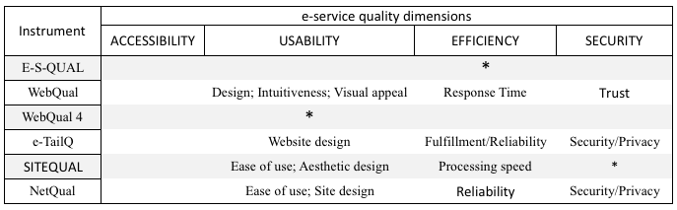
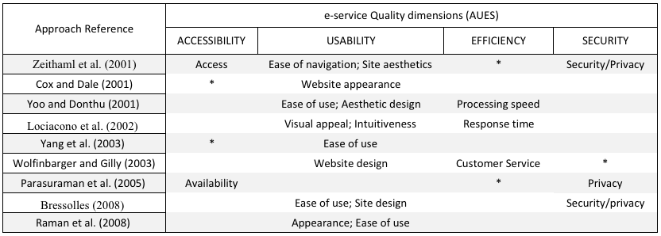

Slide 23
1. Services concept | 7, IT-Services
2. Quality concept | 8. E-Commerce
3. Service quality | 9. E-Government
4. Definitions of e-service | 10. E-Infrastructure
5. ISO/IEC 25010:2011 | 11. E-Services Providers
6. e-service quality | 12.Online and traditional business environment

Slide 24
Prior expectations
Experiences (=perceived performance)
Match between expectations and experiences (=disconfirmation)
Service Quality

Slide 25
Word-of-mouth Communications
Personal Needs
Past Experiences
Expected
Service
Gap 5
Perceived Service
CONSUMER
MARKETER
Service delivery
(pre and post contacts)
Gap 4
External communications to Consumers
Gap 3
Gap 1
Translation of Perception into Service Quality Specifications
Gap 2
Management Perceptions of Consumer Expectations

Slide 26
Determinants of Service Quality
Access
Communication
Competence
Courtesy
Credibility
Reliability
Responsiveness
Security
Tangibles
Understanding /knowing the customer
Word-of-mouth
Personal Needs
Past Experiences
Expected Service
Perceived Service
Quality
Perceived Service

Slide 27
Quality Requirements Division 2503n
Quality Model Division 2501n
Quality Evaluation Division 2504n
Quality Management Division 2500n
Quality Measurement Division 2502n
Extension Division 25050 - 25099

Slide 28
Quality in Use
Effectiveness
Efficiency
Satisfaction
Freedom from risk
Context coverage
Effectiveness
Efficiency
Usefulness
Trust
Pleasure
Comfort
Economic risk migration
Health and safety risk mitigation
Environmental risk migration
Context completeness
Flexibility

Slide 29
System/Software Product Quality
Functional Suitability
Performance Efficiency
Compatibility
Usability
Reliability
Security
Maintainability
Portability
Functional completeness
Functional correctness
Functional appropriateness
Time-behavior
Resource utilization capacity
Co-existence
Interoperability
Appropriateness
recognisability
Learnability
Operability
User error protection
User interface aesthetics
Accessibility
Maturity
Availability
Fault tolerance
Recoverability
Confidentiality
Integrity
Non-repudiation
Accountability
Authenticity
Modularity
Reusability
Analysability
Modifiability
Testability
Adaptability
Instalability
Repleacesibilly

Slide 30
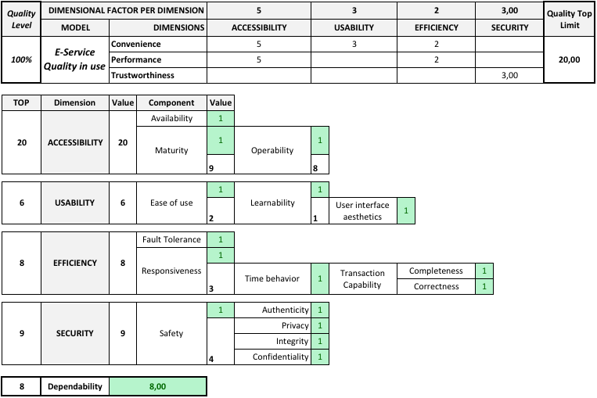
Part A
Part B
Part C

Slide 31
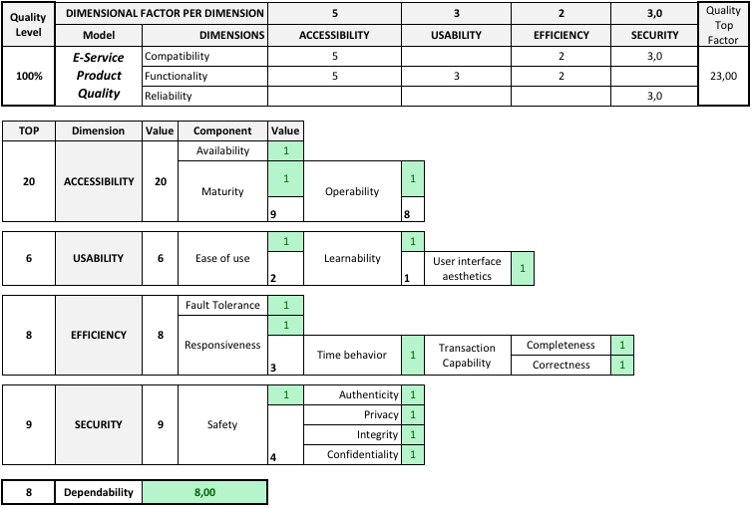
Part A
Part B
Part C

Slide 32
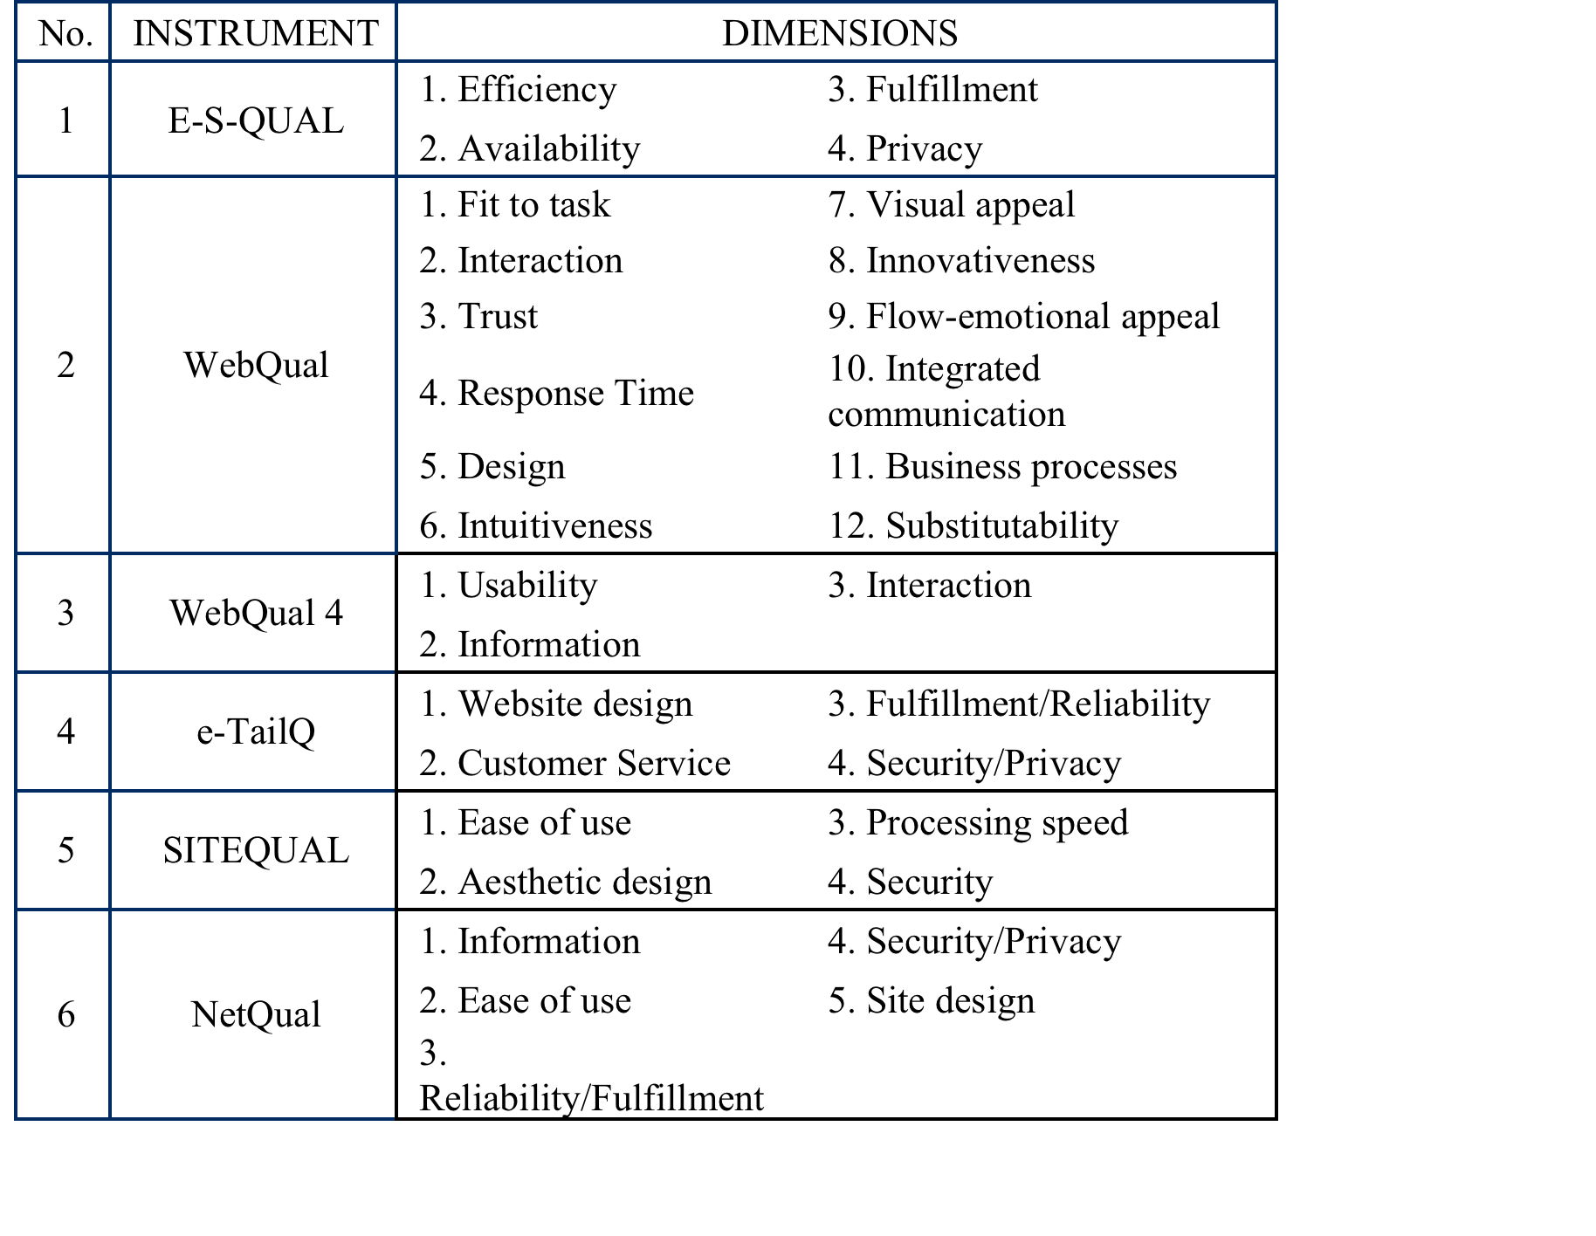

Slide 33
What is E-government?
Registering your car’s license plate online (C2G)
Transferring company tax data online (B2G)
Online archives and central registers (G2G)
Pubic tendering for social projects (N2G)
Business
Citizen
B2G
C2G
Government
Country-Level
State-Level
Local-Level
G2G
G2G
Supranational Level
N2G
NPO / NGO

Slide 34
Advertisement (1)
Discovery
(2)
Negotiation
(3)
Monitoring & Utilization
(4)
Adaptation
(5)

