Slide 1

Ansum Dholakia
Apurva Kumar
Kapil Gupta
Sean Chen
Jonathan Lam
Viral Bhalodia

Slide 2
Agenda
Introduction
Vision
Requirements
Risks
Software Architecture
Demo
Post-mortem

Slide 3
Introduction
People Problem:
People are spontaneous and want to do things on the fly
People get bored and don't know what to do
Technical problem:
No current way for real-time localized event planning
Initially target UC San Diego college students

Slide 4
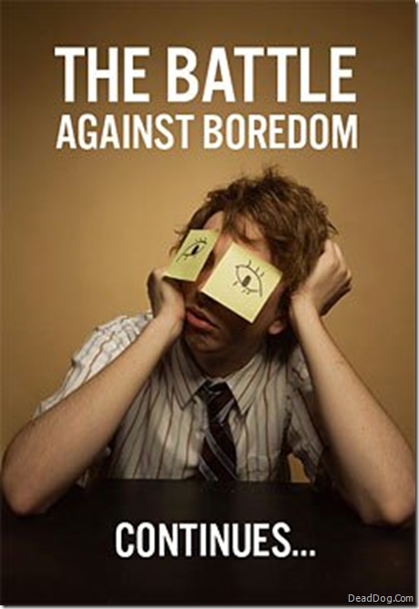
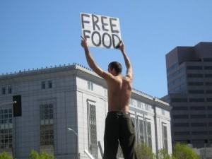
Scenarios
Free Food
Boredom

Slide 5

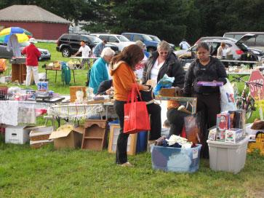
Scenarios
Party
Yard Sale

Slide 6
Vision
Enable broadcasting of events to communities
Solve problems of planning, creating and attending events in real-time
Enable spontaneity among individuals and communities
Create strong communities that are united through common interests

Slide 7
Requirements
Simple web application
Sleek and modern UI
Minimal effort to setup and use
Lightweight and fast
Free to use
Easy to use filtering mechanism of notifications
Real-time schedulability of events via asynchronous updates

Slide 8
Methods
Observing needs of UCSD students around campus
Asking fellow students, various classmates, friends questions
Questions asked include:
Day-to-day, what are some of the methods you use when you want to plan something to do?
When you're bored, what is the first thing you think to do?
What do you not like about events on Meetup and Facebook and how do you think it could be improved?

Slide 9
Team Risks
Version Control
Understanding of product definition and key features of product
Time constraints
Skill sets/Past experience
Schedule conflicts
Efficient division of labor

Slide 10
Product Risks
Clean UI
Intuitive to use
Real-time updates
Lightweight countdown timer
Compatibility with various browsers
Seamless promotion of events
Security
Scalability to users

Slide 11
Software Process
Agile:
Iterative and incremental development
Able to demo in time constraints
Quick response to changes:
Product definition and features always changing
Efficient communication among co-workers and customers
Best utilize skill sets and past experience of teammates

Slide 12
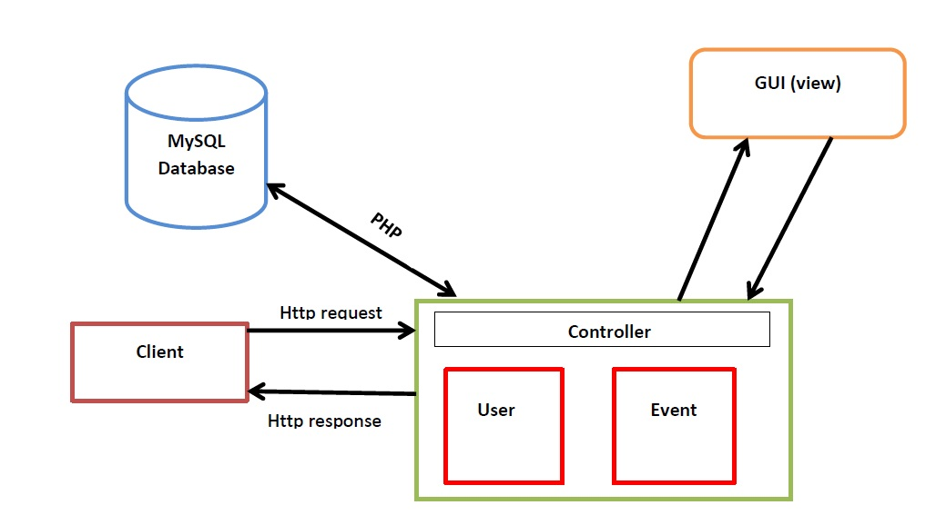
Software Architecture

Slide 13
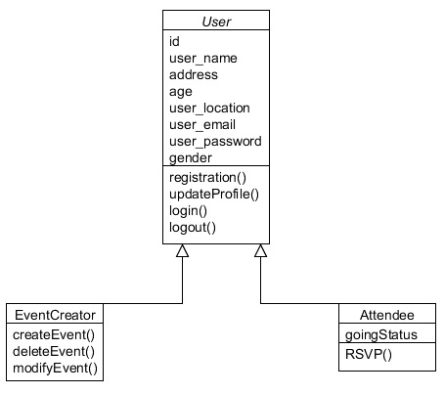
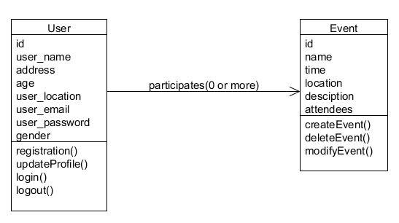
Software Architecture

Slide 14
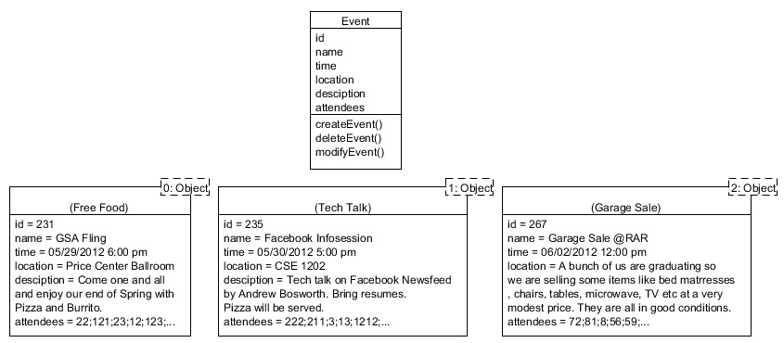
Software Architecture

Slide 15
Demo
whingit.com

Slide 16
What Went Right?
User Interface
Managed user experience well
Signup process
Layout and updates
Asynchronous updates for events feed
Always had a working prototype
Database schema
Cross-browser compatibility

Slide 17
What Went Wrong?
Version control
github
overwriting code on push
Asynchronous updates for countdown
Planning:
Too many features
Feature requirements not properly planned
Design
Scalability
Security

Slide 18
Missed Risks
Security
Scalability
"Blinded by ambition"
Beta test biased towards engineers
Technology risks:
AWS: Porting to server
Limitations of technology for the future
Scalability

Slide 19
Going Back in Time
Use SVN!
Allocate more time for integration of new features
Better division of labor:
Assign specific roles based on software architecture instead of features.
More Pair Programming
More structured development process
Clearly defined development milestones
Scrums

Slide 20
Going Forward in Time
Mobile Deployment
Social Network Integration
Subscriber List
Search
Map View
Separate Networks
Colleges
Organizations

Slide 21
Summary
We addressed the people problem:
Quickly creating and publicizing spontaneous events
Solving boredom problem
Based on time-constraints the project was a success in terms of addressing the people problem but future risks still exists
Unforeseen Risks
Revision control

