Slide 1
Why misinterpretation of electron micrographs in SARS-CoV-2-infected tissue goes viral
Carsten Dittmayer, Jenny Meinhardt, Helena Radbruch, Josefine Radke, Barbara Ingold Heppner, Frank L Heppner, Werner Stenzel, Gudrun Holland, Michael Laue
The Lancet
Volume 396 Issue 10260 Pages e64-e65 (October 2020)
DOI: 10.1016/S0140-6736(20)32079-1
Copyright © 2020 Elsevier Ltd Terms and Conditions

Slide 2
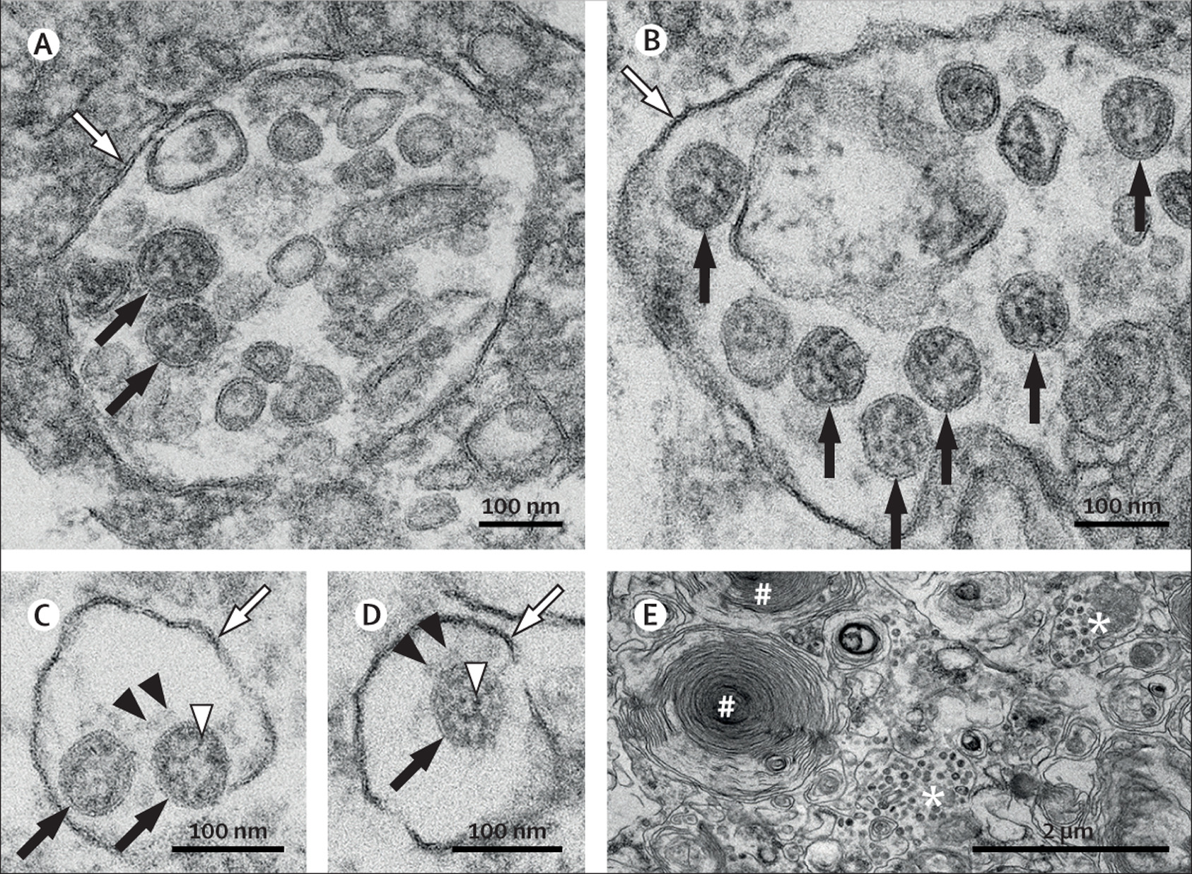
Figure
The Lancet 2020 396e64-e65DOI: (10.1016/S0140-6736(20)32079-1)
Copyright © 2020 Elsevier Ltd Terms and Conditions
Notes:
SARS-CoV-2 ultrastructural morphology in an autopsy lung specimen
Characteristic substructure of SARS-CoV-2 particles at high magnification obtained by electron microscopy (black arrows point to well preserved coronavirus) in an endothelial cell (A) and a type II pneumocyte (B, E). Although characteristic coronavirus morphology might be negatively affected by autolysis of cells, generally complicating cell type assessment, we found these coronavirus particles in a patient with a post-mortem interval of 30 h. Intracellular coronavirus particles are typically located within membrane compartments (A-D; white arrows). A heterogeneous, electron-dense, partly granular interior with ribonucleoprotein can be differentiated (C–D; white arrowheads), envelope membranes of coronavirus are well resolved, and some particles show delicate surface projections (ie, spikes; C–D; black arrowheads). In a type II pneumocyte (E), lamellar bodies are indicated by the # symbol, and compartments with numerous coronavirus particles are indicated by the * symbol. RT-PCR of this lung specimen revealed a high SARS-CoV-2 RNA load. SARS-CoV-2=severe acute respiratory syndrome coronavirus 2

