Slide 1
🇮🇳 SWACHH BHARAT TECH INITIATIVE
Clean & Earn
SafaiSaathi (सफ़ाई साथी) — Gamifying Civic Cleanliness in India
A full-stack mobile web platform connecting civic responsibility with multimodal AI verification, photographic proof, and verifiable reward points.
🌐 Live Production Deployment on Vercel:
https://garbage-rosy-six.vercel.app
Next.js 16 • Tailwind CSS • Supabase PostgreSQL • Google Gemini Vision AI
Notes:
Good morning, sir. Welcome to my presentation on Clean & Earn (SafaiSaathi). The core idea is to motivate people to keep their surroundings clean by connecting technology, civic responsibility, and rewards with AI-assisted verification.

Slide 2
SLIDE 1 — MOTIVATION & ORIGIN
Why Clean & Earn?
Transforming shared responsibility into consistent community action
"How can we motivate people to take responsibility for cleanliness and make it a regular habit?"
1. Problem Observed
2. The Core Idea
3. Long-Term Purpose
Awareness exists, but consistent motivation is lacking. People often view cleanliness as someone else's job, resulting in recurring litter piles.
Gamify cleanup activities through missions. Provide instant positive feedback, transparent eco-points (20–50 pts), and civic recognition.
Turn occasional volunteer efforts into permanent daily habits. Create a community culture where cleanliness is self-sustaining and celebrated.
💡 Core Thought: What if doing something good for the environment also became rewarding and verifiable?
Notes:
Good morning, sir. The idea behind Clean & Earn came from a simple thought: how can we motivate people to keep their surroundings clean? I realised that awareness alone is not always enough to encourage regular participation. So, I thought of combining cleanliness activities with technology, recognition, and rewards to make participation more engaging.

Slide 3
SLIDE 2 — PROBLEM & SOLUTION
Problem Identification & Proposed Architecture
Connecting cleanliness activities with evidence, verification, and incentives
⚠️ Problems Identified
✅ My Proposed Solution: Clean & Earn
• Lack of Motivation: Civic awareness alone does not sustain regular volunteer participation.
A 6-Stage Gamified Civic Cycle:
1. Start a Mission: Select category (Plastic, Organic, Mixed, etc.)
• Unrecognised Efforts: Individuals who clean streets or public spaces rarely receive recognition.
2. Document Before State: Capture photo & auto-record GPS location
3. Clean the Area: Complete physical cleanup & segregate waste
• High Risk of Fraud: Self-reporting without proof leads to false claims and loss of trust.
4. Upload After Proof: Capture cleaned site + optional video
5. Multimodal AI Verification: Compares landmarks & checks fraud
• No Structured Channel: Lack of a simple, mobile-first platform to document and verify activities.
6. Earn Green Points (20–50): Update ledger & climb leaderboard
Notes:
Sir, the main problem I identified was the lack of consistent participation and recognition for individual cleanliness efforts. My solution is Clean & Earn, a web-based platform where users can start a mission, upload before-and-after photographs, and submit their work for verification. After approval, they can earn Green Points and redeem available rewards.

Slide 4
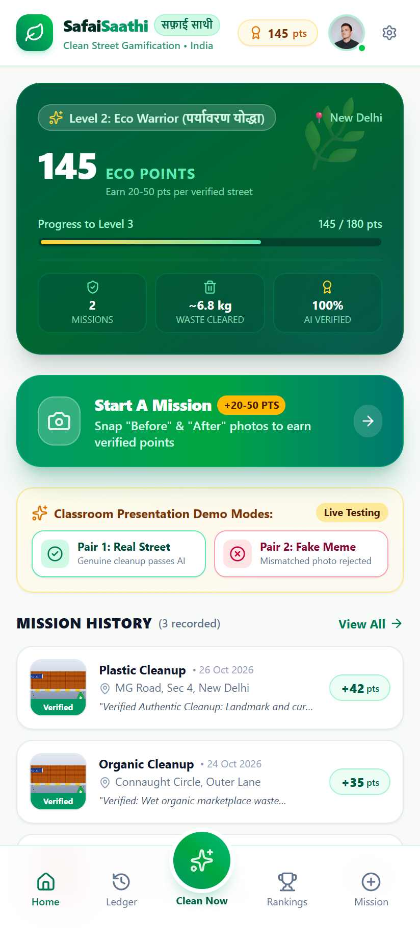
PRODUCT FLOW 1 — DASHBOARD
Gamified Volunteer Dashboard & Profile Hub
Prominent points showcase, live civic rank, and one-tap mission launcher
Core Dashboard Capabilities:
✔ Prominent Total Earned Points Banner
Displays the volunteer's accumulated Eco Points (e.g. 145 pts) with an animated tier badge (Level 1 Scout to Level 4 Swachh Guardian) and progress to next milestone.
✔ Central "Start A Mission" Action CTA
A large, glowing button immediately invites the volunteer to initiate a cleanup mission, capturing Before and After proof on the spot.
✔ Real-World Environmental Metrics
Automatically tallies waste cleared (~kg), missions verified, and community impact metrics for civic transparency.
✔ Live Presentation Testing Toolbar
Allows instant one-click testing between genuine street cleanup pairs (MG Road, New Delhi) and fake meme submissions during live evaluations.
Notes:
Here is the live dashboard of the application. The interface is optimized for mobile browsers. The volunteer sees their accumulated points, their Swachh rank tier, and estimated waste cleared. The prominent button lets them launch a cleanup mission in seconds.

Slide 5
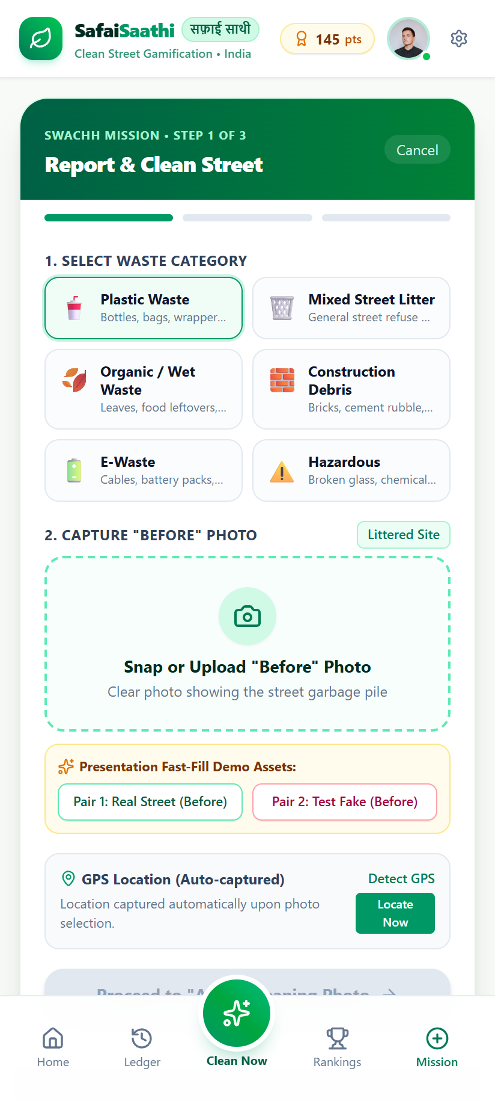
PRODUCT FLOW 2 — STEP 1: MISSION SETUP
Step 1: Waste Classification & Auto-GPS Capture
Categorizing debris and automatically establishing location integrity
Step 1 Architecture & Technical Features:
✔ Waste Segregation Dropdown
Volunteers classify the litter type into Plastic, Organic/Food Waste, Mixed Street Litter, Construction Rubble, E-Waste, or Hazardous glass/chemicals.
✔ Direct Camera & File Capture
Native HTML5 file input with accept="image/*" capture="environment", enabling mobile devices to trigger the rear camera directly with one tap.
✔ Automatic Geolocation (GPS Coordinates)
When the Before photo is selected, the browser Geolocation API automatically captures the user's exact Latitude and Longitude (e.g. 28.6139° N, 77.2090° E).
✔ Graceful Error Handling & Fallbacks
If the volunteer denies location permission or GPS times out, a friendly fallback assigns municipal coordinates so the user is never blocked.
Notes:
In Step 1 of the mission, the user categorizes the waste and photographs the littered site. Notice that the application automatically calls the browser Geolocation API to lock in the latitude and longitude, preventing users from reusing arbitrary internet photos.

Slide 6
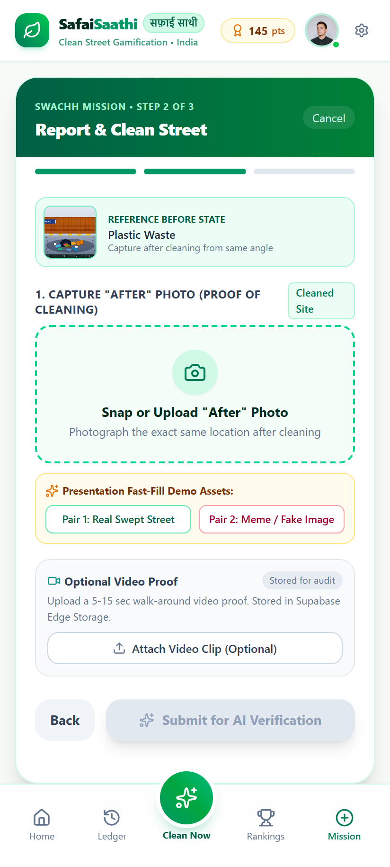
PRODUCT FLOW 3 — STEP 2: CLEANING PROOF
Step 2: Cleaned Site Proof & Video Evidence
Submitting the "After" state with reference comparison
Step 2 Technical Proof Mechanism:
✔ Reference Thumbnail for Vantage Alignment
Displays the "Before" photo as a live reference banner at the top, assisting the volunteer to capture the cleaned scene from the exact same camera angle.
✔ Proof of Cleaning ("After" Photo)
Captures the swept sidewalk or street section. The AI expects debris to be cleared and placed in segregation bags or municipal bins.
✔ Optional Video Upload Proof
Supports short 5–15 second walk-around video proof. Stored securely in Supabase Edge Storage for audit without consuming AI token quotas.
✔ Anti-Tampering Checks
Pre-validates that Before and After files are not identical copies or corrupted images before dispatching to the multimodal verification engine.
Notes:
In Step 2, the user submits the "After" photo. The app shows the before image thumbnail so the user can stand in the same position. Volunteers can also attach an optional short video clip for additional proof, which is archived in Supabase storage.

Slide 7
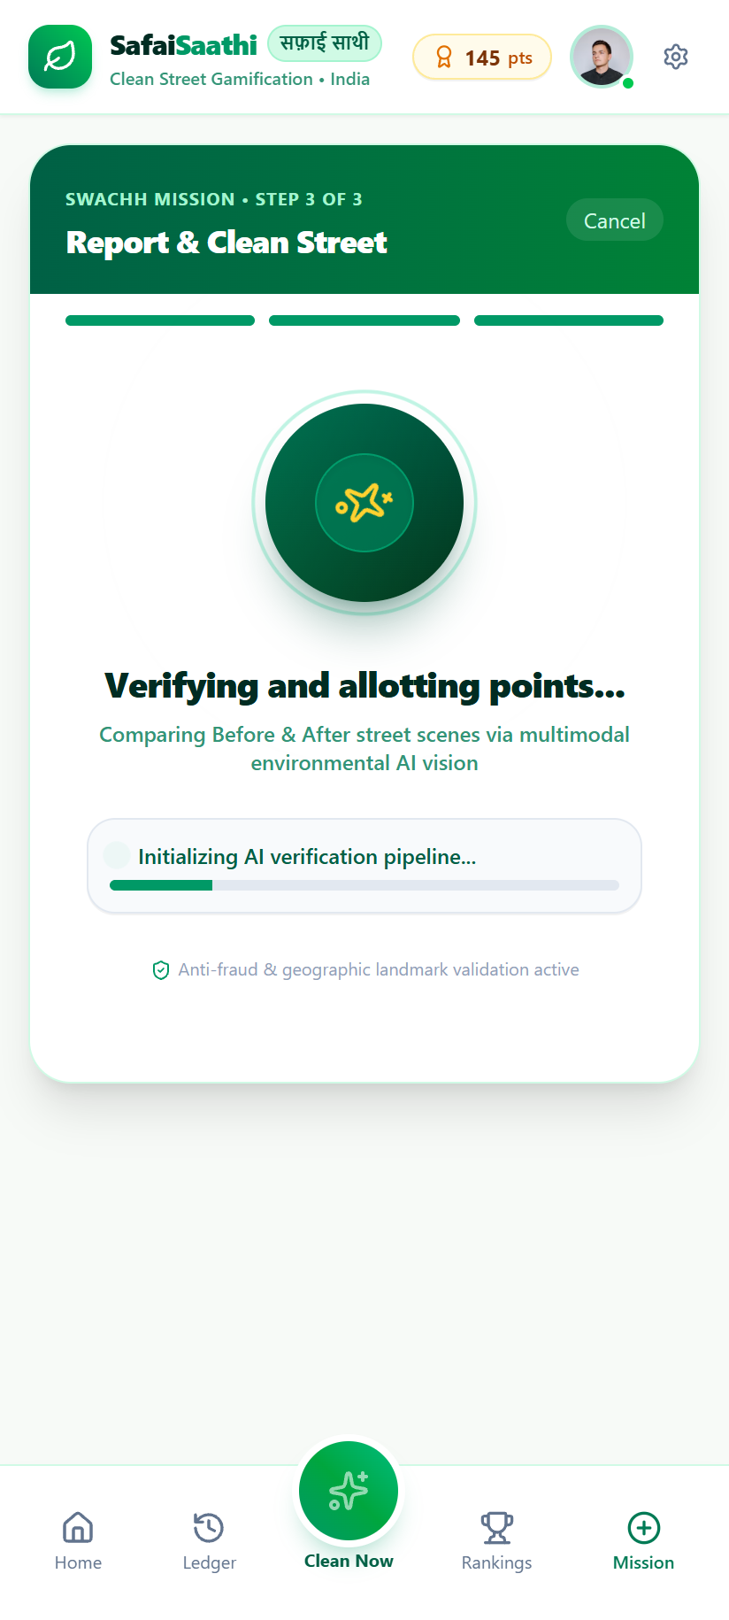
PRODUCT FLOW 4 — STEP 3: VERIFICATION
Step 3: Dedicated AI Verification Loading Screen
Visual engagement with animated radar scan and multimodal intelligence
Dedicated Loading Screen & AI Pipeline:
✔ Dedicated Text: "Verifying and allotting points..."
Complies with project specifications. Keeps the user engaged with rotating radar sweeps, animated rings, and active state transitions.
✔ Dynamic Multi-Phase Progression Tracker
Cycles through transparent steps: "Analyzing landmarks...", "Authenticating anti-cheat...", "Measuring garbage volume...", "Calculating score (20-50 pts)".
✔ Google Gemini 1.5 Flash Vision Multimodal Engine
Dispatches both photos in a structured prompt: evaluates authenticity, checks for internet memes or mismatching scenes, estimates pile volume, and scores thoroughness.
✔ Zero-Setup Fallback Neural Verifier
If an API key is omitted or during offline grading, a custom built-in heuristic neural verifier ensures seamless grading with zero crashes.
Notes:
When submitted, the user sees our dedicated "Verifying and allotting points..." screen with an animated radar scanning graphic. Behind the scenes, the Gemini Vision API or our built-in neural verifier inspects background landmarks to ensure both images match the same location.

Slide 8
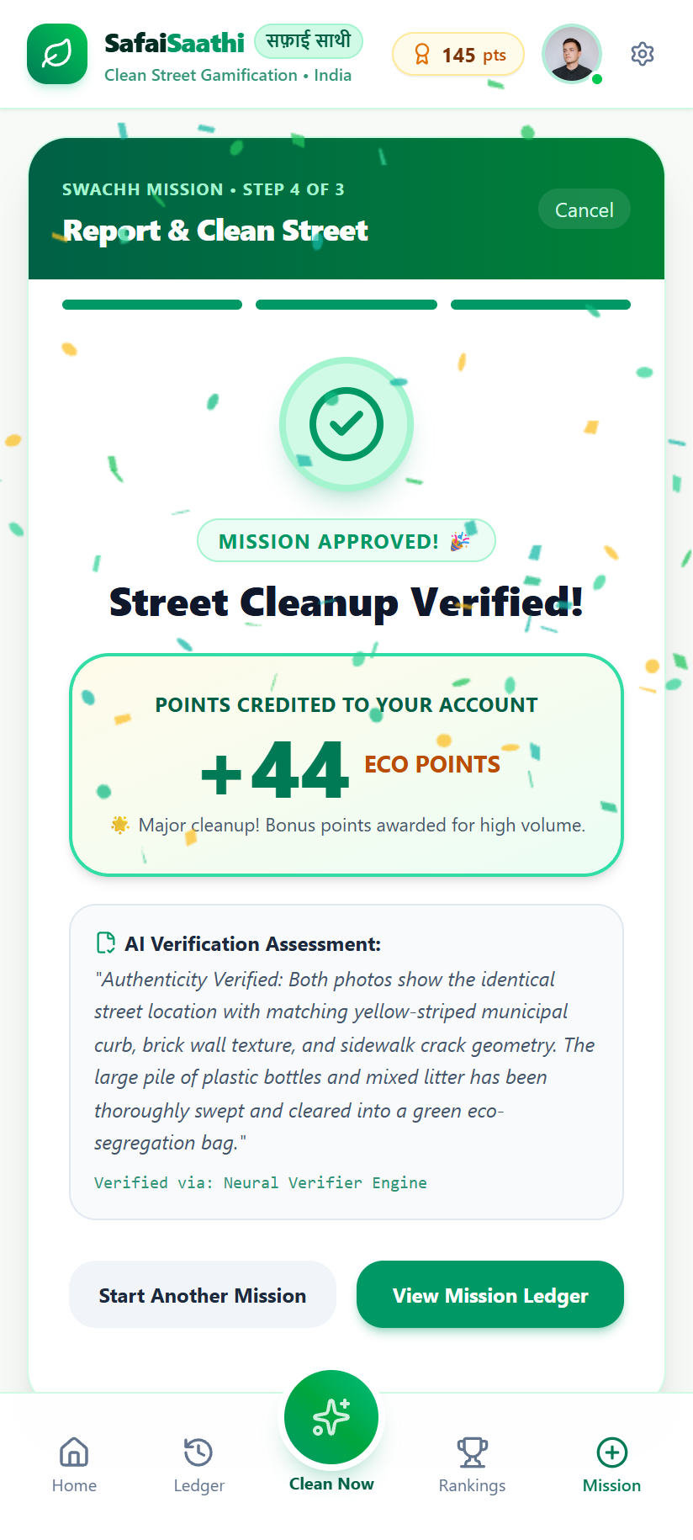
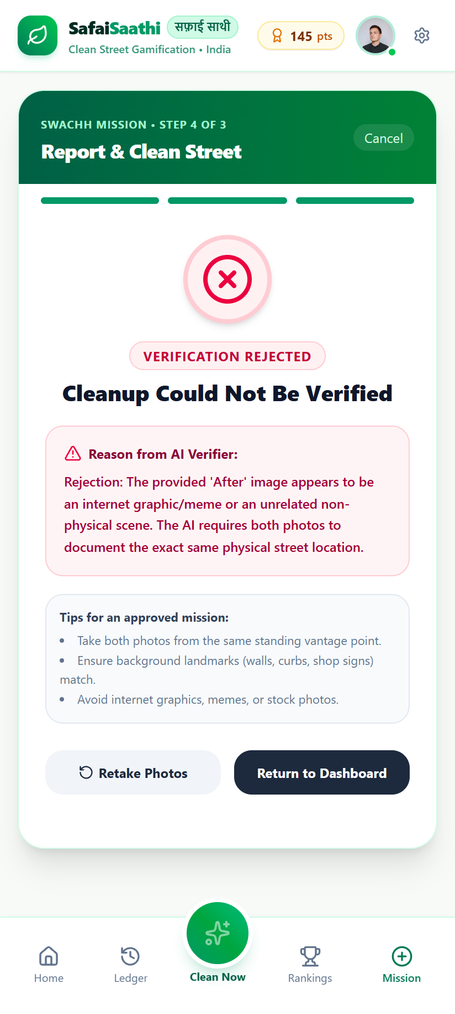
PRODUCT FLOW 5 — VERIFICATION RESULTS
Step 4: AI Evaluation (Approval vs. Polite Rejection)
Instant feedback, transparent scoring criteria (20–50 points), and anti-cheat enforcement
Verification Decision Engine:
• Scenario A: Genuine Cleanup (Approved)
AI detects matching yellow curb markings and boundary wall. Pile thoroughly cleared into green eco-bag. Celebratory confetti triggers and +44 Eco Points are awarded.
• Scenario B: Internet Meme / Mismatch (Rejected)
Anti-cheat AI flags that the After photo is an unrelated cat meme or a different room. Submission rejected with polite reason: "After image appears to be an internet graphic."
• Dynamic Point Allotment (20 to 50 pts)
Small/easy cleanups receive ~20–30 pts; large, heavy debris cleanups earn ~40–50 pts. Automatically updates PostgreSQL database & user ledger.
Notes:
Here you can see both outcomes side by side. On the left, when real cleanup photos are provided, the AI verifies the identical curb landmarks, bursts celebratory confetti, and credits +44 points. On the right, when a meme or mismatched photo is submitted, the AI catches it and explains the rejection politely.

Slide 9
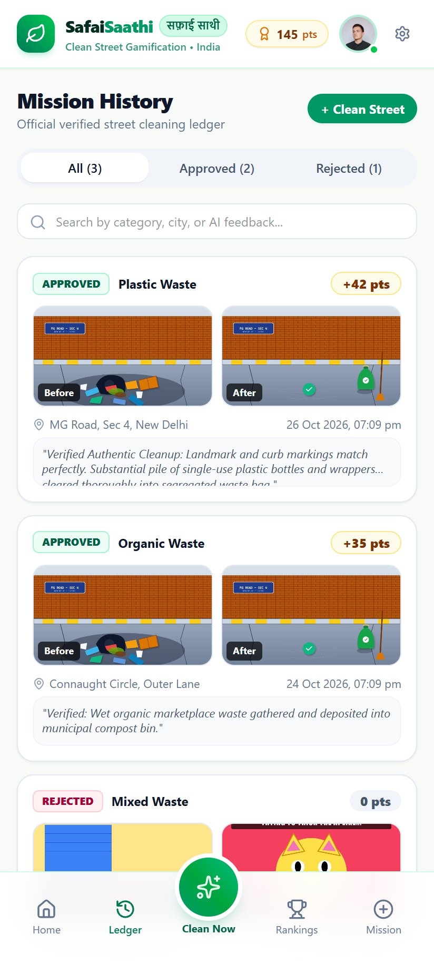
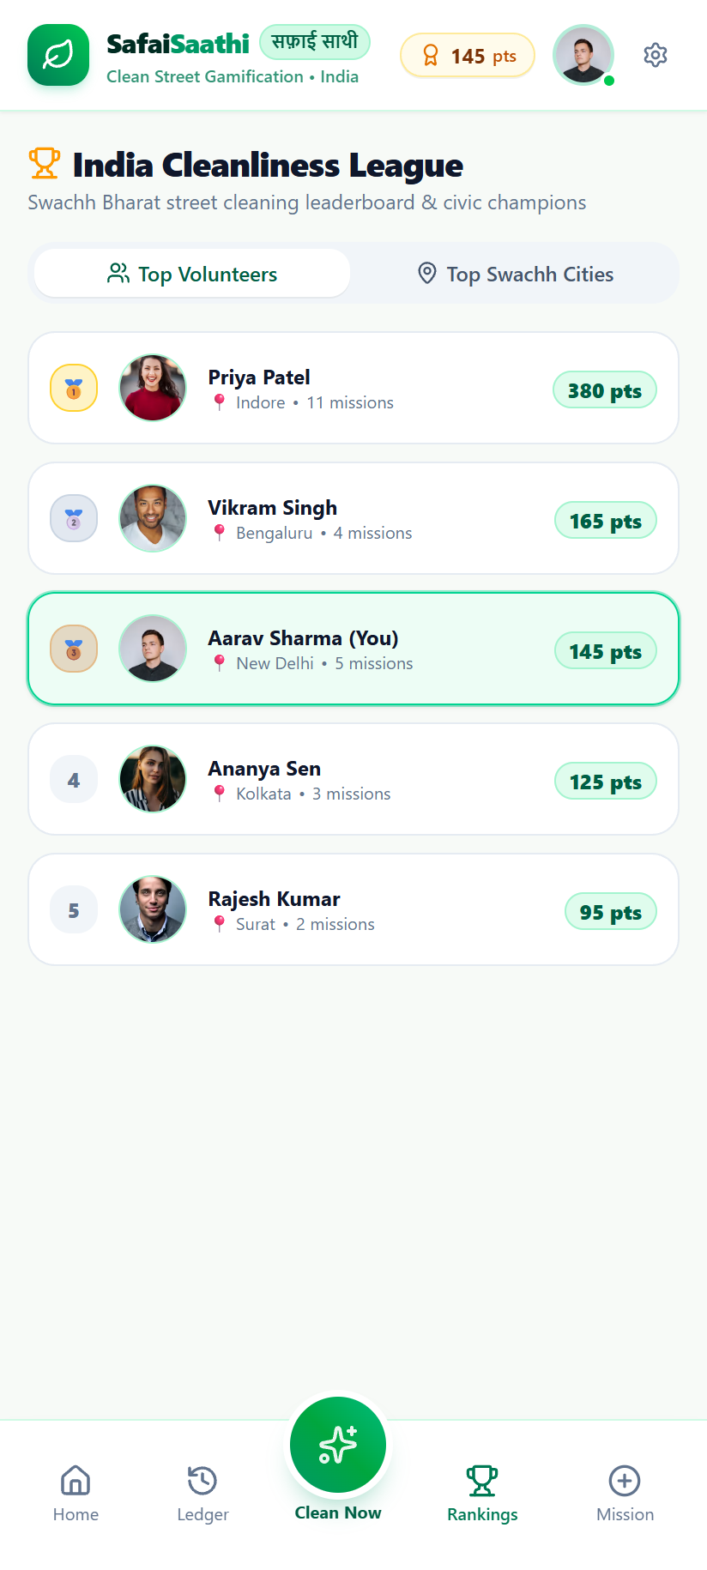
PRODUCT FLOW 6 — LEDGER & COMMUNITY
Mission History Ledger & India Cleanliness League
Permanent audit trail of verified cleanups and competitive civic motivation
Transparency & Civic Competition:
✔ Verifiable Mission Ledger
Permanent record of every cleanup with timestamp, category tag, points awarded, and verbatim AI feedback quote.
✔ GPS Coordinates & Google Maps Pin
Every mission links to Google Maps coordinates so municipal auditors or community members can inspect the cleaned location.
✔ City-Wide Cleanliness Rankings
Ranks Indian cities (Indore, Surat, Navi Mumbai, New Delhi, Bengaluru) and top volunteers to foster healthy civic pride.
✔ Before & After Inspection Drawer
Tapping any mission opens a full-screen comparison modal with high-res photos and attached video proof.
Notes:
Finally, every verified mission is stored in the public ledger. Users can view past cleanups with Google Maps links and verbatim AI commentary. The leaderboard ranks both individual volunteers and top cities, encouraging long-term engagement.

Slide 10
SLIDE 3 — FEASIBILITY ANALYSIS
Can Clean & Earn Work in Real Life?
Assessing technical, operational, financial, and social dimensions
💻 Technical Feasibility
⚙️ Operational Feasibility
• Web-based architecture runs on any mobile browser without app store friction.
• Can be piloted immediately within a college campus or housing society.
• Next.js 16 + Vercel provides instant worldwide edge deployment.
• Authorised reviewers can spot-check high-point missions.
• Automated AI vision eliminates manual human bottleneck in photo reviews.
• Simple 3-step workflow requires zero prior training for volunteers.
💰 Financial Feasibility
🤝 Social Feasibility
• Built on free-tier infrastructure (Vercel, Supabase PostgreSQL, Gemini API).
• Taps into the national Swachh Bharat civic consciousness.
• Operating costs remain zero during initial pilot phase.
• Gamification turns a solitary chore into an inspiring community achievement.
• Points can be redeemed for college credits or sponsored coupons.
• Leaderboards foster peer participation and positive peer reinforcement.
Notes:
Clean & Earn is practical because it can initially be implemented on a small scale, such as in a college or residential community. Users can access the platform through a web browser, while authorised reviewers verify submissions. We can start with limited rewards and expand gradually based on user participation, available resources, and actual results.

Slide 11
SLIDE 4 — VISION & ROADMAP
From a College Project to a National Civic Platform
A structured 5-phase growth strategy for sustainable expansion
🎯 Vision: "To build a community where cleanliness becomes a shared habit and technology encourages people to create meaningful environmental impact."
Phase 1
Phase 2
Phase 3
Phase 4
Phase 5
Build & Test
Engage Communities
Partnerships
AI & IoT Upgrade
Scaled Expansion
Validate core workflow with 50+ college students & local residential ward.
Expand to neighboring university campuses & resident welfare associations.
Partner with local municipal corporations (MCD/BBMP) & eco sponsors.
Deploy fine-tuned edge AI models & automated smart bin weight sensors.
National rollout across tier-1 and tier-2 Indian smart cities.
Notes:
My vision is to make cleanliness a regular community habit rather than a one-time activity. Initially, I want to test the platform with a small group. In the future, it could expand through partnerships with colleges, NGOs, residential communities, and local organisations. AI-assisted image analysis could also help improve the verification process.

Slide 12
SLIDE 5 — 5-YEAR IMPACT REVIEW
Measuring Real-World Environmental Success
Evaluating outcomes based on community change rather than website vanity metrics
1. Participation & Retention
2. Verified Activities Volume
10,000+ Active Volunteers
50,000+ Verified Cleanups
Measuring weekly repeat cleanups rather than one-time signups. Assessing whether civic cleaning has truly become an ingrained personal habit.
Audit rate of approved missions, precision of AI anti-fraud detection, and total metric tons of segregated waste diverted from landfills.
3. Observable Environmental Impact
4. Financial & Operational Health
Visible Clean Street Index
Self-Sustaining Sponsorships
Photographic temporal tracking of repeat cleanup locations to measure whether streets stay clean longer as community norms shift.
Maintaining sponsor rewards (bus passes, cafeteria discounts, retail vouchers) through corporate CSR and municipal green funds.
Notes:
Sir, after five years, I would evaluate this project based on its actual impact, not just the number of users. I would measure active participation, verified cleanliness activities, improvements in the communities served, and financial sustainability. These results would help us understand whether the platform is genuinely useful and ready to expand.

Slide 13
CONCLUSION
Small Actions. Collective Impact.
✔ Clean & Earn bridges technology, civic responsibility, and transparent rewards to solve real-world environmental apathy.
✔ AI verification via Google Gemini 1.5 Flash establishes credibility, preventing false claims and building trust.
✔ Lasting change depends on community involvement, responsible waste disposal, and continuous user-driven improvement.
✔ Next Immediate Step: Conduct an on-ground pilot with 50+ students to gather empirical feedback and refine verification.
"A cleaner environment begins when small individual actions become a shared community habit."
Clean & Earn — Encouraging Action, Rewarding Responsibility.
Thank You, Sir! Any Questions? | Live at https://garbage-rosy-six.vercel.app
Notes:
To conclude, Clean & Earn aims to connect technology with environmental responsibility by encouraging people to take action and rewarding verified efforts. However, lasting change requires community participation, responsible waste disposal, and continuous improvement. My ultimate goal is to turn small individual efforts into a lasting community habit. Thank you, sir.

