Slide 1
Open-source · Apache 2.0 licensed
P
PayProbe
The regression-testing platform for payment terminal ecosystems — from the POS terminal, through the payment server, all the way to HSM, core banking, switch and acquirer.
50K concurrent connections
10K ops / sec
Three-phase execution
No-code test constructor
Created by David Sakhelashvili · github.com/pay-probe/payprobe

Slide 2
THE PROBLEM
Payment stacks are deeply interconnected
A change in one component can silently break another — and teams find out in production, not in a test report.
!
#
?
Silent regressions
Many moving parts
"Something failed"
One config change to the switch breaks settlement two systems away. Nothing fails loudly.
Terminal, payment server, HSM, core banking, switch, acquirer — each with its own protocol.
Existing tools tell you a flow broke — not which component or integration pair regressed.
PayProbe
02 / 16

Slide 3
THE ANSWER
Know exactly what regressed
PayProbe runs structured three-phase suites after every deployment and pinpoints the failing component or integration pair — with a baseline diff against a known-good snapshot.
POS Terminal
EMV sim · physical serial / TCP
✓
Component → integration → end-to-end — gating that stops at the first break
▼
Payment Server · RestPay
✓
Baseline diffing — every run vs a pinned known-good snapshot
REST / ISO 8583
▼
✓
Mock mode — run the whole platform with zero hardware
HSM · Core Bank · Switch · Acquirer
PKCS#11 · SOAP · ISO 8583
PayProbe
03 / 16

Slide 4
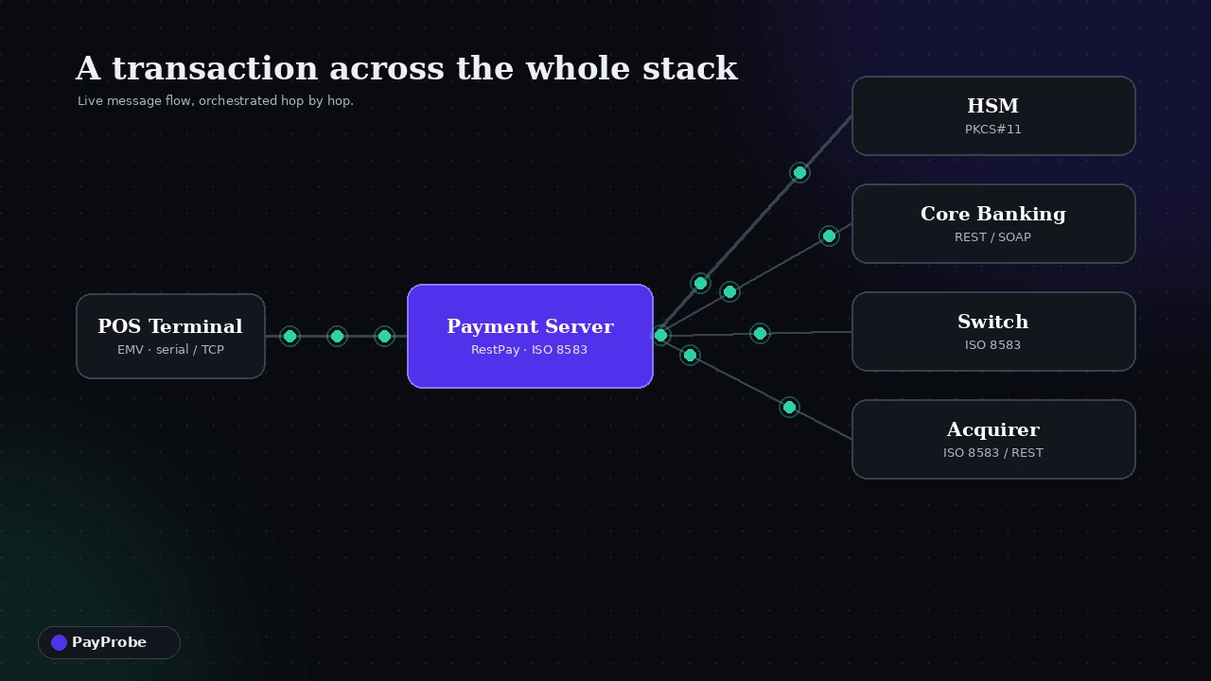
SEE IT IN ACTION
A transaction across the stack
What you're watching
Orchestrated hops
Terminal → payment server → HSM, core, switch, acquirer.
Live message flow
Every leg streamed and timed as the transaction runs.
Pinpoint regressions
PayProbe names the exact pair that broke — not just "failed".
● LIVE CLIP
Click the clip in slideshow mode to play.
PayProbe
04 / 16

Slide 5
PLATFORM
Everything in one platform
⛓
Three-phase execution
✦
Visual constructor
◎
Baseline diffing
Component health → integration pairs → full end-to-end flows, each gating the next.
Angular drag-and-drop workflow editor. Build scenarios with no code.
Every run compared against a pinned known-good snapshot.
⊕
Adapter framework
⚙
CI/CD ready
▣
Mock mode
Plug in any payment system via a clean interface — about 2 hours per adapter.
JUnit XML output, REST trigger, Docker-native deployment.
Run the full platform locally with no payment hardware or secrets.
PayProbe
05 / 16

Slide 6
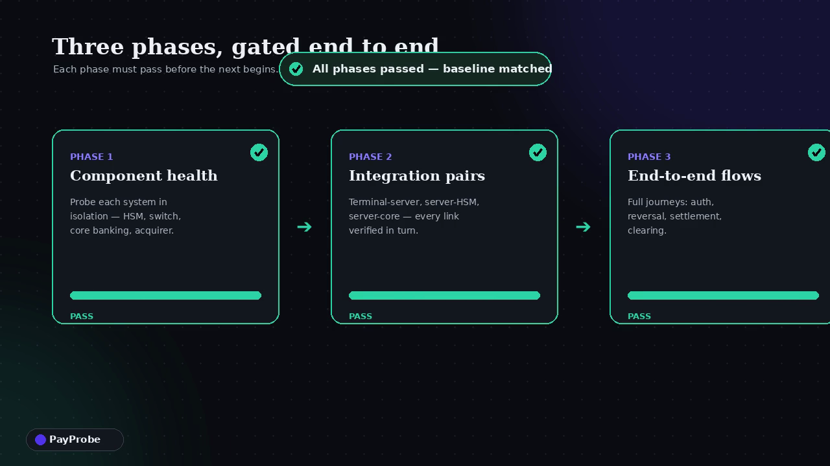
HOW A RUN WORKS
Three phases, gated end to end
1
Component health
Probe each system in isolation.
2
Integration pairs
Every link verified in turn.
3
End-to-end flows
Auth, reversal, settlement, clearing.
● LIVE CLIP
Stops at the first break — so you know exactly where it failed.
PayProbe
06 / 16

Slide 7
NO-CODE AUTHORING
Visual test constructor
A custom drag-and-drop canvas for assembling flows — steps, edges and assertions — with an AI assistant that turns plain English into a runnable scenario.
VIDEO PLACEHOLDER
✦ Ask AI
▶
Import / export JSON & YAML
Starter flows
ISO 8583 inspector
Video placeholder — record building a scenario on the canvas + "✦ Ask AI" generating a flow.
PayProbe
07 / 16

Slide 8
ADAPTERS
Speaks every protocol in the stack
Ships with stable adapters for common payment components. Adding a new one takes about two hours.
http
hsm
terminal_sim
REST / HTTPS
PKCS#11
EMV
terminal_physical
core_banking
switch
Serial / TCP
REST / SOAP
ISO 8583
acquirer
db_probe
mock_*
ISO 8583 / REST
Postgres / Oracle / MSSQL
in-memory · all systems
PayProbe
08 / 16

Slide 9
SIMULATORS
Realistic host & scheme simulators
Stand up the other side of the wire — no third-party sandbox required.
VISA
CyberSource
payShield 10K
Dialect-aware
Base I auth, reversal, network-mgmt, clearing — opt-in CVV2 / PVV / ARQC.
REST gateway sim — auth, capture, refund, reversal, void with a decision ladder.
HSM host-command sim with hybrid real crypto under a test LMK.
Bind a message format; the responder validates inbound ISO 8583 (warn / reject).
PayProbe
09 / 16

Slide 10
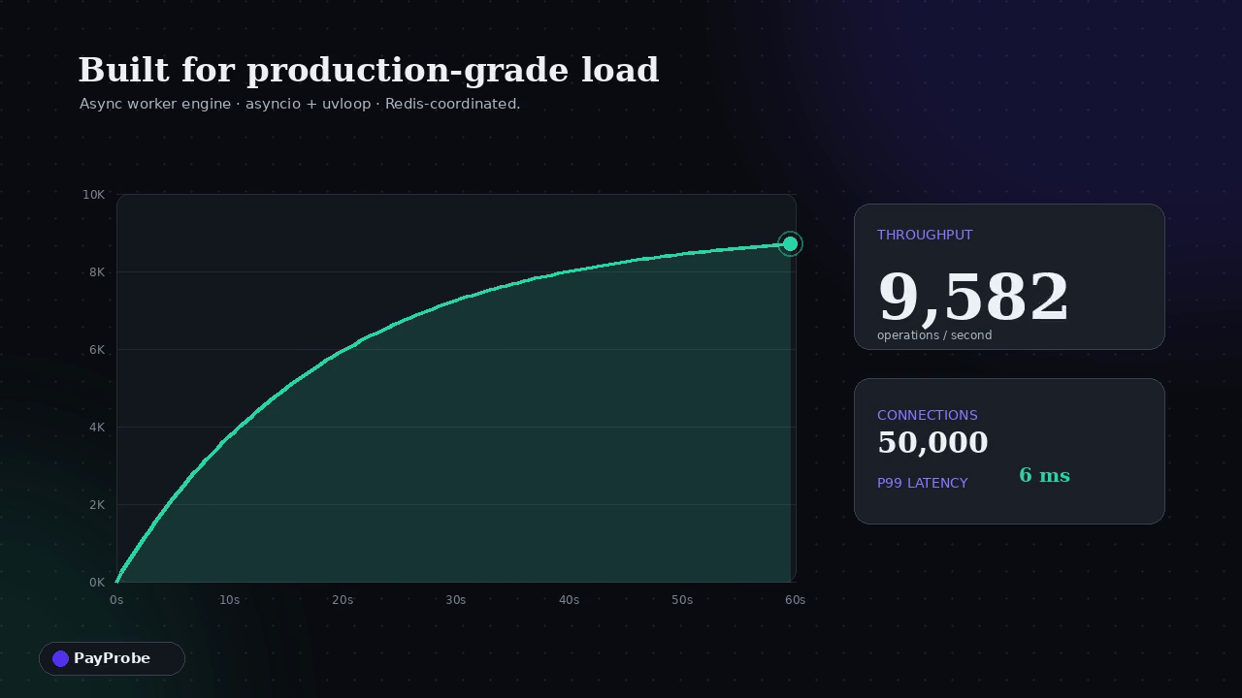
SCALE
Built for production-grade load
An async worker engine on Python asyncio + uvloop, coordinated across Redis-backed workers for distributed load and stress testing.
50K
10K
4
∞
concurrent connections
operations / second
load profiles
horizontal workers
Profiles: ramp · spike · soak · steady — hot re-tune mid-run, backpressure & saturation visibility.
● LIVE CLIP
PayProbe
10 / 16

Slide 11
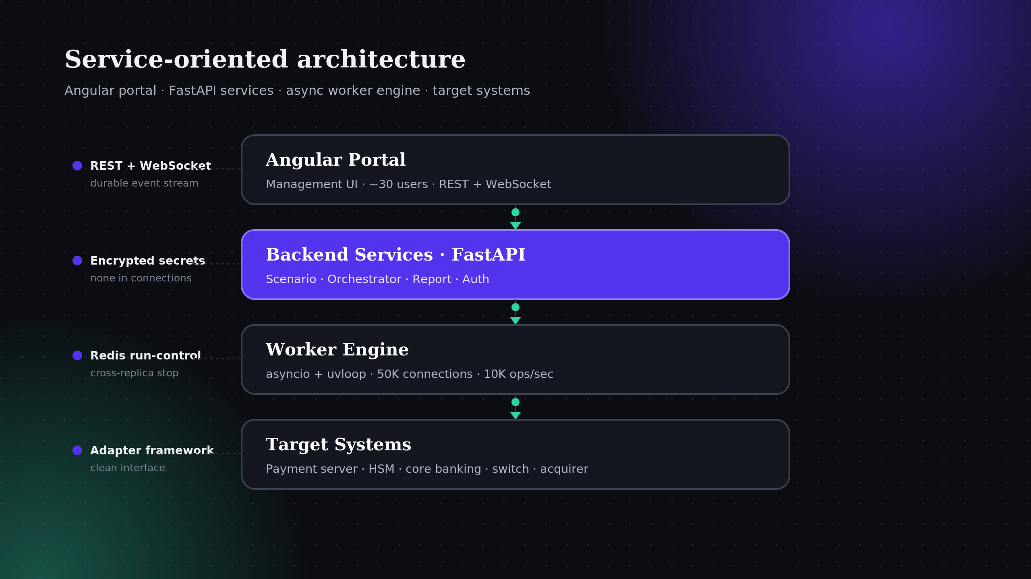
ARCHITECTURE
Clean, service-oriented design
PayProbe
11 / 16

Slide 12
TRUST & CONTROL
Test data & secrets, handled right
Test Data Manager
Secrets vault
Environments
Card pools, BIN ranges, terminal pools, key registry. Generate Luhn-valid PANs from a BIN.
Masked inventory across connections, variables & keys — encrypted at rest, never revealed.
First-class environment registry with per-environment connection overrides.
Trends & flakiness
Packs & certification
Trace viewer
Per-scenario flaky detection and run-trend history to spot intermittent failures.
Curated test-case packs and a compliance certification report with an HTML badge.
Wire-level raw logs + structured engine trace with a per-step timing waterfall.
PayProbe
12 / 16

Slide 13
IN YOUR PIPELINE
Drops into CI/CD on day one
Trigger a run on every deploy; gate the pipeline on the result.
1
Deploy
2
Trigger
3
Diff
4
Gate
Your CI ships a build to a test environment.
➜
A REST call kicks off the three-phase suite.
➜
Results compared against the pinned baseline.
➜
JUnit XML feeds the dashboard; pipeline passes or fails.
Docker-native
JUnit XML
REST trigger
Self-contained HTML report
PayProbe
13 / 16

Slide 14
WHO IT'S FOR
Built for the people who ship payments
⌂
⚒
✓
Issuers & acquirers
Payment platform teams
QA & certification
Validate the full stack before every release without a lab full of hardware.
Catch cross-component regressions the moment they're introduced.
Reusable packs and certification reports for repeatable, auditable testing.
PayProbe
14 / 16

Slide 15
FULL WALKTHROUGH
End-to-end demo
VIDEO PLACEHOLDER
▶
Placeholder for your longer demo video — author a scenario, run it across simulators, read the report.
PayProbe
15 / 16

Slide 16
GET STARTED
Run the whole platform in one command.
Mock mode by default — no hardware, no secrets, no toolchain. Clone, docker compose up, open the portal, start a run.
Apache 2.0 open source
github.com/pay-probe/payprobe
Adapters · Docs · Roadmap
PayProbe — created by David Sakhelashvili

