Slide 1

B-leave staff leave management system
Group members:
group:- a6, B.tech (CS) III year
Archita ohri (9060)
Divyansha bhamu (9080)
Parul sharma (9133)
Payal Chauhan (9134)

Slide 2
contents
1. Introduction
1.1 Scope
1.2 Abbreviations
2. Overall Description
2.1 Project Perspective
2.2 User Characteristics
3. Use case Diagram
4. Requirements
4.1 Hardware Requirements
4.2 Software Requirements
4.3 Functional Requirements
4.4 Non-functional Requirements
4.5 Software Quality Attributes

Slide 3
5. System Architecture
5.1 Entity Relationship Diagram
5.2 Data Flow Diagram
6. Data Design
6.1 Data Description
7. Sample Interface Design
8. References

Slide 4
1. Introduction
What is B-Leave?
- is a staff leave management system.
- aimed at automating the leave record storage and retrieval as well as management of the same.

Slide 5
1.1 SCOPE :
This application aims to provide a special facility to the administrative department of AIM & ACT like keeping records of leaves taken by teaching as well as non-teaching staff.
This application can also be deployed in leave management system task for other departments of the Banasthali Vidyapith campus as well.

Slide 6
1.2 ABBREVIATIONS :

Slide 7
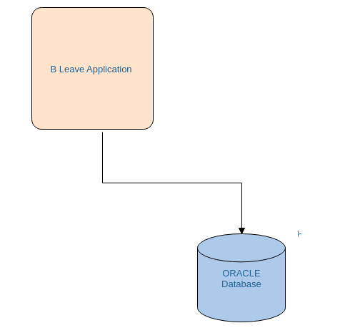
2. Overall description
2.1 PROJECT PERSPECTIVE :
B Leave is a standalone application.
One tiered application.

Slide 8
2.2 USER CHARACTERISTICS :
Primary users of the system will be the Database Administrator and the authorities handling the information retrieval.
Very little technical expertise is required for reading the outputted data since it is in graphical/tabular form.
Educational level(for DBA) of B-Leave computer software - medium level.

Slide 9
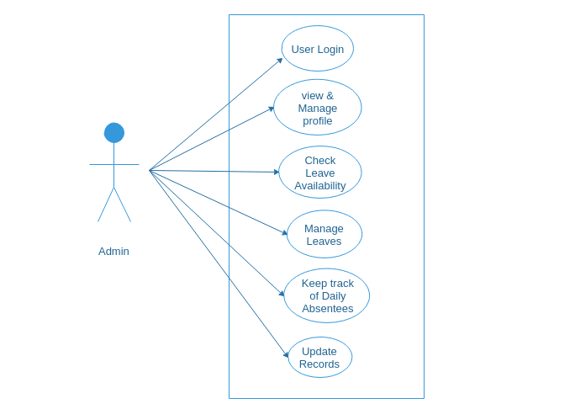
3. USE-CASE DIAGRAM

Slide 10
Name: B-Leave
Identifier LM-04
Description: Retrieve and store the records of staff regarding leaves.
Actors: Admin
Preconditions:
The admin is familiar with the system.
The employee has already undergone the general instructions to apply for leave.
Post Conditions:
The employee will be approved for the leave only if they are eligible.

Slide 11
Basic courses of actions:
The teacher submits a filled copy of form to the admin. [Alternative Course A: Forms not filled out.]
The admin visually inspects the forms.
The admin determines that the forms have been filled properly. [Alternative Course B: Forms improperly filled out.]
The admin clicks on ‘Employee Details’.
The system displays ‘Employee Details’.
The admin inputs “Employee ID” of the employee.
The system displays the basic information and history of leaves taken by the employee. [Alternative Course C: Application per is not eligible to enroll.]
Admin checks for the remaining leaves.
Teacher gets the leave signed by Head of Department.
Teacher submits the copy to the admin.
Admin clicks on “Update Info”.
The system displays “Updation in Leave” and “Updation in Employee’s Detail”.
Admin inputs the employee’s detail in “Updation in Leave” and update status to “Approved” or “Cancelled” and fills out the leave’s duration.
Admin clicks on “Update”.
The admin prints a receipt and hands the teacher.
The use case ends.

Slide 12
Alternative Course A: Forms not filled out
1.1 The employee fills out the forms as appropriate.
1.2 The use case continues at step 2 in basic course of action.
Alternative Course B: Forms improperly filled out
3.1 The employee is asks to correct the form.
3.2 The employee fills out the form properly.
3.3 The use case continues at step 3 in the basic course of action.

Slide 13
4 REQUIREMENTS
4.1 HARDWARE REQUIREMENTS:
Developer side requirements
Intel P2 processor (minimum)
3 GB RAM
5 GB Secondary Storage
User side requirements (Recommended requirements):
Intel P2 processor(minimum)
2 GB RAM
5 GB Secondary storage

Slide 14
4.2 SOFTWARE REQUIREMENTS
Developer side requirements (Recommended Requirements)
NetBeans 8.0.2
Oracle XE 10G
Windows Vista(minimum)
Java Development Kit SE 8
User side requirements (Recommended Requirements):
Windows Vista(minimum)
Oracle XE 10G
Java Runtime Environment 1.8

Slide 15
4.3 FUNCTIONAL REQUIREMENTS
System will keep employee's basic information.
System provides information about the leave availability.
Keep staff record.
Display leave history.
4.4 NON-FUNCTIONAL REQUIREMENTS
Non-functional requirements define the needs in terms of performance, logical database requirements, design constraints, reliability, availability, security and maintainability.

Slide 16
4.5 SOFTWARE QUALITY ATTRIBUTES
CONSISTENCY
There shall be consistency in variable names within the system. The graphical user interface shall have a consistent look and feel.
RELIABILITY
Specify the factors required to establish the required reliability of the software system at time of delivery.

Slide 17
AVAILABILITY
The system shall be available during the office hours.
MAINTAINABILITY
B-Leave is being developed in Java. Java is an object oriented programming language and will be easy to maintain.
PORTABILITY
B-Leave will run in any Microsoft Windows environment that contains Java Runtime and the Oracle database.

Slide 18
5. System architecture

Slide 19
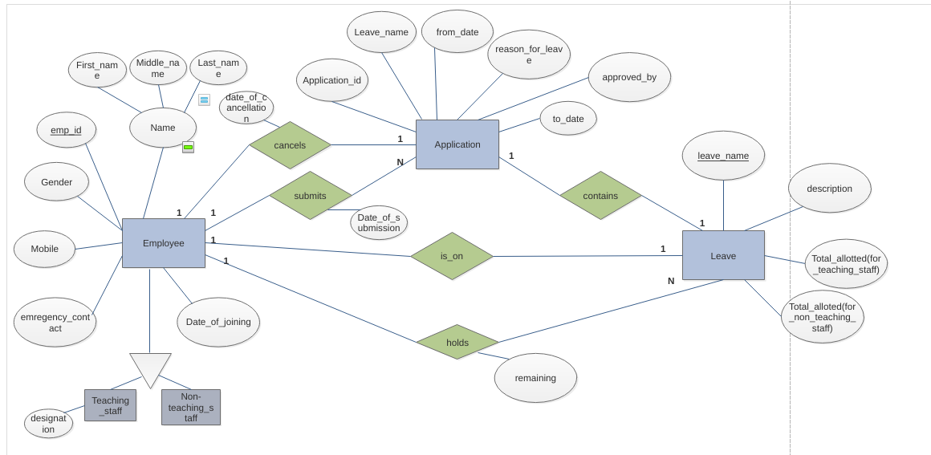
5.1 Entity-Relationship Diagram

Slide 20
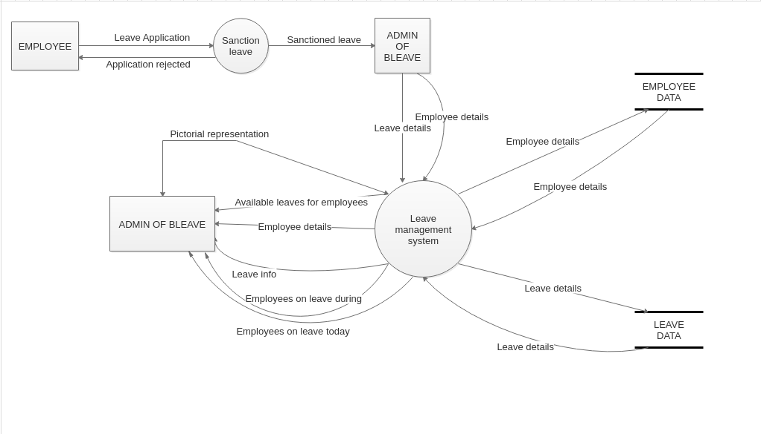
5.2 Data Flow Diagram

Slide 21
6. Data design
6.1 Data Description
Employee :

Slide 22
Application :
Leave :
Sr_no | Column | Type | Constraints
1 | Application_id | Integer (4) | Not Null, Primary Key
2 | Leave_name | Char (4) | Not Null
3 | From_date | Date | Not Null
4 | To_date | Date | Not Null
5 | Reason_for_leave | Varchar(30)
6 | Approved_by | Char (10) | Not Null
Sr_no | Column | Type | constraints
1 | Leave_name | Char (4) | Not Null, Primary Key
2 | Description | Char (20) | Not Null
3 | Total_allotted_leave_for_teaching_staff | Integer (3) | Not Null
4 | Total_allotted_leave_for_non_teaching_staff | Integer (3) | Not Null

Slide 23
Employee_Holds_Leave :
Employee_Submits_Leave:
Sr_no | Column | Type | Constraints
1 | Emp_id | Varchar (10) | Not Null, Foreign Key
2 | Leave_name | Char(3) | Not Null, Foreign Key
3 | Remaining | Integer(3)
Sr_no | Column | Type | Contraints
1 | Emp_id | Varchar (10) | Not Null, Foreign Key
2 | Application_id | Integer(4) | Not Null, Foreign Key
3 | Date_of_submission | Date | Not Null

Slide 24
Employee_Cancels_Leave:
Sr_no | Column | Type | Constraints
1 | Emp_id | Varchar(10) | Not Null, Foreign Key
2 | Application_id | Integer(4) | Not Null, Foreign Key
3 | Date_of_cancellation | Date

Slide 25
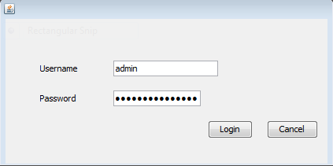
Sample interface design

Slide 26
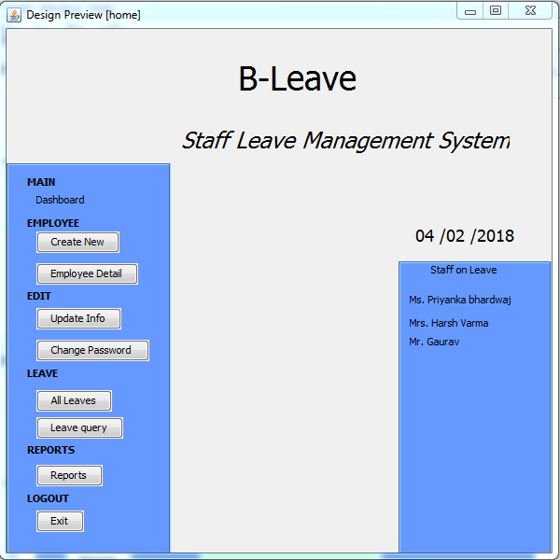

Slide 27
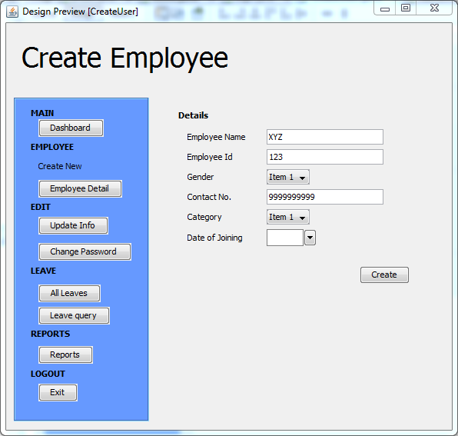

Slide 28
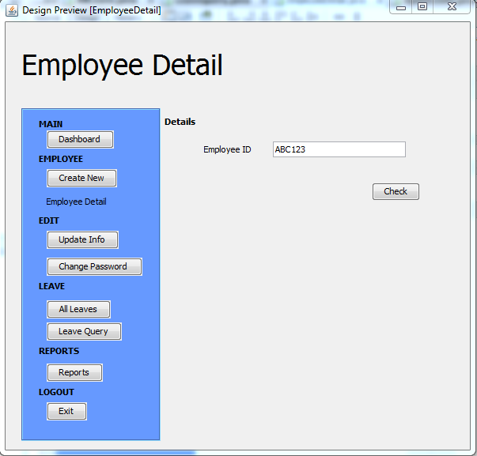

Slide 29
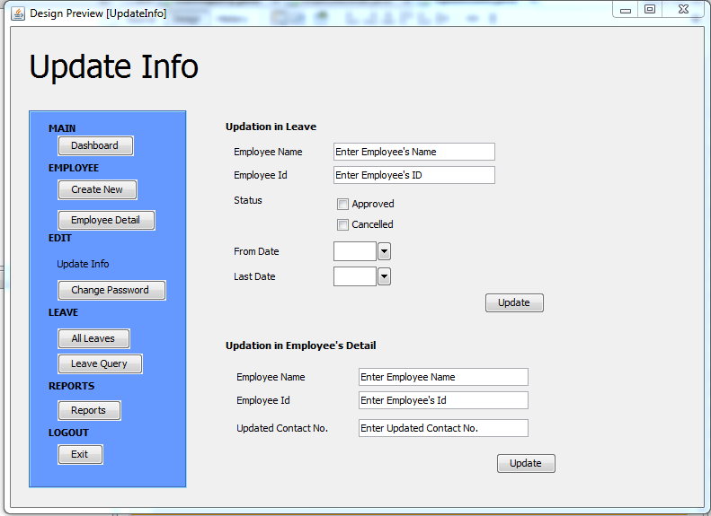

Slide 30
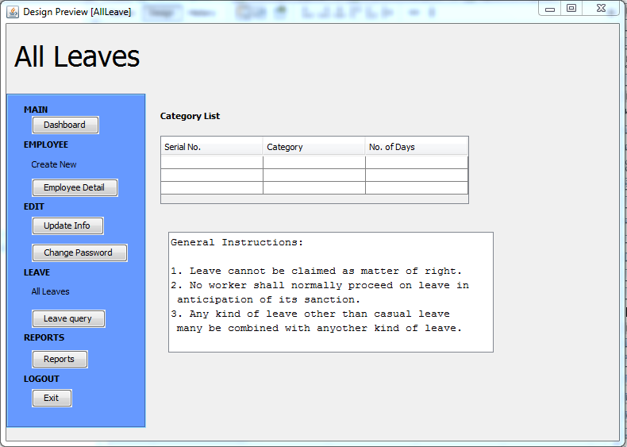

Slide 31
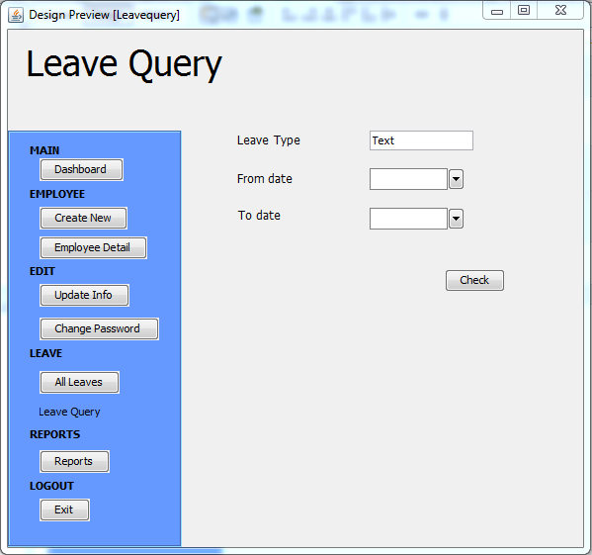

Slide 32
7. REFERENCES :
Database System Concepts , Henry F. Korth, S. Sudarshan, Abraham S., sixth edition.
Fundamentals of Database Systems , Ramez Elmasri, Shamkant B. Navathe, sixth edition.
"Software Engineering ,A Practitioner’s Approach“, Roger S.Pressman, sixth edition.
IEEE Software Engineering Standards Committee , "IEEE Std 830-1998. IEEE Recommended Practice for Software Requirements Specifications", October 20, 1998.
Systems Analysis and Design ,Elias M. Awad.

Slide 33
THANK YOU

