Slide 1
Best First Search
A* Algorithm

Slide 2
Notion of Heuristics
Heuristics use domain specific knowledge to estimate the quality or potential of partial solutions
Examples
Manhattan distance heuristic for 8 puzzle

Slide 3
Calculating Cost
f(n) = g(n) + h(n)
g(n) – Actual cost of traversing from initial state to state n
h(n) – Estimated cost of reaching to the goal from state n

Slide 4
Informed State Space
Given: [S, s, O, G, h] where
S is the (implicitly specified) set of states
s is the start state
O is the set of state transition operators each having some cost
G is the set of goal states
h( ) is a heuristic function estimating the distance to a goal
To find:
Min. cost of sequence of transactions to the goal state

Slide 5
A* Algorithm
Initialize: Set OPEN = {s},
CLOSE = { }, Set f(s) = h(s), g(s)=0
Fail:
If OPEN ={ }, Terminate with Failure
Select: Select the minimum cost state, n, form OPEN and Save n in CLOSE
Terminate:
If n ∈ G, terminate with SUCCESS

Slide 6
A* Algorithm
Expand:
Generate the successors of n using O. For each successor, m, insert m in OPEN only if m ∉ [OPEN ∪ CLOSE]
set g(m) = g(n) + C(n,m)
set f(m) = g(m) + h(m)
insert m in OPEN
if m ∈ [OPEN ∪ CLOSE]
Set g(m) = min{ g(m), g(n)+C(m,n)}
set f(m) = g(m) + h(m)
If f(m) has decreased and m ∈ CLOSE move it to OPEN
Loop: Goto step 2

Slide 7
12
2
10
1
16
2
15
1
2
3
4
3
1
1
3
12
5
7
1
11
5
15
5
6
7
8
1
4
10
15
12
8
4
3
1
1
9
10
11
12
0

Slide 8
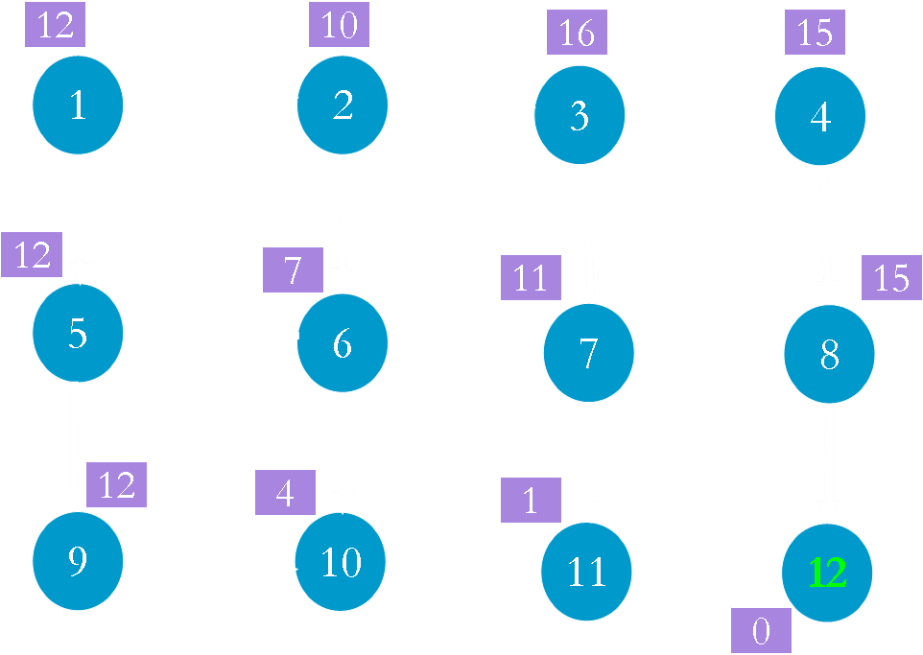
OPEN
1(12)
Node g()
1 0
CLOSE

Slide 9
OPEN
Node g()
1 0
CLOSE
1(12)

Slide 10
OPEN
2(12) 5(13)
Node g()
1 0
2 2
5 1
CLOSE
1(12)

Slide 11
OPEN
5(13)
Node g(n)
1 0
2 2
5 1
CLOSE
1(12) 2(12)

Slide 12
OPEN
5(13) 3(19) 6(12)
Node g()
1 0
2 2
5 1
3 3
6 5
CLOSE
1(12) 2(12)

Slide 13
OPEN
5(13) 3(19)
Node g()
1 0
2 2
5 1
3 3
6 5
CLOSE
1(12) 2(12) 6(12)

Slide 14
OPEN
10(13) 3(19) 5 (13)
7(17)
Node g()
1 0
2 2
5 1
3 3
6 5
7 6
10 9
CLOSE
1(12) 2(12) 6(12)

Slide 15
OPEN
10(13) 3(19) 7(17)
Node g()
1 0
2 2
5 1
3 3
6 5
7 6
10 9
CLOSE
1(12) 2(12) 6(12) 5(13)

Slide 16
OPEN
3(19) 10(13) 7(17)
9(14)
Node g()
1 0
2 2
5 1
3 3
6 5
7 6
10 9
9 2
CLOSE
1(12) 2(12) 6(12) 5 (13)

Slide 17
OPEN
3(19) 7(17) 9(14)
Node g()
1 0
2 2
5 1
3 3
6 5
7 6
10 9
9 2
CLOSE
1(12) 2(12) 6(12) 5 (13)
10(13)

Slide 18
OPEN
3(19) 7(17) 9(14)
11(13)
Node g()
1 0
2 2
5 1
3 3
6 5
7 6
10 9
9 2
11 12
CLOSE
1(12) 2(12) 6(12) 5 (13)
10(13)

Slide 19
OPEN
3(19) 7(17) 9(14)
Node g()
1 0
2 2
5 1
3 3
6 5
7 6
10 9
9 2
11 12
CLOSE
1(12) 2(12) 6(12) 5 (13)
10(13) 11(13)

Slide 20
OPEN
3(19) 7(17) 9 (14)
12 (13)
Node g()
1 0
2 2
5 1
3 3
6 5
7 6
10 9
9 2
11 12
12 13
CLOSE
1(12) 2(12) 6(12) 5 (13)
10(13) 11(13)

Slide 21
OPEN
3(19) 7(17) 9 (14)
Node g()
1 0
2 2
5 1
3 3
6 5
7 6
10 9
9 2
11 12
12 13
CLOSE
1(12) 2(12) 6(12) 5 (13)
10(13) 11(13) 12 (13)

Slide 22
Comparing with OR Graph Search
Instead of 11 nodes (OR) we expanded only 7 nodes in A*
Inference: Nodes which looked promising initially were found to be not so good later on and were ignored/left off

Slide 23
Claims
If f(n) < C* then n must be expanded
Assumption
The heuristic function under estimates
h(n) <= f*(n) (Cost of reaching goal from n)
All costs are +ve
If you have nodes with same costs (f() value) then select the one which has minimum g() value
At times we have to expand sub optimal paths before expanding optimal paths (Non – monotonicity of Heuristic Function)

Slide 24
5
1
3
1
4
2
3
23
4
3
4
2
Suppose h() under
estimates
1
3
5
20
6
0

Slide 25
5
1
OPEN
1(5)
3
1
4
2
3
23
4
3
4
2
1
3
5
20
CLOSE
0
6

Slide 26
5
1
OPEN
3
1
4
2
3
23
4
3
4
2
1
3
5
20
CLOSE
1(5)
0
6

Slide 27
5
1
OPEN
2(7) 3(24)
3
1
4
2
3
23
4
3
4
2
1
3
5
20
CLOSE
1(5)
0
6

Slide 28
5
1
OPEN
3(24)
3
1
4
2
3
23
4
3
4
2
1
3
5
20
CLOSE
1(5) 2(7)
0
6

Slide 29
5
1
OPEN
3(24) 4(9)
3
1
4
2
3
23
4
3
4
2
1
3
5
20
CLOSE
1(5) 2(7)
0
6

Slide 30
5
1
OPEN
3(24)
3
1
4
2
3
23
4
3
4
2
1
3
5
20
CLOSE
1(5) 2(7) 4(9)
0
6

Slide 31
5
1
OPEN
3(24) 5(11)
3
1
4
2
3
23
4
3
4
2
1
3
5
20
CLOSE
1(5) 2(7) 4(9)
0
6

Slide 32
5
1
OPEN
3(24)
3
1
4
2
3
23
4
3
4
2
1
3
5
20
CLOSE
1(5) 2(7) 4(9) 5(11)
0
6

Slide 33
5
1
3
1
OPEN
3(24) 6(28)
4
2
3
23
4
3
4
2
1
3
5
20
6
CLOSE
1(5) 2(7) 4(9) 5(11)
0

Slide 34
5
1
3
1
OPEN
6(28)
4
2
3
23
4
3
4
2
1
3
5
20
CLOSE
1(5) 2(7) 4(9) 5(11)
3(24)
0
6

Slide 35
5
OPEN
6(28) 4(6)
1
3
1
4
2
3
23
4
3
4
2
1
3
5
20
CLOSE
1(5) 2(7) 4(9) 5(11)
3(24)
0
6

Slide 36
5
OPEN
6(28)
1
3
1
4
2
3
23
4
3
4
2
1
3
5
20
CLOSE
1(5) 2(7) 4(9) 5(11)
3(24) 4(6)
0
6

Slide 37
5
OPEN
6(28) 5(8)
1
3
1
4
2
3
23
4
3
4
2
1
3
5
CLOSE
1(5) 2(7) 4(9) 5(11)
3(24) 4(6)
20
0
6

Slide 38
5
1
3
1
4
2
3
23
OPEN
6(28)
4
3
4
2
1
3
5
CLOSE
1(5) 2(7) 4(9) 5(11)
3(24) 4(6) 5(8)
20
0
6

Slide 39
5
1
3
1
4
2
3
23
OPEN
6(28) 6(25)
4
3
4
2
1
3
5
CLOSE
1(5) 2(7) 4(9) 5(11)
3(24) 4(6) 5(8)
20
0
6

Slide 40
5
1
3
1
4
2
3
23
OPEN
4
3
4
2
1
3
5
CLOSE
1(5) 2(7) 4(9) 5(11)
3(24) 4(6) 5(8) 6(25)
20
0
6

Slide 41
Results
A heuristic is called admissible if it always under estimates, that is, we always have h(n) ≤ f*(n), where f*(n) denotes the minimum distance to a goal state from state n
For finite state spaces, A* always terminates
Algorithm A* is admissible, that is, if there is a path from start state to a goal state, A* terminates by finding an optimal path

Slide 42
Results
If A1 and A2 are two versions of A* such that A2 is more informed than A1 , then A1 expands at least as many states as does A2 (Because h2() is more informed then h1())
If we are given two or more admissible heuristics for every state and we do not know which is more informed, then, we can take their max to get a stronger admissible heuristic at every state.
h(n) = max (h1(n), h2(n))

Slide 43
A* Algorithm

