Slide 1
Dilan’s Travel Guide Analysis

Slide 2
Prioritize and Focus

Slide 3
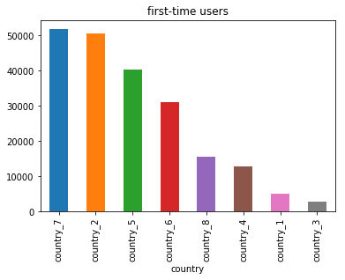
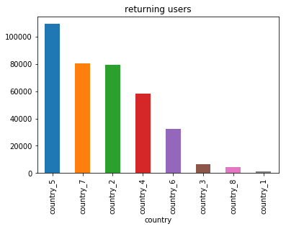
Prioritize effort
Focus on a specific country that is currently bringing in maximum readers
Analysis shows that country_5 should be the focus of attention right now as per the charts below and on the next slide

Slide 4
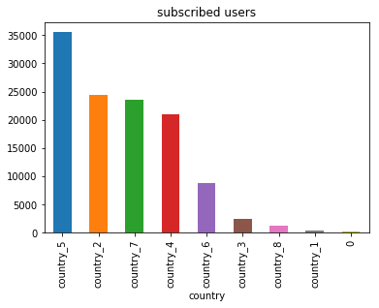
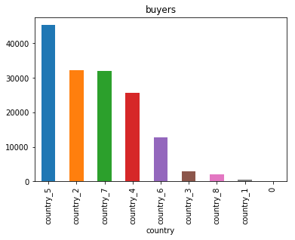

Slide 5
Where to invest?

Slide 6
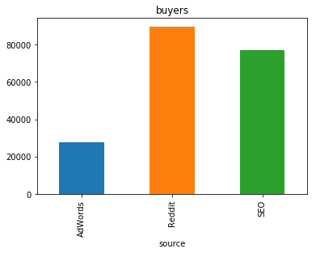
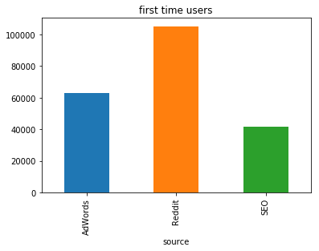
Increase investment in other sources
Following charts show that Reddit and SEO are the bringing in a lot more readers the first time and ones that become buyers
Investing more into them and keeping investing with AdWords constant can help to boost the number of readers coming in

Slide 7
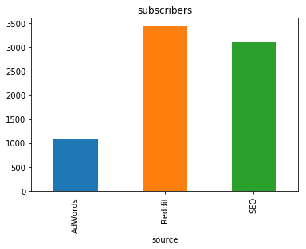

Slide 8
Predictions

Slide 9
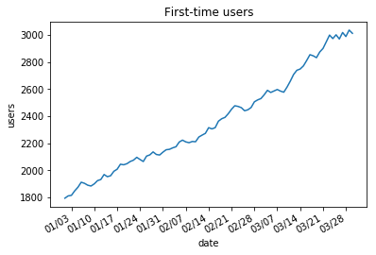
The number of first-time readers have been constantly increasing as shown below.

Slide 10
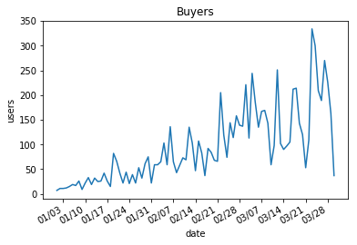
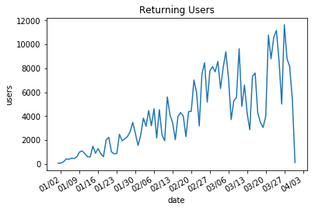
There is also a fair number of increase in returning users and buyers which can be improved further by taking care of the first two analyses.

Slide 11
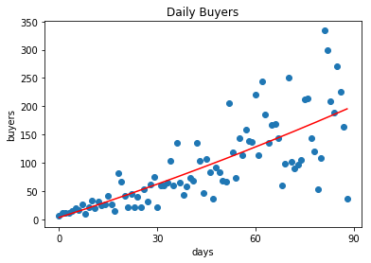

Slide 12
Thank you

