Slide 1
GhostHunter SOC
Autonomous SOC for faster detection & response
Team: GhostHunter — Demo for Jury | TCS - TATA Consultancy Services
Notes:
Greet jury; state project name and goal.

Slide 2
Problem
High alert volumes and long investigation times
Manual triage is slow and error-prone
Enterprises need scalable, automated SOC workflows
Notes:
Speak: Describe the pain — noisy alerts, long MTTR. Mention typical daily alert volumes and analyst load; set expectation for demo showing automation benefits.

Slide 3
Solution Summary
Autonomous pipeline: ingestion → detection → correlation → response
LLM-assisted agents for investigation and reporting
Graph-backed context (Neo4j) + semantic store (Chroma)
Notes:
Speak: Outline the automated flow and how each component reduces manual work. Emphasize novelty: combining graph context with RAG and agents to automate investigation.

Slide 4
Architecture & Tech
Data ingestion: Kafka-based pipeline
Detection: rule + ML models
Knowledge: Neo4j attack graph, Chroma RAG store
Agents: automated response, reporting, correlation
Notes:
Speak: Show architecture diagram. Call out technologies and why chosen (scalability, semantic search, graph relations). Mention data flow and latency expectations.

Slide 5
Demo Preview
Live demo: detection → investigation → response
Fallback: short recorded clip (30s)
Screenshots included in backup slides
Notes:
Speak: Briefly describe the demo steps. If live, we'll trigger an alert and show the agent investigation and generated report. If recorded, play the clip and narrate key moments.

Slide 6
Results & ROI
Reduced mean time to respond (example: 60%)
Fewer analyst hours per incident
Improved detection precision and context for triage
Notes:
Speak: Present conservative estimates: percentage MTTR reduction, analyst hours saved, and potential cost savings. Tie to business impact and compliance benefits.

Slide 7
Roadmap & Risks
Next: field pilot, integration with SIEMs, hardened ops
Risks: model drift, integration efforts; mitigations planned
Notes:
Speak: Show 3-month roadmap and key milestones. Acknowledge risks and mitigation (monitoring, model retraining, phased rollouts).

Slide 8
Ask & Contact
Request: pilots, feedback, potential partners/funding
Contact: ghosthunter-team@example.com
Notes:
Speak: State specific asks (pilot customers, integration partners, seed funding). Provide contact info and invite follow-up demos.

Slide 9
One-page Summary
Problem: Alert overload and slow investigations
Solution: Autonomous SOC combining graph context, RAG, and agent automation
Ask: Pilots & partners; contact ghosthunter-team@example.com
Notes:
Handout: Give this one-page summary as a takeaway for judges.

Slide 10
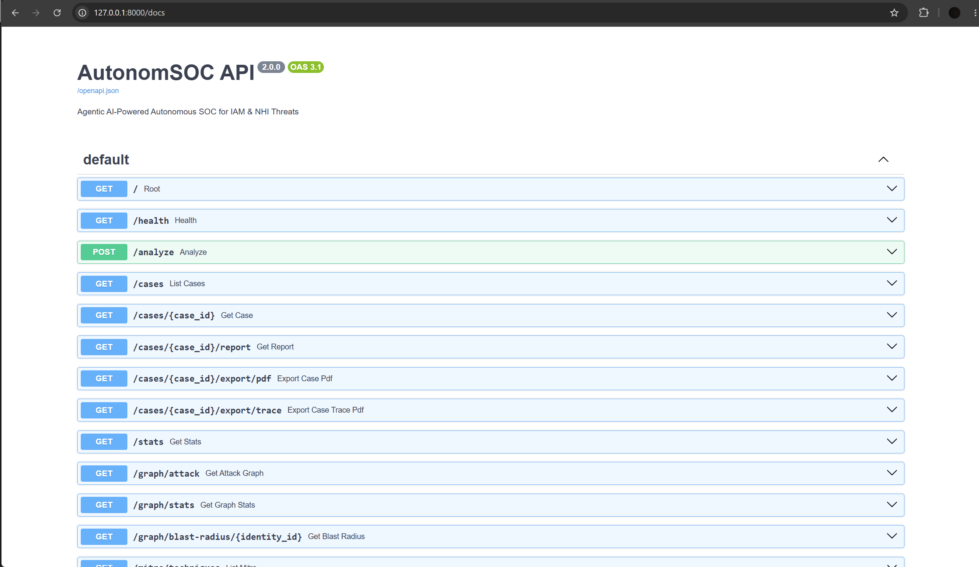
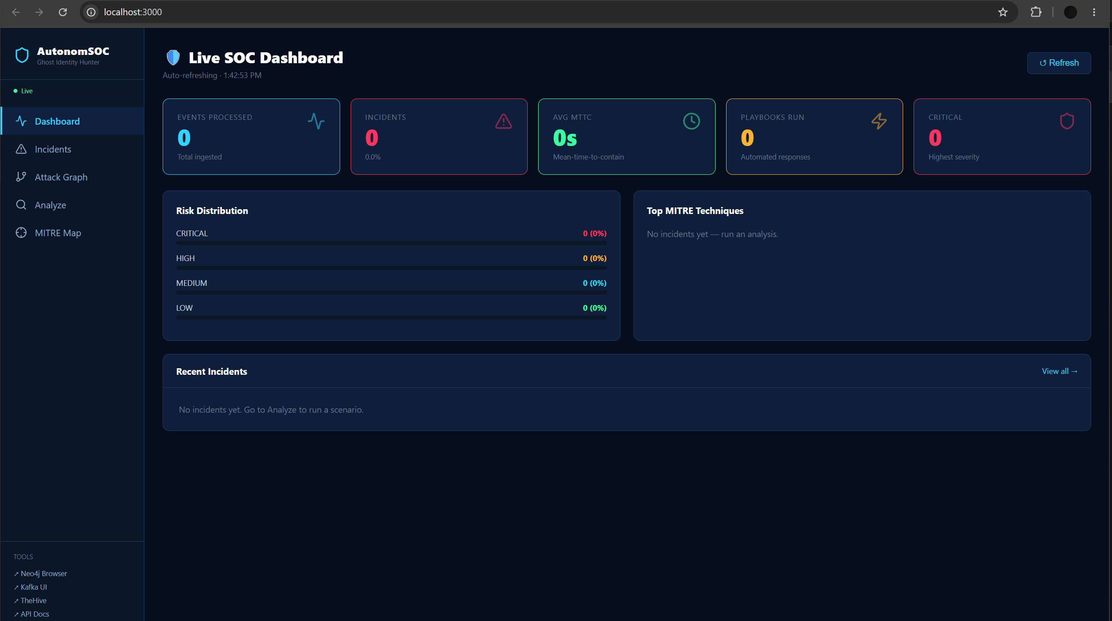

Slide 11
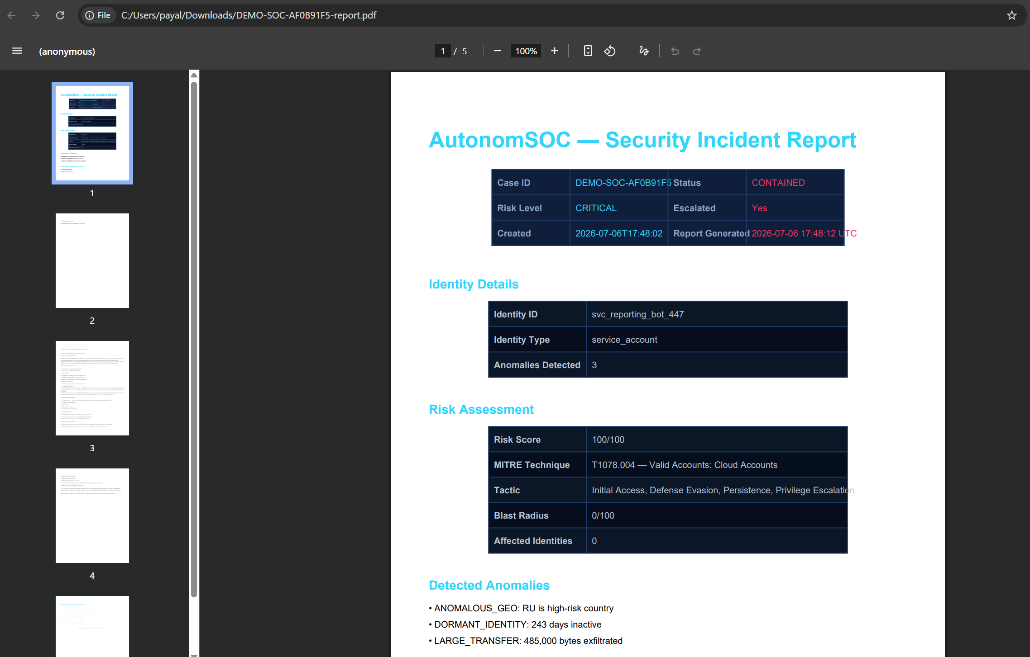
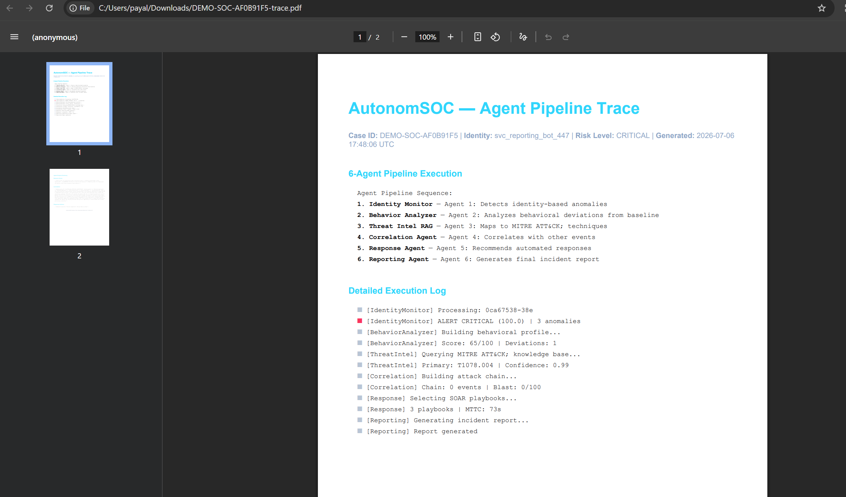

Slide 12
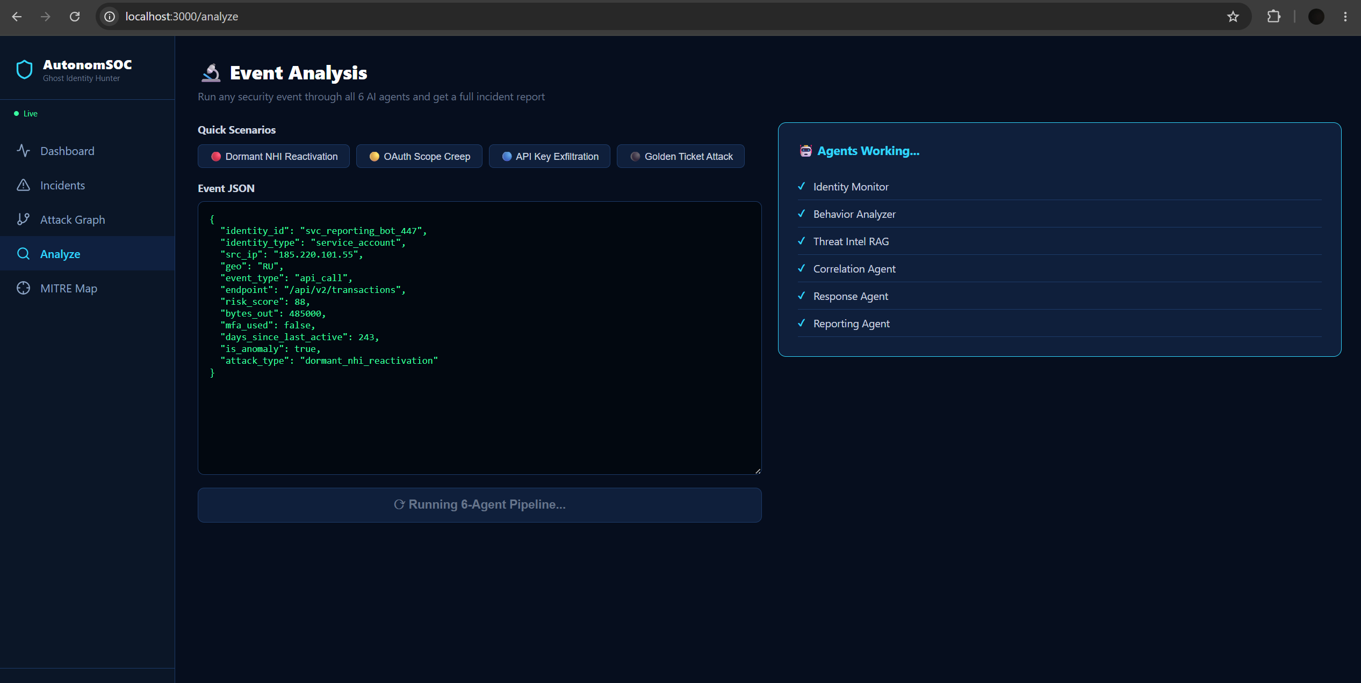
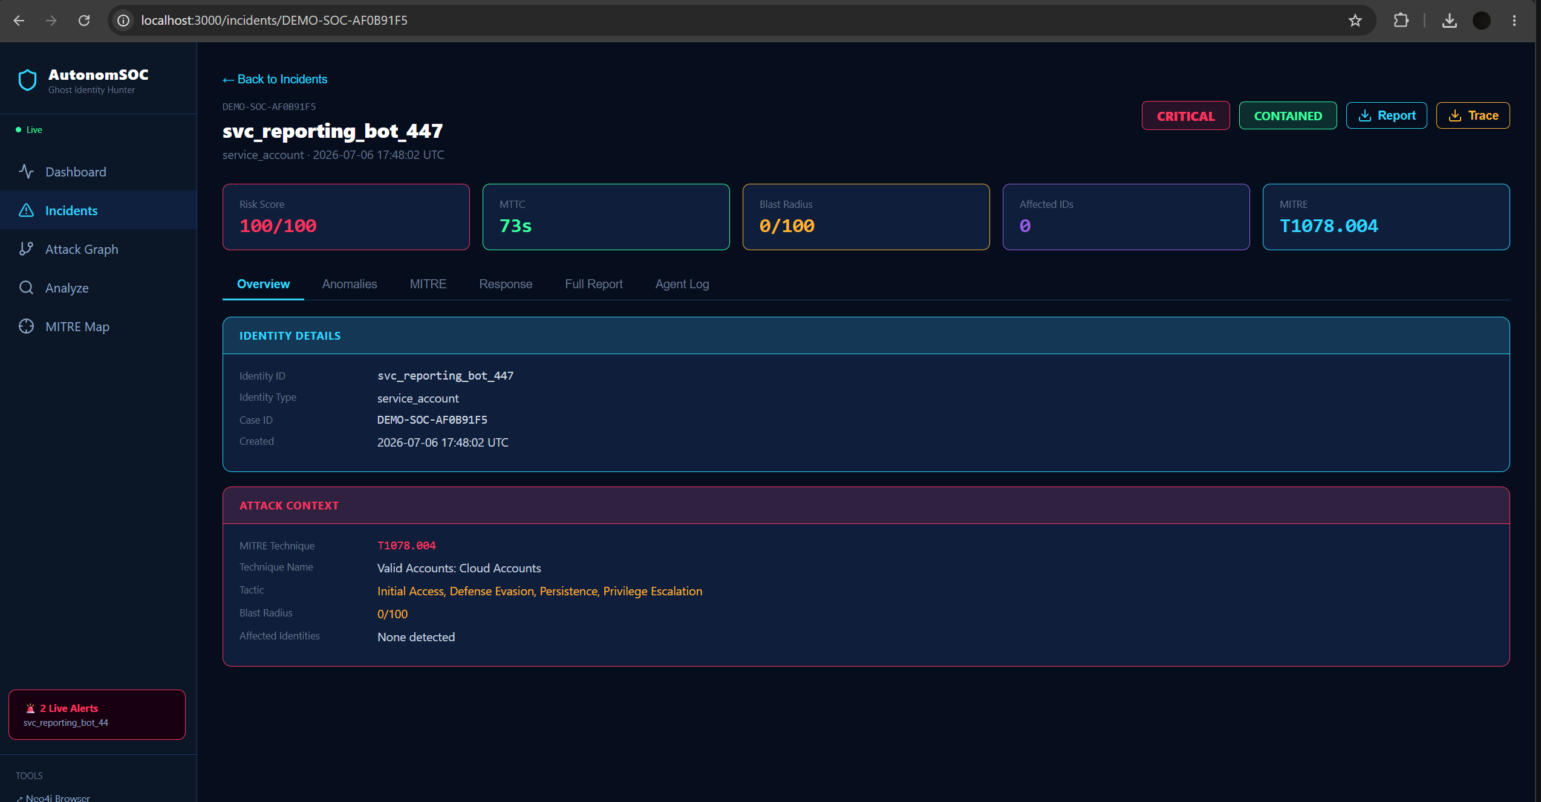

Slide 13
