Slide 1
Car Price Analysis Project
By: Payal Jain

Slide 2
Project Overview
- Analyzed car price data to understand factors influencing prices.
- Cleaned and prepared the dataset, handled categorical variables.
- Visualized data patterns and built insights from key relationships.

Slide 3
Data Cleaning & Feature Engineering
- Removed unwanted columns like car_ID and model.
- Extracted brand from CarName and corrected spelling mistakes.
- Applied one-hot encoding to convert categorical variables.
- Dropped highly correlated numerical features.

Slide 4
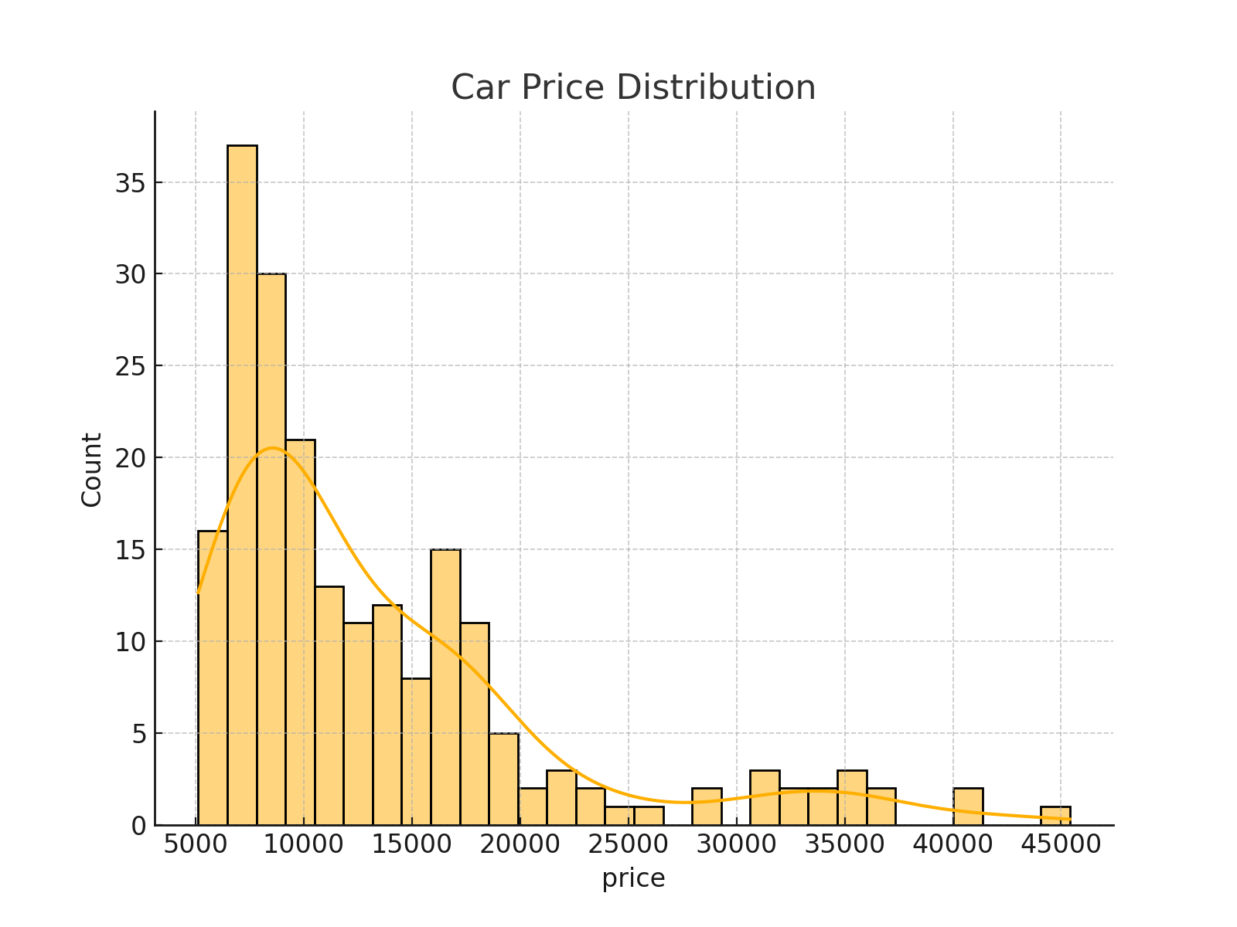
Price Distribution

Slide 5
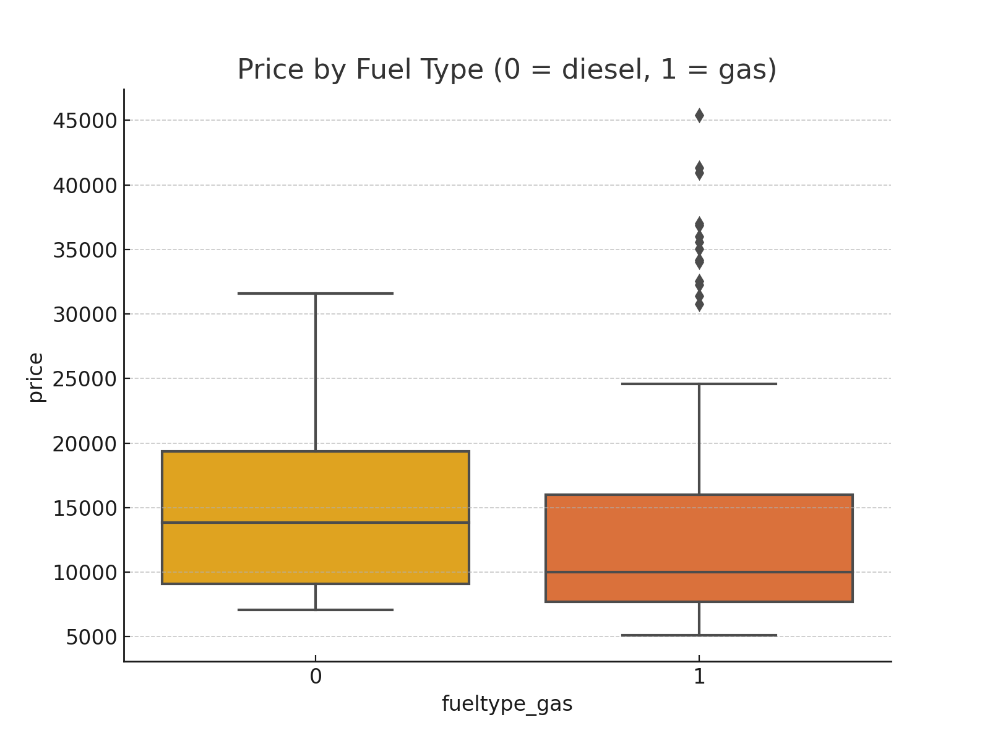
Price by Fuel Type

Slide 6
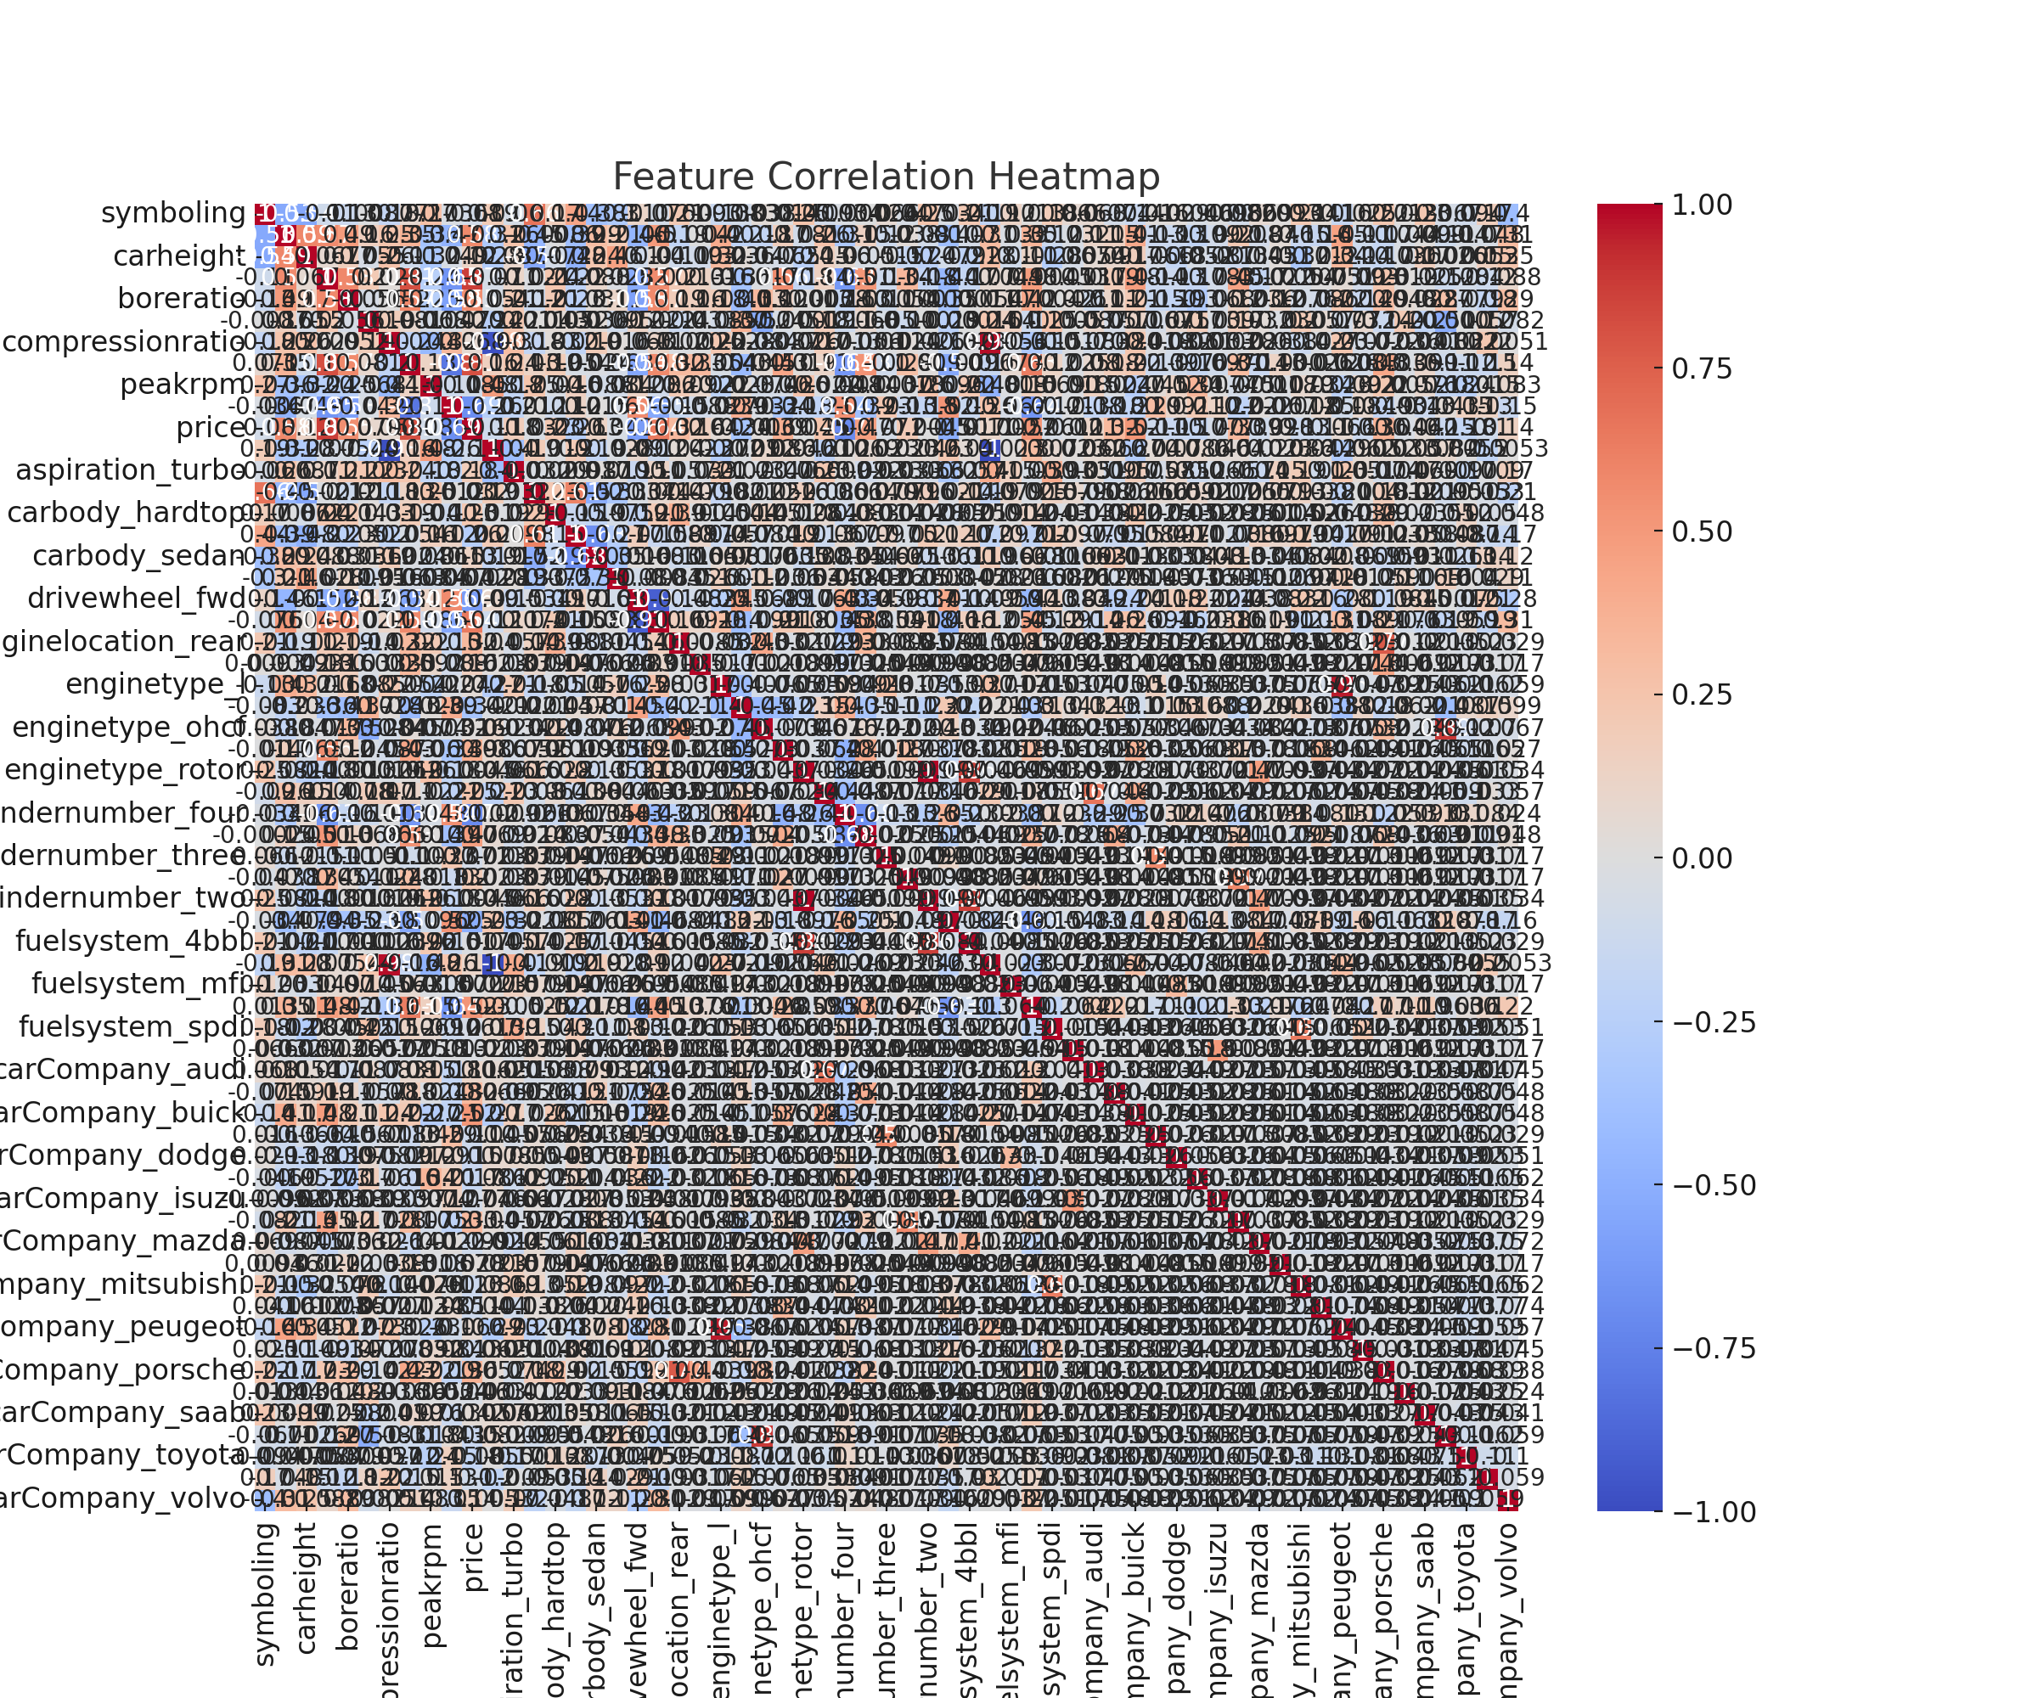
Feature Correlation

Slide 7
Key Insights
- Fuel type impacts price: diesel cars tend to be priced higher.
- Engine size and horsepower are strong price predictors.
- Car brand significantly influences pricing.
- Data preprocessing improved model reliability and insights.

Slide 8
Conclusion
This analysis helped uncover relationships between car attributes and pricing. Clean data and visual exploration allow for deeper understanding, which can support pricing decisions, customer recommendations, or further predictive modeling.

