Slide 1


MACHINE LEARNING
Master Class
---OVERVIEW---

Slide 2
About Pantech.
Established on
2004
01
02
Manufacturer of Lab equipment‘s & Development boards
2000+ Workshops | 250+ FDP | 100+ Seminars
03
04
Mission to serve
10 Million people in the learning

Slide 3
PROBLEMS
PROBLEM IS NOT A LACK OF INFORMATION

Slide 4
Problems in Learning
More Content
Hard to Learn
Less Applications
Not Interactive
Not Precise

Slide 5
PROBLEMS
PROBLEM IS INFORMATION OVERLOAD

Slide 6
SOLUTION
Application Based Learning

Slide 7
What People Need?
Clear-cut, Precise & Focused Implementation with clear Mentorship

Slide 8

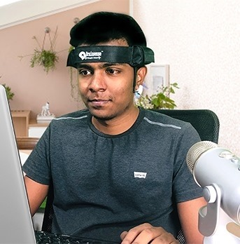
About Me - Sanjay
AI BOARDS: NVidia Jetson Boards, Beagle bone, PYNQ FPGA, Google coral, Raspberry Pi
TECHNOLOGY: AI, Brain Computer Interface(BCI), Robotic Operating System(ROS), IoT, Autonomous Robot design
PROGRAMMING: Python, Matlab, C.
MICROCONTROLLER: 8051, MSP430, Arduino

Slide 9
Artificial Intelligence

Slide 10
How AI?
See & Recognize:
Computer Vision & Deep learning
Eye - Camera
Analyze & Learn:
Machine Learning
Sensing organs - Sensors
Listen & Speak:
Natural Language Processing
ML
Ear & Mouth – Mic & Speaker

Slide 11
Machine Learning

Slide 12
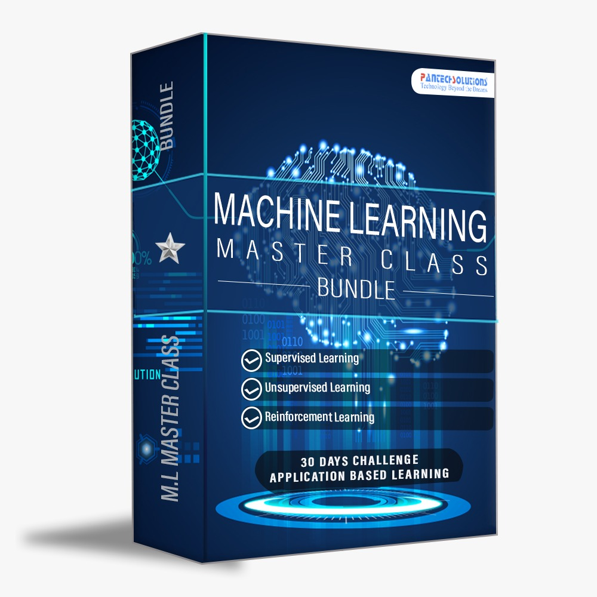

Pantech’s ML Course Value.
Access to 30 Days Video Lectures (Value ₹4,000)
20+ Projects - From Scratch (Value ₹15,000)
10+ Source Code (Value ₹2,000)
Technical Materials (PPT & Mindmap) (Value ₹2,000)
Bonus Task, Assignment(Value ₹1,000)
Forum Telegram discussion & Support (Value ₹2,000)
Internship E-Certificate
₹4999
Total Value
₹750

Slide 13
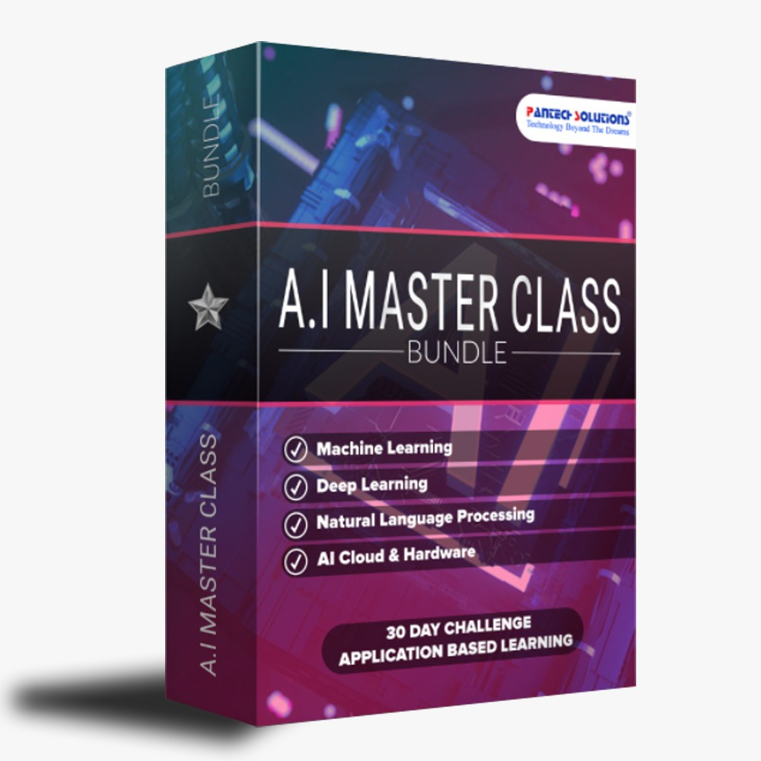
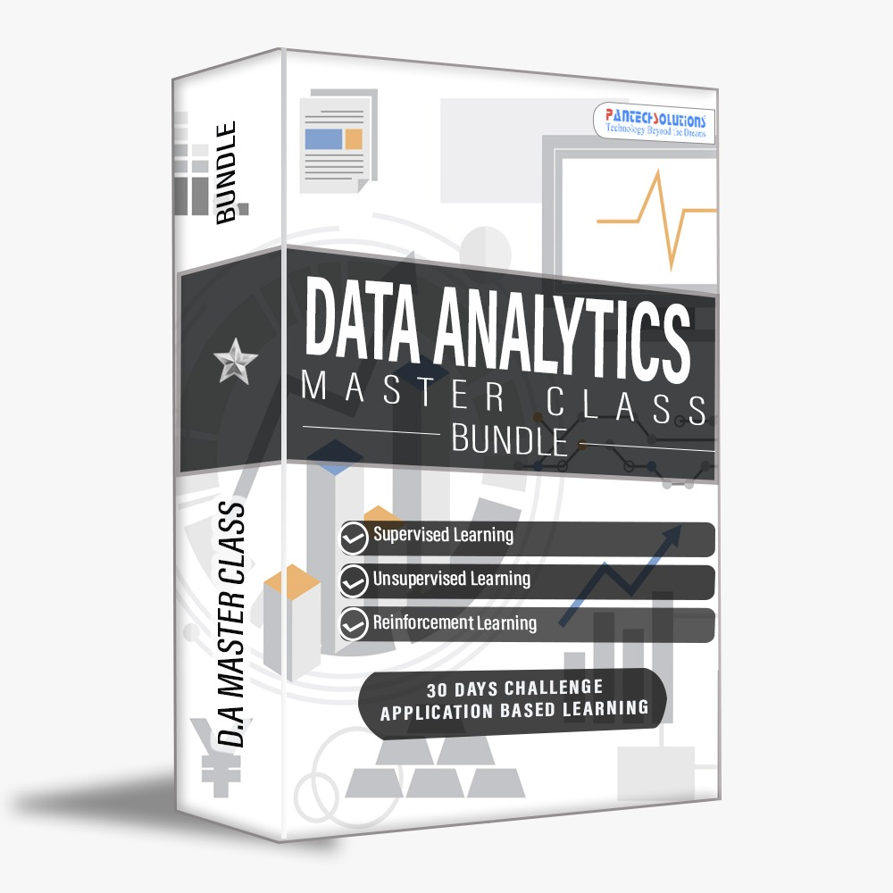
A.I COMBO-3
+
+

Slide 14
Note: People registered for 750, Will get link to upgrade for combo
Access to 90 Days Video Lectures (Value ₹12,000)
50+ Projects - From Scratch (Value ₹75,000)
100+ Source Code (Value ₹10,000)
Technical Materials (PPT & Mindmap) (Value ₹10,000)
Bonus Task, Assignment(Value ₹5,000)
Forum Telegram discussion & Support (Value ₹2,000)
3 Internship E-Certificate(A.I & M.L & D.A)
₹1,14,000
Total Value
₹999 only

Slide 15
THANKS
+91 7305845758
Connect with Me through LinkedIn
Pantechsolutions.net

