Slide 1
Chapter 18 Exception Handling

Slide 2
Motivations
When a program runs into a runtime error, the program terminates abnormally.
How can you handle the runtime error so that the program can continue to run or terminate gracefully?

Slide 3
Exceptions
Unexpected conditions
Disrupt normal flow of program
With exception handling, we can develop more robust programs

Slide 4
Exceptions
Exceptions are thrown
And can be caught.

Slide 5
Where do exceptions come from?
JVM
OR
Java Programs – can throw an exception

Slide 6

Exception Types

Slide 7
System Errors
System errors are thrown by JVM and represented in the Error class. The Error class describes internal system errors. Such errors rarely occur. If one does, there is little you can do beyond notifying the user and trying to terminate the program gracefully.

Slide 8
Exceptions
Exception describes errors caused by your program and external circumstances. These errors can be caught and handled by your program.

Slide 9
Runtime Exceptions
RuntimeException is caused by programming errors, such as bad casting, accessing an out-of-bounds array, and numeric errors.

Slide 10
Types of Exceptions
Errors - serious and fatal problems
Exceptions - can be thrown by any program, user can extend
RuntimException - caused by illegal operations, thrown by JVM (unchecked)

Slide 11
Checked Exceptions vs. Unchecked Exceptions
RuntimeException, Error and their subclasses are known as unchecked exceptions.
All other exceptions are known as checked exceptions - the compiler forces the programmer to check and deal with the exceptions.

Slide 12

Checked or Unchecked Exceptions
Unchecked exception.

Slide 13
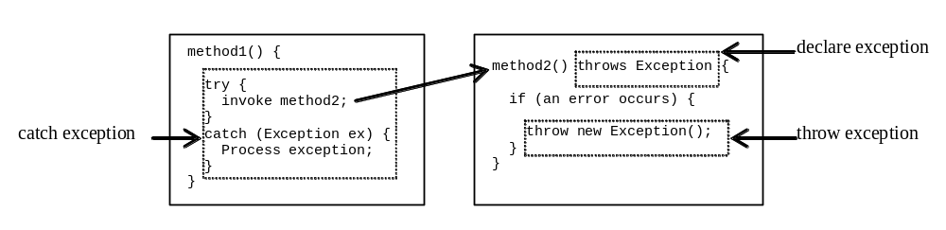
Declaring, Throwing, and Catching Exceptions

Slide 14
Checked Exceptions
Checked exceptions that can be thrown in a method must be
caught and handled
OR
declared in the throws clause

Slide 15
Declaring Exceptions
Every method must state the types of checked exceptions it might throw. This is known as declaring exceptions.
public void myMethod()
throws IOException
public void myMethod()
throws IOException, OtherException

Slide 16
Throwing Exceptions
When the program detects an error, the program can create an instance of an appropriate exception type and throw it. This is known as throwing an exception. Here is an example,
throw new TheException();
TheException ex = new TheException();
throw ex;

Slide 17
Throwing Exceptions Example
/** Set a new radius */
public void setRadius(double newRadius)
throws IllegalArgumentException {
if (newRadius >= 0)
radius = newRadius;
else
throw new IllegalArgumentException(
"Radius cannot be negative");
}

Slide 18
Catching Exceptions
try {
statements; // Statements that may throw exceptions
}
catch (Exception1 exVar1) {
handler for exception1;
}
catch (Exception2 exVar2) {
handler for exception2;
}
...
catch (ExceptionN exVar3) {
handler for exceptionN;
}

Slide 19

Catching Exceptions

Slide 20
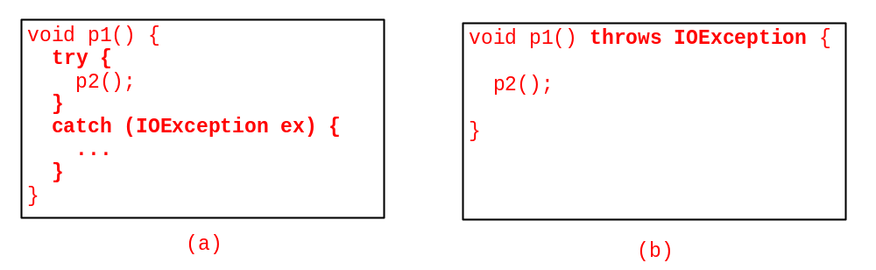
Catch or Declare Checked Exceptions
If a method declares a checked exception, you must invoke it in a try-catch block or declare to throw the exception in the calling method.
In this example, method p1 invokes method p2 and p2 may throw a checked exception (e.g., IOException)

Slide 21
Exceptions in GUI Applications
The methods are executed on the threads. If an exception occurs on a thread, the thread is terminated if the exception is not handled. However, the other threads in the application are not affected. There are several threads running to support a GUI application. A thread is launched to execute an event handler (e.g., the actionPerformed method for the ActionEvent). If an exception occurs during the execution of a GUI event handler, the thread is terminated if the exception is not handled. Interestingly, Java prints the error message on the console, but does not terminate the application. The program goes back to its user-interface-processing loop to run continuously.

Slide 22
Rethrowing Exceptions
try {
statements;
}
catch(TheException ex) {
perform operations before exits;
throw ex;
}

Slide 23
The finally Clause
try {
statements;
}
catch(TheException ex) {
handling ex;
}
finally {
finalStatements;
}

Slide 24
Trace a Program Execution
animation
Suppose no exceptions in the statements
try {
statements;
}
catch(TheException ex) {
handling ex;
}
finally {
finalStatements;
}
Next statement;

Slide 25
Trace a Program Execution
animation
The final block is always executed
try {
statements;
}
catch(TheException ex) {
handling ex;
}
finally {
finalStatements;
}
Next statement;

Slide 26
Trace a Program Execution
animation
Next statement in the method is executed
try {
statements;
}
catch(TheException ex) {
handling ex;
}
finally {
finalStatements;
}
Next statement;

Slide 27
Trace a Program Execution
animation
try {
statement1;
statement2;
statement3;
}
catch(Exception1 ex) {
handling ex;
}
finally {
finalStatements;
}
Next statement;
Suppose an exception of type Exception1 is thrown in statement2

Slide 28
Trace a Program Execution
animation
try {
statement1;
statement2;
statement3;
}
catch(Exception1 ex) {
handling ex;
}
finally {
finalStatements;
}
Next statement;
The exception is handled.

Slide 29
Trace a Program Execution
animation
try {
statement1;
statement2;
statement3;
}
catch(Exception1 ex) {
handling ex;
}
finally {
finalStatements;
}
Next statement;
The final block is always executed.

Slide 30
Trace a Program Execution
animation
try {
statement1;
statement2;
statement3;
}
catch(Exception1 ex) {
handling ex;
}
finally {
finalStatements;
}
Next statement;
The next statement in the method is now executed.

Slide 31
Trace a Program Execution
animation
try {
statement1;
statement2;
statement3;
}
catch(Exception1 ex) {
handling ex;
}
catch(Exception2 ex) {
handling ex;
throw ex;
}
finally {
finalStatements;
}
Next statement;
statement2 throws an exception of type Exception2.

Slide 32
Trace a Program Execution
animation
try {
statement1;
statement2;
statement3;
}
catch(Exception1 ex) {
handling ex;
}
catch(Exception2 ex) {
handling ex;
throw ex;
}
finally {
finalStatements;
}
Next statement;
Handling exception

Slide 33
Trace a Program Execution
animation
try {
statement1;
statement2;
statement3;
}
catch(Exception1 ex) {
handling ex;
}
catch(Exception2 ex) {
handling ex;
throw ex;
}
finally {
finalStatements;
}
Next statement;
Execute the final block

Slide 34
Trace a Program Execution
animation
try {
statement1;
statement2;
statement3;
}
catch(Exception1 ex) {
handling ex;
}
catch(Exception2 ex) {
handling ex;
throw ex;
}
finally {
finalStatements;
}
Next statement;
Rethrow the exception and control is transferred to the caller

Slide 35
Cautions When Using Exceptions
Exception handling separates error-handling code from normal programming tasks, thus making programs easier to read and to modify.
Exception handling usually requires more time and resources because it requires instantiating a new exception object, rolling back the call stack, and propagating the errors to the calling methods.

Slide 36
When to Throw Exceptions
An exception occurs in a method.
If you want the exception to be processed by its caller, you should create an exception object and throw it.
If you can handle the exception in the method where it occurs, there is no need to throw it.

Slide 37
When to Use Exceptions
When should you use the try-catch block in the code? You should use it to deal with unexpected error conditions. Do not use it to deal with simple, expected situations. For example, the following code
try {
System.out.println(refVar.toString());
}
catch (NullPointerException ex) {
System.out.println("refVar is null");
}

Slide 38
When to Use Exceptions
is better to be replaced by
if (refVar != null)
System.out.println(refVar.toString());
else
System.out.println("refVar is null");

Slide 39
Creating Custom Exception Classes
Use the exception classes in the API whenever possible.
Create custom exception classes if the predefined classes are not sufficient.
Declare custom exception classes by extending Exception or a subclass of Exception.

Slide 40
Exceptions and Generics
A generic class cannot extend Throwable.
An Exception cannot be of a generic type.

Slide 41
Exceptions and Inheritance
How do you think exceptions affect overridden methods?
if a method overrides a base class method, the new method cannot throw a more general error, but can throw more specific
if the base class method throws no errors, the subclass method can't either.

Slide 42
Assertions
Companion Website
An assertion is a Java statement that enables you to assert an assumption about your program.
An assertion contains a Boolean expression that should be true during program execution.
Assertions can be used to assure program correctness and avoid logic errors.

Slide 43
Declaring Assertions
Companion Website
An assertion is declared using the new Java keyword assert in JDK 1.4 as follows:
assert assertion; or
assert assertion : detailMessage;
where assertion is a Boolean expression and detailMessage is a primitive-type or an Object value.

Slide 44
Assertions
If an assertion evaluates true, there are no effects.
If an assertion fails, AssertionError is thrown.

Slide 45
Executing Assertions Example
Companion Website
public class AssertionDemo {
public static void main(String[] args) {
int i; int sum = 0;
for (i = 0; i < 10; i++) {
sum += i;
}
assert i == 10;
assert sum > 10 && sum < 5 * 10 : "sum is " + sum;
}
}

Slide 46
Running Programs with Assertions
Companion Website
By default, the assertions are disabled at runtime. To enable it, use the switch –enableassertions, or –ea for short, as follows:
java –ea AssertionDemo
Assertions can be selectively enabled or disabled at class level or package level. The disable switch is –disableassertions or –da for short. For example, the following command enables assertions in package package1 and disables assertions in class Class1.
java –ea:package1 –da:Class1 AssertionDemo

Slide 47
Assertions
Use assertions for verification:
preconditions: beginning of method body
postconditions: before each return statement
invariants of class: entry and exit points of public methods
Good for debugging.

Slide 48
Using Exception Handling or Assertions
Companion Website
Assertion should not be used to replace exception handling.
Exception handling addresses robustness and assertion addresses correctness.
Like exception handling, assertions are not used for normal tests, but for internal consistency and validity checks.
Assertions are checked at runtime and can be turned on or off at startup time.

Slide 49
Using Exception Handling or Assertions, cont.
Companion Website
Use assertions to reaffirm assumptions. This gives you more confidence to assure correctness of the program. A common use of assertions is to replace assumptions with assertions in the code.

Slide 50
Using Exception Handling or Assertions, cont.
Companion Website
Another good use of assertions is place assertions in a switch statement without a default case. For example,
switch (month) {
case 1: ... ; break;
case 2: ... ; break;
...
case 12: ... ; break;
default: assert false : "Invalid month: " + month
}

