Slide 1

Gitlab CI-CD

Slide 2


Knolx Etiquettes
Lack of etiquette and manners is a huge turn off.
Punctuality
Join the session 5 minutes prior to the session start time. We start on
time and conclude on time!
Feedback
Make sure to submit a constructive feedback for all sessions as it is very helpful for the presenter.
Silent Mode
Keep your mobile devices in silent mode, feel free to move out of session
in case you need to attend an urgent call.
Avoid Disturbance
Avoid unwanted chit chat during the session.

Slide 3

What is CI-CD
Tools for CI-CD
Why GitLab CI-CD
What is GitLab CI-CD
Gitlab CI-CD features
Use Case & Best Practices
Demo

Slide 4
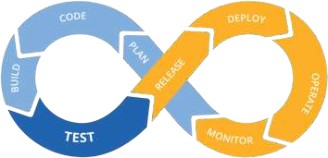
What is CI -CD
Continuous Integration (CI) : Continuous Integration is the consistent and automated practice of compiling, testing, and merging code changes into a shared code repository.
Continuous Delivery (CD) : It is the automated procedure of deploying software updates to either a staging or production environment after they have been effectively built and tested.
Continuous Deployment (CD) : Continuous Deployment resembles Continuous Delivery but uniquely involves the automatic release of changes to the production environment as soon as they are deemed ready, without an intermediary staging phase.

Slide 5
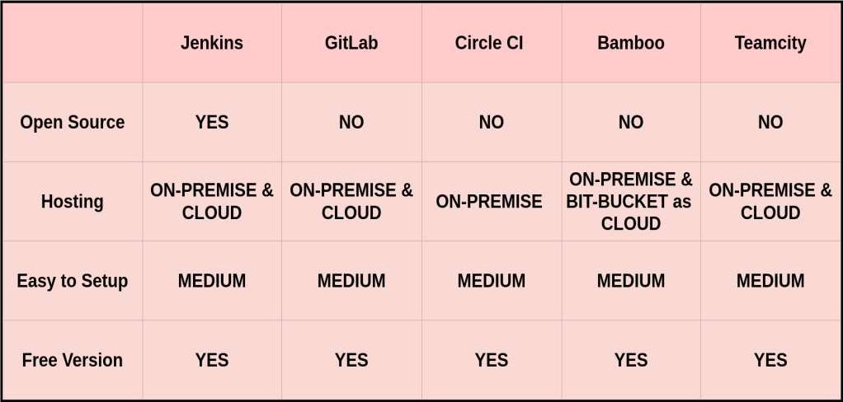
Tools for CI-CD

Slide 6
Comparison Table: Jenkins vs GitLab CI vs CircleCI vs Bamboo vs TeamCity
Feature / Tool | Jenkins | GitLab CI | CircleCI | Bamboo (Atlassian) | TeamCity (JetBrains)
Type | Open Source | Open Source + SaaS | SaaS + Self-hosted | Commercial | Commercial
Ease of Setup | Complex (manual plugin setup) | Easy (integrated into GitLab) | Very Easy (SaaS) | Medium (on-premises) | Medium (on-premises)
UI/UX | Basic (improved with Blue Ocean) | Modern, integrated UI | Modern, clean UI | Good UI | Excellent UI with JetBrains quality
Pipeline as Code | Yes (Jenkinsfile) | Yes (.gitlab-ci.yml) | Yes (config.yml) | Yes (YAML + GUI) | Yes (Kotlin DSL, also GUI based)
Scalability | Very High (plugin-based, master-agent) | High (Auto-scaling runners) | High (Docker-based, parallel jobs) | Medium (agent-based) | Medium (agent-based)

Slide 7
Comparison Table: Jenkins vs GitLab CI vs CircleCI vs Bamboo vs TeamCity
Feature / Tool | Jenkins | GitLab CI | CircleCI | Bamboo (Atlassian) | TeamCity (JetBrains)
Docker Support | Strong (via plugin) | Native | Excellent (Docker-first) | Good (Docker agent) | Good (Docker and Kubernetes support)
Kubernetes Support | Yes (via plugin) | Yes (via GitLab K8s executor) | Yes (orbs or custom runners) | Limited (not native) | Yes (K8s plugin or custom runners)
Parallel Execution | Yes (manual config with agents) | Yes (matrix jobs, dynamic pipelines) | Yes (easy parallelism setup) | Yes | Yes
Secrets Management | Plugin-based (Vault, credentials) | Built-in (masked CI/CD variables) | Built-in (env vars, contexts) | Built-in | Built-in
Plugin Ecosystem | Very large (~1800+) | Smaller, focused | Small, focused | Limited | Moderate
Notifications | Via Plugins (Slack, Email, etc.) | Built-in | Built-in (Slack, Email) | Built-in | Built-in (customizable)
Test Reporting | Via Plugins | Built-in (JUnit, Code coverage) | Built-in | Built-in | Built-in

Slide 8
Comparison Table: Jenkins vs GitLab CI vs CircleCI vs Bamboo vs TeamCity
Feature / Tool | Jenkins | GitLab CI | CircleCI | Bamboo (Atlassian) | TeamCity (JetBrains)
Test Reporting | Via Plugins | Built-in (JUnit, Code coverage) | Built-in | Built-in | Built-in
Manual Approval / Gates | Plugin-based | Built-in (Environments / approvals) | Built-in (with workflows) | Built-in | Built-in
Security | Requires hardening | Good (RBAC, project/group level) | Good (context-based) | Good (integrates with LDAP/SSO) | Good (LDAP, RBAC)
Maintenance Overhead | High (self-managed) | Low (SaaS) to Medium (self-hosted) | Very Low (SaaS) | Medium to High | Medium
Cost | Free (self-hosted) | Free tier + paid runners | Free tier + paid usage | Paid | Paid (free tier for OSS)
Best for | Custom, complex pipelines | GitLab users; integrated DevOps | Quick CI/CD setup, Docker-heavy apps | Jira/Bitbucket users | JetBrains ecosystem or .NET-heavy teams

Slide 9

What is Gitlab CI-CD
GitLab CI/CD is a built-in Continuous Integration and Continuous Deployment (CI/CD) tool provided by GitLab, a popular web-based Git repository manager.
GitLab CI/CD automates building, testing, and deploying code changes.
CI/CD pipelines are defined using a version-controlled .gitlab-ci.yml file.
GitLab CI/CD is tightly integrated with GitLab's collaboration and source
code management features.
It supports parallel job execution, speeding up testing and deployment processes.
GitLab CI/CD facilitates container-based development and deployment using Docker.

Slide 10
Key Components of Gitlab CI-CD
GitLab CI/CD consists of several key components that work together to automate the software development lifecycle. The main components are :
Runner
Pipeline
Gitlab CI file
Artifacts
Triggers
CI-CD Variables

Slide 11
Why Gitlab CI-CD
GitLab CI/CD is a popular choice for many development teams and organizations for several reasons:
Automated and Consistent Build and Deployment Process
Faster Time-to-Market
Continuous Integration and Testing
Improved Collaboration
Enhanced Security and Stability

Slide 12
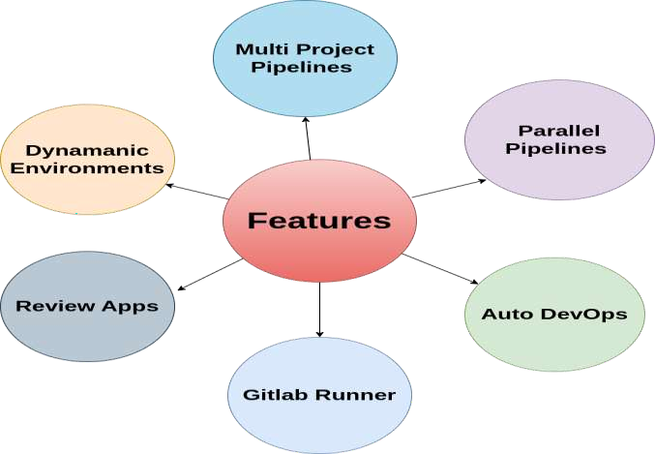
Gitlab CI-CD features

Slide 13

Use Case and Best practices
Use Case -
Continuous integration and deployment for web applications
Infrastructure automation
Data pipelines
Automated Testing
Containerized Applications
Best Practise -
Security and secrets management
Parallelization and caching
Infrastructure as code
Pipeline testing

Slide 14
DEMO

Slide 15


For more information and any queries contact to Deeksha.Tripathi@nashtechglobal.com

