Slide 1
Azure – Devops Training
Terraform - Variables
EMPOWERING High Performance Technology Teams

Slide 2
Agenda for the Day
Terraform Variables
Terraform Input Variables
Terraform Output Variables
Terraform Local Variables

Slide 3
Terraform Variables

Slide 4
Variable a symbolic name associated with a value and whose associated value may be changed

Slide 5
Variables in Terraform are a great way to define centrally controlled reusable values. The information in Terraform variables is saved independently from the deployment plans, which makes the values easy to read and edit from a single file.

Slide 6
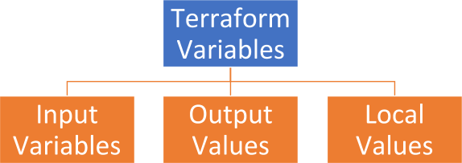

Slide 7
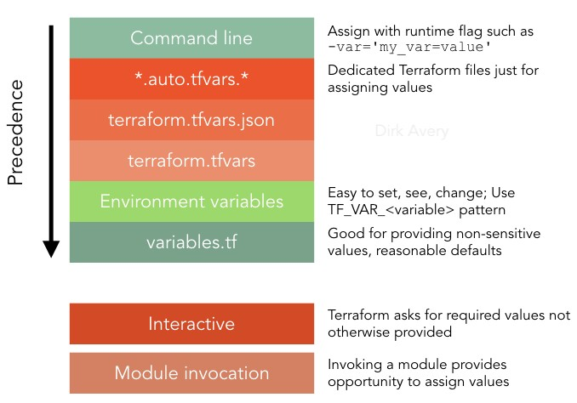

Slide 8
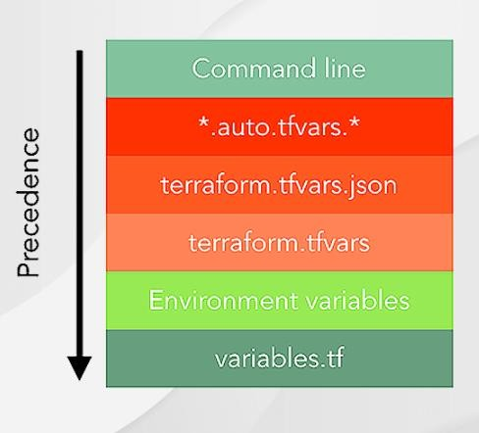

Slide 9
Terraform Input Variables

Slide 10
Terraform Input Variable
Input variables serve as parameters for a Terraform module/Terrform code, allowing aspects of the module/Terrform code to be customized without altering the module's own source code, and allowing modules to be shared between different configurations.
When you declare variables in the root module of your configuration, you can set their values using CLI options and environment variables.
When you declare them in child modules, the calling module should pass values in the module block.

Slide 11
Terraform Input Variable Types
Terraform Input Variables
String
Number
List
Map
Boolean
Set
Object
Tuple

Slide 12
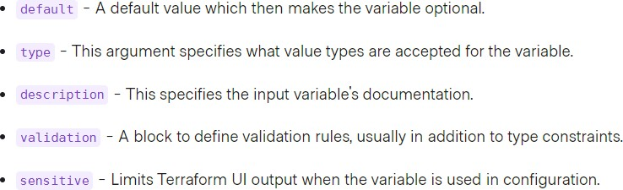
Terraform Input Variable
Variable blocks have 5 optional arguments.
We recommend setting a description and type for all variables, and setting a default value when practical.
If you do not set a default value for a variable, you must assign a value before Terraform
can apply the configuration. Terraform does not support unassigned variables.

Slide 13
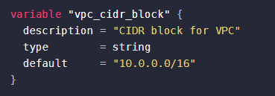
How to declare?

Slide 14
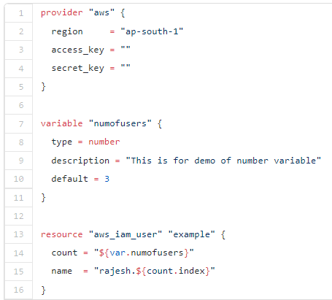
Terraform Variable Type: Number

Slide 15
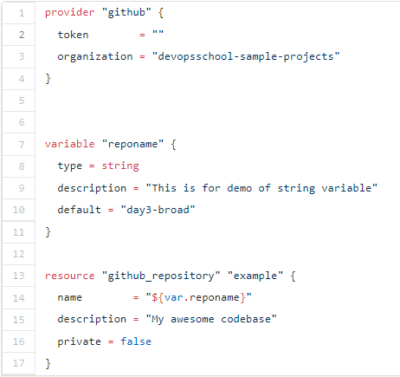
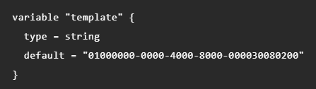

Terraform Variable Type: String

Slide 16
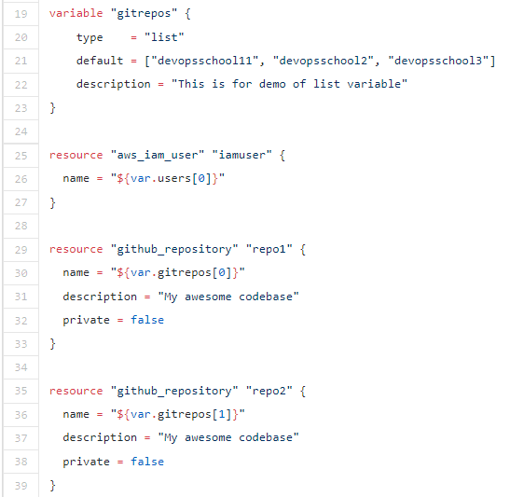
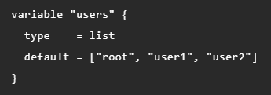

Terraform Variable Type: List

Slide 17
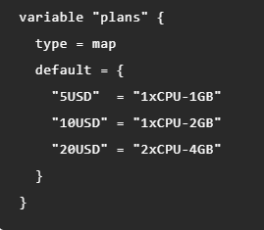

Terraform Variable Type: Map

Slide 18
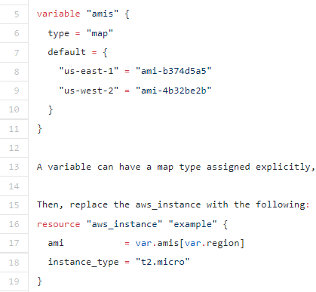
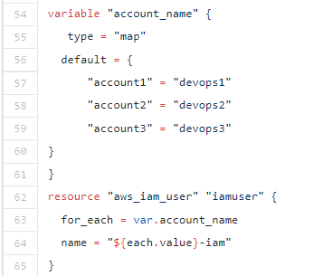
Terraform Variable Type: Map

Slide 19
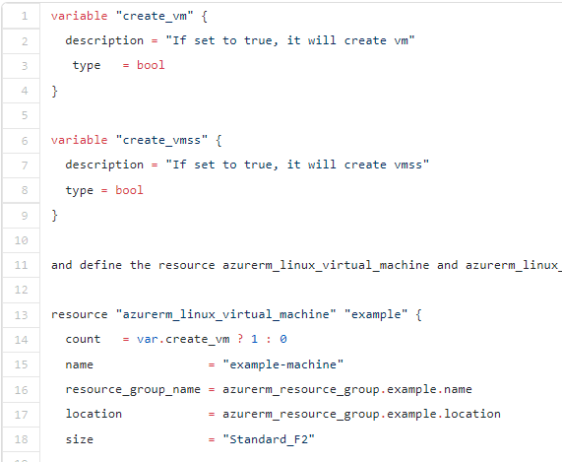



Terraform Variable Type: Bool

Slide 20
Terraform Output Variables

Slide 21
Terraform Variable: Output
Terraform will store hundreds or even thousands of attribute values for all the defined resources in our
infrastructure in state file.
An outputted attributes can not only be used for the user reference but it can also act as an input to other resources being created via Terraform. We can use output variables to organize data to be easily queried and shown back to the Terraform user.
While Terraform stores hundreds or thousands of attribute values for all our resources, we are more likely to be
interested in a few values of importance, such as a load balancer IP, VPN address, etc.
Output values are like the return values of a Terraform module, and have several uses:
A child module can use outputs to expose a subset of its resource attributes to a parent module.
A root module can use outputs to print certain values in the CLI output after running terraform apply.
When using remote state, root module outputs can be accessed by other configurations via a terraform_remote_state data source.

Slide 22
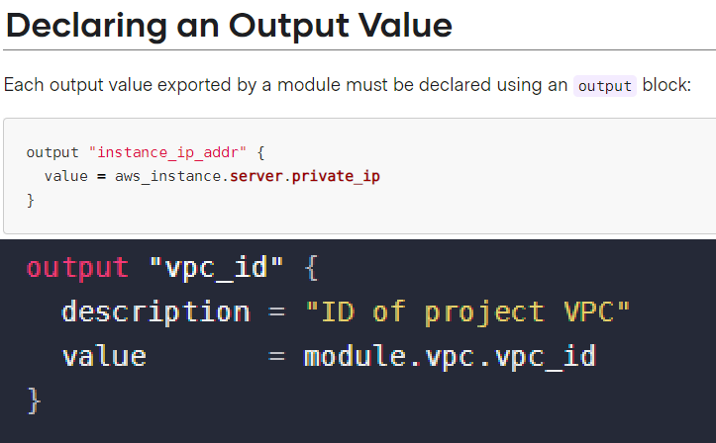
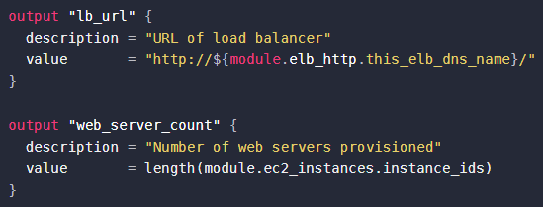
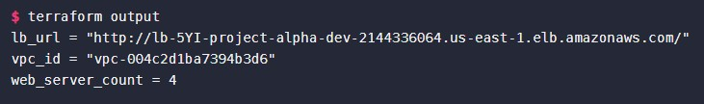
Terraform Variable: Output

Slide 23
Terraform Local Variables

Slide 24
What is local value in terraform?
These are variables that are local to a module. They are defined, assigned, and used in the same module, and defined in the “locals” block. Below is an example snippet on a local block:
Local variables can be declared once and used any number of times in the module. These
can be accessed as objects by using the format of "local.Variable_Name".
Unlike variables found in programming languages, Terraform's locals don't change values during or between Terraform runs such as plan, apply, or destroy. You can use locals to give a name to the result of any Terraform expression, and re-use that name throughout your configuration. Unlike input variables, locals are not set directly by users of your configuration.

Slide 25
What is local value in terraform?
Comparing modules to functions in a traditional programming language:
Input variables are analogous to function arguments and
Outputs values are analogous to function return values, then
local values are comparable to a function’s local temporary symbols.

Slide 26
When To Use Local Values?
Local values can be helpful to avoid repeating the same values or expressions multiple times in a configuration, but if overused they can also make a configuration hard to read by future maintainers by hiding the actual values used.
Use local values only in moderation, in situations where a single value or result is used in many places and that value is likely to be changed in future. The ability to easily change the value in a central place is the key advantage of local values.
Each locals block can have as many locals as needed, and there can be any number of locals blocks within a module. The names given for the items in the local block must be unique throughout a module. The given value can be any expression that is valid within the current module.
The expression of a local value can refer to other locals, but as usual reference cycles are not allowed. That is, a local cannot refer to itself or to a variable that refers (directly or indirectly) back to it.

Slide 27
Overall Summary

Slide 28
THANK YOU

