Slide 1
TERRAFORM – Condition-Operations
VishwanaTH m s
VISHWACLOUDLAB.COM

Slide 2
Agenda for the Day
Conditioning in Terraform
Iterations in Terraform
Resources Metadata
Data Source in Terraform
Operators in Terraform
Interpolation in Terraform

Slide 3
Conditioning in Terraform

Slide 4
conditional expression
Method 1
Method 2
Depends_on

Slide 5
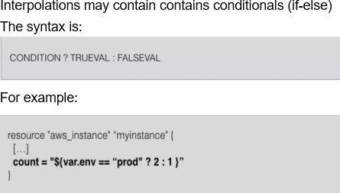
Conditions in Terraform

Slide 6
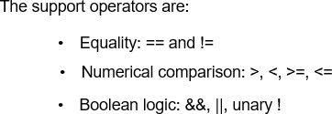
Conditions in Terraform

Slide 7
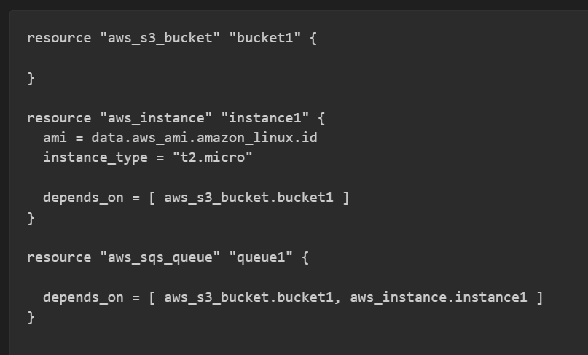
Conditions in Terraform
Since both the instance and the SQS Queue are dependent upon the S3 Bucket.
Terraform Waits until the bucket is created to begin creating the other two resources.

Slide 8
Interpolation in Terraform

Slide 9
Interpolation
In Terraform, you can Interpolate other values, Using ${...}
You can use simple math functions, refer to other variables, or use conditionals (if-else)
I have been using them already throughout the course, without naming them
Variables: ${var.VARIABLE-NAME} refers to a variable
Resources: ${aws_instance.name.id} (type.resource-name.attr)
Data Source: ${data.template_file.name.rendered} (data.type.resource- name.attr)

Slide 10

Interpolation: variables
Name | Syntax | Example
String variable | var.name | ${var.SOMETHING}
Map variable | var.MAP["key"] | ${var.AMIS ["us-east-1"]} 2) ${lookup(var.AMIS, var.AWS_REGION)}
List variable | var.LIST, var.LIST[i] | ${var.subnets [i]} ${join(",", var.subnets)}

Slide 11

Interpolation: various
Name | Syntax | Example
Outputs of a module | module.Name.output | ${module.aws_vpc.vpcid}
Count information | count.FIELD | When using the attribute count = number in a resource, you can use ${count.index}
Path information | Path.TYPE | path.cwd (current directory) path.module (module path) path.root (root module path )
Meta information | terraform.FIELD | terraform.env shows active workspace

Slide 12
Interpolation
Math:
Add (+), Subtract (-), multiply (*), and Divide (/) for float types
Add (+), Subtract (-), multiply (*), Divide (/) and Modulo (%) for float types for integer types
For example: ${2+3*4} results in 14

Slide 13
Iterations in Terraform

Slide 14
for
Method 1
Method 2
for_each

Slide 15
Resources Metadata

Slide 16
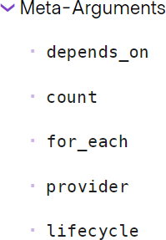


Slide 17
Resource Meta Arg: depends_on
Use the depends_on meta-argument to handle hidden resource or module dependencies that Terraform can't automatically infer.
Explicitly specifying a dependency is only necessary when a resource or module relies on some other resource's behavior but doesn't access any of that resource's data in its arguments.

Slide 18
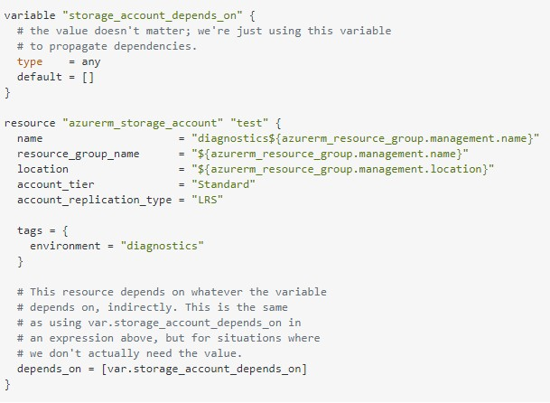
Resource Meta Arg: depends_on – with resource

Slide 19
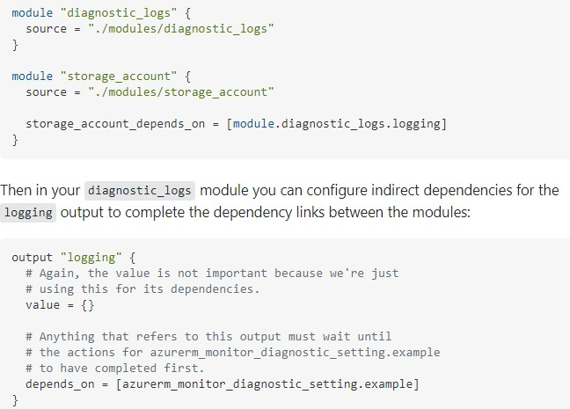
Resource Meta Arg: depends_on – with Module

Slide 20
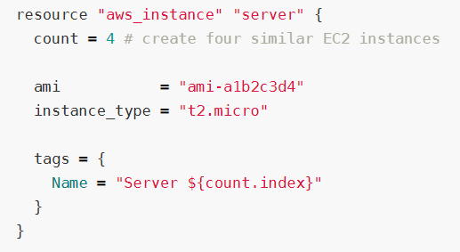
Resource Meta Arg: count
count is a meta-argument defined by the Terraform language. It can be used with modules and with every resource type.
The count meta-argument accepts a whole number, and creates that many instances of the resource or module. Each instance has a distinct infrastructure object associated with it, and each is separately created, updated, or destroyed when the configuration is applied.

Slide 21
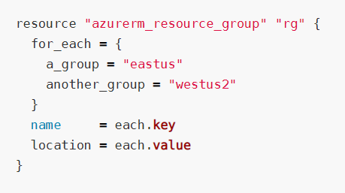
Resource Meta Arg: for_each
for_each is a meta-argument defined by the Terraform language. It can be used with modules and with every resource type.
The for_each meta-argument accepts a map or a set of strings, and creates an instance for each item in that map or set. Each instance has a distinct infrastructure object associated with it, and each is separately created, updated, or destroyed when the configuration is applied.

Slide 22
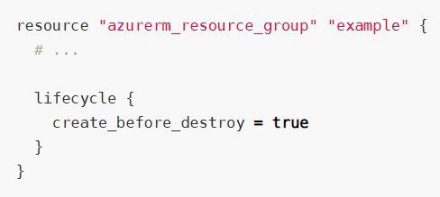
Resource Meta Arg: lifecycle
lifecycle is a nested block that can appear within a resource block. The lifecycle block and its contents are meta-arguments, available for all resource blocks regardless of type.
The following arguments can be used within a lifecycle block:
create_before_destroy
prevent_destroy
ignore_changes

Slide 23
Operators in Terraform

Slide 24
Arithmetic Operators
Operators
Equality Operators
Comparison Operators
Logical Operators

Slide 25
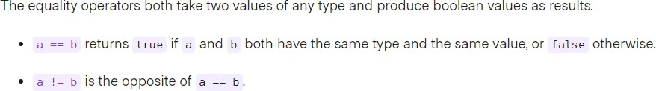
Terraform: Equality Operators

Slide 26
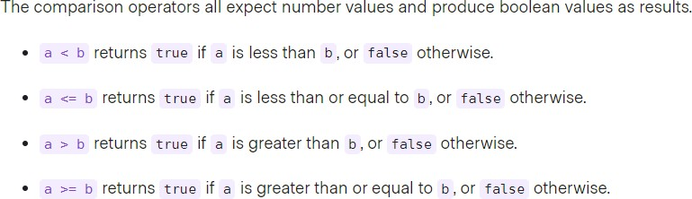
Terraform: Comparison Operators

Slide 27
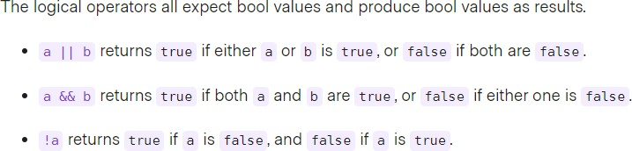
Terraform: Logical Operators

Slide 28
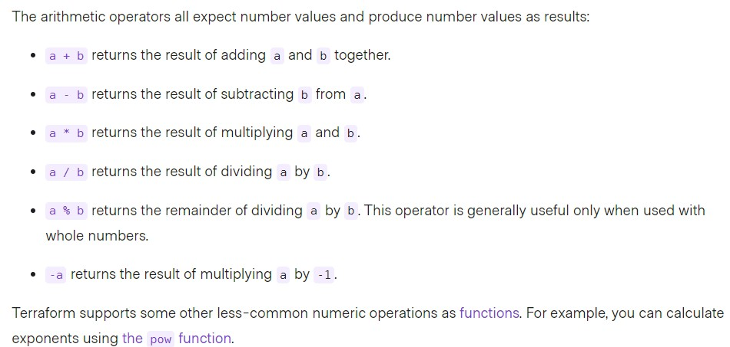
Terraform: Arithmetic Operators

Slide 29
Data Source in Terraform

Slide 30
Datasources
For certain providers (like AWS), terraform provides datasources
Datasources provide you with dynamic information
A lot of data is available by AWS in a structured format using their API
Terraform also exposes this information using data sources
Examples:
list of AMIs
List of availability Zones

Slide 31
Datasources
Another great example is the datasource that gives you all IP addresses in use by AWS
This is great if you want to filter traffic based on an AWS region
e.g. allow all traffic from amazon instances in Europe
Filtering traffic in AWS can be done using security groups Incoming and outgoing traffic can be filtered by
protocol, IP range, and port
Similar to iptables (Linux) or a firewall appliance

Slide 32
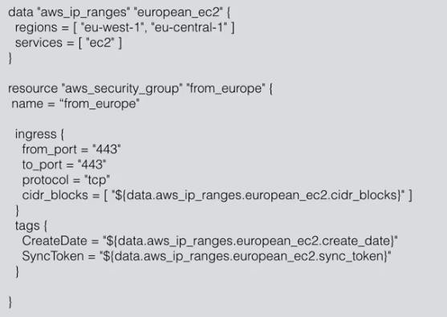
Datasources

Slide 33
Assignment
Output all the UBUNTU VM Image from Azure from one region but Use one of these image in Creating VM.

Slide 34
Debug
TF_FORK=0
add an environment variable to prevent forking #8795
TF_LOG → TRACE, DEBUG, INFO, WARN or ERROR
TF_LOG_PATH
Found a bug? Report to the right place:
Check GitHub, it’s highly likely a known bug/”feature”
https://github.com/hashicorp/terraform - Core Issues
https://github.com/terraform-providers - Provider Plugins
Check Golang SDK’s bugs
Check Cloud provider documentation
Don’t forget to obfuscate your crash log :)
Use delve debugger to learn how Terraform core works!

Slide 35
Terraform tips
Use terraform console
echo "random_string.new.result" | terraform console
Use workspaces for simple scenarios
Isolate state files and don’t use workspaces :)
To review output from terraform modules:
terraform output -module=mymodule
My state is changed every time when I’m running terraform with different
users! (binary files/lambda functions)
substr("${path.module}"/, length(path.cwd) + 1, -1)
ignore_changes = ["filename"]

Slide 36
Terraform: common workflow issues
Mess up with workspaces
Hard-coded values
Not following naming convention (tags)
TF can’t detect changes to computed values
Renaming modules, resources
Double references
Syntax problems
Variable “somevar” should be type map, got list
Timeouts
Permissions

Slide 37
Terraform: Sensitive information
terraform plan “-out plan-latest” - is not secured
terraform state - not secured.
Encryption on backend at rest
terraform pull - exposes sensitive
use data sources - grant only what you need
Data remote state - Not possible to expose just single or few outputs
Sensitive output
Encrypt tfvars
terraform output sensitive = true
seems ok? remote_secured = <sensitive>
terraform refresh → exposed, remote_secured = 79e6

Slide 38
Terraform: Sensitive information
How to handle secrets in state file?
Terrahelp - https://github.com/opencredo/terrahelp
Don’t store secrets :) Use:
AWS/Google Cloud/Azure Key Vault/ etc. KMS -like + user-data mechanisms
AWS System Manager Parameter store
AWS Secrets manager
Use resource Roles
If set master-password for DB service - change it after creation.
Secure state at rest using backend built-in encryption
Secure tfvars and other project/module specific information with:
pass - The password store - https://www.passwordstore.org/
git-crypt - https://github.com/AGWA/git-crypt

Slide 39
Overall Summary

Slide 40
THANK YOU

