Slide 1

Docker

Slide 2
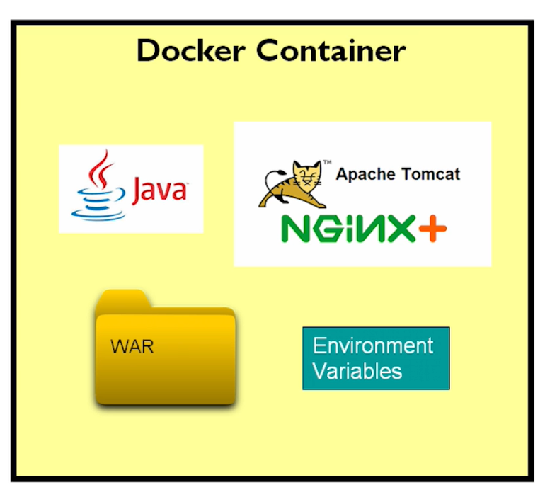
Why docker

Slide 3
Solves Jar / war file problems: it works on my machine
Portable: A Docker image is a self-contained unit that includes your application, the specific version of the JRE it needs, and all required system libraries. This means that a single Docker image will run consistently on any machine that has the Docker Engine, whether it's a developer's laptop, a test server, or a production environment. Packages env variables, binaries, system libraries, applications etc
Docker images isolate each application's environment, so it can run with its specific dependencies without affecting other applications.
You can quickly spin up new instances of your container, faster and efficient than provisioning new VM

Slide 4
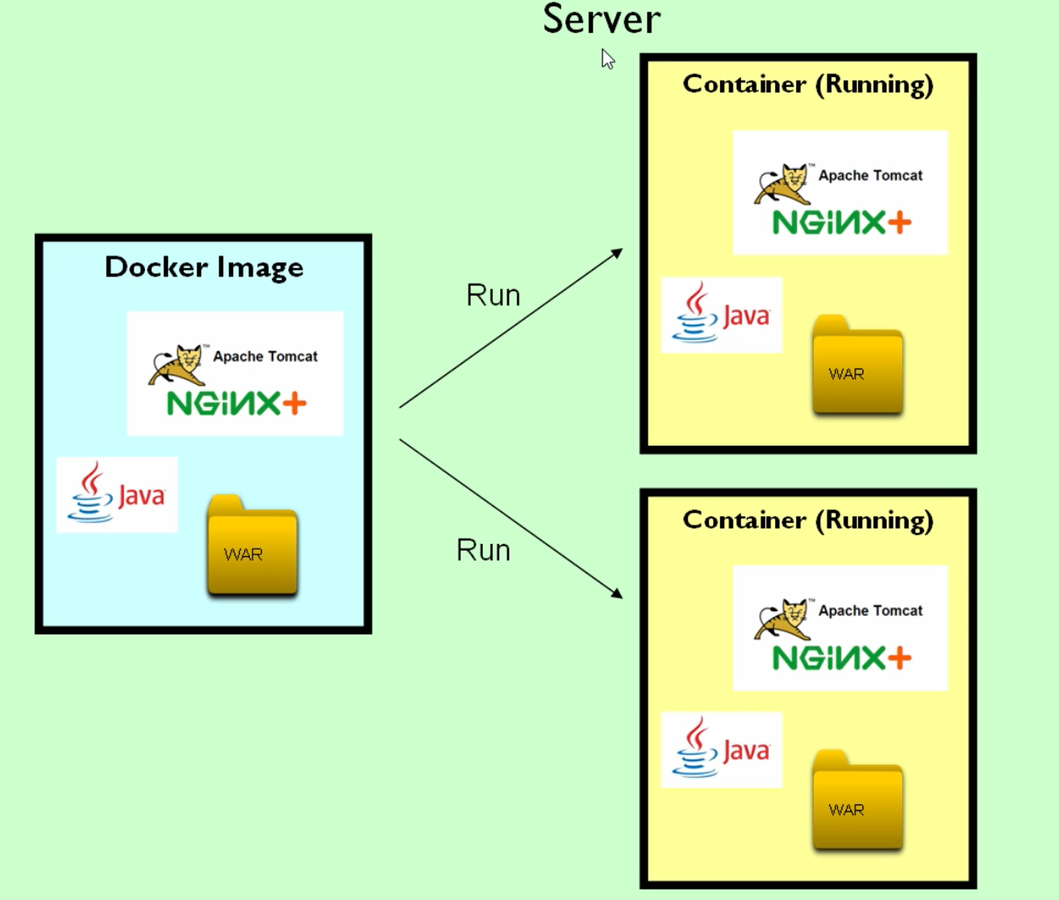

Slide 5
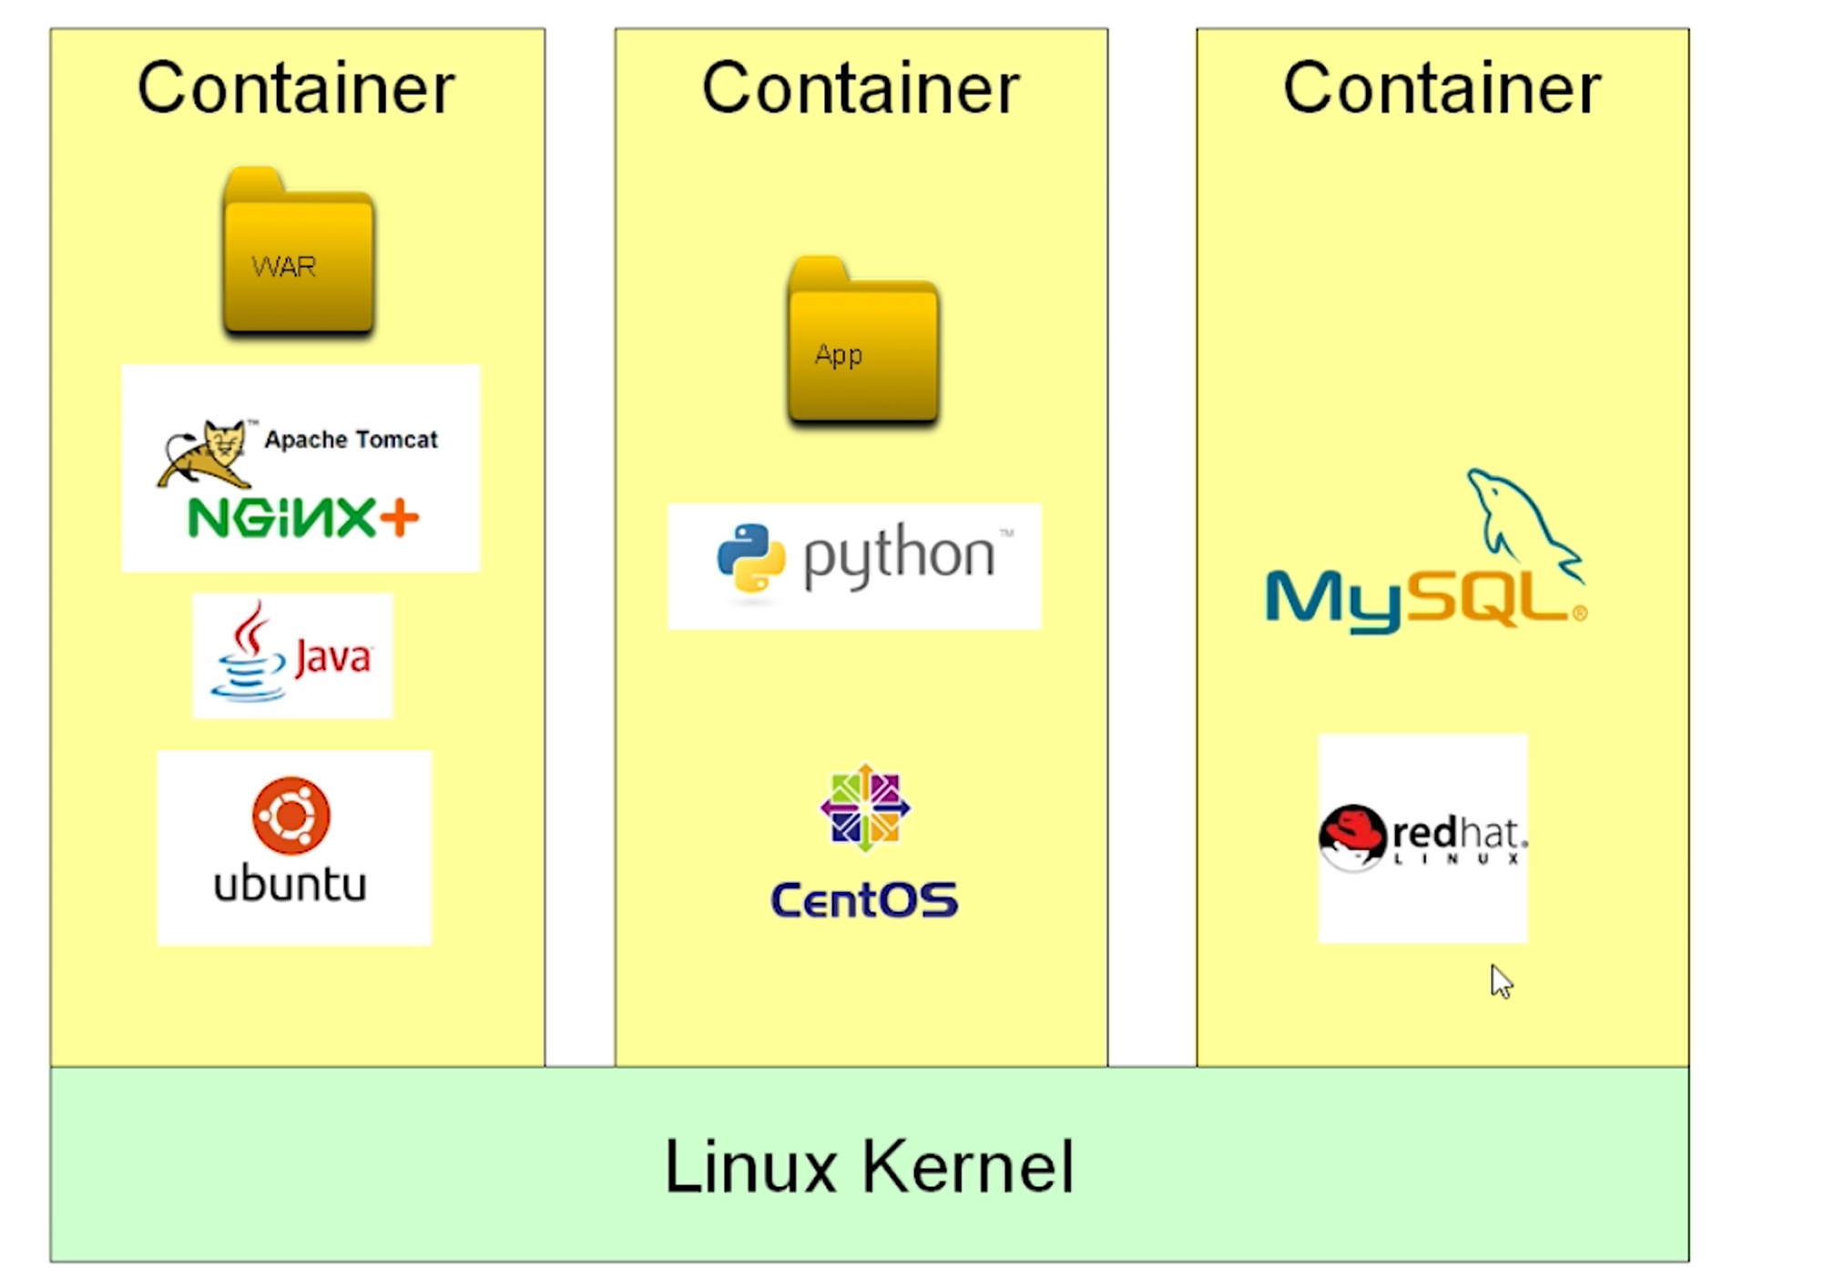
Tools and utilities,
Not OS
Like package manager,
Text editor, cat command

Slide 6
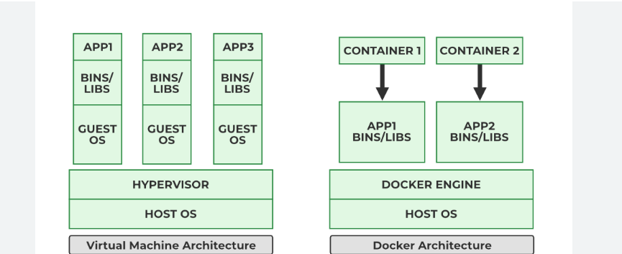
VM vs Docker Containers
VMs virtualize the entire hardware stack, including the CPU, memory, storage, and network interfaces. Each VM has own kernel and OS
Consumes more CPU, RAM, disk space while running a whole OS
Preferred when applications require different operating systems or strong security isolation
Share host OS kernel.
Lightweight
Process level isolation,
Faster starts

Slide 7
Docker installed?
docker
Podman
docker image pull hello-world
docker <container> run hello-world

Slide 8
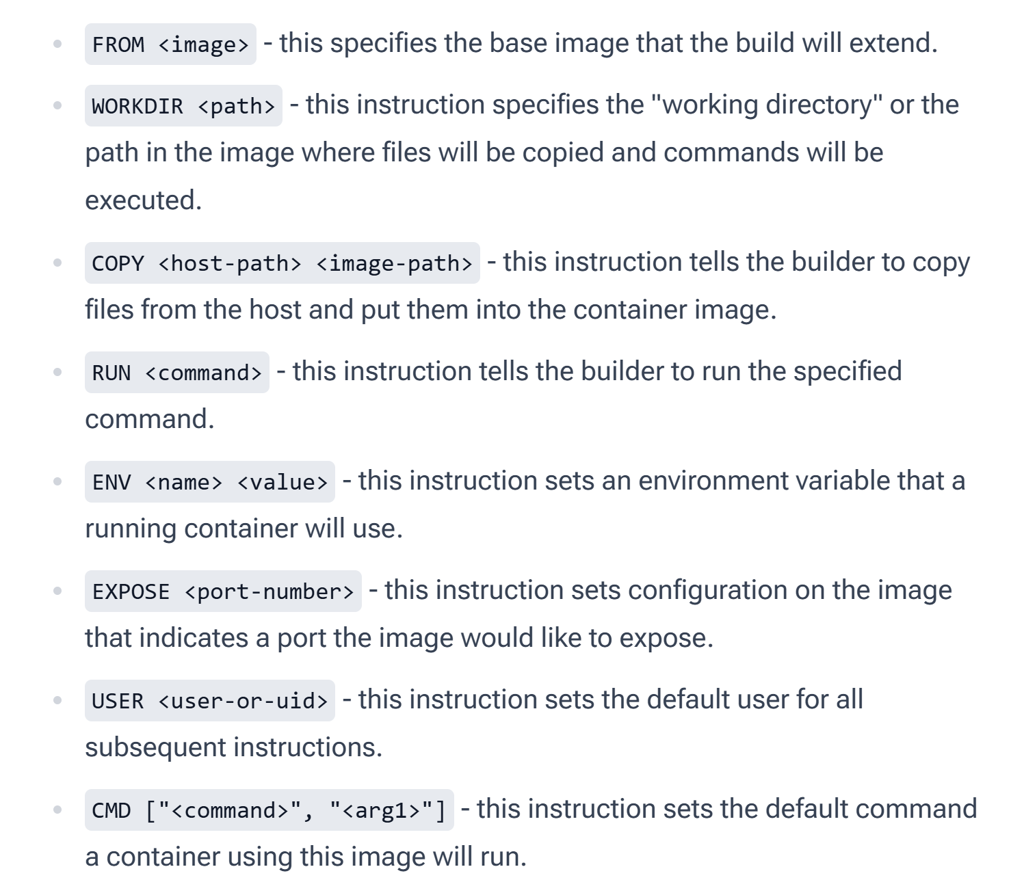

Slide 9
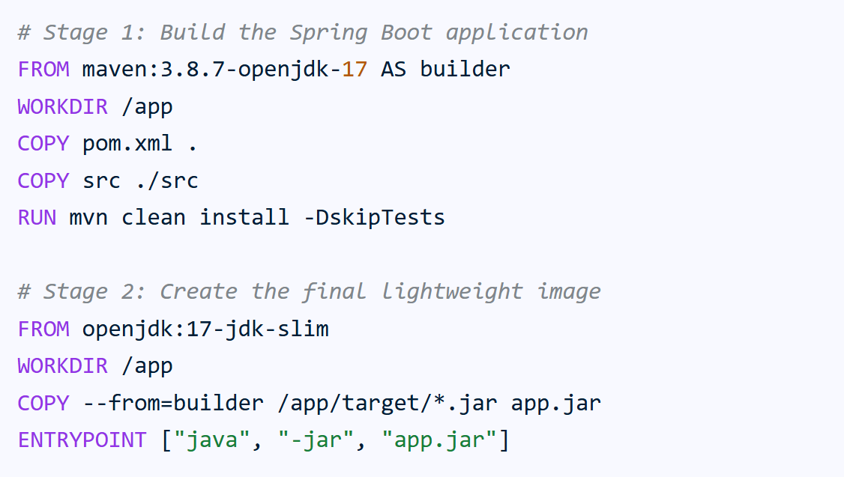

Slide 10
Build image and run container
docker build -t my-spring-boot-app .
docker run -p 8080:8080 my-spring-boot-app

Slide 11
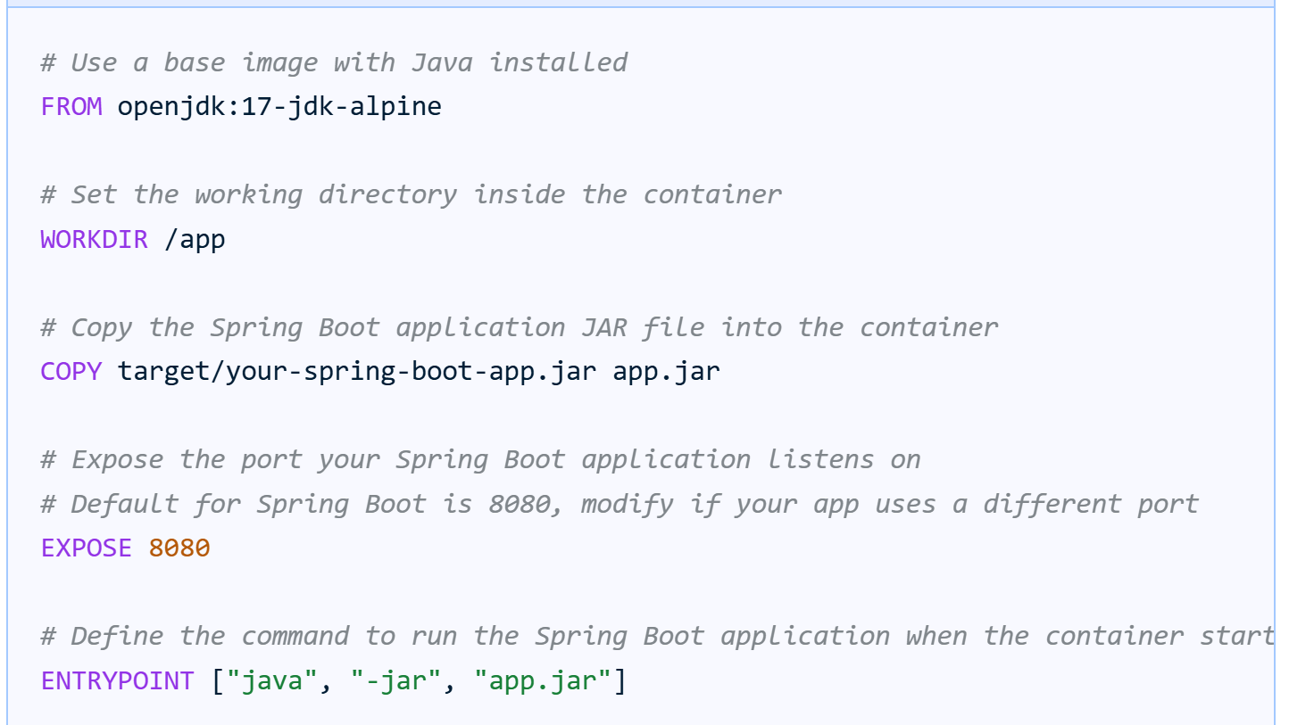
# which port the application inside the container will run on.

Slide 12
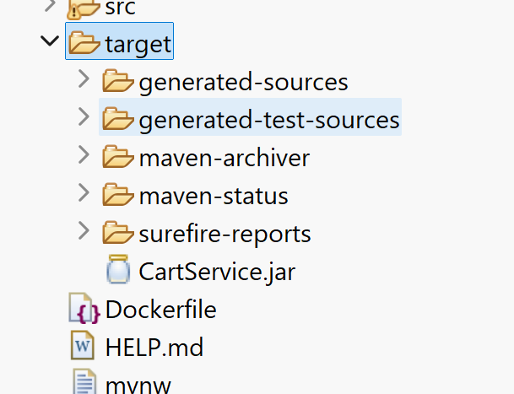
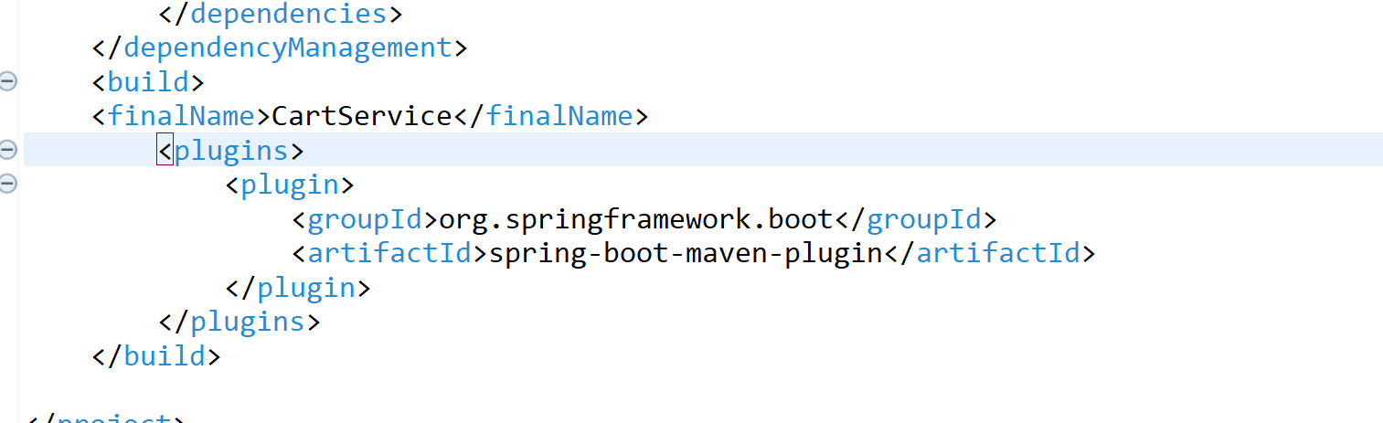
Jar name

Slide 13
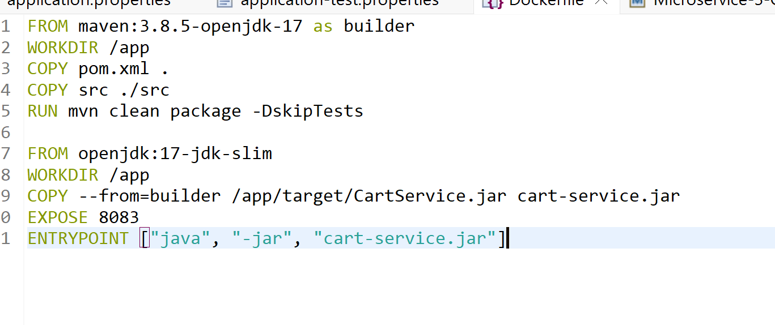
Dockerfile

Slide 14
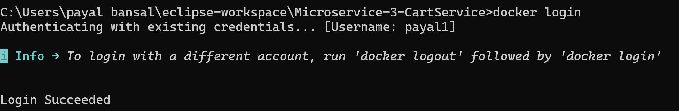
Login to docker hub

Slide 15
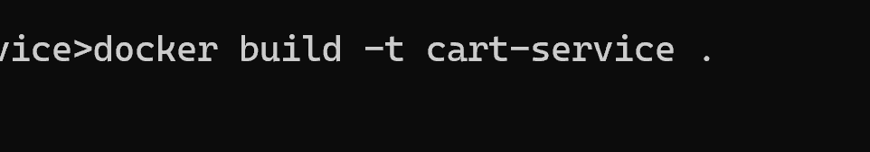
PATH: dockerfile
Name of build in lowercase

Slide 16
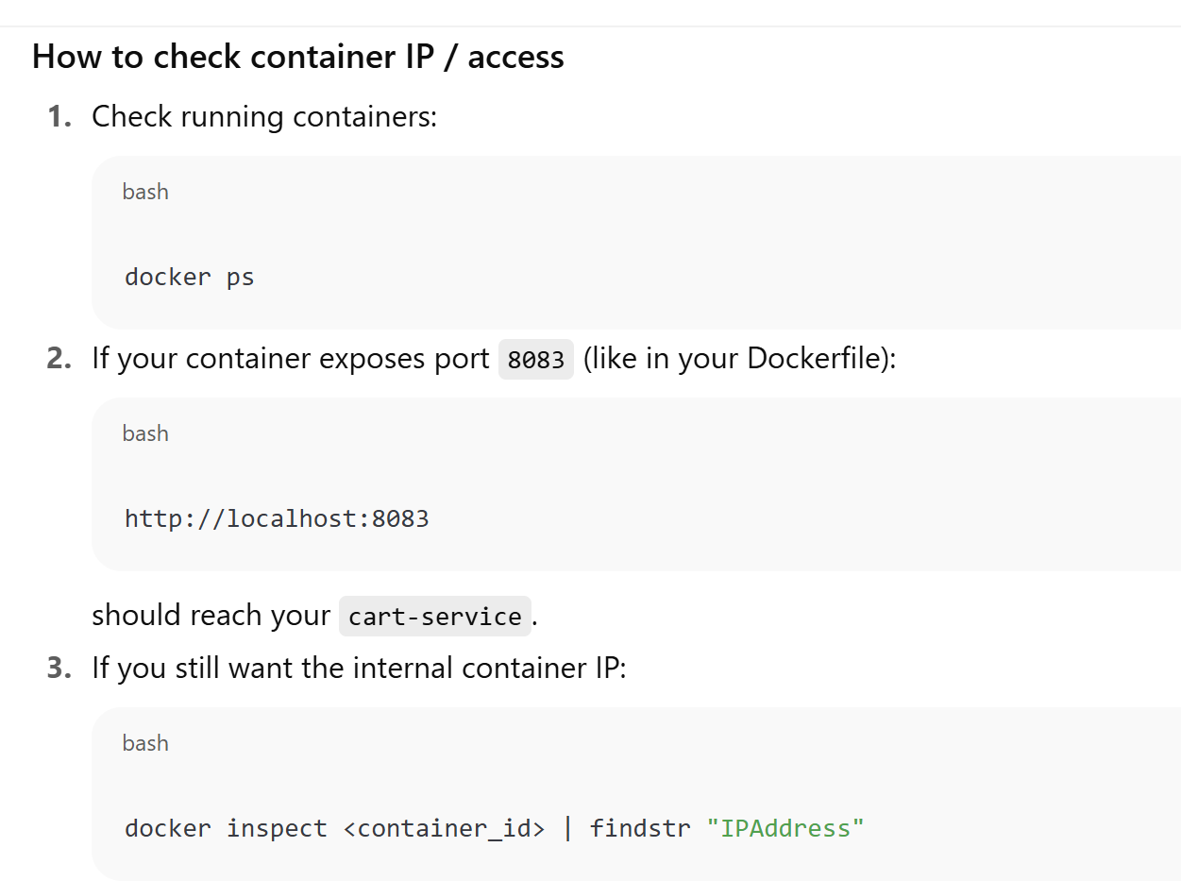

Slide 17
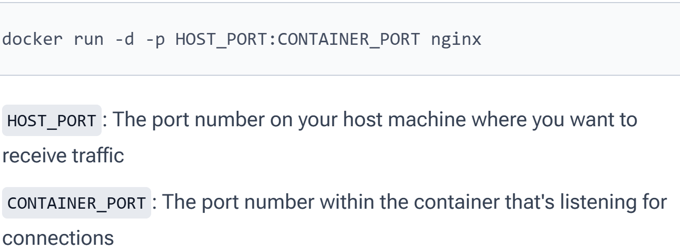
Expose port

Slide 18
Exposed port
-p 9090:8080 would map host port 9090 to container port 8080. Exposing
Port 9090 to outside world for app running internally on 8080

Slide 19
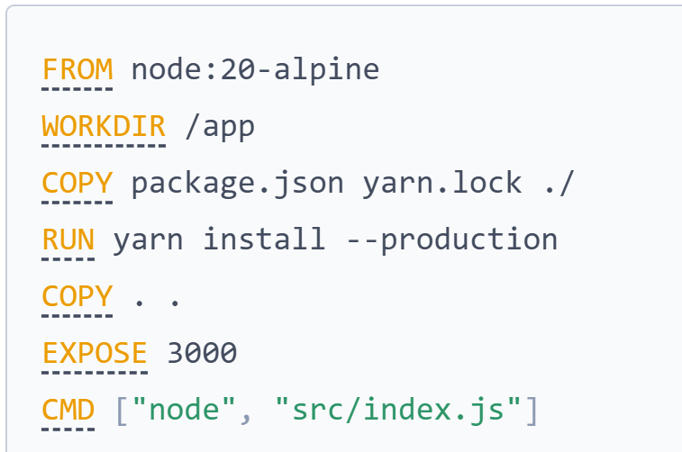

Slide 20
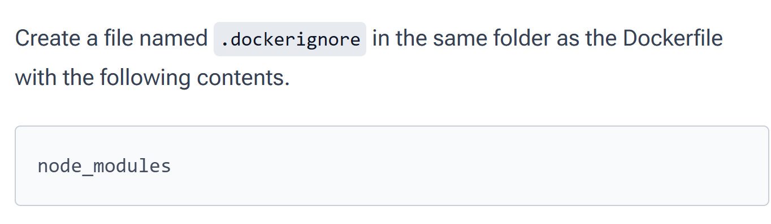

Slide 21
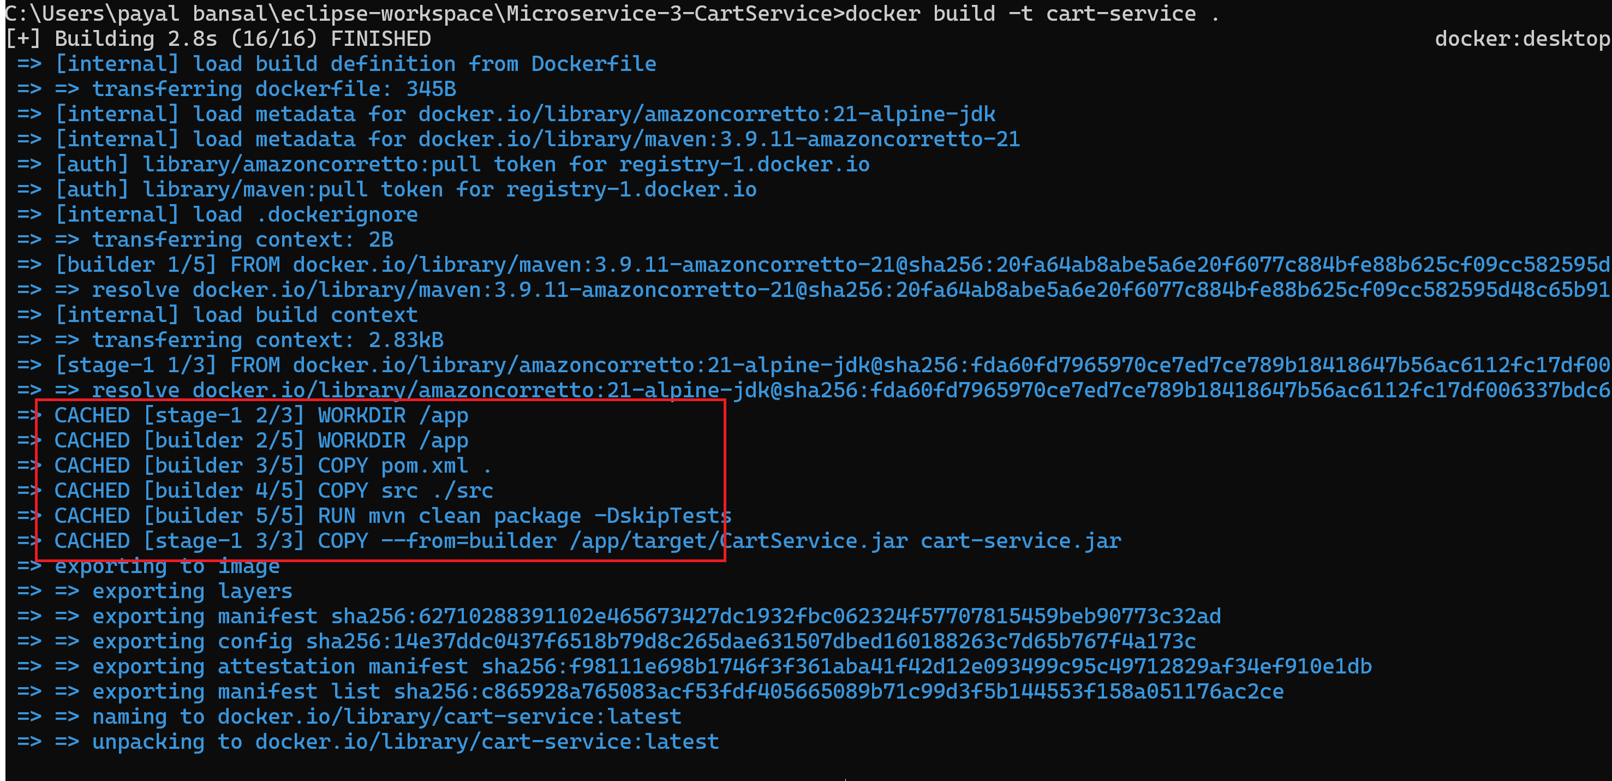

Slide 22
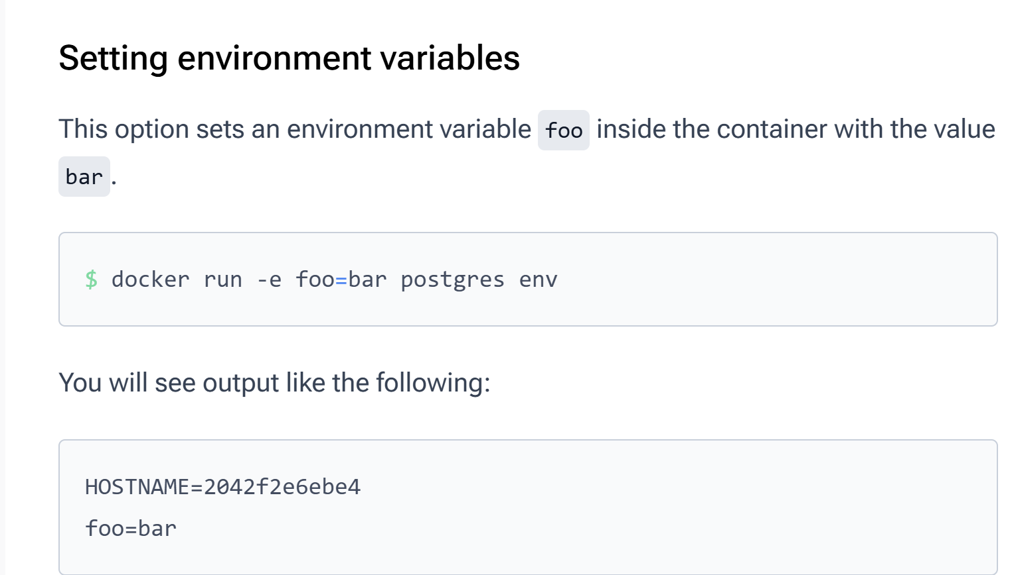

Slide 23
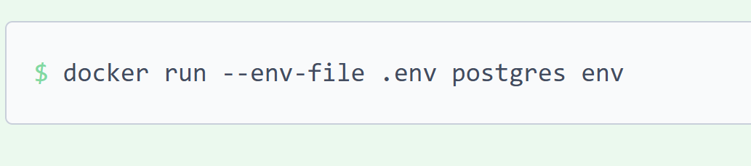
Use env file

Slide 24
Allocate resources to containers
docker run -e POSTGRES_PASSWORD=secret --memory="512m" --cpus="0.5" postgres

Slide 25
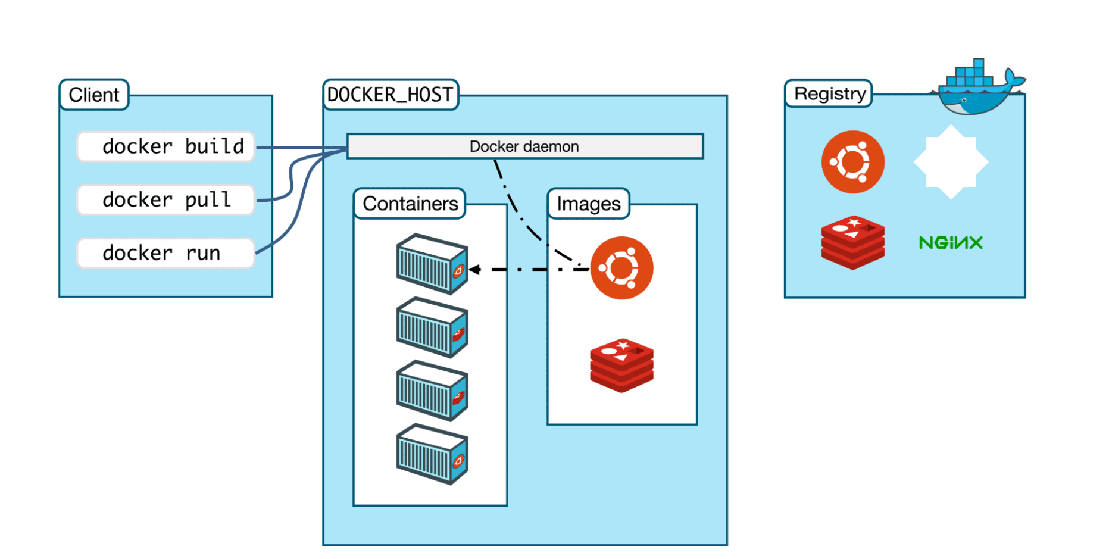
Architecture
Env for running apps
Gets API requests
Manages objects
Store docker images
CLI for user
to interact
Read only templates

Slide 26
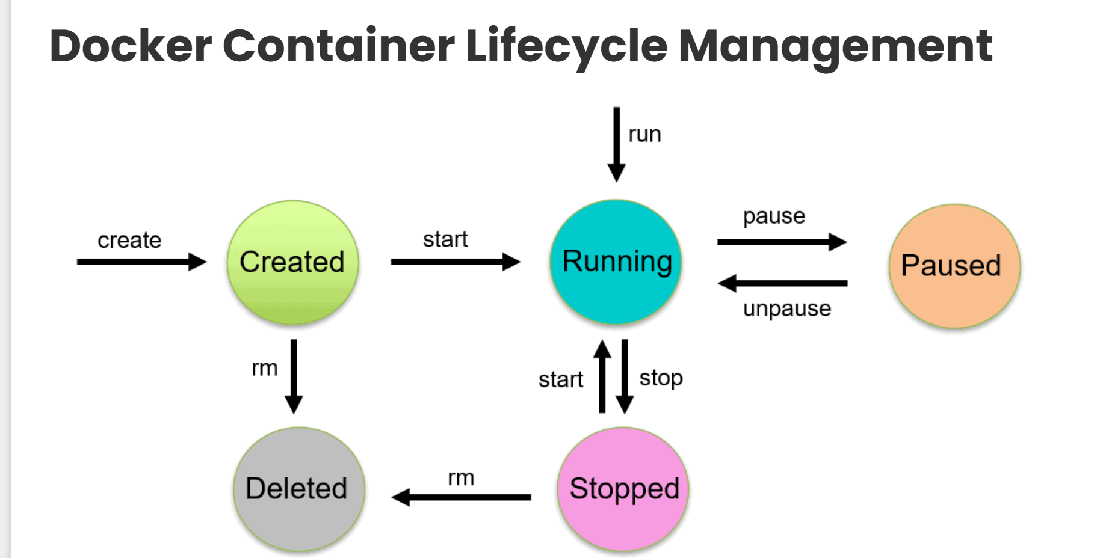

Slide 27
Network
For better isolation and communication with other containers
docker network create mynetwork
docker network ls
docker run -d -e POSTGRES_PASSWORD=secret -p 5434:5432 --network mynetwork postgres
docker run -d -e POSTGRES_PASSWORD=secret --memory="512m" --cpus=".5" postgres

Slide 28
Postgres container
docker run -p 5432:5432 --name postgres -e POSTGRES_PASSWORD=postgres -e POSTGRES_USER=postgres -e POSTGRES_DB=postgres postgres:13.22-trixie

Slide 29
Coming up next
Volumes
Networking
Docker compose

