Slide 1
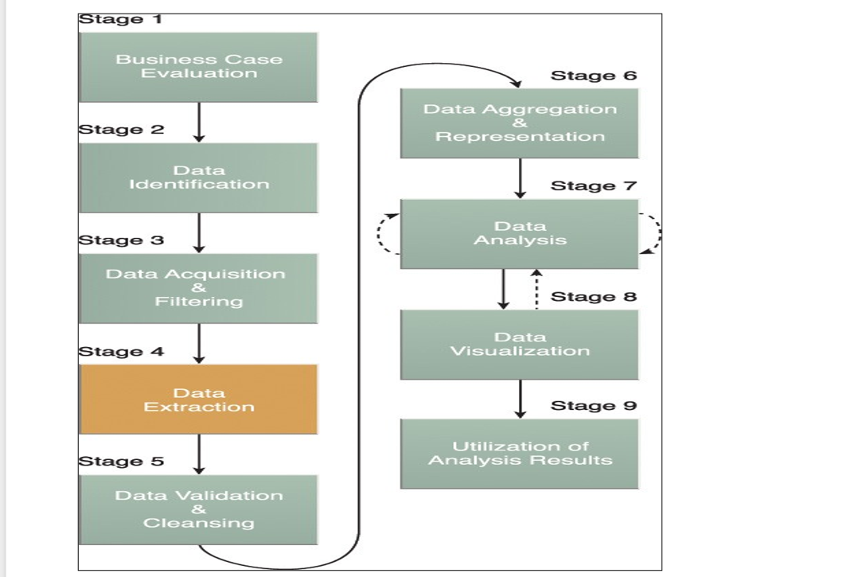

Slide 2
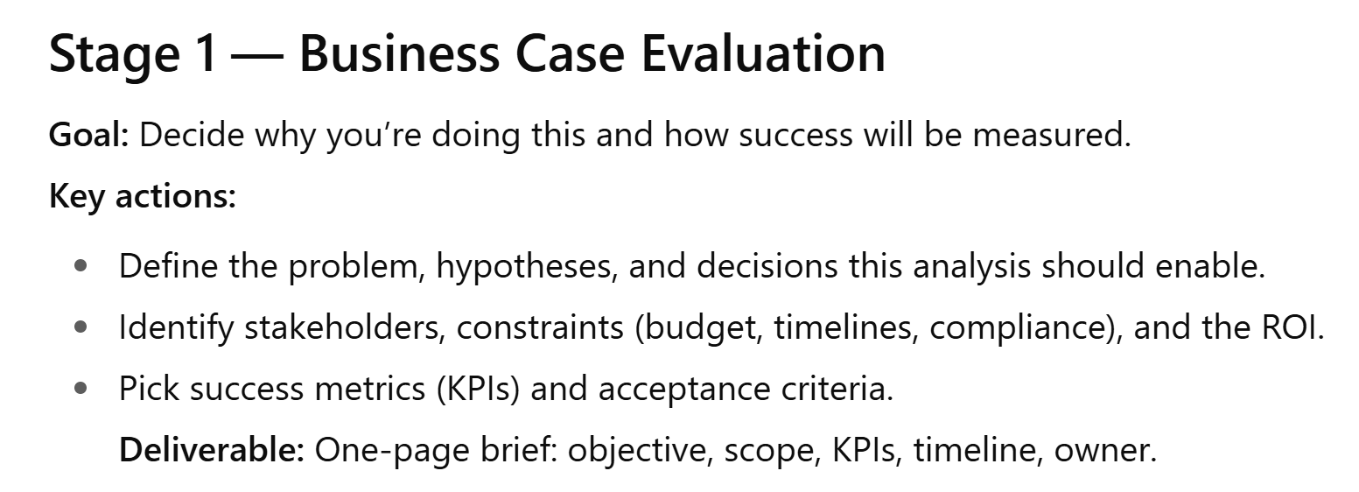

Slide 3
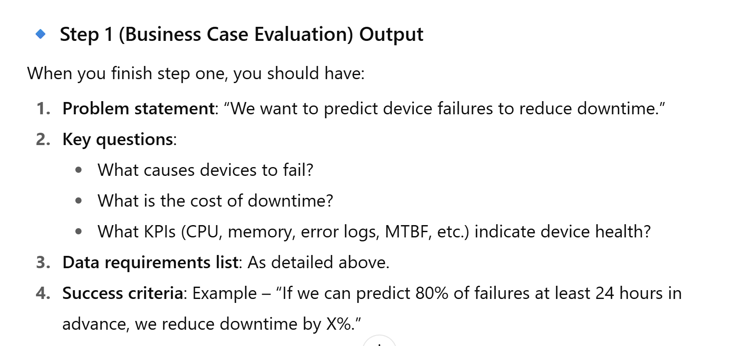

Slide 4
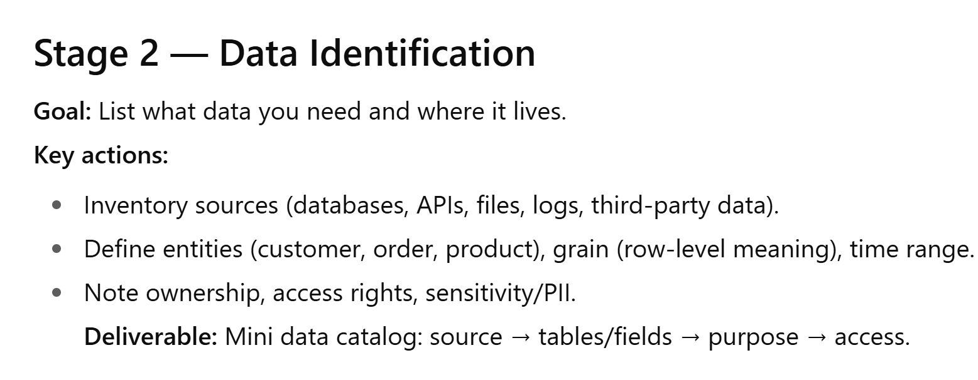

Slide 5
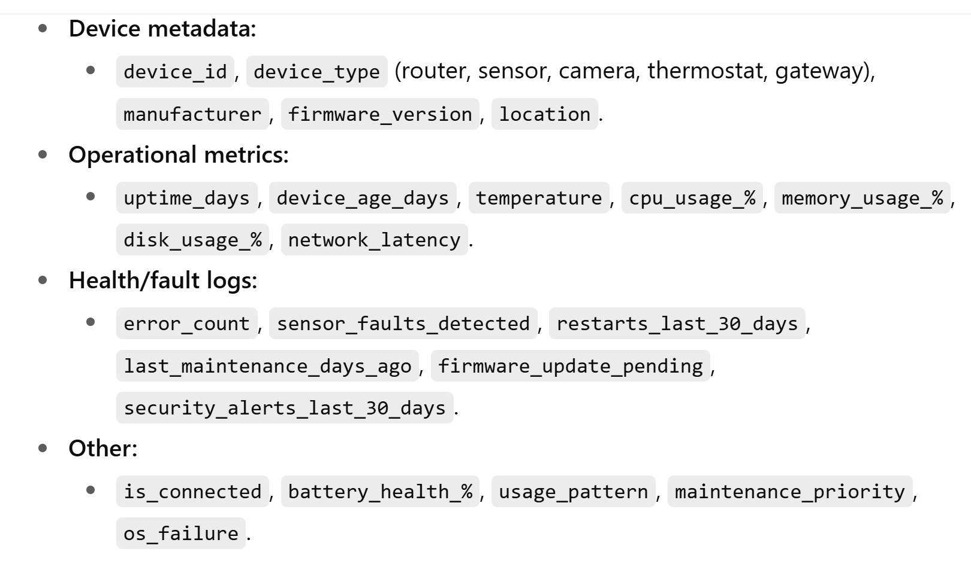

Slide 6
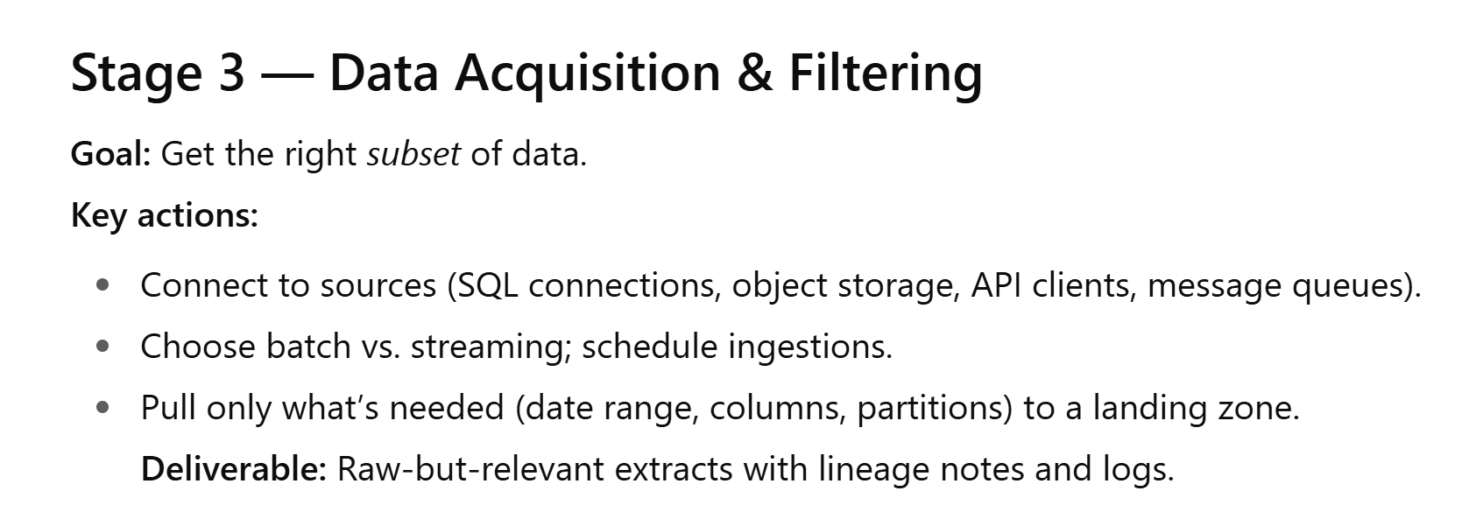

Slide 7
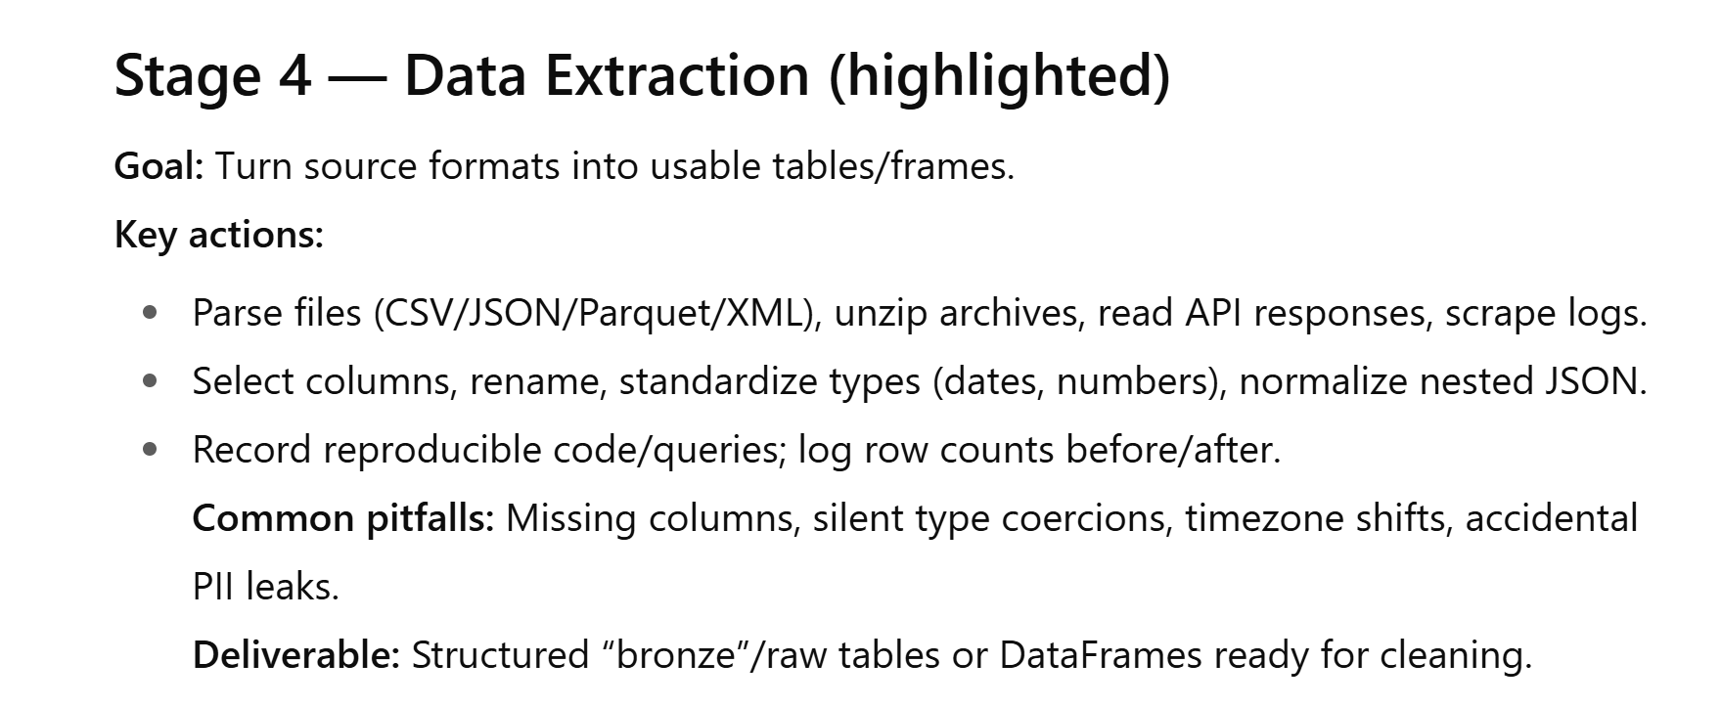

Slide 8
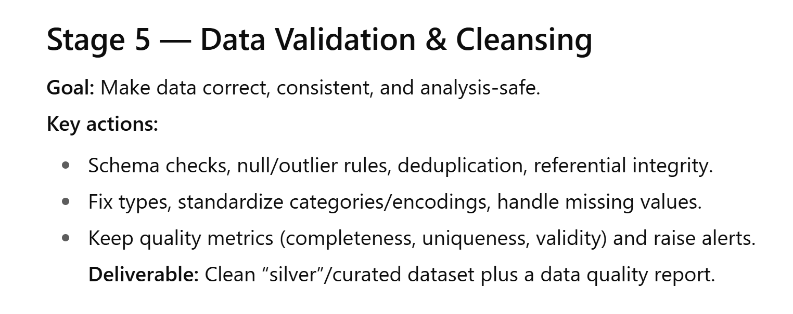

Slide 9
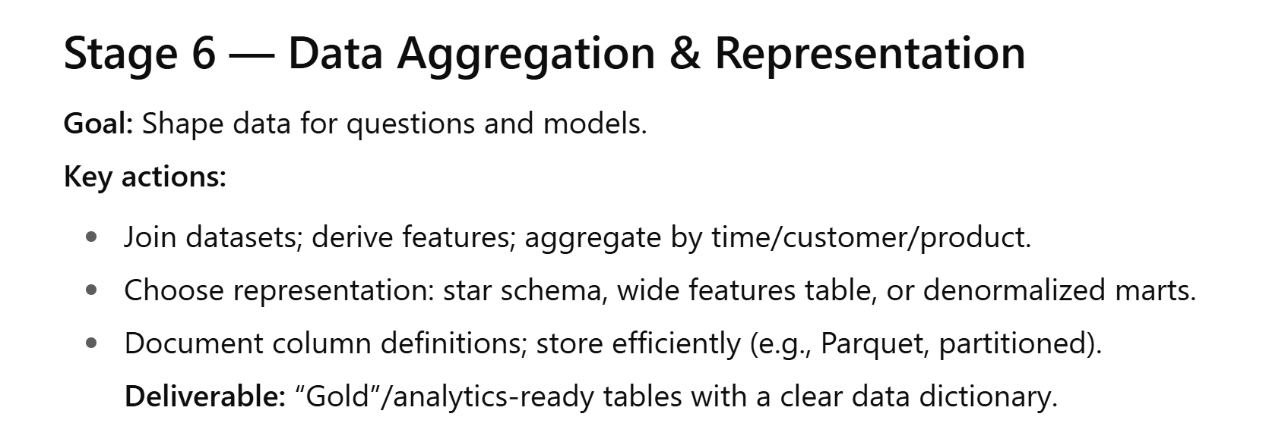

Slide 10
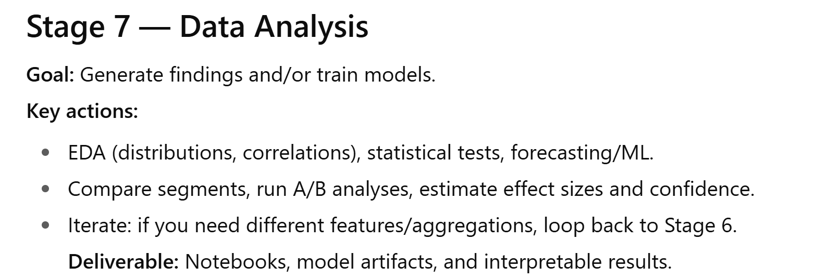

Slide 11
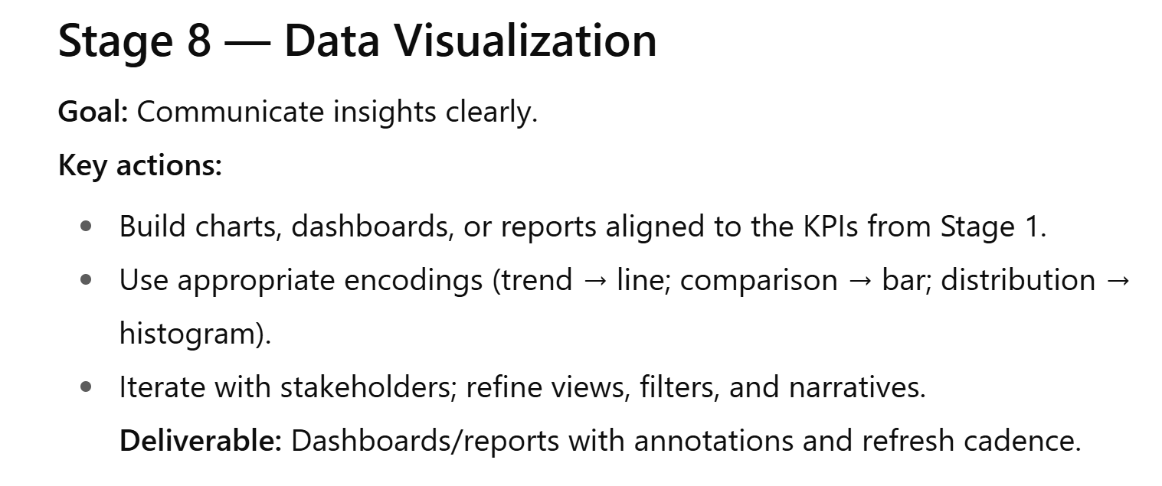

Slide 12
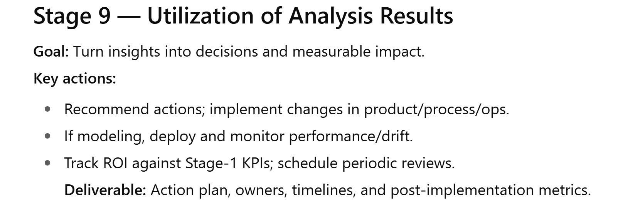

Slide 13
Pandas Operations
Common operations with syntax examples

Slide 14
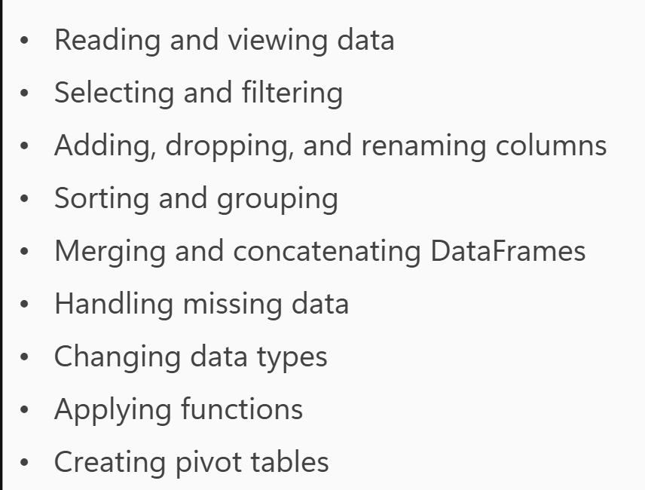

Slide 15
Extracting the data

Slide 16
Reading Data
pd.read_csv('file.csv')
df = pd.read_excel('filename.xlsx', sheet_name='Sheet1')
df = pd.read_json('filename.json')
import sqlite3
conn = sqlite3.connect('database.db’)
df = pd.read_sql_query('SELECT * FROM table_name', conn)

Slide 17
Viewing Data
Syntax:
df.head(), df.tail(),
df.info(): summary of data
df.describe(): general statistics
df.dtypes: each col with datatype
df.shape: # rows and cols

Slide 18
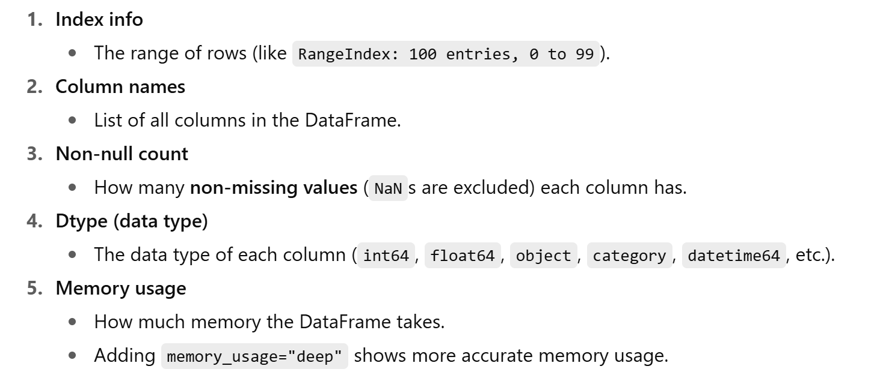
df.info(): Summary

Slide 19
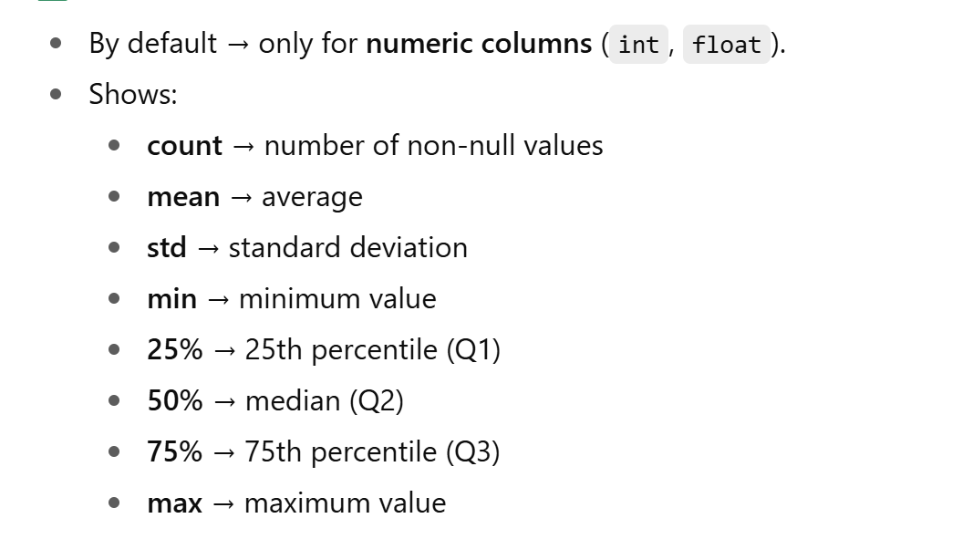
df.describe()

Slide 20
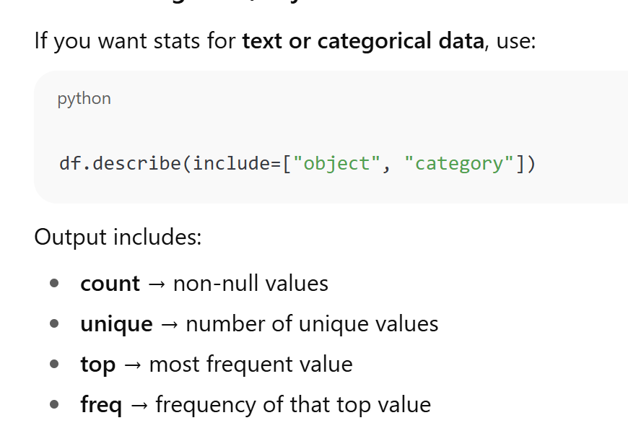

Slide 21
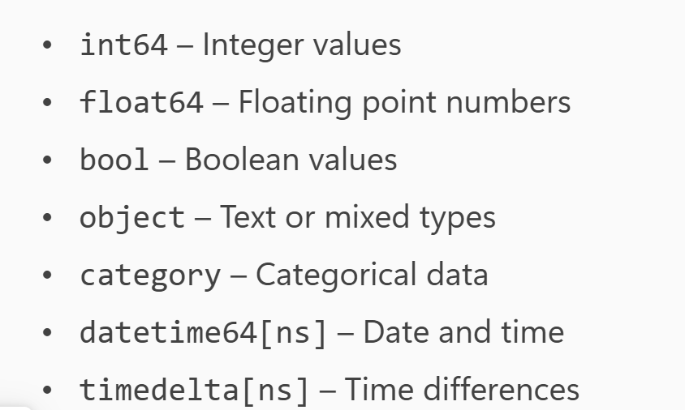
DataTypes

Slide 22
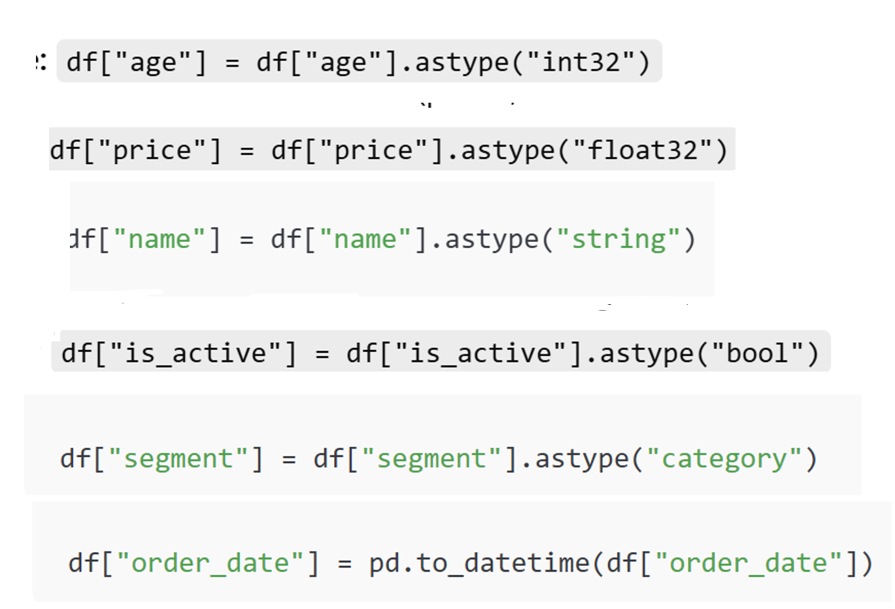

Slide 23
Show all columns in head/ describe, dtypes …
pd.set_option("display.max_columns", None)

Slide 24
Validating and Cleansing the data

Slide 25
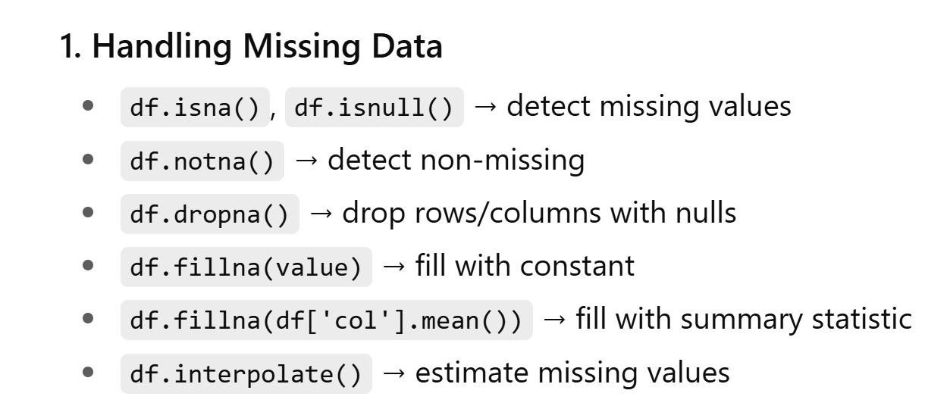

Slide 26
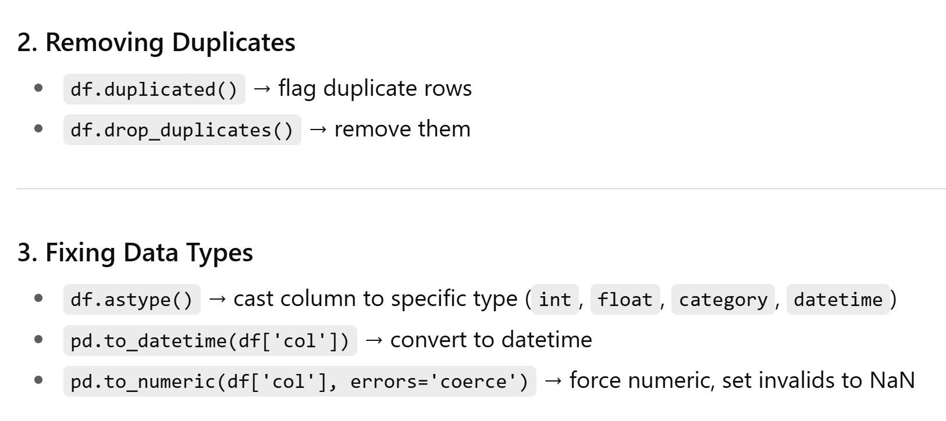

Slide 27
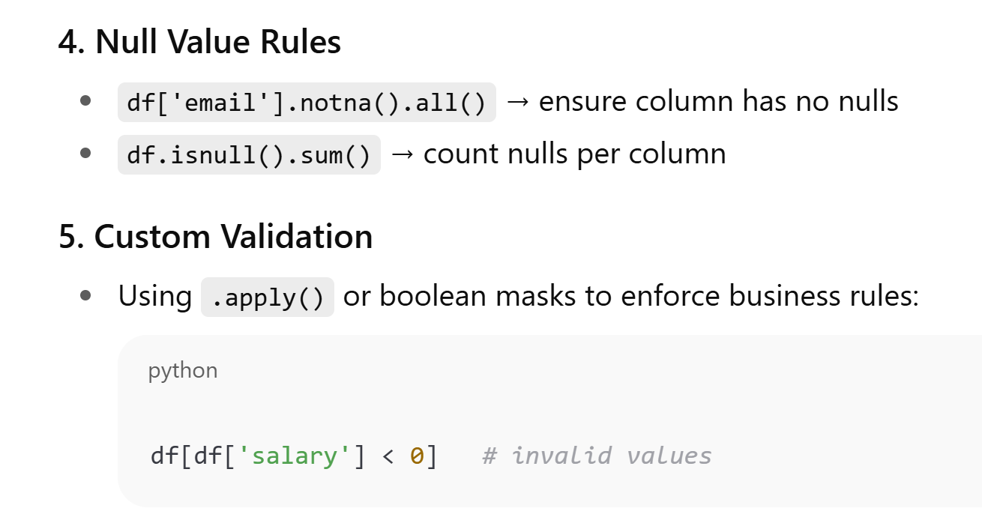

Slide 28
Transform data

Slide 29
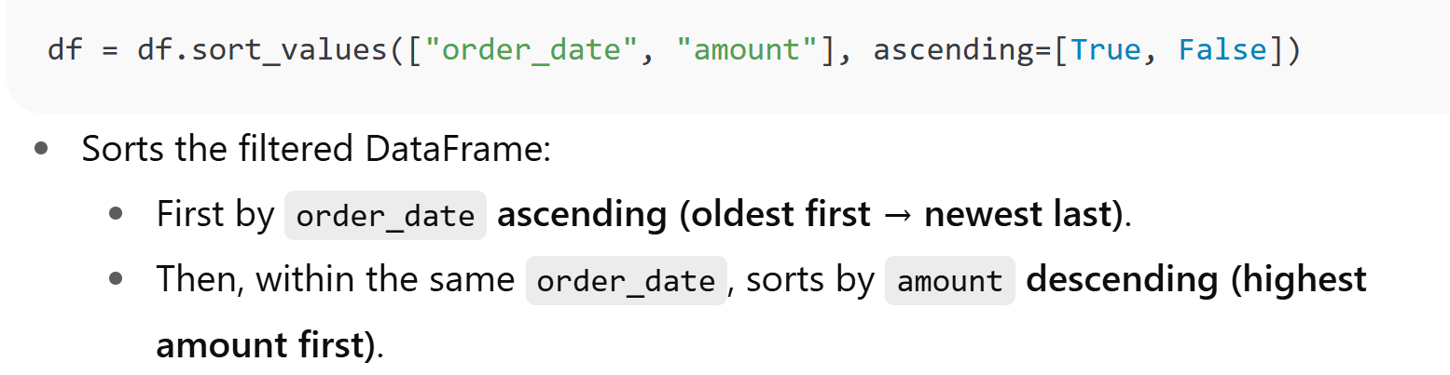

Slide 30
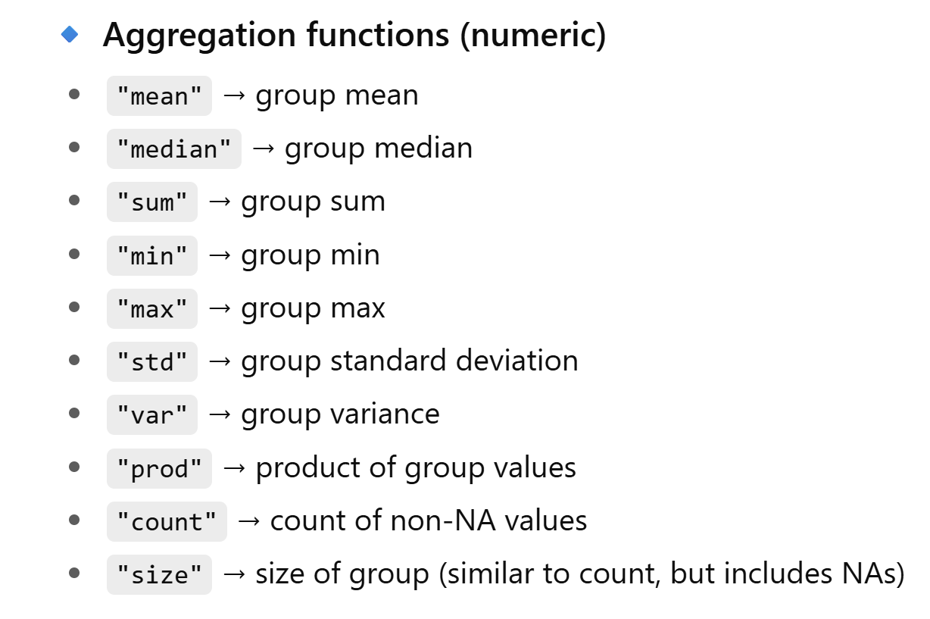

Slide 31
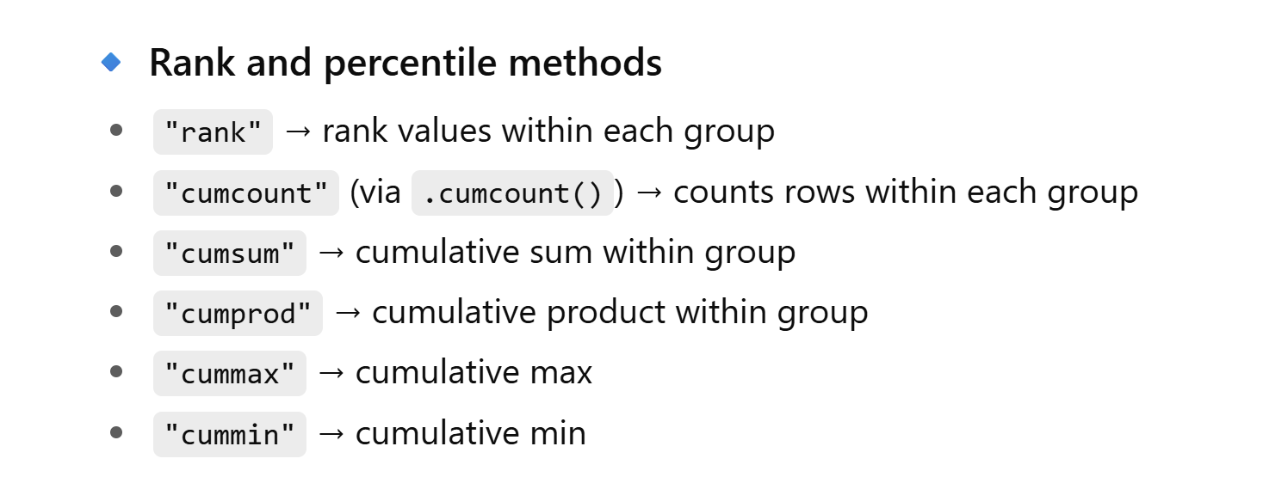

Slide 32
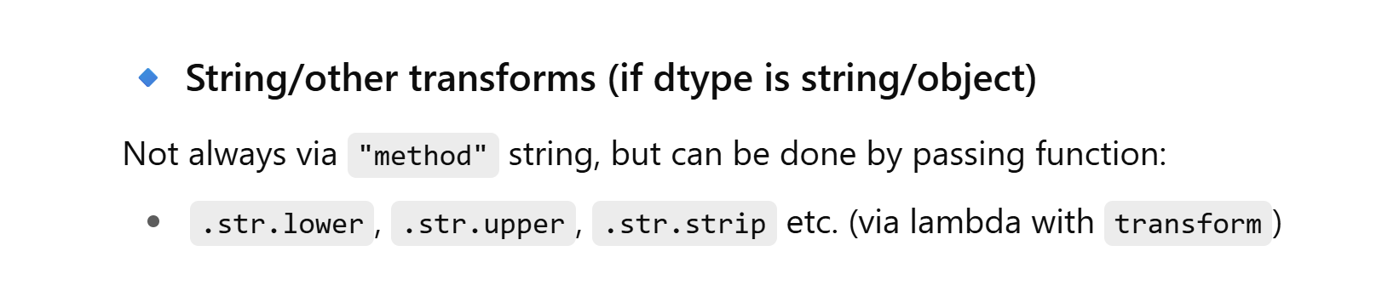
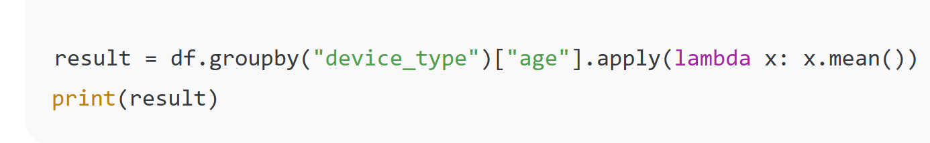
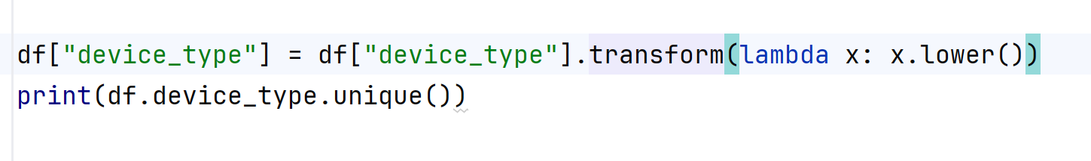

Slide 33
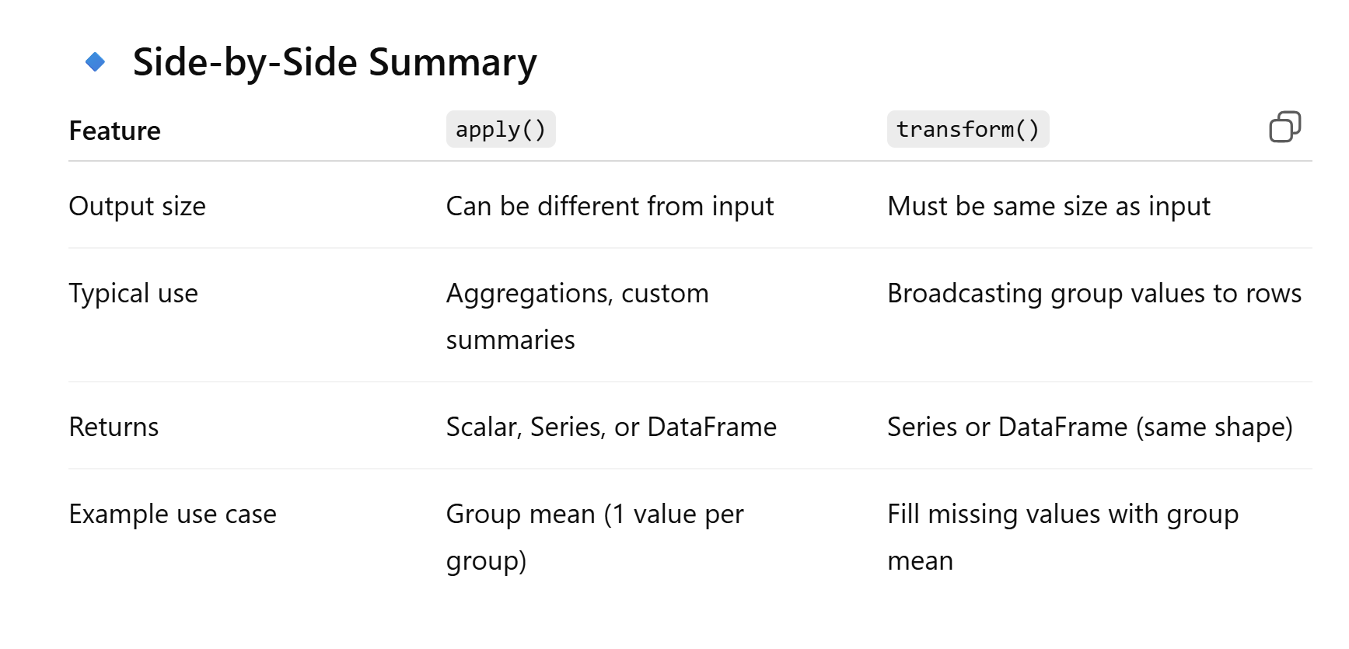

Slide 34
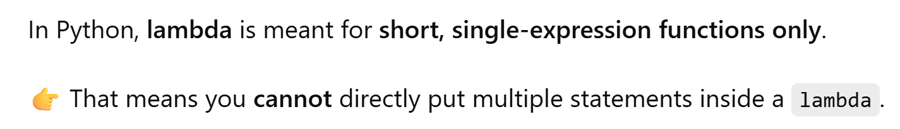

Slide 35
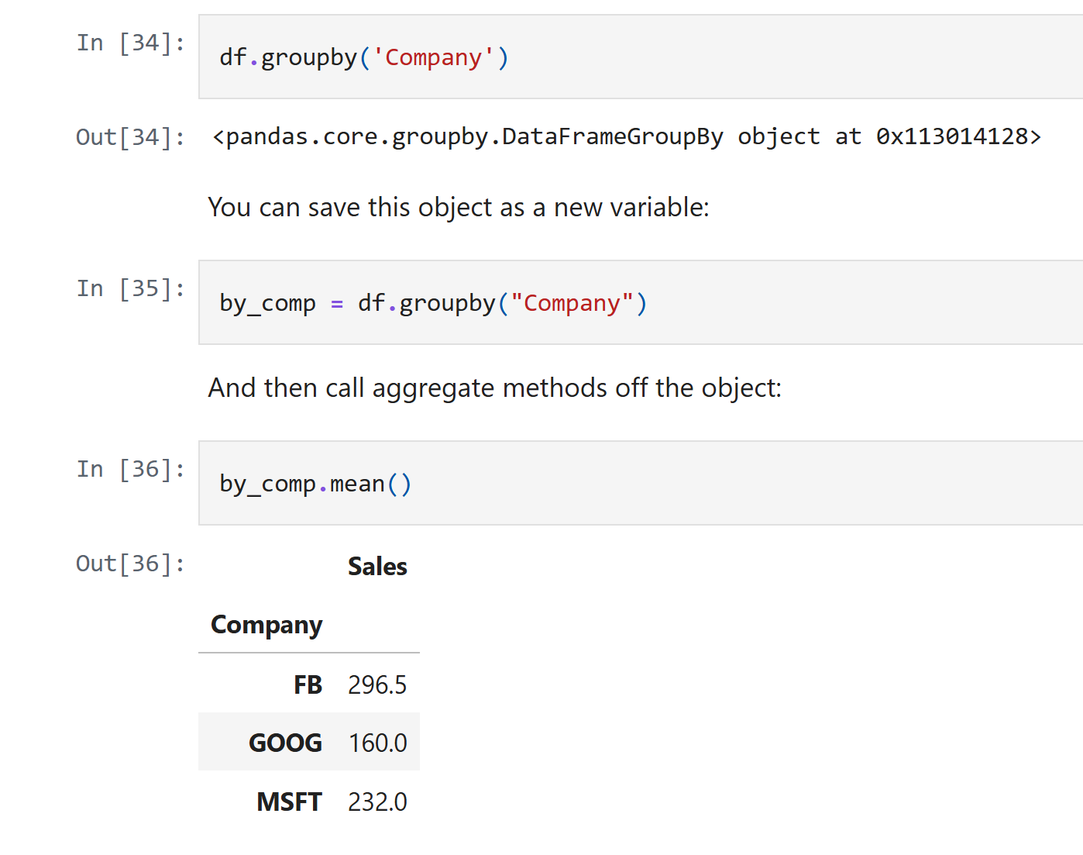

Slide 36
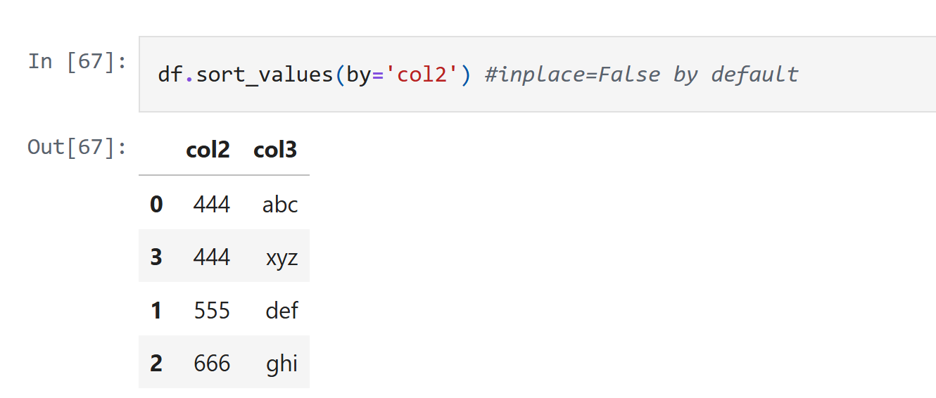

Slide 37
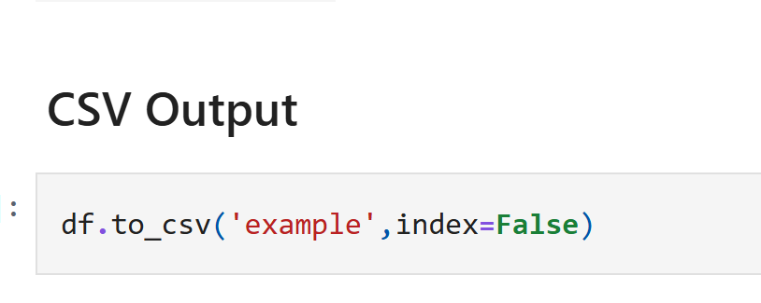

Slide 38
Selecting Columns
Syntax:
df['column_name'], df[['col1', 'col2']]

Slide 39
Filtering Rows
Syntax:
df[df['column'] > value]

Slide 40
Adding Columns
Syntax:
df['new_col'] = df['col1'] + df['col2']

Slide 41
Dropping Columns
Syntax:
df.drop('column_name', axis=1)

Slide 42
Renaming Columns
Syntax:
df.rename(columns={'old_name': 'new_name'})

Slide 43
Sorting Data
Syntax:
df.sort_values(by='column_name')

Slide 44
Grouping Data
Syntax:
df.groupby('column_name').mean()

Slide 45
Merging DataFrames
Syntax:
pd.merge(df1, df2, on='key')

Slide 46
Concatenating DataFrames
Syntax:
pd.concat([df1, df2])

Slide 47
Handling Missing Data
Syntax:
df.dropna(), df.fillna(value)

Slide 48
Changing Data Types
Syntax:
df['column'] = df['column'].astype('type')

Slide 49
Applying Functions
Syntax:
df['column'].apply(lambda x: x*2)

