Slide 1




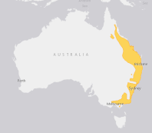

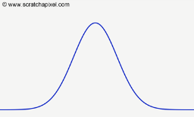
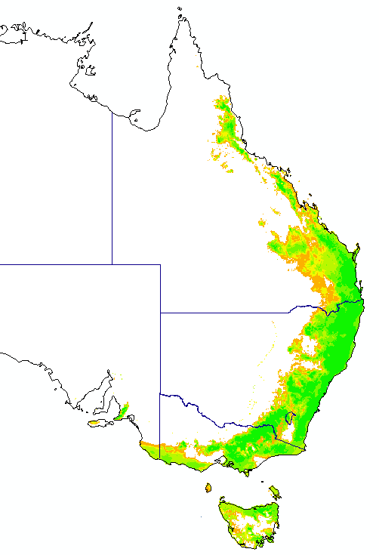
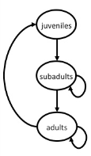
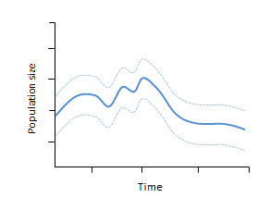
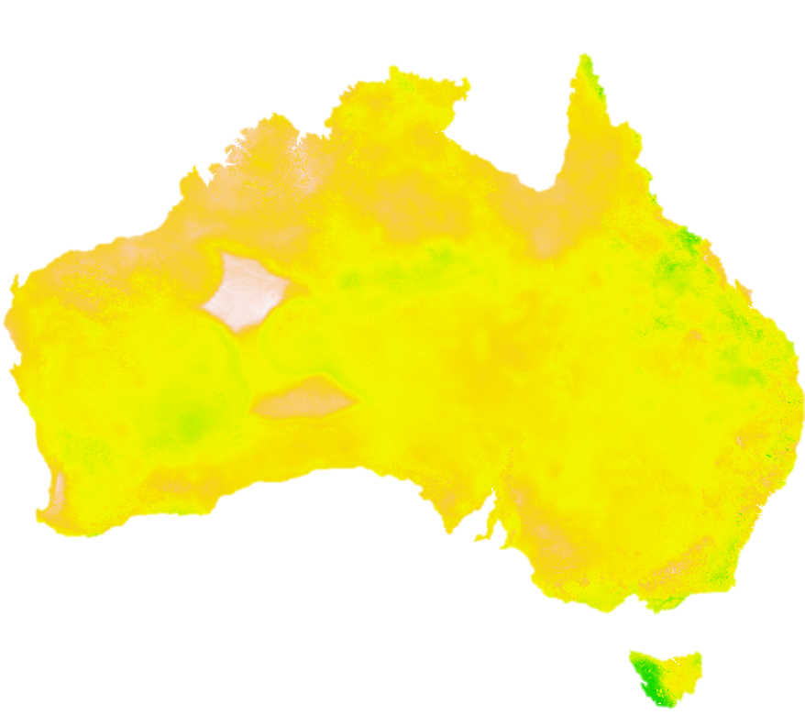
Spatial processes
Species datasets
Environmental data
Demographic processes
Demographic & trait databases
IUCN range maps
Species distribution models
for 1000’s of species
Climate change projections
Temperature
Rainfall
Extreme weather
Hierarchical trait models
Maps of carrying capacity change
Population dynamics models
2020
2030
2010
Land use
Land use model
Land use
Land use change
Meta-population model trajectories
Aggregate biodiversity persistence
Trade
Computable general equilibrium (CGE) model
Global scenarios
Australian National Outlook

Slide 2
Economic model
Land-use model
Biodiversity model
Species distribution models
for 1000’s of species
IUCN range maps
Species datasets
Climate change projections
temperature, rainfall, extreme weather
Aggregate biodiversity index of change
Maps of carrying capacity change
Socio-economic predictors
Environmental data
2030
2010
2020

Slide 3
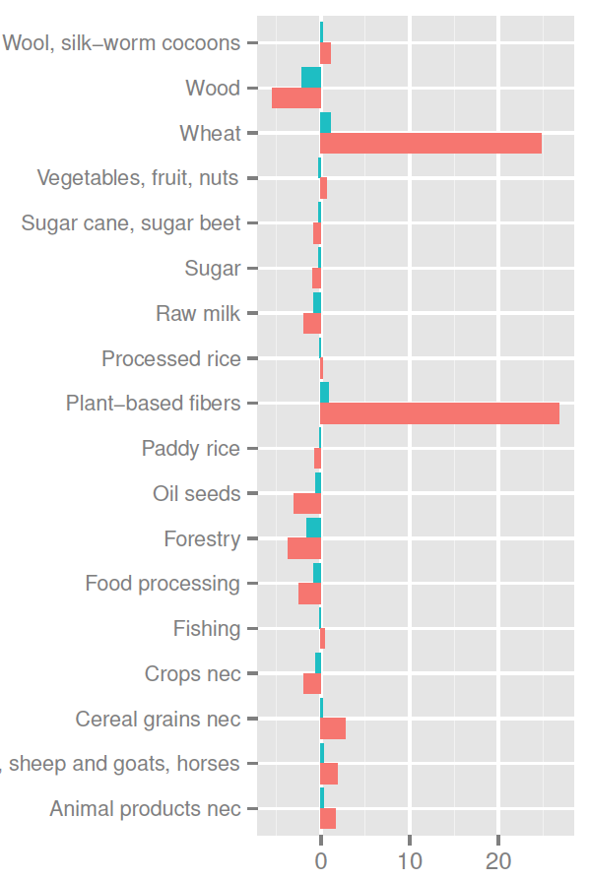
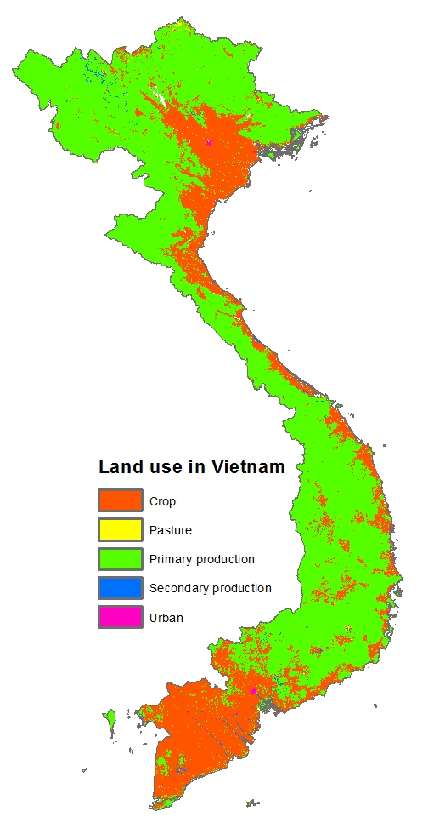
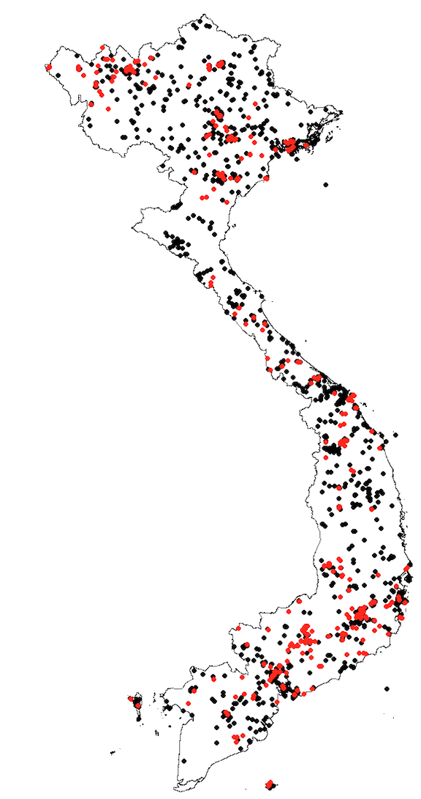
CGE
Land-use
Biodiversity
Result map

