Slide 1
About Me
Payal
(22112075)
2nd year Undergrad student in Chemical Engineering, IITR
Contact Details
Email ID : payal@ch.iitr.ac.in
Phone no. : 8295803134
Github : https://github.com/payalkanyan

Slide 2
Strategy Overview -Ichimoku + ADX
Key Components:
Ichimoku Cloud:
Tenkan-sen (Conversion Line): 9-day moving average.
Kijun-sen (Base Line): 26-day moving average.
Senkou Span A (Leading Span A): Average of Tenkan-sen and Kijun-sen.
Senkou Span B (Leading Span B): 52-day moving average.
Average Directional Index (ADX):
Measures trend strength with a window of 14 days.
DI+ and DI- (Directional Indicators): Calculate trend direction.
ADX: Indicates trend strength, with values above 25 suggesting a strong trend.

Slide 3
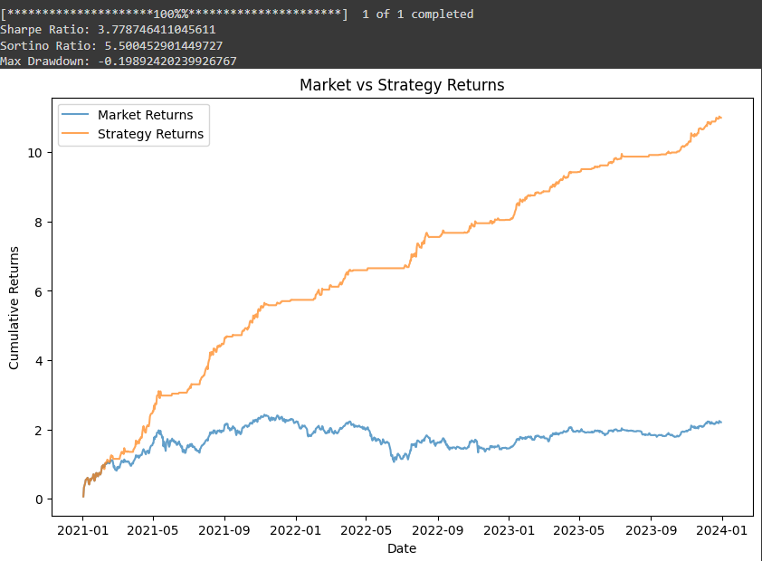
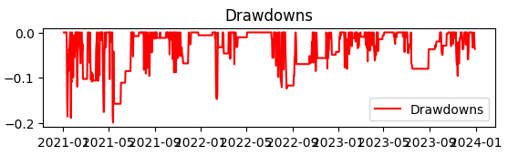

Slide 4
Performance Metrics and Visualization
Performance Metrics:
Sharpe Ratio: Measures risk-adjusted returns.
Sortino Ratio: Focuses on downside risk.
Maximum Drawdown: Assesses potential losses.
Results:
Sharpe Ratio: Indicates risk-adjusted performance.
Sortino Ratio: Highlights returns relative to downside risk.
Maximum Drawdown: Demonstrates the worst peak-to-trough decline.

Slide 5
Thank You!

