Slide 1
ScreenShot
Why screenshot Required.
How to capture screenshot.

Slide 2
Why ScreenShot Required
Screenshot helps us to understand the flow of application whether application is behaving correctly or not.
It helps us while doing cross browser testing.
Screenshot on failure.

Slide 3
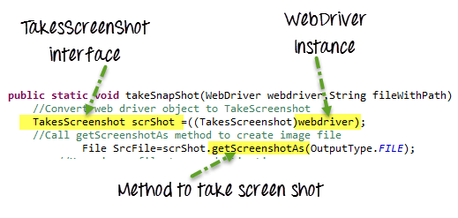
How To Take ScreenShot
Step 1. Convert web driver object to TakeScreenshot
Step 2. Call getScreenshotAs method to create image file
Step 3..Copy file to Desired Location

Slide 4
How To Take Screenshot on Failure
Use @AfterMethod annotation.
Use ITestResult interface’s getStatus() method that returns the test result
ITestResult interface provides the test case execution status and test case name
Using ITestResult.FAILURE ==result.getStatus then it enter into if condition
In case of failure we can use the commands to take screenshot.

Slide 5
Thank You

