Slide 1

" HAND-GESTURE-PRESENTATION-SYSTEM”
Project Presentation
ADT23SOCB0716:- Payal Verma
ADT23ZSOCB1035:- Shipra Raj
ADT23SOCB0678 :- Omkar Kalamkar
ADT23SOCB1120 :- Siddhesh Saravade
Guided by
Prof. Archana Pakhare
Department of Computer Science & Engineering, MITSoC, Loni Kalbhor

Slide 2
Outline
Introduction
Problem Statement
Objectives
Concepts & Methods
Literature Review
Identification of gaps & scope of work
RESULT
Reference
Q&A
Department of Computer Science & Engineering, MITSoE, Loni Kalbhor

Slide 3
Introduction
In today’s rapidly evolving digital world, the way we interact with technology is constantly being reimagined. Traditional methods like keyboards and mice are being replaced with more natural and intuitive interfaces. One such innovation is the Hand Gesture Presentation System, which allows users to control presentation slides using simple hand movements. This system leverages computer vision and machine learning techniques to recognize and interpret hand gestures in real-time, offering a touchless, efficient, and interactive way to navigate through presentations. Such systems not only enhance user experience but also prove especially useful in situations where contactless interaction is preferred, such as during public speaking, teaching, or in hygiene-sensitive environments.
Department of Computer Science & Engineering, MITSoE, Loni Kalbhor

Slide 4
Problem Statement
Traditional presentation controls are restrictive and disrupt the flow. A hands-free solution is needed for smoother interaction
Limited Interaction Flexibility: Traditional presentation tools rely on physical input devices like keyboards, mice, or clickers, which can restrict the speaker's movement and reduce engagement with the audience.
Lack of Contactless Control: In scenarios where hygiene or accessibility is important (e.g., during a pandemic or in smart classrooms), there is a need for a touch-free way to control presentations.
User Dependency on External Devices: Carrying and setting up external controllers or remotes can be inconvenient and unreliable, highlighting the need for a more natural, gesture-based control system using just the user's hand and a camera.
Objectives
The primary objective of the Hand Gesture Presentation System is to develop a touchless, real-time control mechanism that allows users to navigate through presentation slides using hand gestures detected via a camera. This system aims to: Enhance user interaction by replacing traditional input devices with intuitive hand gestures . Improve mobility and presentation flow for speakers, especially in professional and academic settings . Provide a hygienic and accessible alternative for controlling presentations without physical contact.
Department of Computer Science & Engineering, MITSoE, Loni Kalbhor

Slide 5
4. Concepts and Methods
Concept :
The Hand Gesture Presentation System is based on the idea of using computer vision and gesture recognition to create a more natural and seamless human-computer interaction. Instead of using conventional devices like a mouse or a remote, this system tracks and interprets hand gestures through a webcam or camera sensor to control slide navigation in real-time. It makes use of advanced algorithms to detect hand position, shape, and movement, translating them into specific commands such as "next slide," "previous slide," or "pause."
Method:
Capture Input: A webcam or inbuilt camera captures live video of the user's hand.
Preprocessing: The video frames are processed to detect the hand using libraries like OpenCV and MediaPipe. Background noise is reduced, and the region of interest (ROI) is extracted.
Hand Landmark Detection: Using tools like MediaPipe Hands, the system identifies 21 key landmarks on the hand and tracks their movement and orientation.
Gesture Recognition: Specific gestures (like swiping left or right, thumbs up, etc.) are recognized using rule-based logic or machine learning models.
Action Mapping: Each recognized gesture is mapped to a specific presentation command (e.g., swipe right → next slide).
Execution: The system simulates keyboard inputs (using libraries like PyAutoGUI) to control the presentation software accordingly.
Department of Computer Science & Engineering, MITSoE, Loni Kalbhor

Slide 6
5. Literature Survey
Sr. no | Literature Title | Author | Findings
1. | AI-Powered Contactless Interface for Smart Classrooms (2020) | Dr. Ramesh Sharma, Anjali Verma, Priya Mehta | Proposed hygienic, AI-driven gesture control for classrooms, especially relevant during the pandemic.
2. | Real-time Hand Gesture Recognition for Touchless Presentation Control Using MediaPipe (2022) | Harshil Patel, Neha Joshi, Akash Bhandari | Utilized Google’s MediaPipe framework for efficient and real-time hand gesture recognition using standard webcams.
3. | Gesture Recognition Based Smart Presentation System Using YOLO and OpenCV (2023) | Sandeep Reddy, Kavya Nair, Ritu Sharma | Combined YOLO object detection with OpenCV gesture tracking to create a responsive, touchless presentation control interface.
Department of Computer Science & Engineering, MITSoE, Loni Kalbhor

Slide 7
Identification of Gaps
Dependence on Physical Devices: Current presentation systems mostly rely on external hardware like remotes, keyboards, or mice, limiting the speaker's freedom of movement.
Lack of Natural Interaction: Many existing systems do not support natural human gestures, making the interaction less intuitive and sometimes distracting during live presentations.
Limited Accessibility: There is a lack of inclusive solutions that support touchless interaction, which can benefit individuals with physical disabilities or in environments where hygiene is critical.
Scope of Work
Real-Time Gesture Control: This system can be used to navigate slides during presentations using simple hand gestures, providing a more fluid and engaging experience.
Wide Application Areas: It can be implemented in classrooms, corporate settings, virtual meetings, exhibitions, and even in touchless kiosks or smart boards.
Future Enhancements: The system can be expanded to recognize a wider variety of gestures, include voice commands, support multiple users, or even integrate with VR/AR for immersive experiences.
Department of Computer Science & Engineering, MITSoE, Loni Kalbhor

Slide 8
6. Tools and Languages
OpenCV
For image and video processing, including frame capture, color filtering, and contour detection.
MediaPip
A powerful framework by Google for real-time hand tracking and gesture recognition using pre-trained models.
PyAutoGUI
Used to simulate keyboard inputs (like pressing the left/right arrow key) for controlling presentation software.
NumPy
For efficient numerical operations on arrays and image data during processing.
Programming Language Used:
Python
Chosen for its simplicity, rich ecosystem of libraries, and strong support for computer vision and automation tasks.
Department of Computer Science & Engineering, MITSoE, Loni Kalbhor

Slide 9
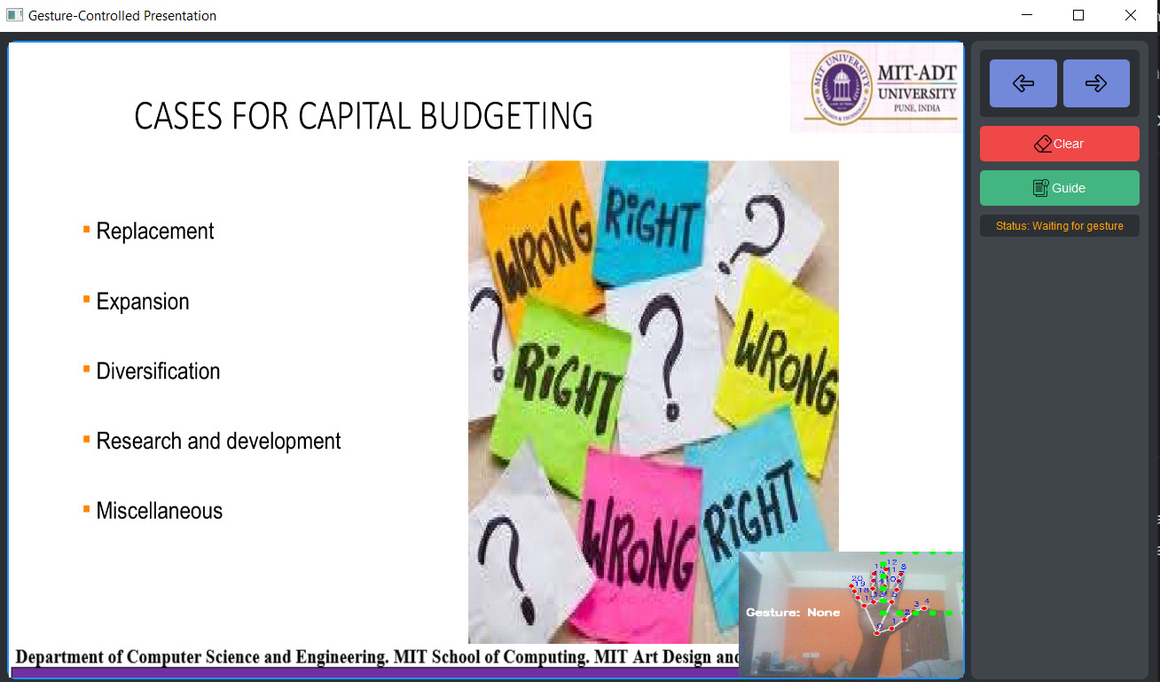
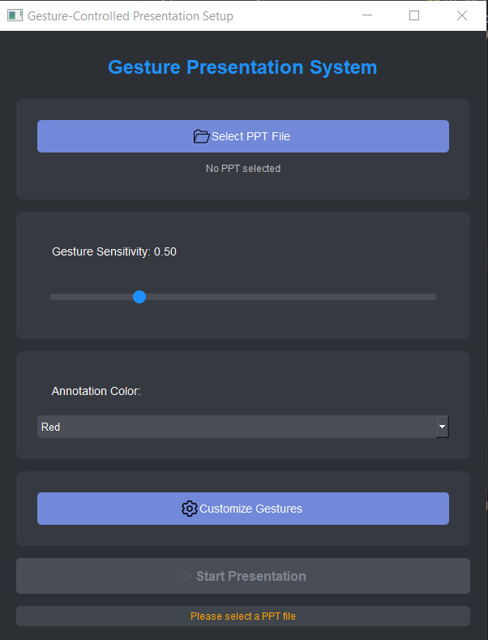
7. RESULT
Department of Computer Science & Engineering, MITSoE, Loni Kalbhor

Slide 10
8. Conclusion and Future Work
Conclusion:
The Hand Gesture Presentation System offers a smart and interactive way to control presentations using natural hand movements. By eliminating the need for physical input devices, it enhances the speaker's freedom and improves audience engagement. Using tools like OpenCV, MediaPipe, and PyAutoGUI, the system effectively detects and interprets gestures in real-time. This technology provides a hygienic, accessible, and modern solution for various environments such as classrooms, conferences, and public presentations.
Future Work:
Gesture Customization: Allow users to define and train their own custom gestures for different commands.
Voice Integration: Combine hand gestures with voice recognition for hybrid, multimodal control.
Robustness Improvement: Improve detection accuracy under different lighting conditions and backgrounds.
Multi-User Support: Extend functionality to detect and differentiate gestures from multiple users in collaborative settings.
Cross-Platform Compatibility: Adapt the system to work on mobile platforms, web apps, or AR/VR environments.
Department of Computer Science & Engineering, MITSoE, Loni Kalbhor

Slide 11
References
Sharma, R., Verma, A., & Mehta, P. (2020). AI-powered contactless interface for smart classrooms. International Journal of Smart Education Systems, 5(2), 45–52.
Patel, H., Joshi, N., & Bhandari, A. (2022). Real-time hand gesture recognition for touchless presentation control using MediaPipe. Proceedings of the 3rd International Conference on Intelligent Computing and Control Systems (ICICCS), 321–327.
Reddy, S., Nair, K., & Sharma, R. (2023). Gesture recognition-based smart presentation system using YOLO and OpenCV. Journal of Artificial Intelligence and Computer Vision, 11(1), 88–96.
Department of Computer Science & Engineering, MITSoE, Loni Kalbhor

Slide 12
Thank You
Department of Computer Science & Engineering, MITSoE, Loni Kalbhor

Slide 13
Questions
Department of Computer Science & Engineering, MITSoE, Loni Kalbhor

