Slide 1


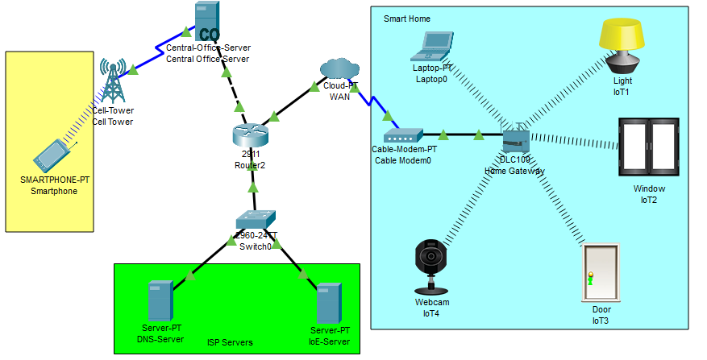










An exploratory study of the security for IoT devices
Payam Ismaili, BSc Hons in IT Management,
Department of Computer Science, Cork Institute of Technology
Introduction
The smart home is the fastest-growing field of IoT technology and it provides innovative, intelligent, ubiquitous and interactive services to users using different operations. Due to internet-connected, dynamic and heterogeneous nature, the smart home creates new security issues and challenges. we investigate security attacks in smart homes and evaluate their impact on the overall system security by using an online survey to audit the level of security of a network based on IoT devices.
IoT-based Smart home Layers, Protocols & Vulnerabilities on Each Layer
Vulnerabilities:
Reply Attack
Weak Password
Man in middle attacks
Encryption Attacks:
Sniffing Attack
Phishing Attack
Virus, Worms, Spyware
Vulnerabilities :
Physical damage
Node Tampering
Malicious Code Injection Attack
Vulnerabilities:
Dos Attack
RFID Spoofing
Routing information attack
Vulnerabilities :
Sniffing Attack
Phishing Attack
Virus, Worms, Spyware
Online Survey:
The smart home simulation in packet tracer:
To evaluate the security level of IoT based smart home by conducting an online survey which consists of several security questions that determine the level of security in a smart home environment.
Some example questions:
What type of encryption used on Wi-Fi?
Have you changed the default setting on IoT devices?
Have you set a strong password on IoT network devices?
Technologies To be evaluated:
Tools Used:
Conclusions
Data confidentiality, integrity, and availability are three basic security concerns from the end-user point-of-view. To evaluate and audit the security level of IoT network-based smart home, we are conducting an online survey that consists of several security questions to determine the level of security in a smart home environment. while users answer the questions, the result will determine the level of security within their IoT network which can help us to come up with a solution to secure their smart home.
References
Acknowledgments
B. Ali and A. Awad, “Cyber and physical security vulnerability assessment for iot-based smart homes,” Sensors, vol. 18, no. 3, p. 817, 2018.
H. Lin and N. Bergmann, “Iot privacy and security challenges for smart home environments,” Information, vol. 7, no. 3, p. 44, 2016Etc.
M. Domb, “Smart home systems based on internet of things,” in IoT and Smart Home Automation. IntechOpen, 2019.
The authors would like to acknowledge the support of CIT Computer Science Department as well support from project supervisor Manuel Caballero in advising and providing data for the presented research.

