Slide 1

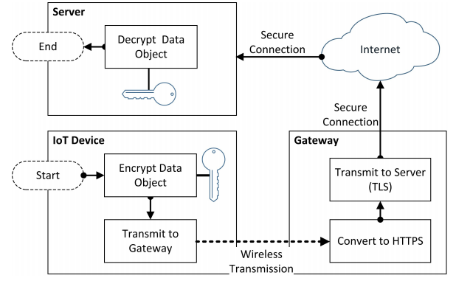








An exploratory study of the security for IoT devices
Payam Ismaili, BSc Hons in IT Management,
Department of Computer Science, Cork Institute of Technology
Introduction
The Internet of things is the trending direction when it comes to designing a smart living environment. A smart home system usually consists of various types of connected sensors, actuators, appliances, and a controller that builds a dynamic heterogeneous architecture with the aim of efficiently managing home devices and providing to users advanced services. Security issues are the biggest concerns with IoT based smart homes, including privacy risks as well as vulnerable and unreliable devices.
IoT-based Smart home Layers & Protocols
.
How It Works
Encryption Security Mechanism
The smart home system is divided into three main layers: application layer, network layer, and sensing layer. Starting from the sensing layer is responsible for data collection from all the home appliances and it sends data to the middle layer that is the network layer. The network layer uses the internet for sending data to the uppermost application layer which has different applications on a different level for different purposes.
Middleware Layers are consist of protocols to transfer data between main Layers securely.
Encryption is used to prevent the data from being tampered with and to maintain confidentiality as well as data integrity.
Technologies used
Vulnerabilities on Each Layers
Perception Layer:
Physical damage
Node Tampering
Side Channel Attack
Sleep deprivation attack
False Data Injection Attack
Malicious Code Injection Attack
Network Layer:
Dos Attack
Sybil attack
RFID Cloning
RFID Spoofing
Traffic Analysis attack
Routing information attack
Application Layer:
Sniffing Attack
Phishing Attack
Denial of Service Attack
Malicious Code Injection
Virus, Worms, Trojan horse, Spyware
Middleware Layers:
Reply Attacks
Wormhole Attacks
Jamming Techniques
Rogue access point
Man in middle attacks
Weak Password/open network
Conclusions
A home is a place where privacy is expected to be respected. there are three basic security concerns from the end-user point-of-view such as data confidentiality, data integrity, and data availability. Breaching any one of these three basic security areas may cause critical security problems to the smart home system.
References
Acknowledgments
B. Ali and A. Awad, “Cyber and physical security vulnerability assessment for iot-based smart homes,” Sensors, vol. 18, no. 3, p. 817, 2018.
H. Lin and N. Bergmann, “Iot privacy and security challenges for smart home environments,” Information, vol. 7, no. 3, p. 44, 2016Etc.
M. Domb, “Smart home systems based on internet of things,” in IoT and Smart Home Automation. IntechOpen, 2019.
The authors would like to acknowledge the support of CIT Computer Science Department as well support from project supervisor Manuel Caballero in advising and providing data for the presented research..

