Slide 1
CAPSTONE-CKME136
Chang School – Ryerson University, Toronto
Payam Karbasi, Big Data Analytics
June 2020

Slide 2
1. Introduction
A clickstream is a list of all the pages viewed by a visitor, presented in the order the pages were viewed, also defined as the 'succession of mouse clicks' that each visitor makes. The Recommender Systems (RS) are aimed to personalize users experiences and help them to discover relevant articles from large “news domains” and dynamic search space, using different Machine Learning models.
In this research, we review a sample file of a large dataset with users’ interactions logs (page views) from Globo.com news portal (the most popular news portal in Brazil) containing articles clicked per user session (cold-start, no authentication).

Slide 3
2. Problem, Solution
Problem:
We need to know what are the predictions on next clicked article after an “article” or a “pattern of clicked articles”. We need to know the article-ID and the probability of that predicted article being clicked.
Benefits to: News Website Owners (to efficiently/effectively advertise), On-line Store Providers (to increase the sales volume), …
Solution:
First we study the descriptive stats of our dataset to pick the targeted variables for studying the clickstreams. Then we review the most famous literatures and released articles to let us pick a feasible model to apply on.
Lastly, we need a solution to validate our model accuracy.

Slide 4
3. Literature Review
Gabriel de Souza Pereira Moreira, Felipe Ferreira, and Adilson Marques da Cunha at ACM, New York, NY, USA
Gabriel de Souza Pereira Moreira, Dietmar Jannach, and Adilson Marques da Cunha, Contextual Hybrid Session-Based News Recommendation With Recurrent Neural Networks, published at IEEE, revised Nov 21st, 2019
Sequence Analysis reviews:
Analysis of finding proper Package to review Sequence Analysis and Click Streams.
  TraMineR package: http://mephisto.unige.ch/pub/TraMineR/doc/TraMineR-Users-Guide.pdf
  PST: http://r-forge.r-project.org/projects/pst
  WeightedCluster: http://mephisto.unige.ch/weightedcluster/
  ClickStream: https://cran.r-project.org/web/packages/clickstream/clickstream.pdf
Almost most of them had restrictions on number of events/clicks! And the best fit package was the latest version on ClickStream updated Jan 30th, 2020.

Slide 5
4. Dataset
A sample .csv file is picked having 1883 user sessions, and 707 distinct clicked articles.
str(clicks)
'data.frame': 1883 obs. of 12 variables:
$ user_id : int 0 0 1 1 2 2 3 3 4 4 ...
$ session_id : chr "1506825423271737" "1506825423271737" "1506825426267738"
$ session_start : POSIXct, format: "2017-10-01 02:37:03" "2017-10-01 02:37:03"
$ session_size : int 2 2 2 2 2 2 2 2 2 2 ...
$ click_article_id : int 157541 68866 235840 96663 119592 30970 236065 236294
$ click_timestamp : POSIXct, format: "2017-10-01 03:00:28" "2017-10-01 03:00:58"
$ click_environment : int 4 4 4 4 4 4 4 4 4 4 ...
$ click_deviceGroup : int 3 3 1 1 1 1 3 3 1 1 ...
$ click_os : int 20 20 17 17 17 17 2 2 17 17 ...
$ click_country : int 1 1 1 1 1 1 1 1 1 1 ...
$ click_region : int 20 20 16 16 24 24 21 21 17 17 ...
$ click_referrer_type : int 2 2 2 2 2 2 1 1 1 1 ...

Slide 6
4. Dataset (Cont’d)
As none of the variables are truly numeric in nature, plotting correlations is meaningless..
summary(clicks)
user_id session_id session_start session_size click_article_id click_timestamp
Min. : 0.0 Length:1883 Min. :2017-10-01 02:37:03 Min. : 2.00 Min. : 2137 Min. :2017-10-01 03:00:00
1st Qu.:181.5 Class :character 1st Qu.:2017-10-01 03:02:05 1st Qu.: 2.00 1st Qu.:108854 1st Qu.:2017-10-01 03:11:57
Median :353.0 Mode :character Median :2017-10-01 03:13:32 Median : 3.00 Median :157541 Median :2017-10-01 03:22:43
Mean :355.9 Mean :2017-10-01 03:12:36 Mean : 3.46 Mean :176718 Mean :2017-10-01 03:47:21
3rd Qu.:537.0 3rd Qu.:2017-10-01 03:24:56 3rd Qu.: 4.00 3rd Qu.:236698 3rd Qu.:2017-10-01 03:35:13
Max. :706.0 Max. :2017-10-01 03:36:19 Max. :24.00 Max. :363291 Max. :2017-10-03 02:35:54
click_environment click_deviceGroup click_os click_country click_region click_referrer_type
Min. :1.000 Min. :1.000 Min. : 2.00 Min. : 1.000 Min. : 1.00 Min. :1.000
1st Qu.:4.000 1st Qu.:1.000 1st Qu.: 2.00 1st Qu.: 1.000 1st Qu.:13.00 1st Qu.:1.000
Median :4.000 Median :3.000 Median :17.00 Median : 1.000 Median :21.00 Median :1.000
Mean :3.917 Mean :2.306 Mean :12.11 Mean : 1.492 Mean :18.77 Mean :1.764
3rd Qu.:4.000 3rd Qu.:3.000 3rd Qu.:19.00 3rd Qu.: 1.000 3rd Qu.:25.00 3rd Qu.:2.000
Max. :4.000 Max. :4.000 Max. :20.00 Max. :11.000 Max. :28.00 Max. :7.000

Slide 7
4. Dataset (Cont’d)
Top 6 session_ids: session_id frequency ------------------------------------ 1506828869280418 24 1506826382352801 16 1506826927304920 10 1506827223286992 9 1506827346241020 9 1506826599396839 8
Top 6 clicked articles: click_article_id frequency ------------------------------------------- 119592 202 96663 153 108854 126 284847 126 235840 106 145166 83

Slide 8
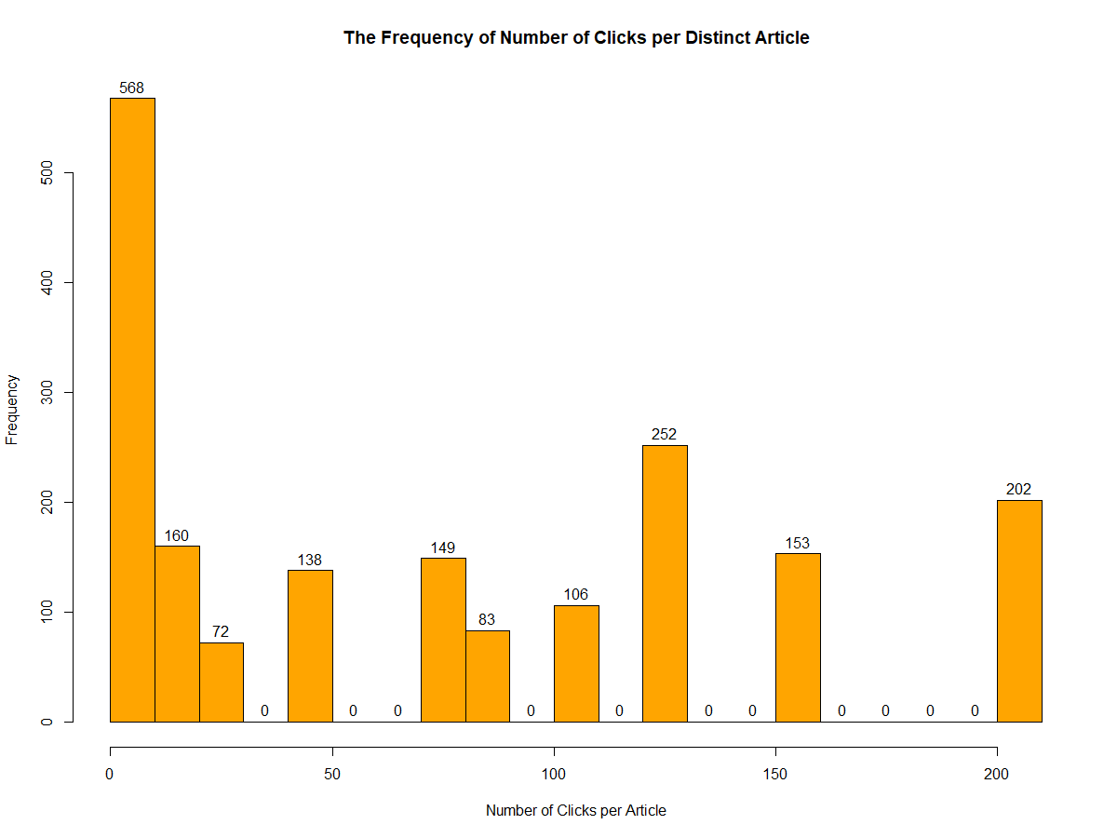
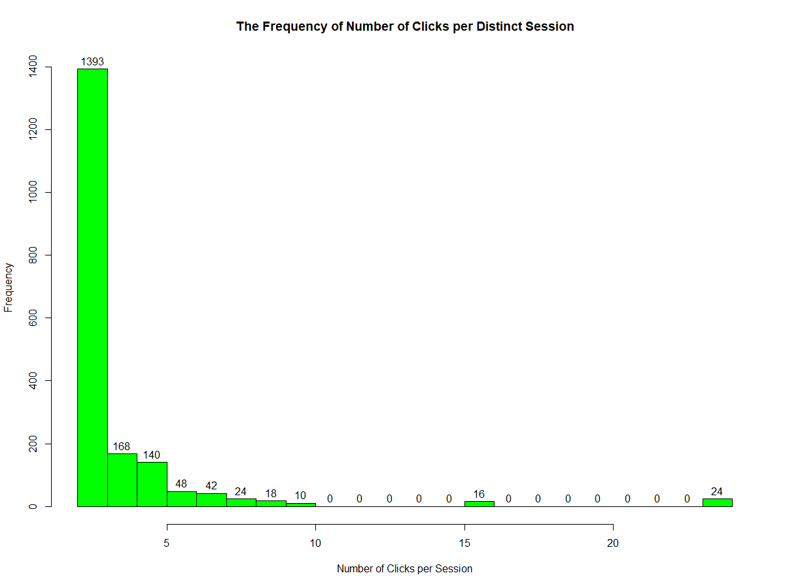
4. Dataset (Cont’d)

Slide 9
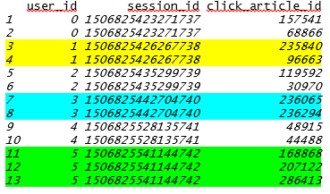

5. EDA (Exploratory Data Analysis)
The main variables to review are user_id, session_id and click_article_id which are extracted as a new subset, then it is reshaped as below:
Each Clickstream changes to a comma-separated String, represented: UserID, Click_Article_IDs happened in a session
Also those sessions having just one click are also removed to get the data ready for ClickStream package with Level-1 clicks (at least 2 articles are clicked).

Slide 10
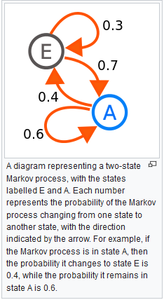
6. Markov Chain
A Markov chain is a stochastic model describing a sequence of possible events in which the probability of each event depends only on the state attained in the previous event.
Thus we use n-order Markov Chains to model clickstreams.
A 1-Level Markov Chain is used in this diagram, showing next click probabilities.

Slide 11
7. Clustering (Unsupervised)
    On Clickstreams
Clicked (Article) Frequencies
Clicked (Article) Transitions
K-Means
To Determine “K” level: Silhouette
K-Means
(w/ orders)
Sequential Patterns
K-Prototypes
K-Medoids
K-Medians
PAM & …
K!
arulesSequences:
Not reasonable results, here!
K-Modes:
Good for mixed Categorical and Numeric variables,
No good results!

Slide 12
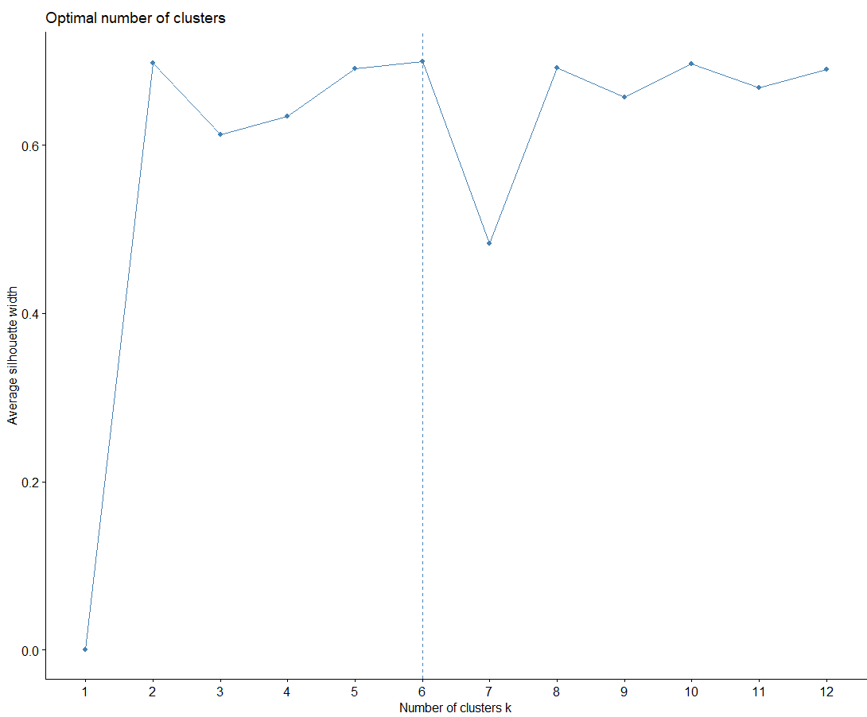
7. Clustering (Cont’d)
All algorithms and methods were tried and finally:
Silhouette determined K=6
Based on transitions matrix of “order-1 clicks” with k-means algorithm, the clusterClickstreams() function is exhausted
Figure 1: K=6 is determined as the best K-level in k-means on clicked articles clustered by Frequency of clicks.

Slide 13
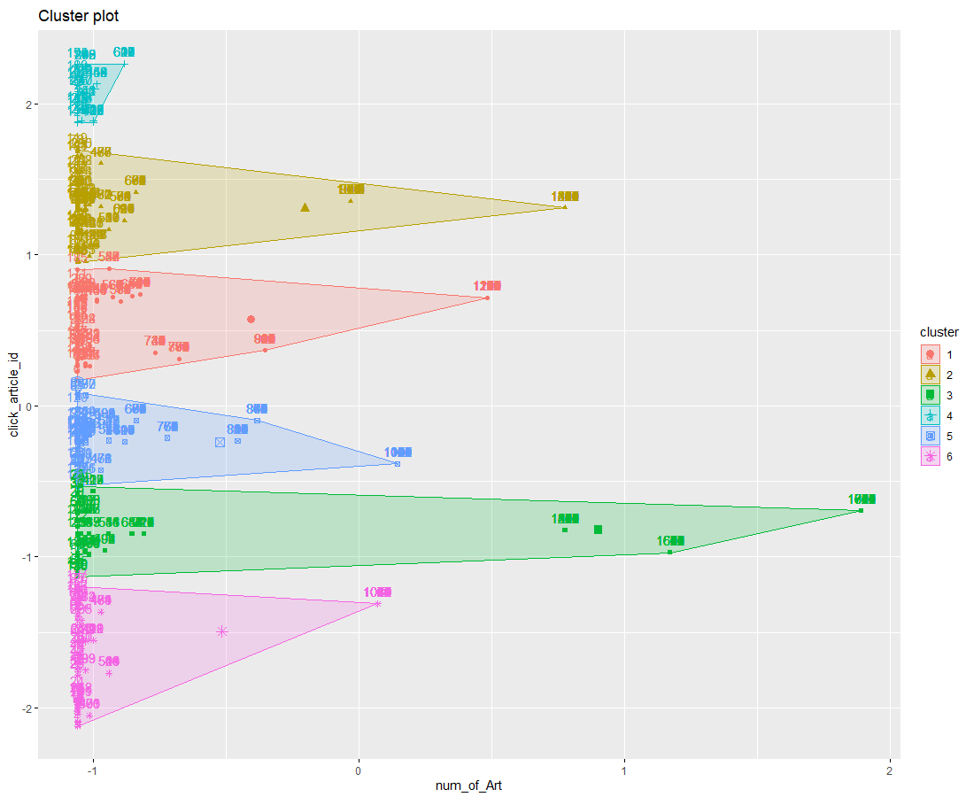
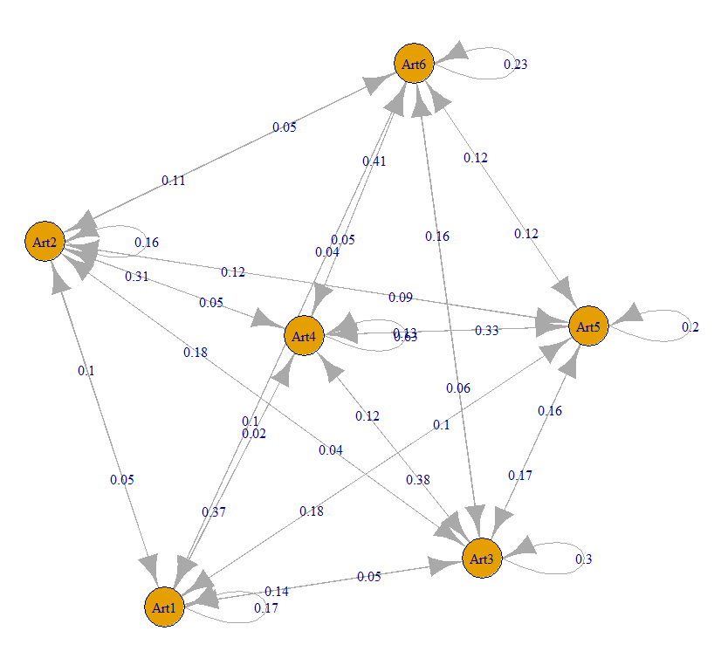
7. Clustering (Cont’d)
Figure 2: Clicked Articles clustered in six groups, based on Frequency of clicks.
Figure 3: Dataset is clustered in six, based on final picked algorithm, including transition matrix and k-means.

Slide 14
8. Prediction
After clustering clickstreams, we can predict the probability of next clicking article having a certain starting article_ID or a specific pattern of few clicks.
The function “prediction(pattern)” section #5 in coding performs the prediction

Slide 15
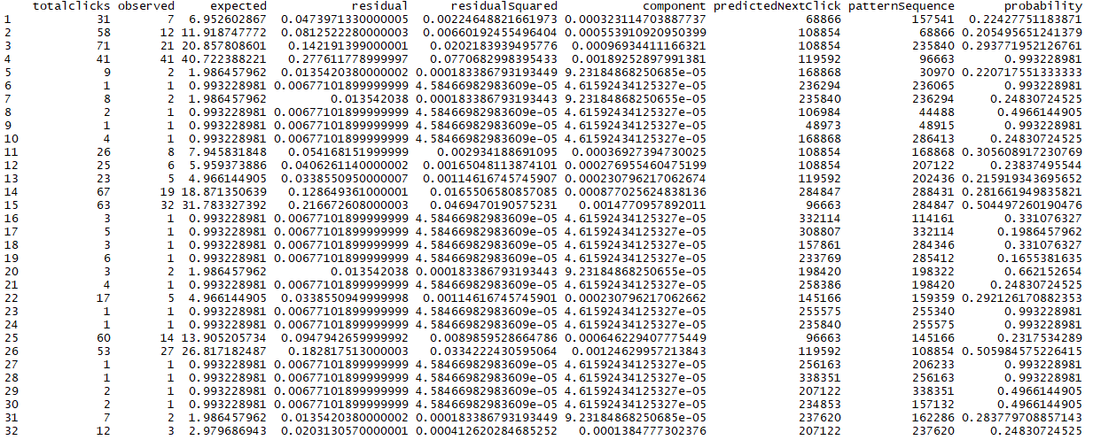
8. Prediction (Cont’d)
1st click
predicted Probability
2nd click
Predictions are made based on first-click probabilities.
Here is a sample of 1-order Probabilities on a Training set:

Slide 16
9. Model Validation
As we don’t have any particular variable to PREDICT on to use Random Forest, K-NN, or as the variables are not parametric, we cannot use Multi Linear Regression techniques.
Therefore first, it has been validated on ground-truth data, using small samples to make sure if the Clickstream package performs accurately.
Next, to evaluate our Model for the Next Click Probabilities’ Accuracy, we tried splitting our Clickstream Data using a N-Fold Cross Validation model, having the facility to choose number of folds per sample dataset. In this way, we can compare the results and see if the Model works fine.

Slide 17
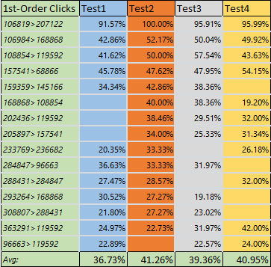
9. Model Validation (Cont’d)
We target an average probability of each next page click prediction in a first order Markov Chain (optimalProbMean) such as 20% in this sample dataset having iteration of 10x times each.
We consider N=4 as another assumption in this validation.

Slide 18
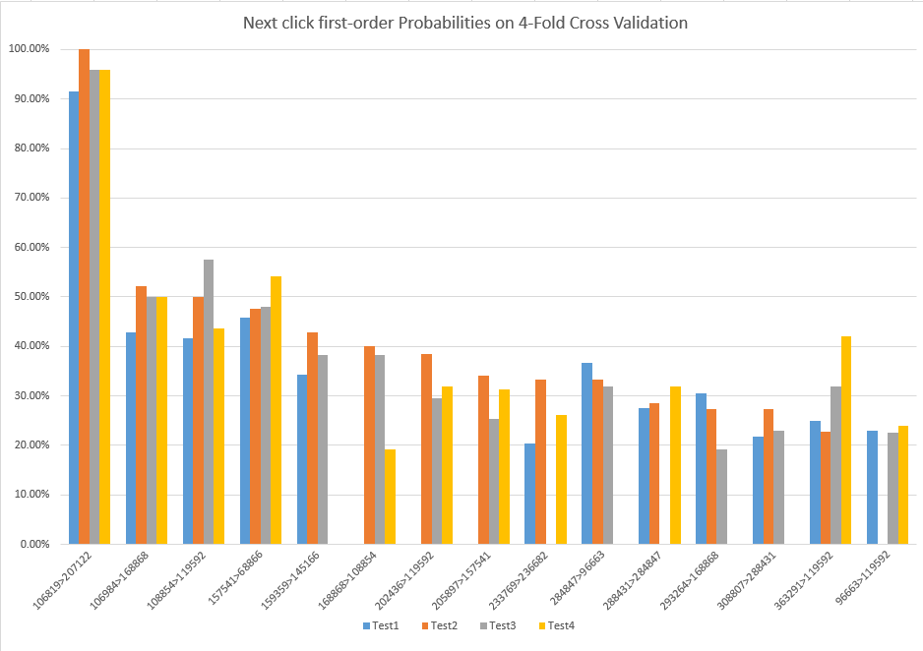
9. Model Validation (Cont’d)
Figure 4: Probability of first-order clicks through a 4-Fold Cross Validation by Clickstream package for comparing 4 different Tests’ results.

Slide 19
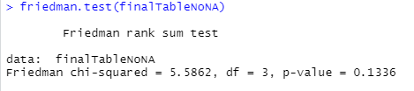
9. Model Validation (Cont’d)
Paired (N-Fold Validation Results): Friedman Test
  The results of N-Fold Cross Validation data (10x iteration Training/Test sets) is:
    Paired, if the sessions are considered time-independent, as folds are similar.
    less than 100 records (Non-parametric)
    Not a normal data at all
    Over two groups (variables to be tested on, here 4)
  Thus we use Friedman Test (instead of ANOVA two-way):
  H0: The Medians of “Probabilities of 1st-order clicks” on different folds are identical
  H1: The Medians of “Probabilities of 1st-order clicks” on different folds are not equal
As p-value (0.1336) is greater than 0.05, therefore, we cannot reject the H0 assumption of “Having all N-Fold Tests’ results identical” and our Model is approved.

Slide 20
9. Model Validation (Cont’d)
Not-Paired (N-Fold Validation Results): Kruskal Wallis Test
  The results of N-Fold Cross Validation data (Training/Test sets) is:
    Not Paired, if the session time-stamps are so wide and clicks are time-dependant, then each Fold might address different parts of dataset, time-oriented and so data is not .
    less than 100 records (Non-parametric)
    Not a normal data at all
    Over two groups (variables to be tested on, here 4)
  Thus we use Kruskal Wallis Test (instead of ANOVA one-way):
  H0: The Medians of “Probabilities of 1st-order clicks” on different folds are identical
  H1: The Medians of “Probabilities of 1st-order clicks” on different folds are not equal
kruskal.test(finalTable[1:4])
Kruskal-Wallis rank sum test
data: finalTable[1:4]
Kruskal-Wallis chi-squared = 0.59839, df = 3, p-value = 0.8968
As p-value is greater than 0.05, therefore, we cannot reject the H0 assumption of “Having all 4 Tests’ results identical” and our Model is approved.

Slide 21
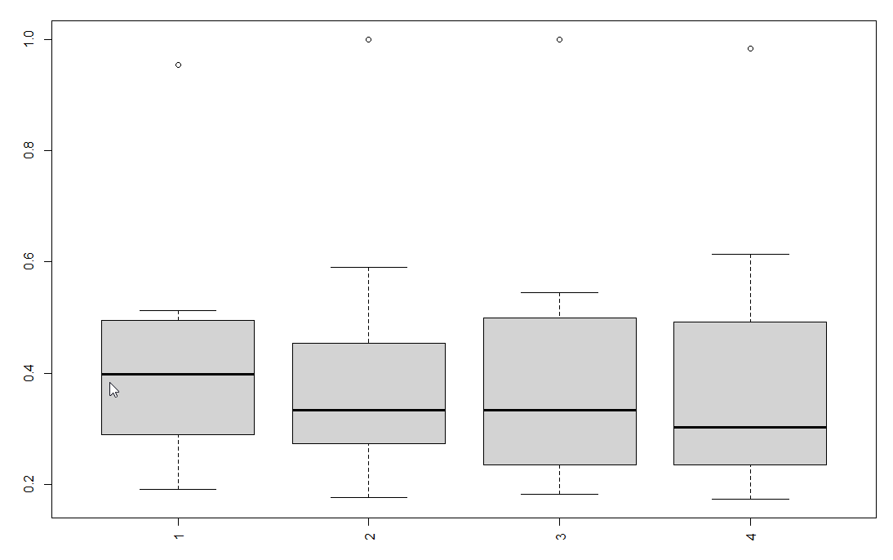
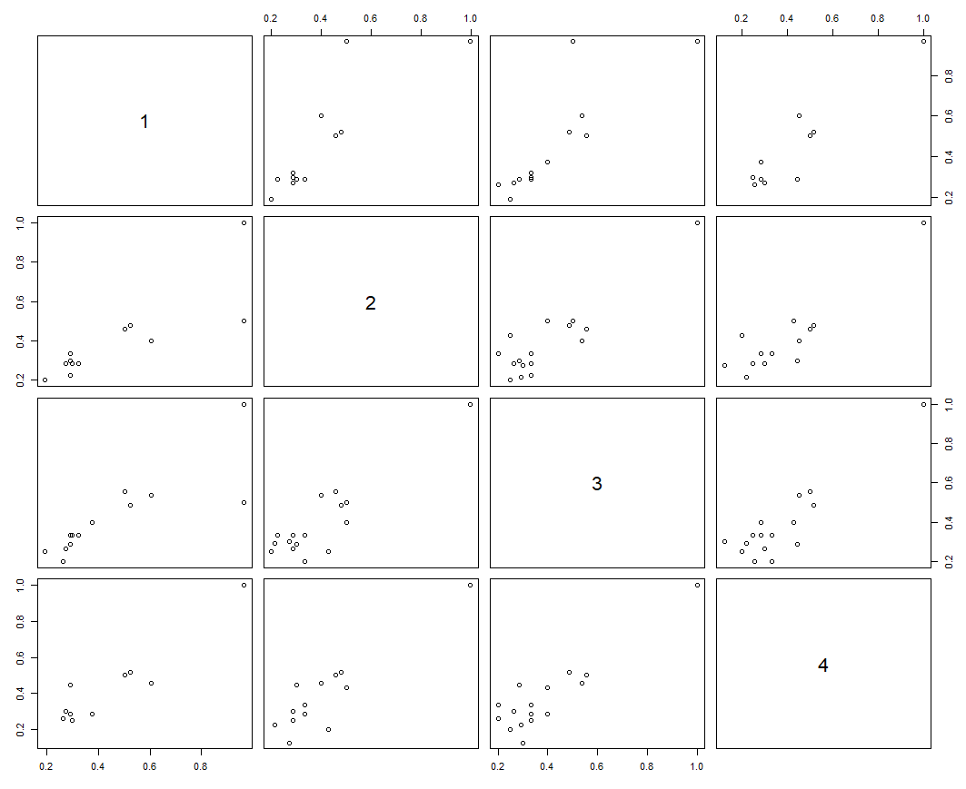
9. Model Validation (Cont’d)
Figure 5: The boxplot of Probability distribution of first-order clicks in 4 different Tests through a 4-Fold Cross Validation method performed by Clickstream package for comparing 4 different Tests’ results.
Figure 6: The Plot of Correlations on Probability distribution of first-order clicks in 4 different Tests through a 4-Fold Cross Validation method performed by Clickstream package for comparing 4 different Tests’ results.

Slide 22
10. Conclusion & Discussions
We found “Clickstream Package” the best fit for reviewing this clickstream dataset. It simply calculates/predicts on:
  Next Article to be clicked after a certain Article/Patterns_of_Articles and its Probability
  The Probability of All First-Order Clicks based on a manual configured Optimal Probability Mean to be achieved.
In this survey we considered time-independency although cold-start news websites are time-dependent and it is intended to use time stamps as additional data in clustering clickstreams and predicting the next clicks of a user.
Also as we didn’t have any info available on topics of articles, we better to cluster articles based on topics or built-in keywords.

Slide 23
Appendix
My codes as a R-script is publically published here:
https://github.com/payamkarbasi/MyCapstone_RyersonUniv

