Slide 1
Machine learning
Sangerbayev maxat and markitanov denis

Slide 2
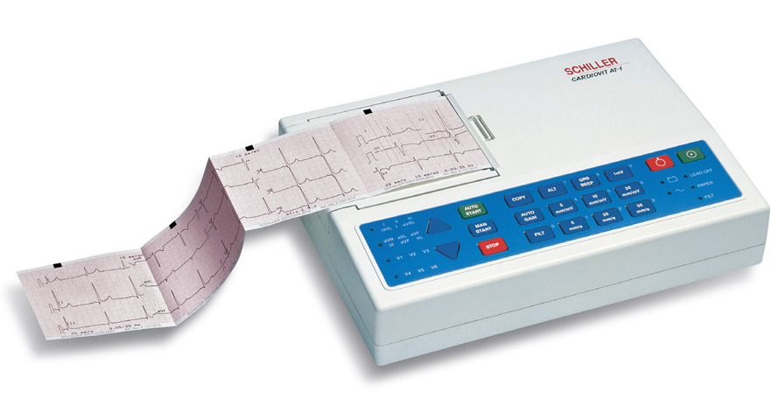
electrocardiograph
Costs ~150000tg

Slide 3

Abstract cardio reader
Give input
Processing
Diagnosis

Slide 4

Abstract cardiodiagram reader
Data
Goes to
Output

Slide 5
SHOULD YOU VISIT THE DOCTOR?
Yes
No
Yes for prophylaxis

Slide 6
What format?
Photo
Data
OCR

Slide 7
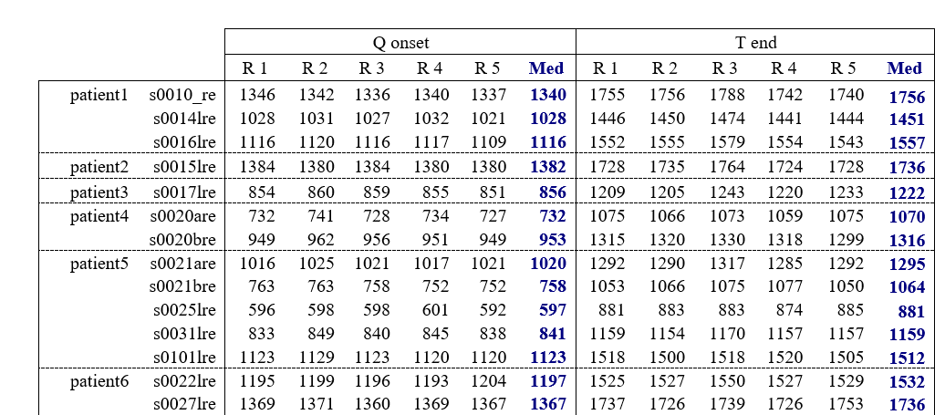
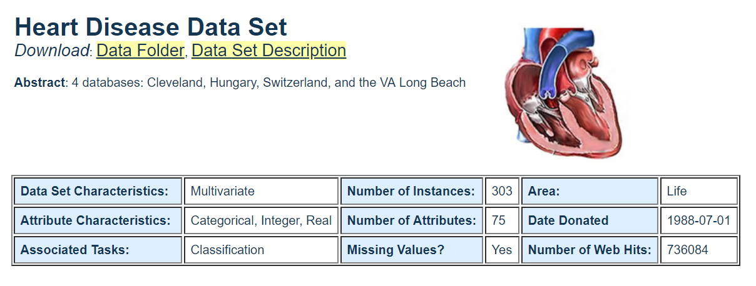
Data for education
Complex UCI
Time-based data

Slide 8
Conclusion
Cardiogram reader
Inputs: Data and Photo (if we manage to build an OCR)
Output: Answer on question – should you visit the doctor?

