Slide 1
VIGNAN’S INSTITUTE OF INFORMATION TECHNOLOGY
: PROJECT TITLE: NUMBER PLATE DETECTION
BATCH NO : C-15
DEPARTMENT : CSE
SECTION : CSE-C
TEAM MEMBERS : D.JHANSI (17L31A05P7)
B.PALINA HARITHA KUMARI (17L31A05N7)
M.PAVAN DEEPAK (17L31A05J9)
A.TARUNJAY (17L31A05M3)
GUIDE : MR.E.STEPHEN NEAL

Slide 2
INTRODUCTION
With the growth of the urbanization, industrialization and population, there has been a tremendous growth in the traffic.
Today red light violation is one of the most common and serious problem .which results in the collision of millions of vehicles at the traffic light signals every year.
Number Plate Recognition (NPR) is an image technology used to identify plates for their vehicles. This technology is gaining popularity in security and traffic facilities.

Slide 3
ABSTRACT
The traffic police work is to manually take down the details or to take the photos of the vehicles and identify the number plates. One of the most violated traffic rules is jumping the signal .
The basic idea of our project is to take the photos of vehicles that jump the signal using the camera fixed at the signal .

Slide 4
EXISTING SYSTEM
A traffic police captures the pictures of number plates /Registration number of the violating vehicle using a mobile pre-installed with traffic department’s software.
The individual has to control the traffic and take the pictures of violating vehicles simultaneously which leads to lack of efficiency in both.
He can concentrate & capture only some vehicles but not all.
The pictures may not be clear enough to identify the number/person.
The individual himself may met with an accident while doing his duties.
Vehicles moving Swiftly may not be captured.
To avoid all the above and to increase the efficiency we propose to automate the traffic control system.

Slide 5
PROPOSED SYSTEM
To solve this alarming problem and prevent such consequences, traffic violation detection systems are needed .
A user friendly graphical interface is associated with the system to make it simple for the user to operate the system, monitor traffic and take action against the violations of traffic rules.
The goal of the project is to automate the traffic signal violation detection system, especially signal jumping and make it easy for the traffic police department to monitor the traffic and take action against the violated vehicle owner in a fast and efficient way.

Slide 6
REQUIREMENTS
SOFTWARE REQUIREMENTS :-
Requires latest Version of python or above > 3.0 (python version 3.0) .
Requires OpenCv2 Package installed in the python.
Requires Numpy package installed in the python and open cv.
HARDWARE REQUIREMENTS :-
Requires good amount of ram

Slide 7
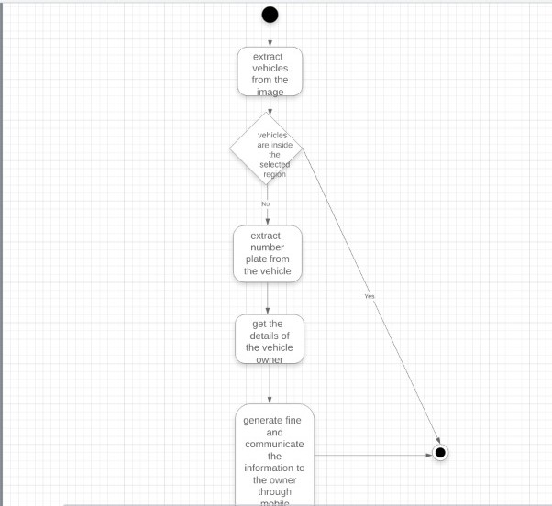
ACTIVITY DIAGRAM

Slide 8
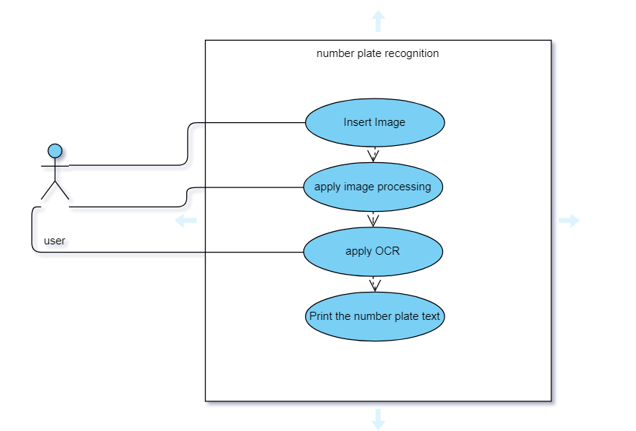
Use Case Diagram

Slide 9
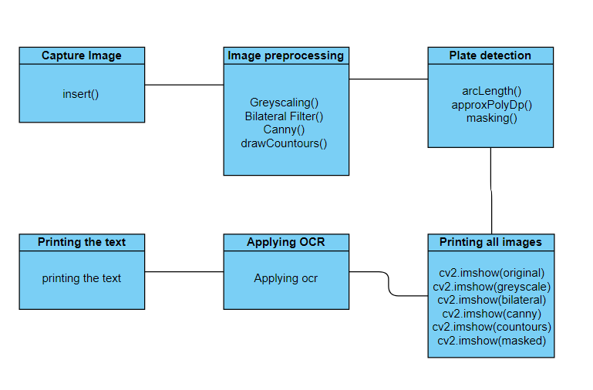
Class Diagram

Slide 10
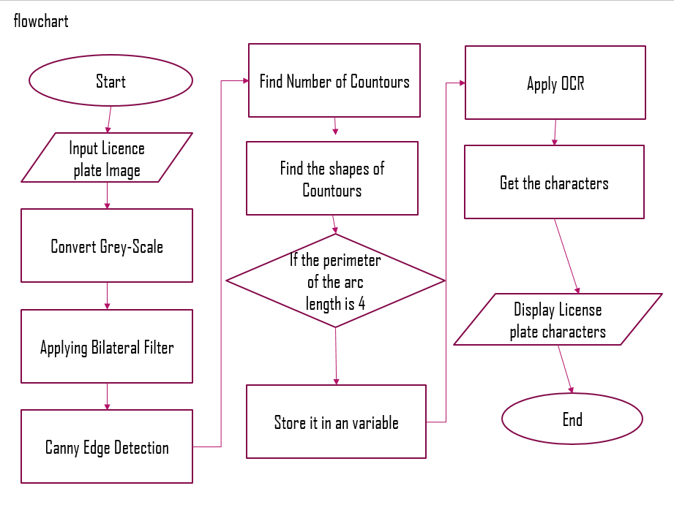
FLOWCHART

Slide 11
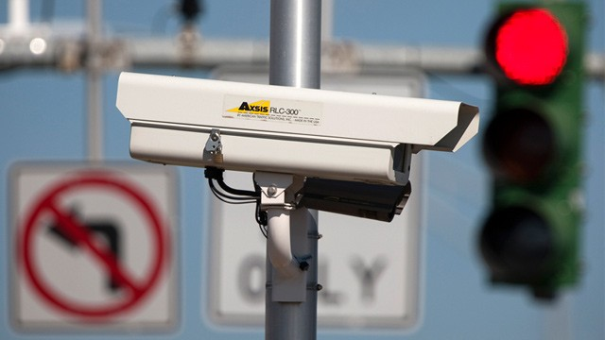
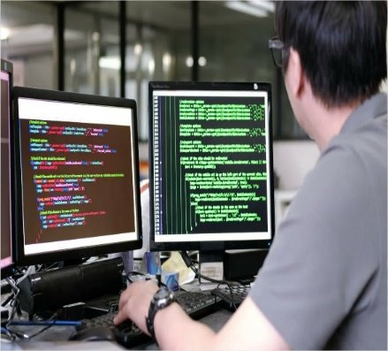

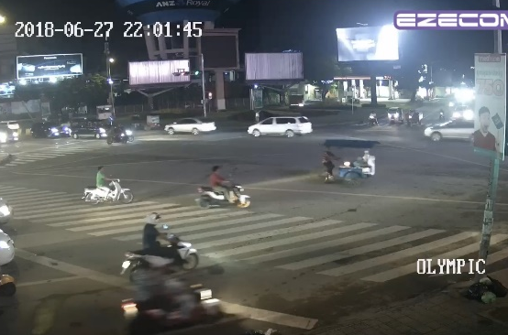



Graphical Abstraction
Camera monitoring
Sending data to app
Traffic rule violation
Database operators
Wireless LAN
Databases

Slide 12
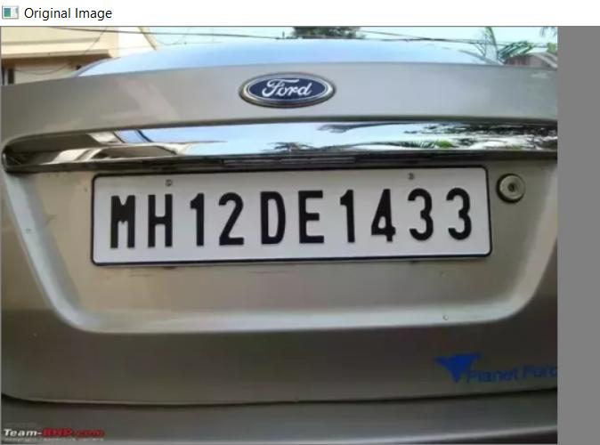
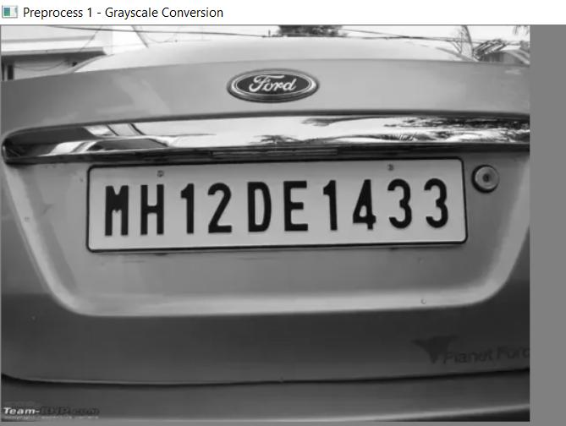
PROCESS
STEP1: STEP2:

Slide 13
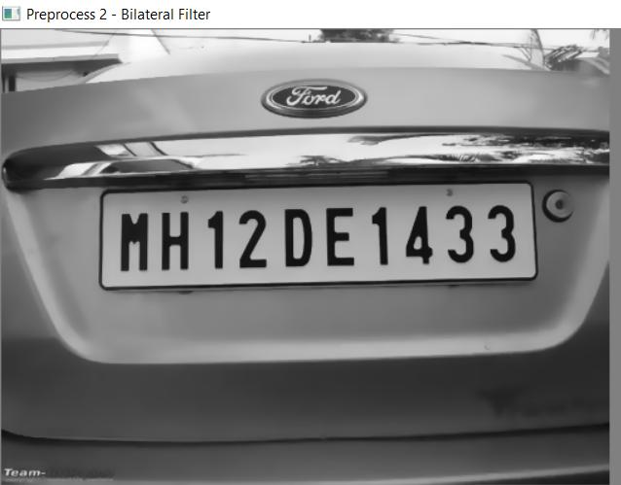
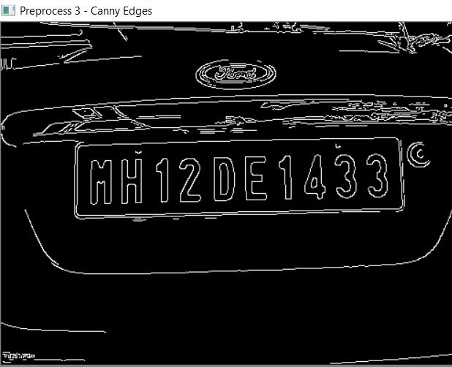
STEP3: STEP4:

Slide 14
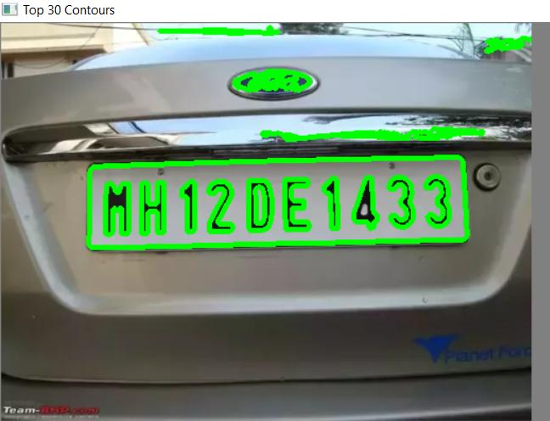
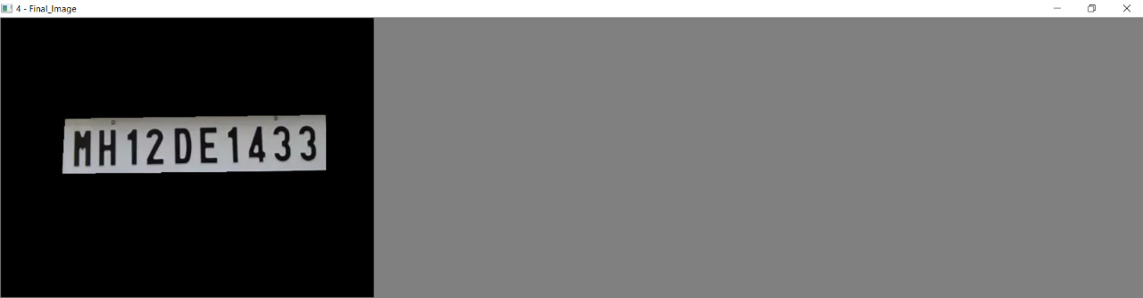
STEP5: STEP6:

Slide 15
STATUS OF WORK
S.NO | DESCRIPTION | % COMPLETED | % PENDING
1. | Requirement analysis phase | 100% | 0%
2. | Analysis phases | 100% | 0%
3. | Design phases | 90% | 10%
4. | Coding phases | 95% | 5%
5. | Testing phases | 95% | 5%
6. | Execution/Reports/Outputs | 90% | 10%
7. | Documentation | 95% | 5%

Slide 16
THANK YOU!
Any queries?

