Slide 1
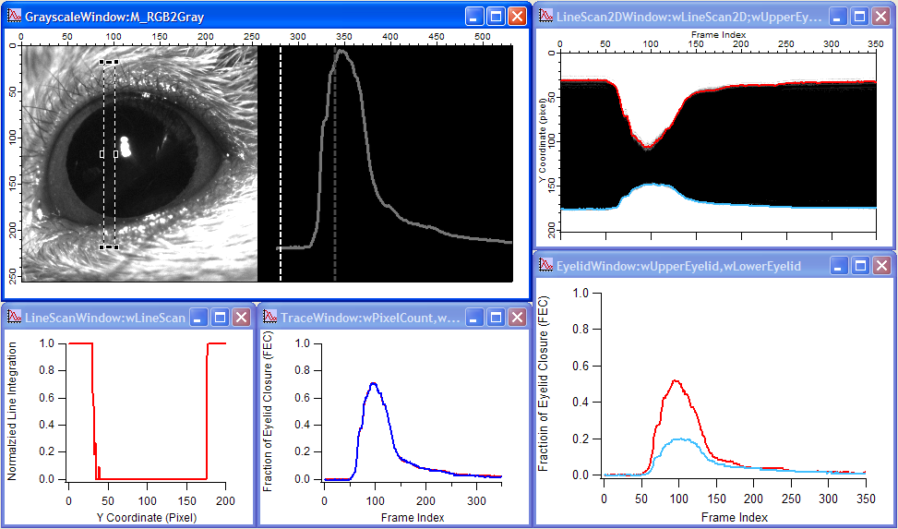
ROI
FEC of Upper Eyelid
FEC
(Dr. Medina)
FEC of Lower Eyelid
Upper Eyelid
Total Fraction of
Eyelid Closure (FEC)
FEC of Upper Eyelid
FEC of Lower Eyelid
Lower Eyelid

