Slide 1
StreamSense
Autonomous MNP Monitoring for the Gulf of Maine
Turning every boat into a floating research station

Slide 2
The Invisible Threat
Micro- and Nanoplastics in Gulf of Maine Waters
MNPs found in commercially harvested seafood: lobsters, mussels, oysters, clams
Detected in human cardiovascular tissue with increased heart attack risk
Gulf of Maine: warming faster than 99% of ocean, accelerating plastic breakdown
Current Data Gap
Sparse sampling: Manual collection and expensive automation limits coverage
Expensive research cruises: $50K/day with limited reach
We don't know enough about where MNPs concentrate or how they move

Slide 3
Public Health & Marine Ecology Impact
Human Health Risks
Marine Ecosystem Threats
Found in blood, lungs, placenta
Cardiovascular disease links
Inflammation & oxidative stress
Enter via seafood consumption
Ingested by zooplankton to whales
Bioaccumulates up food chain
Carries toxic chemicals
Alters organism behavior
Maine's $1.5B lobster industry and coastal communities rely on healthy waters—but we're monitoring MNPs blind

Slide 4
Introducing StreamSense
Autonomous tow-behind MNP sampler for lobster boats & recreational boats
Set & Forget
GPS-Aware
Dock & Drop
Clips to stern, tows behind vessel. No power, no monitoring. Collects samples automatically during normal fishing/sailing operations
Every sample selected and tagged with precise coordinates. Builds comprehensive spatial map of MNP distribution
Return to dock, drop device in collection bin. Instant payment. Zero processing burden on fishermen
Turn 500+ working boats into a distributed research network

Slide 5
How StreamSense Works
Device Features
User Journey
Torpedo-shaped, 18" × 6"
Passive intake, 3-stage filtration
GPS for site selection & tracking
6-month battery
Pick up free device at dock
Attach tow line to stern cleat
Fish or sail as normal
Return device to dock bin per counter display
Receive $25-40 payment
Unit Cost: $180 at scale
Lifespan: 50+ deployments

Slide 6
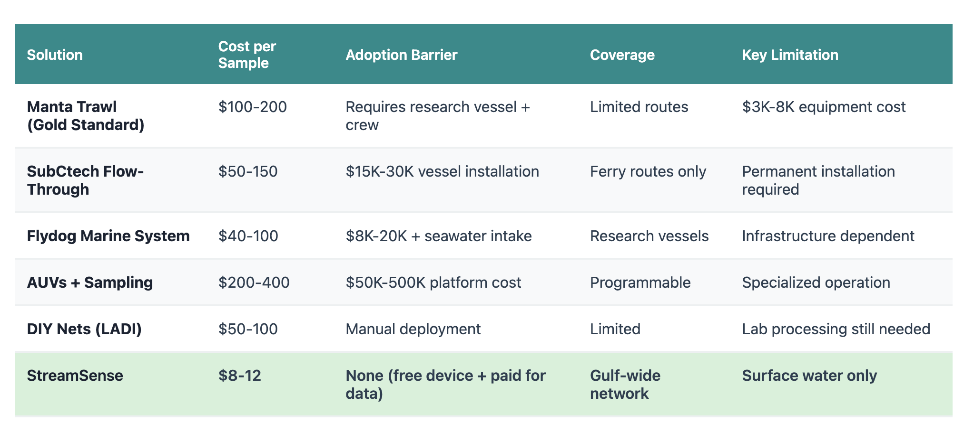
Competitive Landscape

Slide 7
Development Roadmap
Phase 1: Validation (Months 1-4)
Test with 10 volunteer lobstermen
Compare vs. manual net sampling (manta net)
Validate GPS, filters, durability
Phase 2: Economics (Months 3-6)
Optimize payment and dock logistics
Partner with MCFA, Maine Lobstermen's Association
Challenge the Process: Fishermen as co-designers inform device attachment, durability, and seasonal patterns

Slide 8
Impact & Business Model
Revenue Model
Environmental Impact
$3.2M
First comprehensive MNP map of Gulf of Maine
Identify pollution hotspots & sources
Inform policy on single-use / degrading plastics
Track remediation effectiveness
Raise public awareness via data visualization
Year 3 Annual Revenue Target
Research grants: NOAA, EPA, NSF ($2M)
State agencies: Data subscription ($400K)
Corporate sponsors: Seafood cos. ($300K)
Academic partnerships: UMaine, UNH ($500K)

Slide 9
3-Year Growth Strategy
Gulf of Maine Launch
Regional Expansion
National Network
200 devices deployed
50 lobstermen + 20 recreational boaters
15,000+ samples collected
Dock infrastructure: 5 major ports
Baseline MNP distribution map
800 devices active
Expand to Georges Bank, Cape Cod Bay
Add charter fishing boats
Partnership with sailing clubs
Real-time public data dashboard
2,500 devices nationwide
Chesapeake Bay, Puget Sound, Great Lakes
AI-powered MNP prediction models
Licensing model to other regions
Mobile app: 10K+ active users

Slide 10

Join the Movement
Transform the Gulf of Maine into the world's most comprehensively monitored marine ecosystem for microplastics
500+
100K+
$0
Partner Vessels
Annual Samples
Cost to Fishermen
Let's turn awareness into action—one sample at a time

