Slide 1
Kirana Khata Btech Project Presentation Prof. M. Balakrishnan
Payoj Jain Shantanu Dahiya
2011CS10241 2011CS10253

Slide 2
AIM of the Project
Smoothening the process of paying change either from shopkeeper side or customer side.
Using Mobile application (Smart Phones)
Work without net connectivity

Slide 3
Features
Easy interface with last 5 transaction on the screen
Facility for online debit or credit to both customer and shopkeeper
Bluetooth connectivity
Secured from shopkeeper, customer and any third party
One touch transaction on shopkeeper side
Shopkeeper can see the list of all the customers on one screen

Slide 4
Work Flow
Shows vicinity devices
Shows last 5 transactions + Option to ask money + send money
Bluetooth on
On start
Select one of
the devices
Bluetooth off
Yes
Transaction added
Ask to switch on bluetooth
Confirms
Tap on Ask
Money
Enter Amount
Ask Money
Notification to shopkeeper
Tap on send
Money
Enter Item (Optional) and Amount
Send Money

Slide 5
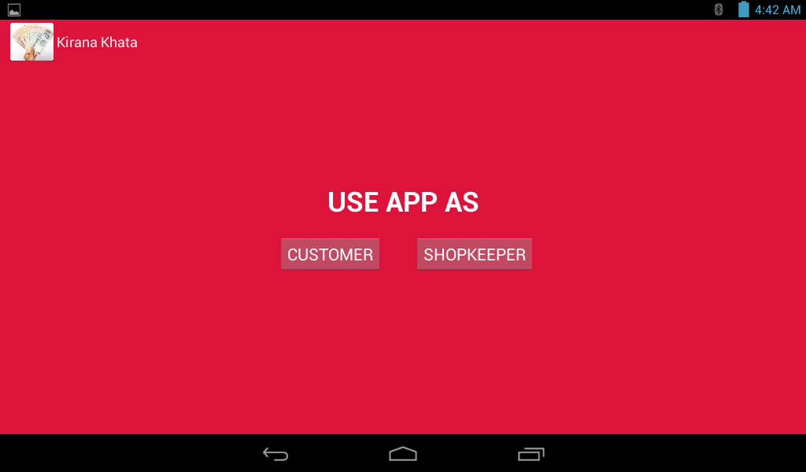
How does Kirana Khata Work?
On Start

Slide 6
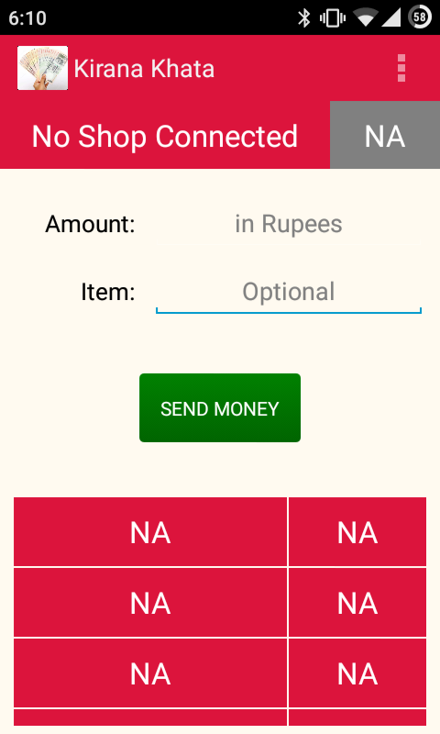
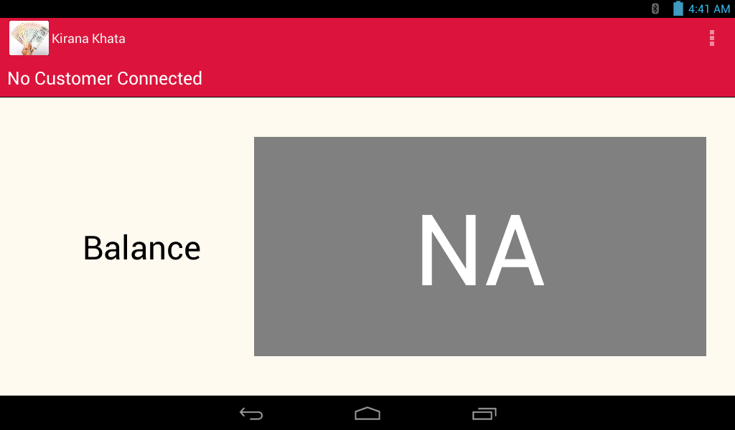
Shopkeeper’s Tablet
Customer’s Phone

Slide 7

Bluetooth Connection
Shopkeeper’s Tablet
Customer’s Phone

Slide 8
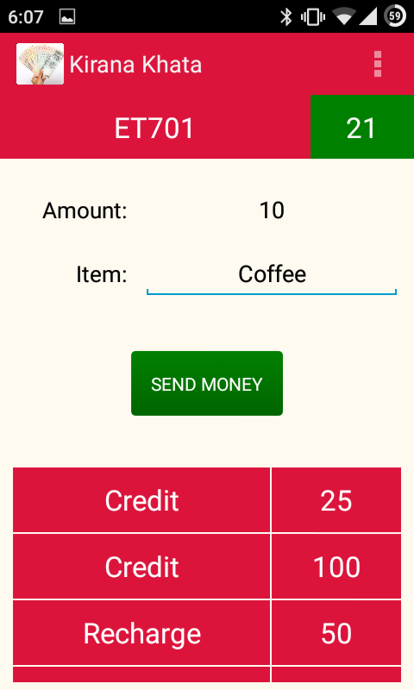
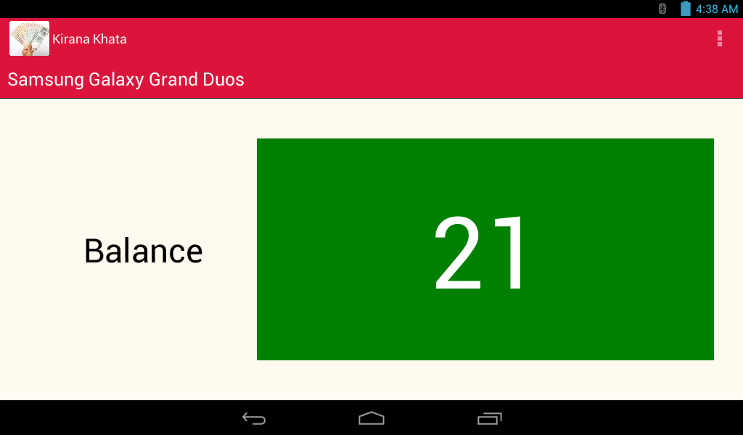
Connection Established
Shopkeeper’s Tablet
Customer’s Phone

Slide 9
Adding Transaction
Shopkeeper’s Tablet
Customer’s Phone

Slide 10
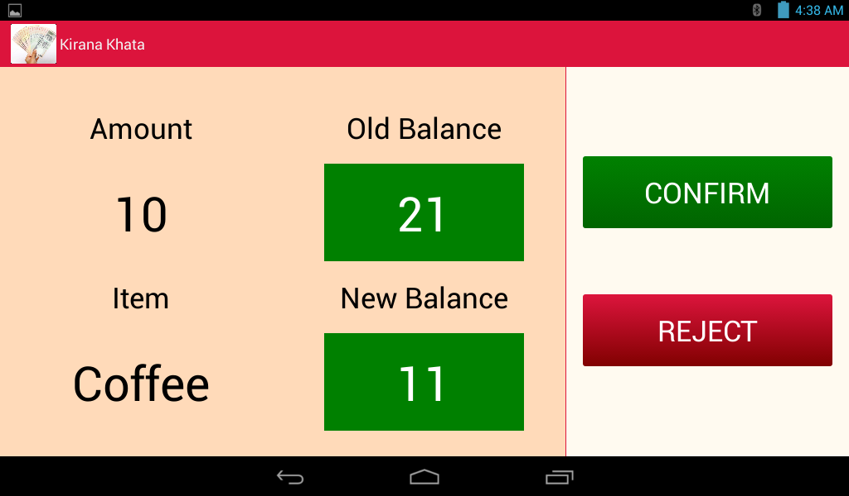
Verification
Shopkeeper’s Tablet
Customer’s Phone

Slide 11

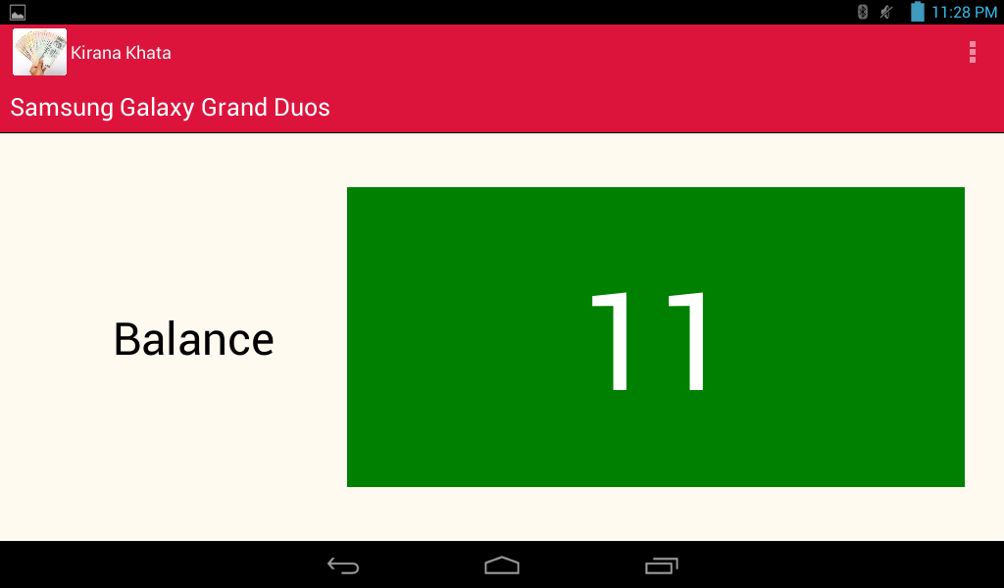
Adding the transaction in the list
Shopkeeper’s Tablet
Customer’s Phone

Slide 12
How we started
Defining the problem statement
Coming up with a solution which is cheap, easy to implement and can be easily accessed by the common people
Defining specifications for the application
Came up with the work flow of the application
Refining and optimising the steps involved in the transactions

Slide 13
How we started
Creating a basic app
Testing for bugs and connectivity issues alpha testing
Implemented the project in a general store for beta testing
Improved UI as suggested by the shopkeeper

Slide 14
Observations
Average time taken to do a normal money exchange (having change issues) is over 30 seconds
Average time taken for one transaction using Kirana Khata is less than 15 seconds (assuming the devices were already paired in the past)
Shopkeeper preferred the app over maintaining a separate register for running accounts
Simple interface of the app makes it easy for the shopkeeper to understand the system

Slide 15
Problems Faced
Bluetooth connection issue – Connection lost after 1 transaction
Database of shopkeeper’s side updates but not from customer’s side or vice versa
Connection from one side but not from the other

Slide 16
Advantages
Easy book keeping
No change problem

Slide 17
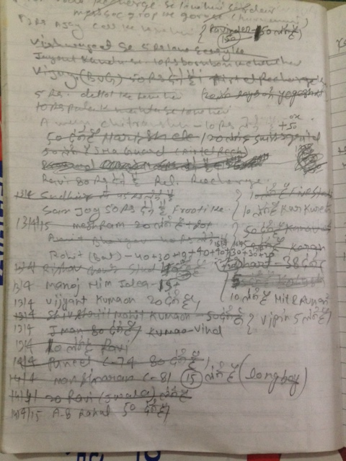
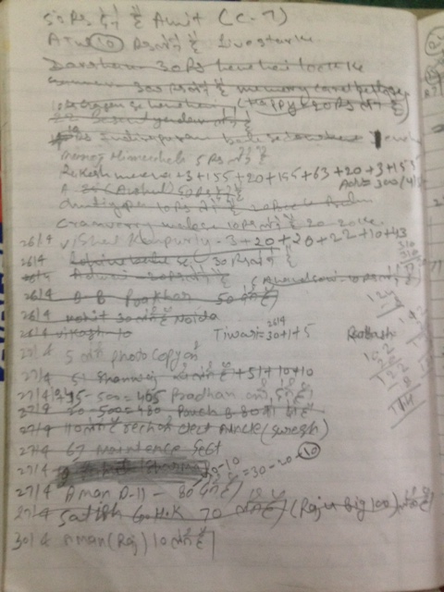
Before

Slide 18
After

Slide 19
Disadvantages
Shopkeeper needs to have a separate device for this system

Slide 20
Future Improvements
More work can be done to replace the change system in a locality or college campus
Password protected
Alternate methods other than bluetooth since bluetooth is not very reliable in connectivity

