Slide 1

Monetization
PayPal & Kaltura
Using PayPal's HTML5 Toolkit

Slide 2


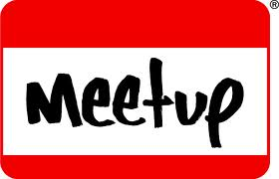


About Me

Slide 3

Notes:
Everyone wants something for free.
Why is this?
Some deep psychological drivers
We are both attracted and suspicious of Free
When a price is involved - cognative work is involved.
There is a world of difference between free and one penny. It’s an entirely other category
College students - Lindt Truffles $0.15 Hersey Kiss is $0.01 - over 70% chose truffle
Reduce each price by a penny and the Hersey Kiss is a Smash. Though the math hasn’t changed.

Slide 4
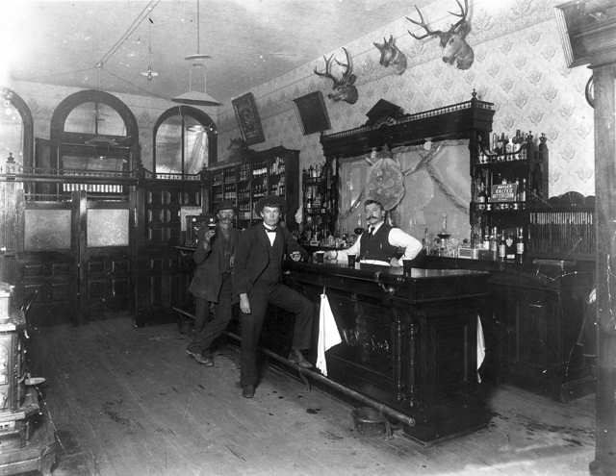
Atoms vs. Bits

Slide 5



Check please!

Slide 6
“Bits want to be free”
“If it’s digital sooner, or later
it’s going to be free”
“You can still make money off FREE”
- Chris Anderson
Notes:
Steward Brand - founded Whole Earth Catalog - part of the counterculture
On the one hand information wants to be expensive, because it's so valuable. The right information in the right place just changes your life. On the other hand, information wants to be free, because the cost of getting it out is getting lower and lower all the time. So you have these two fighting against each other.
You can’t stop free.
As the cost heads towards zero,free is a matter of when NOT if
Sooner or Later you’ll compete with free
First to free gets attention

Slide 7
Ways to leverage Free
Limited Time - Subscribe to keep access
Limited Features - Purchase all features
Free Sample - Subscription for access
Free Sample - Pay for what you use (meter)
Free Sample - Purchase the whole thing
Buy one get one Free
Free Content - Sell the Audience info
Free Content - Sell Advertising

Slide 8
When FREE works
Creativity
Technology

Slide 9

The Technology

Slide 10
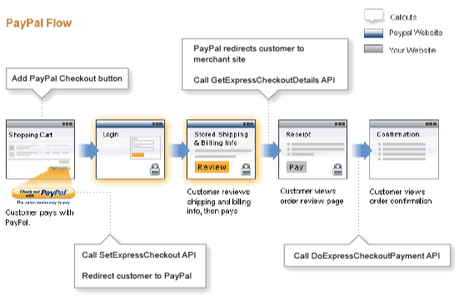
Express Checkout API

Slide 11
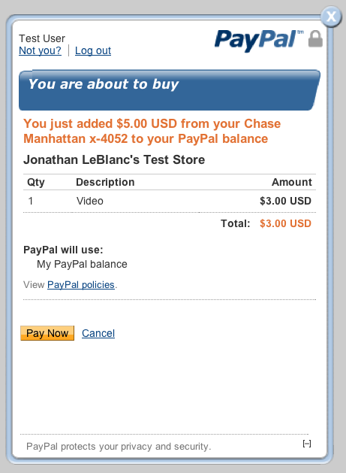
PayPal for Digital Goods

Slide 12

HTML5 Toolkit
Bill
Verify
localStorage
jQuery

Slide 13
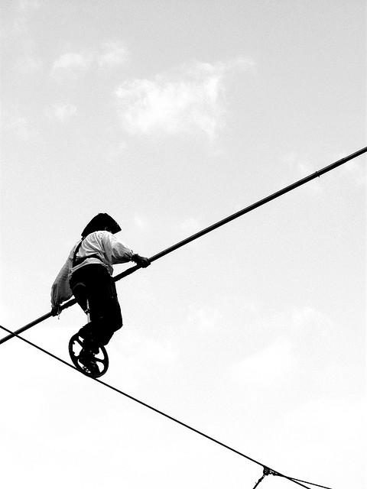
Demo

Slide 14
Getting Started
https://github.com/paypalx/html5-dg/

Slide 15
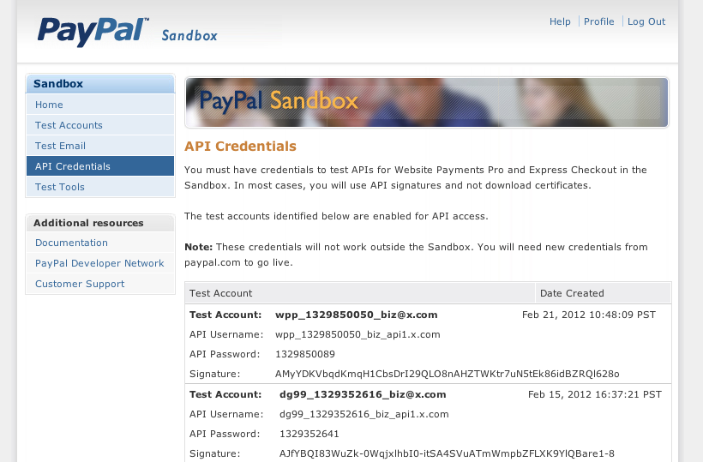
Developer Account

Slide 16
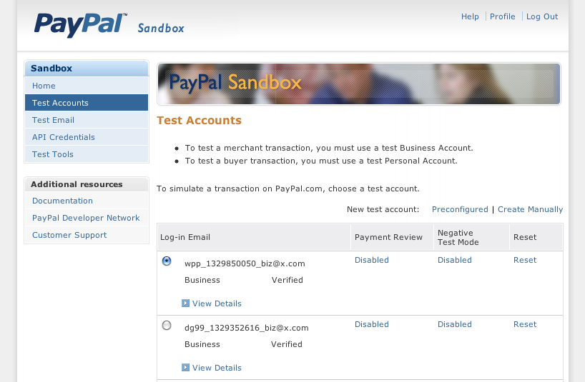
Test Account

Slide 17



Identity

Slide 18
Inventory

Slide 19
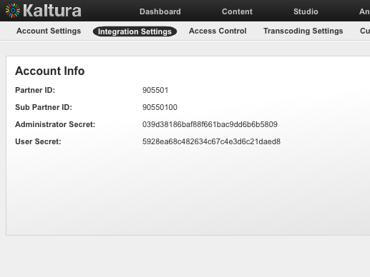
Get Your Creds

Slide 20
katura.php
function getSession($itemId,$userId){ define("PARTNER_ID", "905501"); define("USER_SECRET", "5928ea68XXXXXXXd8"); define("ENTRY_ID", $itemId); $user = $userId;
...
}
function getPlayList(){ define("PARTNER_ID", "905501"); define("ADMIN_SECRET", "039d3818XXXXX9dd6b6b5809");
...
}

Slide 21
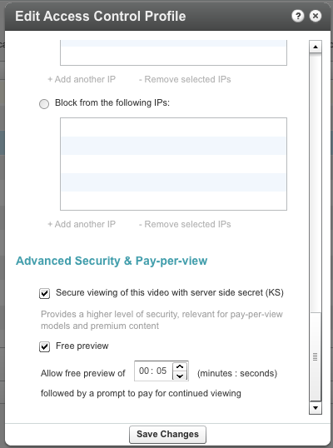
Setup Access Control

Slide 22
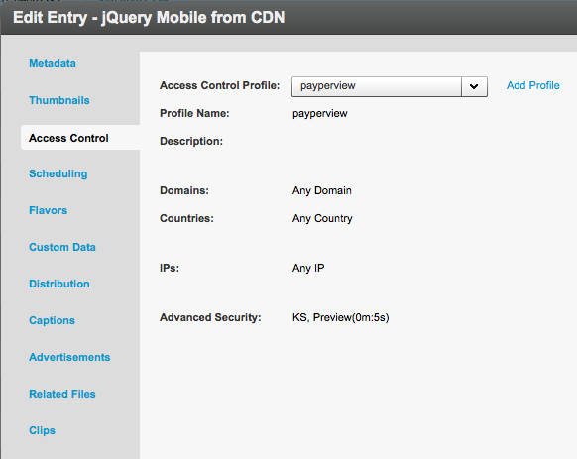
Set Access on videos

Slide 23
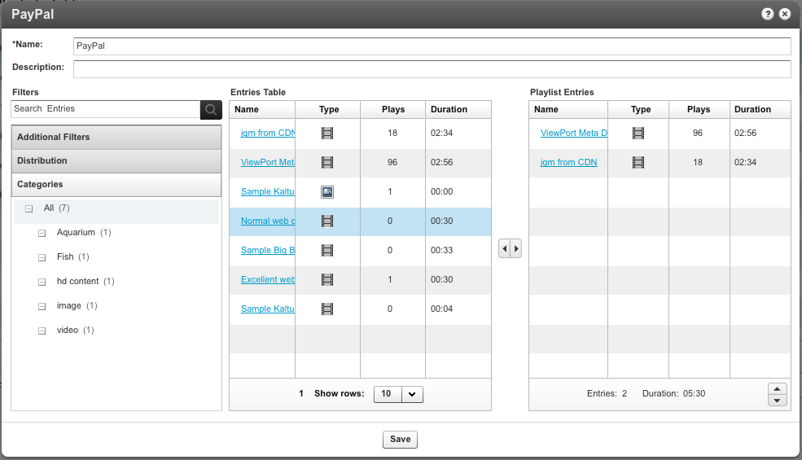
Create Playlist

Slide 24
getPlayList()
$kclient->setKs($ksession);$result = $kclient->playlist->get('YOUR_PLAYLIST_ID');

Slide 25
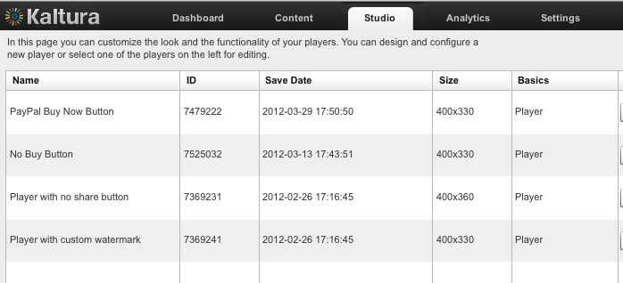
Create 2 Players

Slide 26
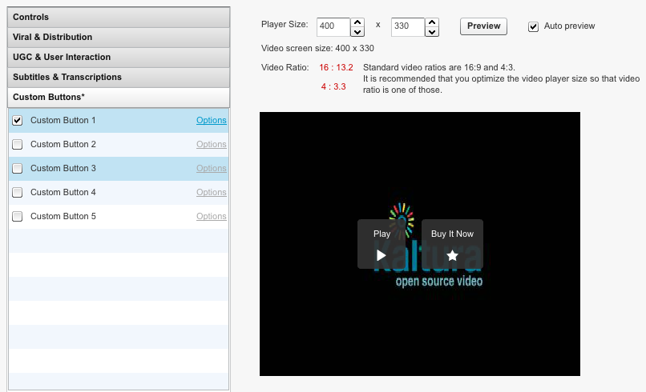
Custom Button

Slide 27
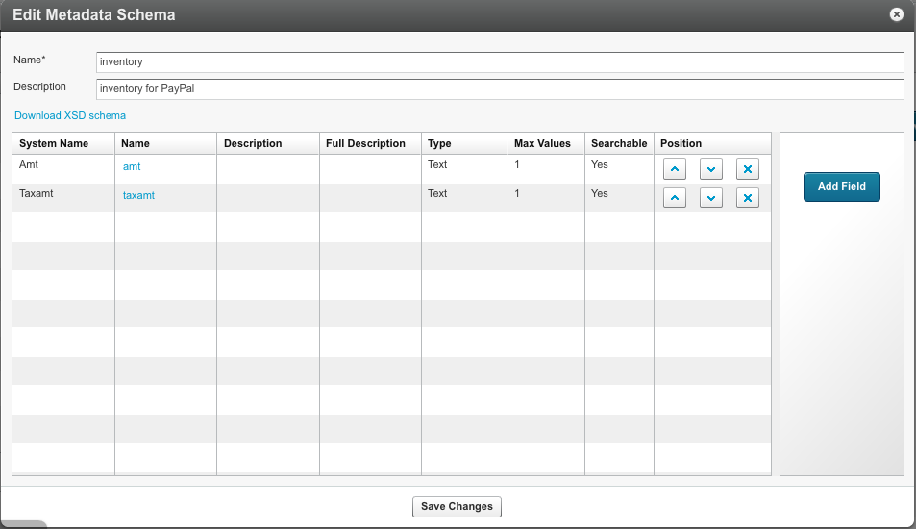
Add Custom Data

Slide 28
Get Custom data
$l = explode(",",$result->playlistContent);
foreach ($l as $key => $value) { $filter = new KalturaMetadataFilter(); $filter->objectIdEqual = $value; $metadata = $kclient->metadata->listAction
  ($filter)->objects; $id = $metadata[0]->objectId; if (isset($metadata[0]->xml)) { $xml = $metadata[0]->xml; $meta = new SimpleXMLElement($xml); $amt = (string) $meta->Amt; $taxamt = (string) $meta->Taxamt; }...
}

Slide 29
Bill

Slide 30
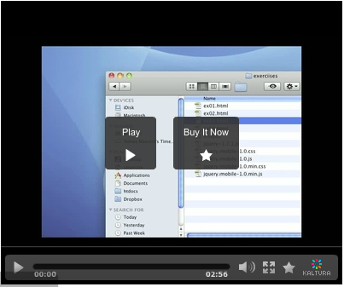
Custom Button

Slide 31
Custom Button JS
//KALTURA button INSIDE my video player "Buy Now"
function customFunc1(entryId){ bill(entryId);}

Slide 32
PayPal Bill JavaScript
pptransact.init('php',false);function bill(entryId){ pptransact.bill({ userId:'888888', itemId:entryId, itemQty:'1', successCallback: function(){ verify(entryId); }, failCallback: function(){ //bill cancelled } });}

Slide 33
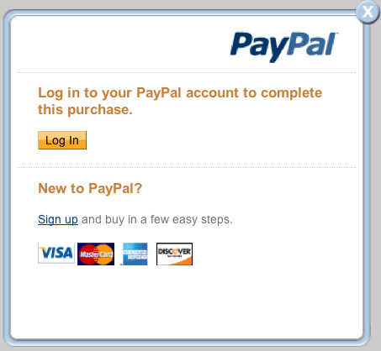
Login prompt

Slide 34
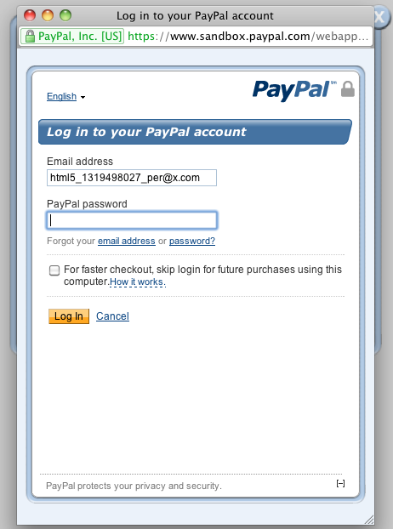
Login Popup

Slide 35
Verify

Slide 36
function verify(entryId)
successCallback: function(){
loadVideo(pptransact.getVerifyData().ks
  ,'NO_BUY_BUTTON_ID'
  ,pptransact.getVerifyData().itemId);
},
failCallback: function(){
var flashVars = "";
loadVideo(flashVars,'BUY_BUTTON_ID',entryId); }

Slide 37
getSession
$ks = getSession($itemId,$userId);
$returnObj = array(
success => true, error => "", transactionId => $response["TRANSACTIONID"], orderTime => $response["ORDERTIME"], paymentStatus => $response["PAYMENTSTATUS"], itemId => $itemId, userId => $userId, ks => $ks
);

Slide 38
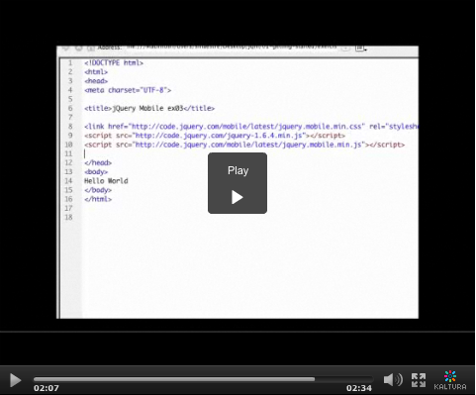
Video Unlocked

Slide 39
Fork Me
https://github.com/paypalx/html5-dg/

Slide 40
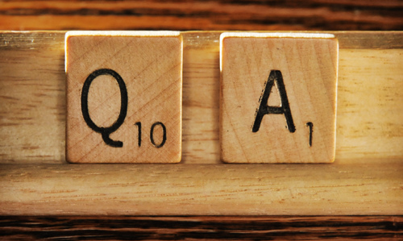
sidney@x.com
@SidneyAllen

