Slide 1
PayPal Mobile Express Checkout & Sencha Touch
March, 31 2011

Slide 2
What we’ll cover
Overview of Mobile Express Checkout
Adding PayPal to Sencha Touch
Client/Server workflow
Modify server-side code
Working with the PayPal Sandbox

Slide 3
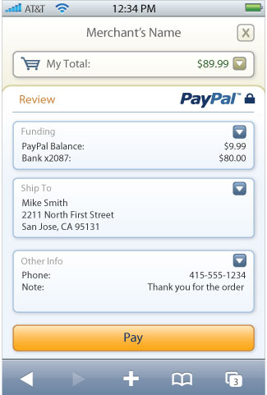
Mobile Express Checkout
Mobile Express Checkout used by top merchants (Nike.com, Buy.com, Footlocker.com)
Optimized UI for webkit browsers
Supports iPhone and Android 2.0 browsers
Uses the same APIs as the web version so any online integrations can be reused
More information at www.x.com/mobile

Slide 4
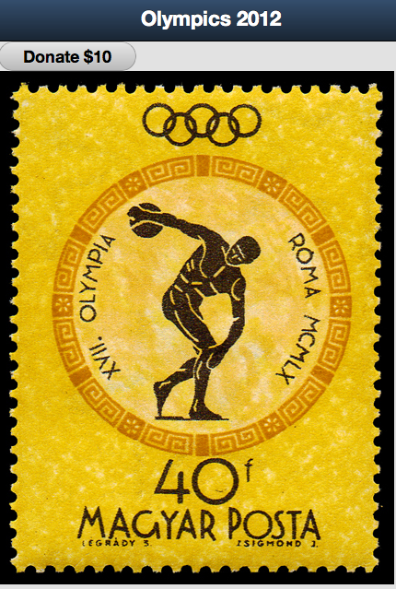
Olympics Donation App

Slide 5
Add Donate button in Sencha
var donateButton = new Ext.Button({
text:"Donate $10",
ui:"round",
handler: makeAjaxRequest,
width:150,
})

Slide 6
Add ajax request in Sencha
var makeAjaxRequest = function() {
Ext.getBody().mask('Loading...', 'x-mask-loading', true);
Ext.Ajax.request({
url: 'Order.cfm',
success: function(response, opts) {
// redirect to PayPal with Token
window.location.href = response.responseText;
}
});
};

Slide 7
How to use PayPal Sandbox
Signup
developer.paypal.com
Create Test Accounts
Seller, Buyer
Get API Credentials
API username
API password
Signature

Slide 8
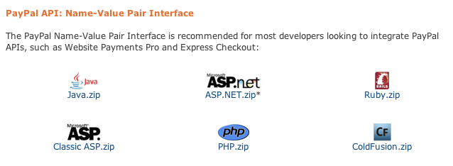
Get Express Checkout server-side code
x.com >> Under “DevTools” >> SDKs
Code available for
Java
ASP.NET
Ruby
ColdFusion
PHP
Classic ASP
https://www.x.com/community/ppx/sdks#NVP

Slide 9
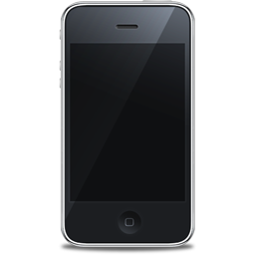

Client/Server Workflow
User
Your Server
PayPal Server
Order.cfm
www.paypal.com
Token returned
Redirected to PayPal Login

Slide 10
Order.cfm on Server
Add API Credentials
API username
API password
Signature
Set Method, PaymentAction, & Version
Change the redirect to just return the URL
Let’s review the code

Slide 11
Client/Server Workflow
User
Your Server
PayPal Server
Checkout.cfm
Token & PayerId
DoExpressCheckoutPayment
Redirected back to Sencha

Slide 12
Checkout.cfm on Server
Duplicate of Order.cfm with a few tweaks
Set Method, Token and PayerId
Set returnURLPath
Redirect back to your Sencha App
Let’s review the code

Slide 13
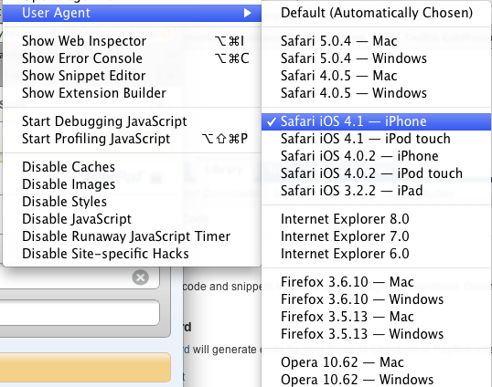
Don’t forget …
In Safari, you need to change the User Agent to iPhone.
Express Checkout will detect this and display the mobile friendly layout.

Slide 14

Android DevChallenge
Deadline to submit app is May 14th
Use PayPal to integrate secure payments into your Android app and you could win $25,000, or $15,000, or $10,000.
More Information at
https://www.x.com/community/ppx/devchallenge

