Slide 1
ADW — Architecture Reference
16 functional subsystems · as-is · dependency order
Each subsystem plotted against the pipeline and its interaction neighborhood. Ground truth: source code. Companion: rewrite/*.md specs + suggestions.txt.

Slide 2
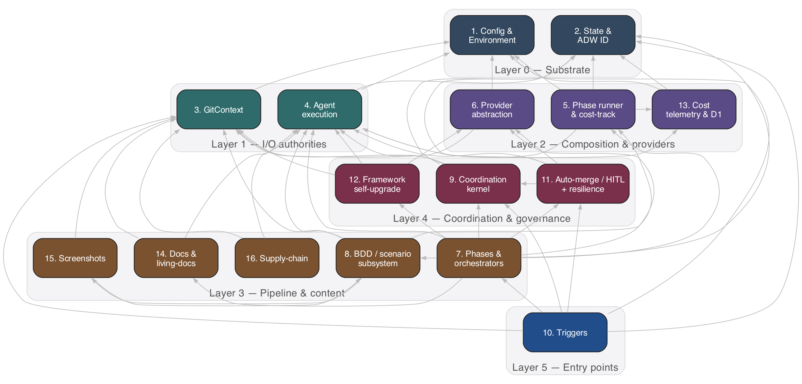
Master Architecture
All 16 subsystems, grouped into six dependency layers. Arrows: “calls / depends on”.
Read bottom-up: substrate (L0) → I/O authorities (L1) → composition (L2) → pipeline & content (L3) → coordination & governance (L4) → entry points (L5).

Slide 3
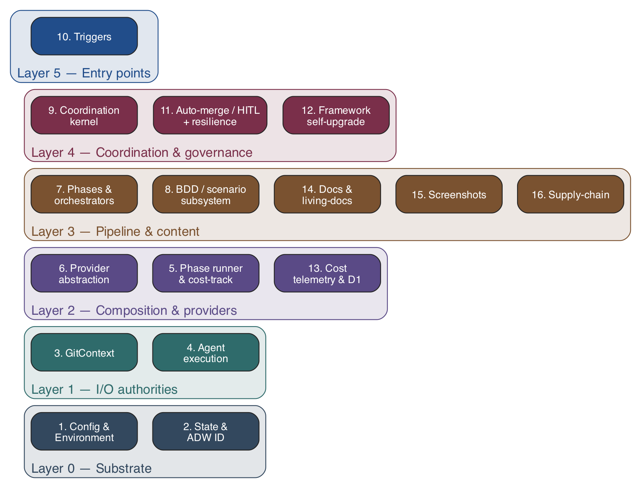
Dependency Layers — Build Order
The order to (re)implement: each layer depends only on the ones beneath it.
This ordering also indexes the rewrite/NN-*.md specs. Lower layers are model-agnostic substrate; the model coupling concentrates in 4 (Agent execution) and 13 (Cost).

Slide 4
Data Flow — One Issue's Life
A single GitHub issue traversing the pipeline, with cross-cutting subsystems feeding every step.
Linear happy path. Coordination (9), upgrade (12), and auto-merge (11) gate the flow; cross-cutting subsystems (rail) are invoked throughout.

Slide 5
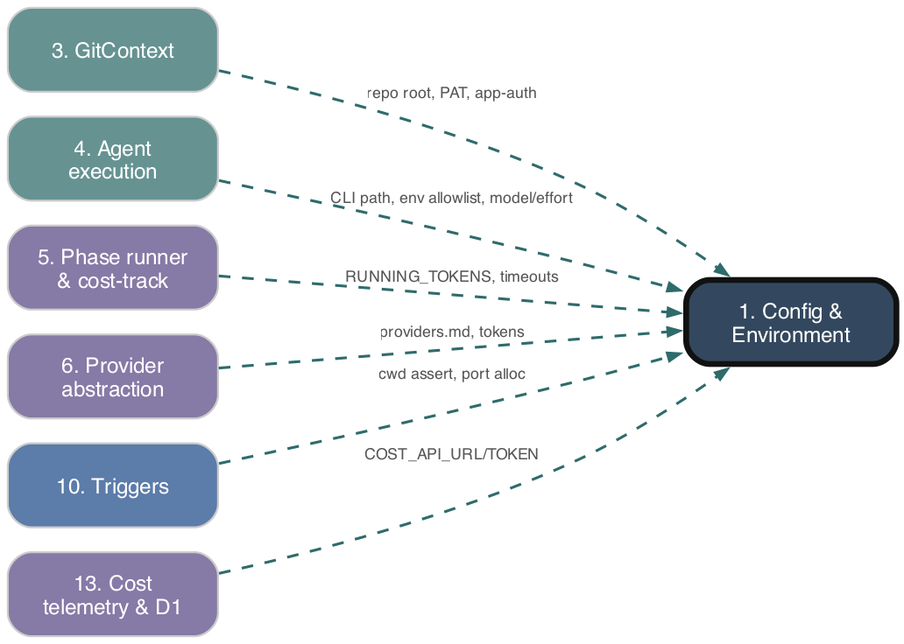
1. Config & Environment
Layer 0 — Substrate
WHAT IT DOES
Static-config substrate: env-var accessors & secrets, runtime tuning constants, per-command model/effort routing maps, and per-target-repo .adw/ markdown config parsed into a typed ProjectConfig. Performs no orchestration. The single source every other subsystem reads.
AS-IS NOTE
loadProjectConfig re-parses all .adw/ files on every call (no caching).
Solid red → this subsystem calls out · Dashed teal → called by · spec: rewrite/01-*.md

Slide 6
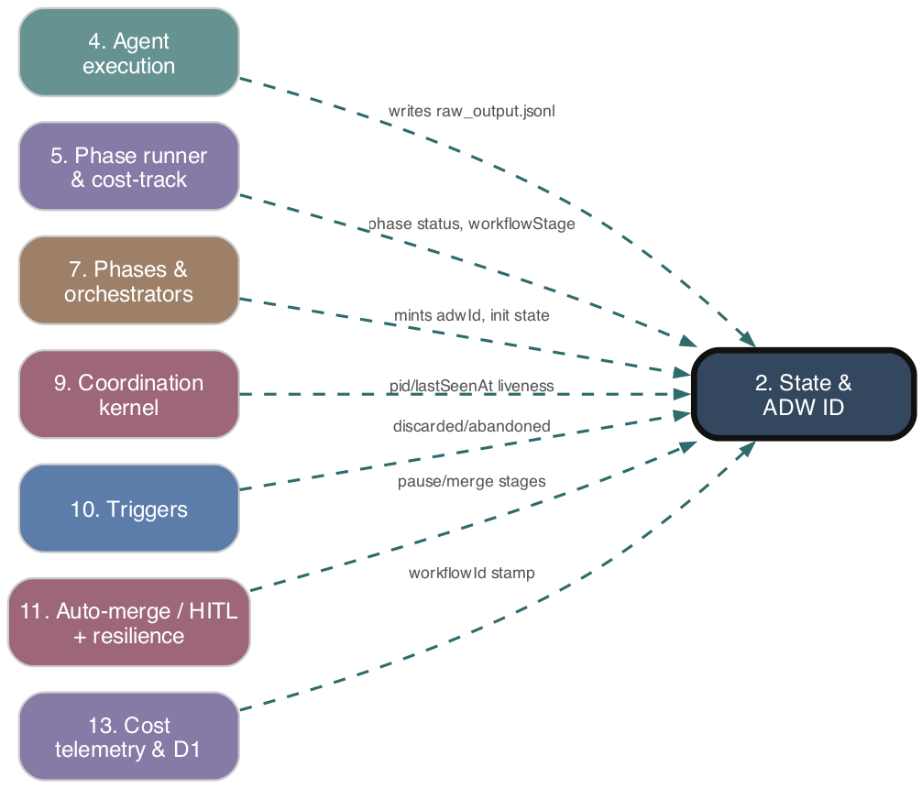
2. State & ADW ID
Layer 0 — Substrate
WHAT IT DOES
Persistence substrate: mints the per-run adwId, owns the agents/{adwId}/ layout, and provides merge-aware read/write of the top-level state file (pid, pidStartedAt, lastSeenAt, workflowStage) and per-agent state. Enables phase chaining, resume, and out-of-band liveness queries.
AS-IS NOTE
generateAdwId uses Math.random() (non-crypto); per-agent writes are non-atomic.
Solid red → this subsystem calls out · Dashed teal → called by · spec: rewrite/02-*.md

Slide 7
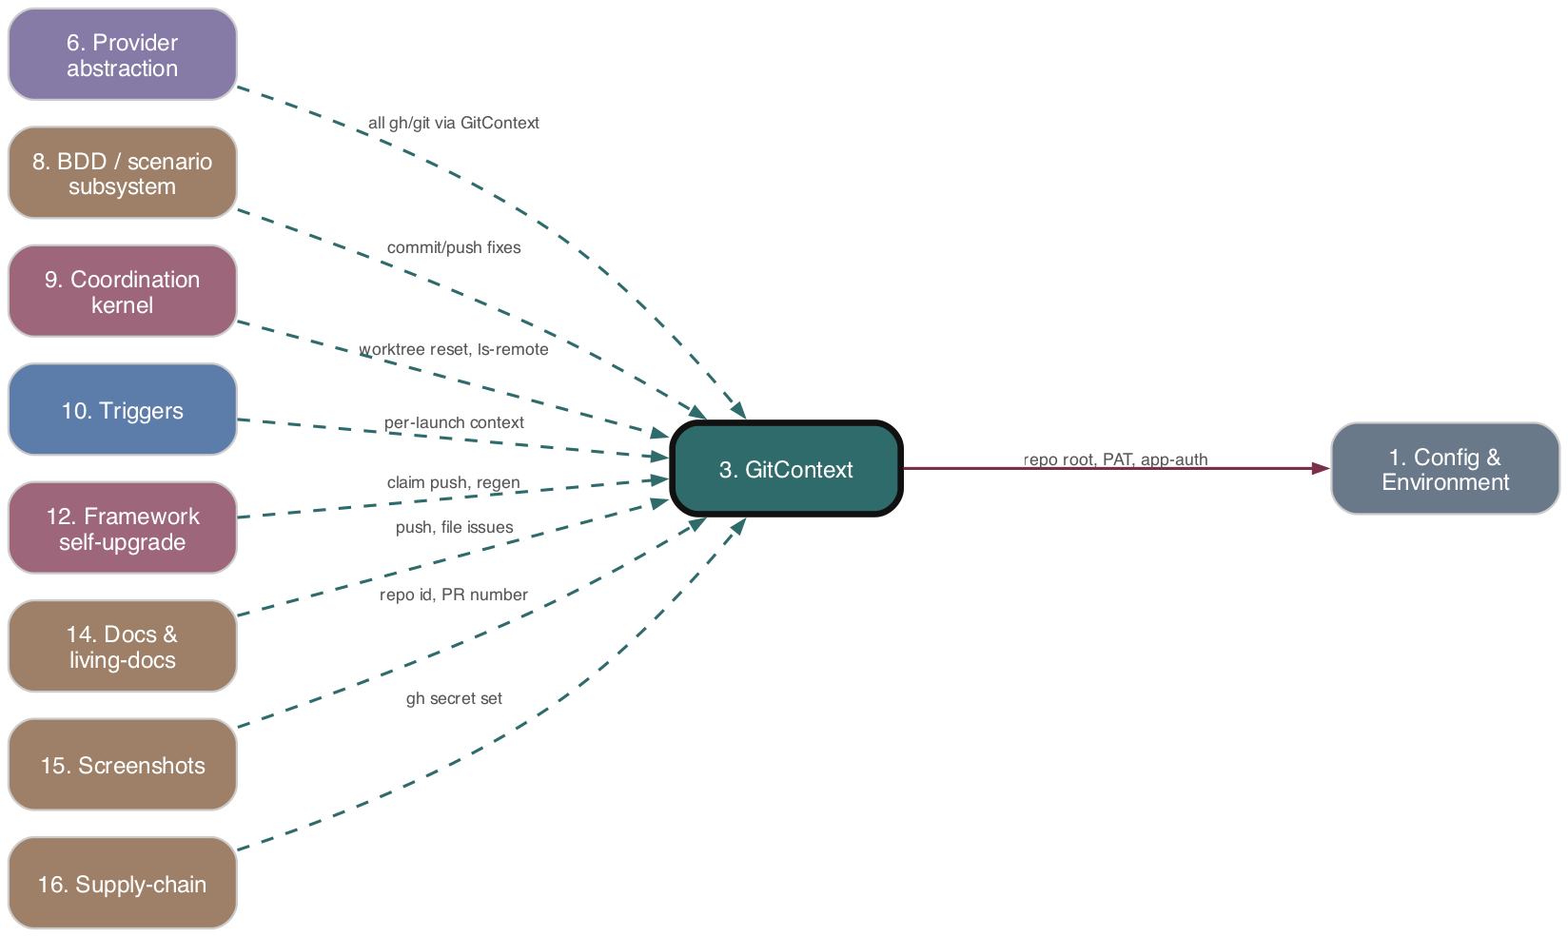
3. GitContext
Layer 1 — I/O authorities
WHAT IT DOES
Deep-module authority for ALL git and gh I/O. Constructed once per launch from a mandatory identity, resolves its base path in the constructor (self-host vs target), and injects auth per spawned command through one private #run() chokepoint — never mutating process.env. Eliminated the wrong-repo / token-bleed bug class.
AS-IS NOTE
Two parallel boundary builders (launchGitContext + gitContextFactory); guard still allowlists ~25 residual direct git/gh sites.
Solid red → this subsystem calls out · Dashed teal → called by · spec: rewrite/03-*.md

Slide 8
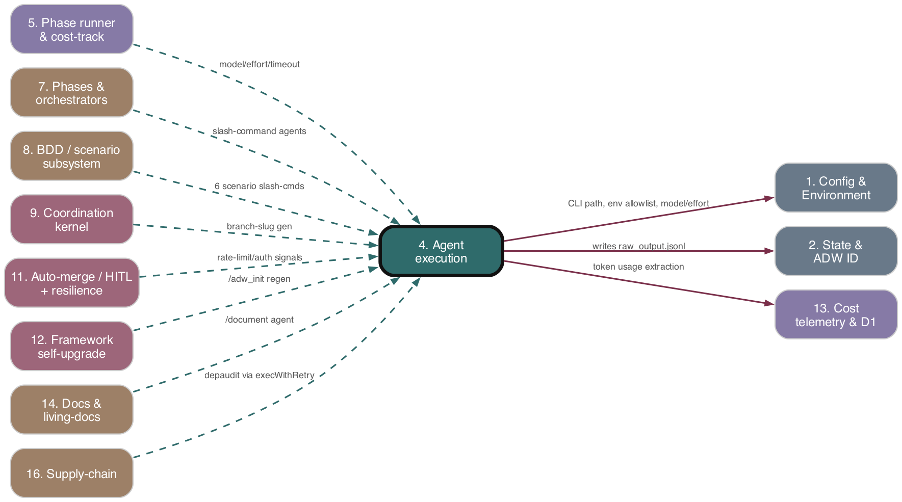
4. Agent execution
Layer 1 — I/O authorities
WHAT IT DOES
The single seam to the model. Spawns the `claude` CLI as a detached child, drives it with a slash command, parses streamed JSONL (assistant text, tool calls, result, errors), enforces watchdog/kill/retry policy, returns a typed AgentResult. THE model-coupling core.
AS-IS NOTE
CLI flags, JSONL field names, and error heuristics are scattered across 4 files — the coupling is not isolated behind one adapter.
Solid red → this subsystem calls out · Dashed teal → called by · spec: rewrite/04-*.md

Slide 9
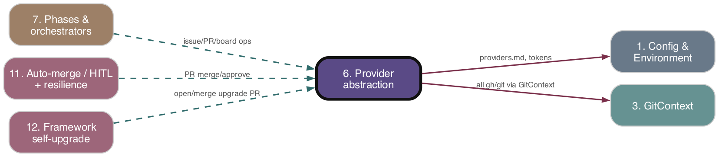
6. Provider abstraction
Layer 2 — Composition & providers
WHAT IT DOES
Portability seam: IssueTracker / CodeHost / BoardManager interfaces bundled into a validated RepoContext, with GitHub / GitLab / Jira impls over a thin GitHub API wrapper layer. Lets pipeline phases do issue/PR/board ops without binding to one platform.
AS-IS NOTE
Sync interface signatures force Jira into fire-and-forget placeholders; Bitbucket defined but unimplemented.
Solid red → this subsystem calls out · Dashed teal → called by · spec: rewrite/06-*.md

Slide 10
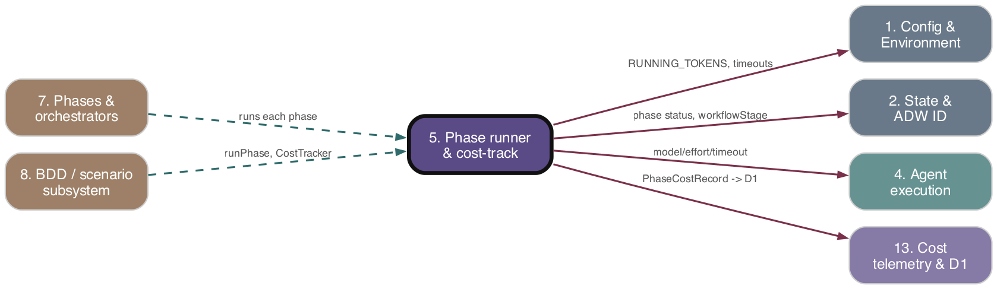
5. Phase runner & cost-track
Layer 2 — Composition & providers
WHAT IT DOES
Composition glue around each phase: CostTracker + runPhase accumulate/persist/commit per-phase cost, route slash commands to model tier + effort, apply per-phase watchdog timeouts, and run a generic retry-with-resolution loop. Owns the cost-capture seam; not the cost math (13).
AS-IS NOTE
CostTracker.commit fires postCostRecordsToD1 without awaiting; runPhasesParallel skips per-phase status writes.
Solid red → this subsystem calls out · Dashed teal → called by · spec: rewrite/05-*.md

Slide 11
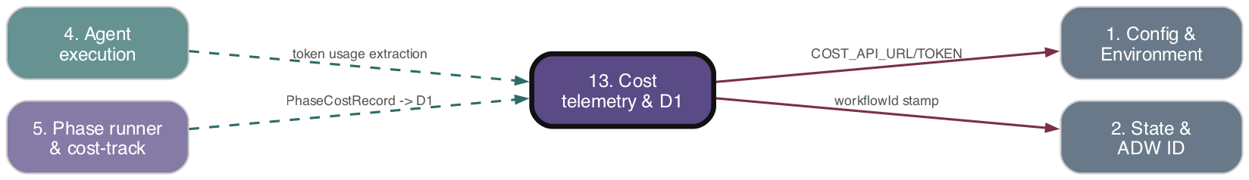
13. Cost telemetry & D1
Layer 2 — Composition & providers
WHAT IT DOES
Cost engine: extract Anthropic token usage from Claude JSONL, price against per-model tables, detect divergence vs CLI-reported cost, render multi-currency comment tables, and dual-write PhaseCostRecord rows to a Cloudflare D1-backed Cost API Worker.
AS-IS NOTE
Local computed cost is NOT independent — CLI cost copied into both fields, so divergence detection is inert; pricing tables hardcoded.
Solid red → this subsystem calls out · Dashed teal → called by · spec: rewrite/13-*.md

Slide 12
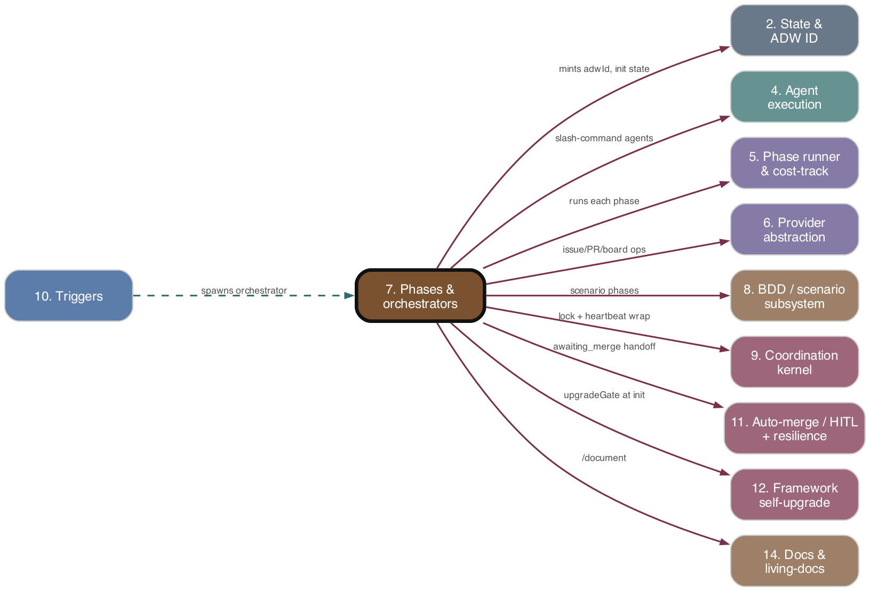
7. Phases & orchestrators
Layer 3 — Pipeline & content
WHAT IT DOES
The linear SDLC pipeline: classify issue -> route to orchestrator -> compose plan/build/test/review/document/PR phases, each wrapping Claude agents plus git/state side-effects. The root adw*.tsx entry scripts live here.
AS-IS NOTE
review->patch->retest loop copy-pasted across 5 orchestrators; classification parses free-form LLM text with a /feature default-on-failure.
Solid red → this subsystem calls out · Dashed teal → called by · spec: rewrite/07-*.md

Slide 13
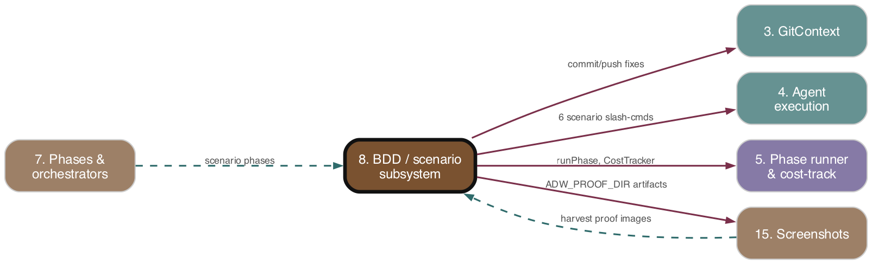
8. BDD / scenario subsystem
Layer 3 — Pipeline & content
WHAT IT DOES
BDD-driven validation: generate per-issue Gherkin + step defs, reconcile plan vs scenarios, run tag-filtered suites as subprocesses, loop resolve+retest under Gherkin-freeze + fidelity governance, publish PR proof, and sweep scenarios for regression promotion. The plan/implementation contract.
AS-IS NOTE
Two parallel plan<->scenario reconcilers (validation-loop vs alignment); step-def generation split between a phase and the TDD loop.
Solid red → this subsystem calls out · Dashed teal → called by · spec: rewrite/08-*.md

Slide 14
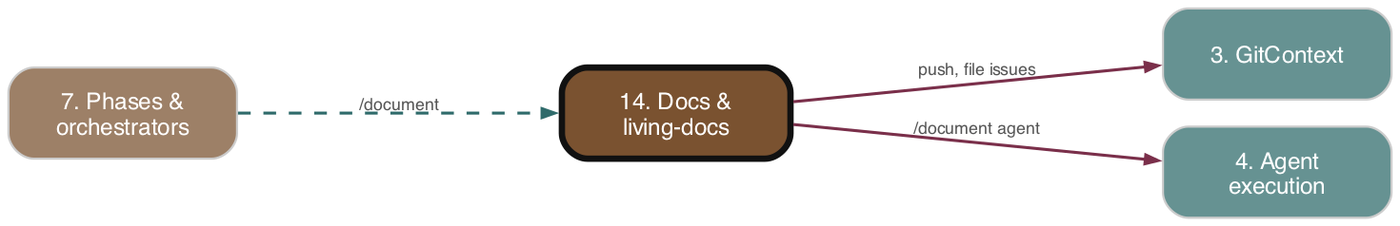
14. Docs & living-docs
Layer 3 — Pipeline & content
WHAT IT DOES
Living docs: the /document skill routes a change to its owning module doc and rewrites it in place, converging .adw/conditional_docs.md toward one entry per module. Deterministic guards flag doc bloat (files issues) and ownership regrowth as a post-write self-check.
AS-IS NOTE
One-off migration incomplete: live index has 221 entries vs the ~40 target / 60 gate — the flat-prime-cost goal is unmet.
Solid red → this subsystem calls out · Dashed teal → called by · spec: rewrite/14-*.md

Slide 15
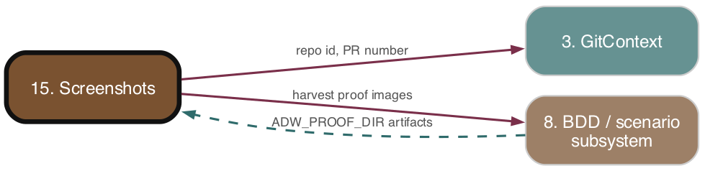
15. Screenshots
Layer 3 — Pipeline & content
WHAT IT DOES
Review-screenshot pipeline: harvest BDD scenario screenshot artifacts, upload to per-repo Cloudflare R2 buckets, embed public URLs in a PR 'BDD Proof' comment. A standalone Worker serves images under screenshots.paysdoc.nl and GCs empty buckets.
AS-IS NOTE
Worker hardcodes OWNER='paysdoc' while uploads are owner-parameterized; dead screenshotUrls placeholders in the review path.
Solid red → this subsystem calls out · Dashed teal → called by · spec: rewrite/15-*.md

Slide 16
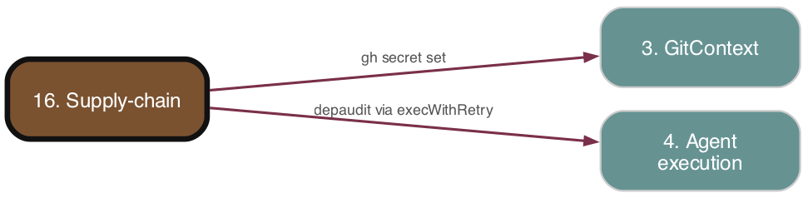
16. Supply-chain
Layer 3 — Pipeline & content
WHAT IT DOES
Integration with the external depaudit gate: run `depaudit setup` during target onboarding and propagate SOCKET_API_TOKEN / SLACK_WEBHOOK_URL to the target's GitHub Actions secrets. Ships the depaudit-triage Claude skill for reviewing findings.
AS-IS NOTE
executeDepauditSetup is defined, tested, and gh-guard-allowlisted but NOT invoked by any orchestrator — the adw_init wiring is absent.
Solid red → this subsystem calls out · Dashed teal → called by · spec: rewrite/16-*.md

Slide 17
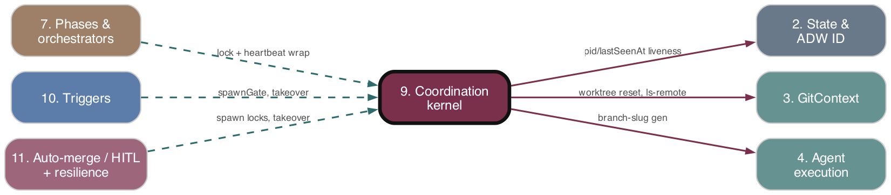
9. Coordination kernel
Layer 4 — Coordination & governance
WHAT IT DOES
Single-host coordination & recovery: per-issue spawn lock, PID+start-time liveness, heartbeat, hung-orchestrator detector, stage classifier, resume policy, remote reconcile, takeover handler, worktree reset/probe/reuse. The anti-split-brain layer.
AS-IS NOTE
Lock release on crash relies on next-caller staleness reclaim; stage routing split across stageClassifier + inline string checks.
Solid red → this subsystem calls out · Dashed teal → called by · spec: rewrite/09-*.md

Slide 18
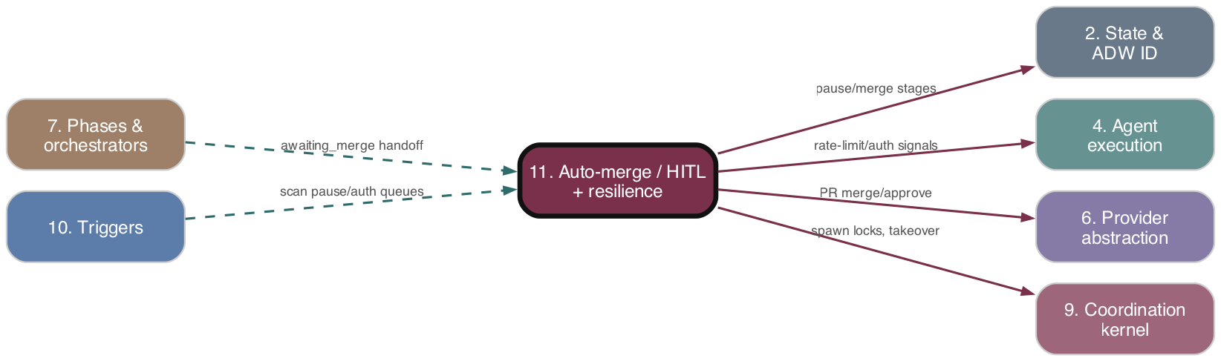
11. Auto-merge / HITL + resilience
Layer 4 — Coordination & governance
WHAT IT DOES
Governance + pause/resume: the stateless auto-merge gate (no hitl) OR (PR approved), a conflict-resolving merge orchestrator, durable pause queues for rate-limit/billing, a host-wide auth gate with Slack alerting, and a dev-server janitor.
AS-IS NOTE
Two near-identical pause paths (rate-limit queue file vs auth-gate state-scan); rate-limit indicator strings hard-coded in multiple files.
Solid red → this subsystem calls out · Dashed teal → called by · spec: rewrite/11-*.md

Slide 19
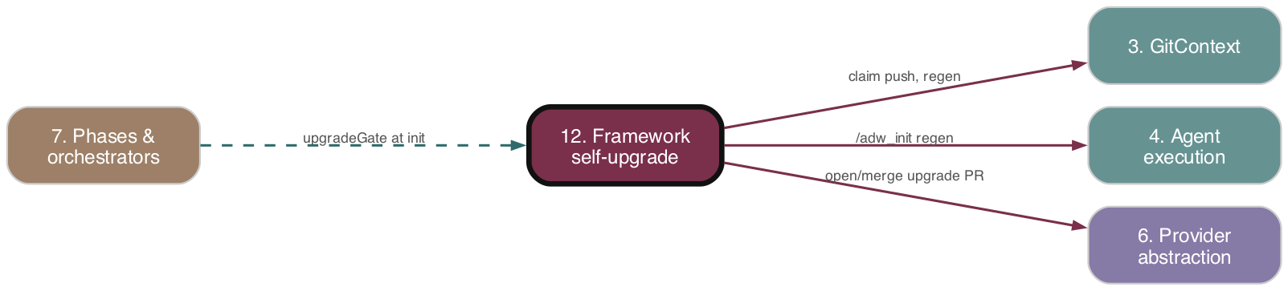
12. Framework self-upgrade
Layer 4 — Coordination & governance
WHAT IT DOES
Hash-driven self-upgrade + bootstrap: a content hash over /adw_init inputs vs each target's .adw-version; on drift an atomic branch-namespace claim elects one winner to regenerate .adw/ and open an (optionally HITL-gated) PR. Same flow handles first-time bootstrap.
AS-IS NOTE
Hash recomputed at gate and again at regen (TOCTOU window); verifyAdwRegen checks presence, not content validity.
Solid red → this subsystem calls out · Dashed teal → called by · spec: rewrite/12-*.md

Slide 20
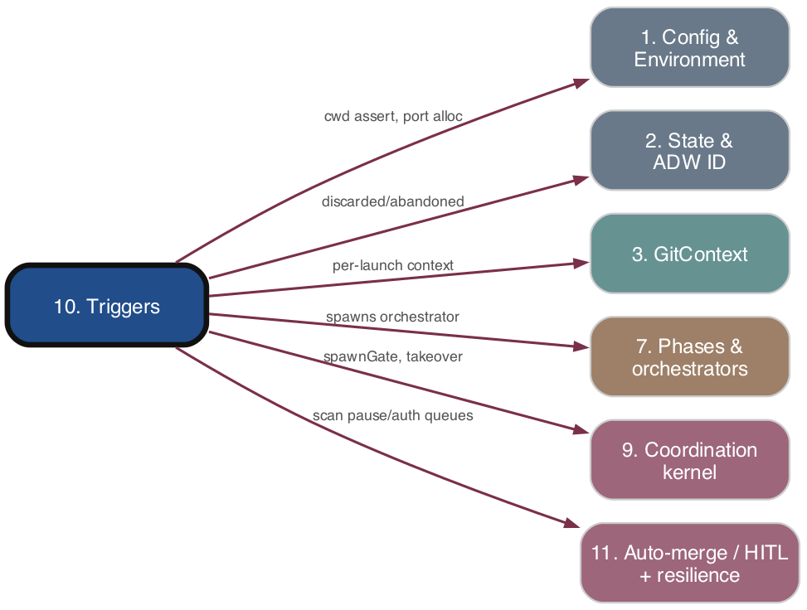
10. Triggers
Layer 5 — Entry points
WHAT IT DOES
Two automation entry points: a 20s cron backlog sweeper and an HMAC-validated webhook server. Both resolve issue eligibility, run the takeover decision, and dispatch detached orchestrator processes — delegating all coordination primitives to subsystem 9.
AS-IS NOTE
Takeover invoked from two paths with duplicated branch handling; dedup split across in-memory maps + on-disk locks.
Solid red → this subsystem calls out · Dashed teal → called by · spec: rewrite/10-*.md

