Slide 1
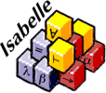
Isabelle Theorem Prover
Payton Shafer

Slide 2
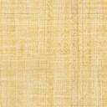


History
Written in Standard ML and Scala
Initially released in 1986
Isabelle/HOL released in late 1990s
Named after Gérad Huet’s daughter
Notes:
I will start with some history of the application:
Written in Standard ML and Scala
Developed at _ and _
Released in 1986 but updated and improved by many institutes/individuals
The version I will focus on in Isabelle/HOL, released in late 90s
This version is most widely used, the HOL is higher order logic
Fun fact: named after _’s daughter by UK guy

Slide 3
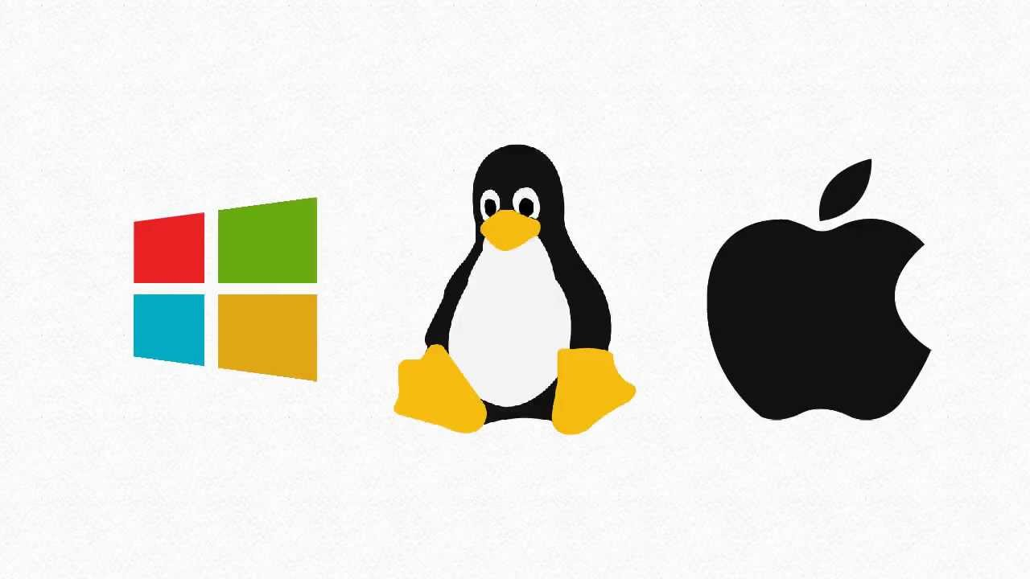

What is Isabelle?
Formalization of mathematical proofs and formal verification
Structured Proof Language: Isar
Uses tools such as: classical reasoner, simplifier, first-order provers
Isabelle/jEdit UI and Prover IDE
Notes:
Genaric proof assistant
Allows for math formulas to be represented in a formal language and
Provides tools to prove these in a logical calculus
This means the formalization of math proofs and
Formal verification – soft/hardware verif, prove props of comp langs/protocols
Isar – actual proof language cool bc it is super human readable (and machine)
Isabelle has many tools that are used to help proofs
Classical reasoner performs long chains of reasoning steps to prove exprs
Simplifier can reason with and about equations (think equality)
Linear arithmetic and various algebraic decision procedures are provided
External first-order provers (for first order logic)
jEdit UI for Isabelle IDE, download on linux mac and windows

Slide 4

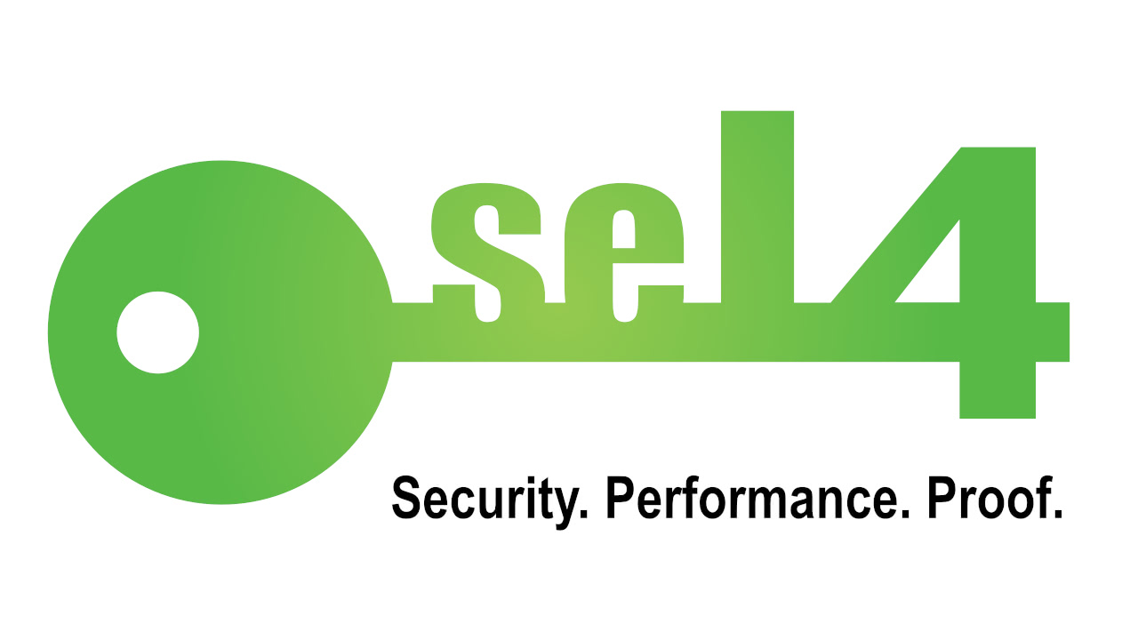

Where has Isabelle been used?
Verification of the seL4 microkernel, created by NICTA
Isabelle/HOL
Over 200,000 lines of proof to verify 7,500 lines of C
Uncovered 144 bugs
Isabelle Archive of Formal Proofs
At least 500 articles with over 2 million lines of proofs
Formalize theorems from Math and Computer Science
Axiom of Choice
Prime Number Theorem
Security Protocol Correctness
Notes:
seL4 chip verif by NICTA – National Info and communications tech of Australia
the main theorem stated that the C code correctly implements the formal specification of the kernel, used on all parts (design, code, implementation)
bugs in early version and over 150 issues in each of design and specification
Isabelle AFP – lots of proofs, can use to prove other things
Formalize thms such as those on the slides

Slide 5
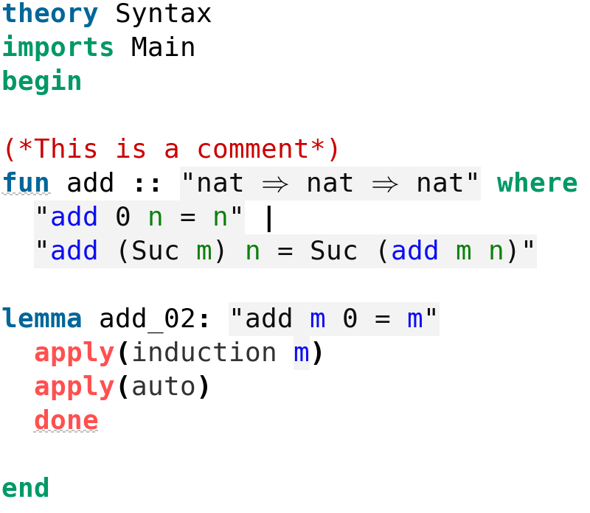
How do you use Isabelle?
Syntax →
Demo of Isabelle/HOL
Communitive property of Addition
Binary Trees
Notes:
Run through file syntax – think header, imports, begin, then func dec (relations to functional programming and use of recursion) – then simple lemma syntax

