Slide 1
Weighted Gene Co-Expression Network Analysis (WGCNA)

Slide 2
WGCNA概念:
基因共表达网络—寻找协同表达的基因模块(module),探索基因网络与研究的性状之间的联系。
WGCNA（加权基因共表达网络）--构建基因表达网络的典型系统生物学算法。（芯片、RNA-seq)

Slide 3
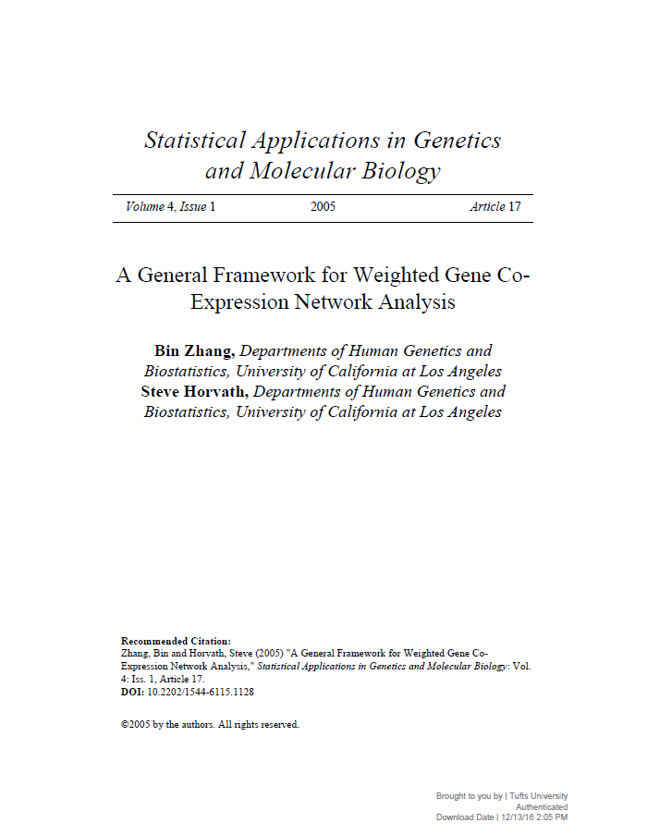
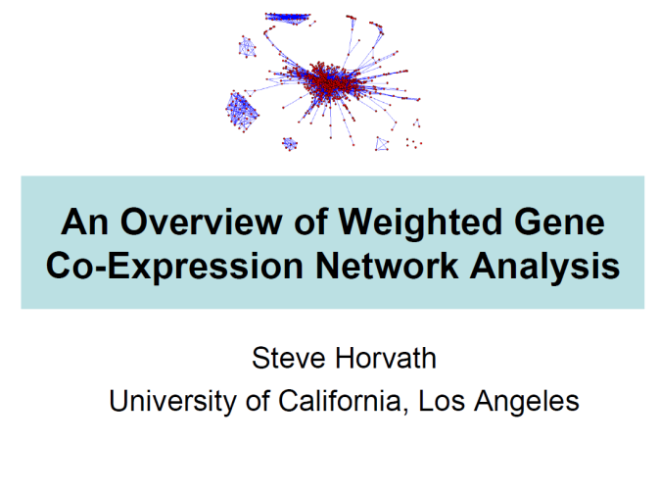
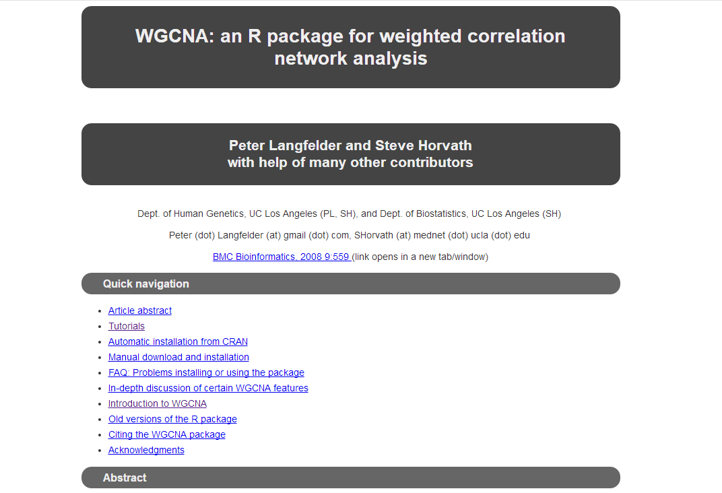
https://labs.genetics.ucla.edu/horvath/CoexpressionNetwork/Rpackages/WGCNA/
system、module

Slide 4
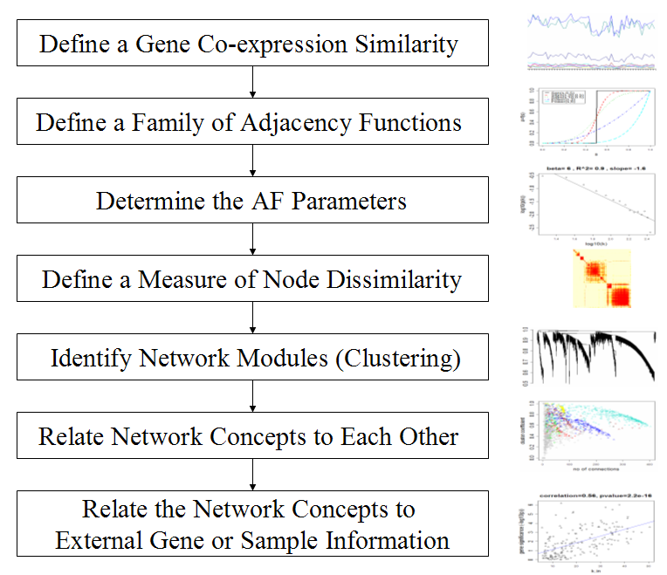
WGCNA原理（建立基因模块流程）:
建立关系矩阵
建立邻接矩阵，并引入幂指数加权，从而构建无尺度网络
建立TOM，计算distTOM
Identifying Gene Modules

Slide 5
WGCNA原理（建立基因模块流程）:
1、建立关系矩阵
由表达数据转换成关系矩阵
suitably quantified and normalized
Pearson correlation coefficient 计算出两个基因表达量之间的线性相关程度
s_{ij} = |cor(i,j)|
The similarity matrix / correlation matrix
S = [s_{ij} ]

Slide 6
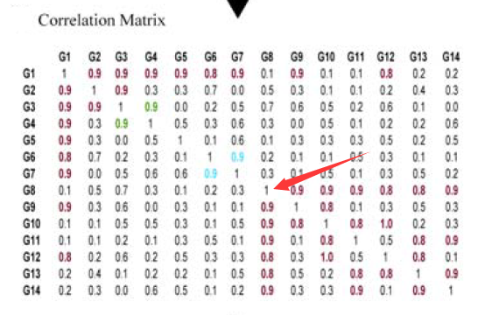
矩阵的列和行都是基因的名字
基因和基因之间的相关系数在0~1之间
对角线上的值都是1

Slide 7
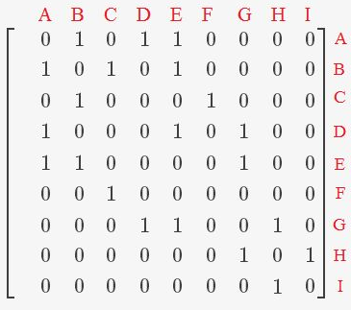
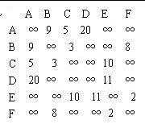
WGCNA原理（建立基因模块流程）:
2、建立邻接矩阵
由关系矩阵转换成邻接矩阵
Network=Adjacency Matrix
Unweighted [0,1] whether or not
Weighted the connection strength
A=[a_{ij} ]
a_{ij}=|cor(x_{i},x_{j})|^{β}
β
scale free topology criterion
Why？

Slide 8
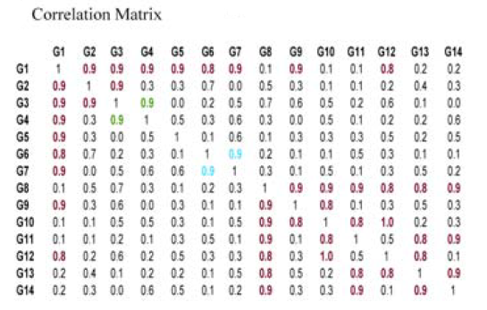
Adjacency Matrix
 | G1 | G2 | G3 | G4 | G5 | G6 | G7 | G8 | G9 | G10 | G11 | G12 | G13 | G14
G1 | 1 | 1 | 1 | 1 | 1 | 1 | 1 | 0 | 1 | 0 | 0 | 1 | 0 | 0
G2 | 1 | 1 | 1 | 0 | 0 | 0 | 0 | 0 | 0 | 0 | 0 | 0 | 0 | 0
G3 | 1 | 1 | 1 | 1 | 0 | 0 | 0 | 0 | 0 | 0 | 0 | 0 | 0 | 0
G4 | 1 | 0 | 1 | 1 | 0 | 0 | 0 | 0 | 0 | 0 | 0 | 0 | 0 | 0
G5 | 1 | 0 | 0 | 0 | 1 | 0 | 0 | 0 | 0 | 0 | 0 | 0 | 0 | 0
G6 | 1 | 0 | 0 | 0 | 0 | 1 | 1 | 0 | 0 | 0 | 0 | 0 | 0 | 0
G7 | 1 | 0 | 0 | 0 | 0 | 1 | 1 | 0 | 0 | 0 | 0 | 0 | 0 | 0
G8 | 0 | 0 | 0 | 0 | 0 | 0 | 0 | 1 | 1 | 1 | 1 | 1 | 1 | 1
G9 | 1 | 0 | 0 | 0 | 0 | 0 | 0 | 1 | 1 | 1 | 0 | 0 | 0 | 0
G10 | 0 | 0 | 0 | 0 | 0 | 0 | 0 | 1 | 1 | 1 | 1 | 1 | 0 | 0
G11 | 0 | 0 | 0 | 0 | 0 | 0 | 0 | 1 | 0 | 1 | 1 | 0 | 1 | 1
G12 | 1 | 0 | 0 | 0 | 0 | 0 | 0 | 1 | 0 | 1 | 0 | 1 | 1 | 0
G13 | 0 | 0 | 0 | 0 | 0 | 0 | 0 | 1 | 0 | 0 | 1 | 1 | 1 | 1
G14 | 0 | 0 | 0 | 0 | 0 | 0 | 0 | 1 | 0 | 0 | 1 | 0 | 1 | 1

Slide 9

WGCNA原理（建立基因模块流程）:
2、建立邻接矩阵
a_{ij}=|cor(x_{i},x_{j})|^{β}
connectivity
log₁₀(p(k)) versus log₁₀(k) 负相关
连接数为i 的概率p(i)与i 的n 次方成反比
1：30

Slide 10
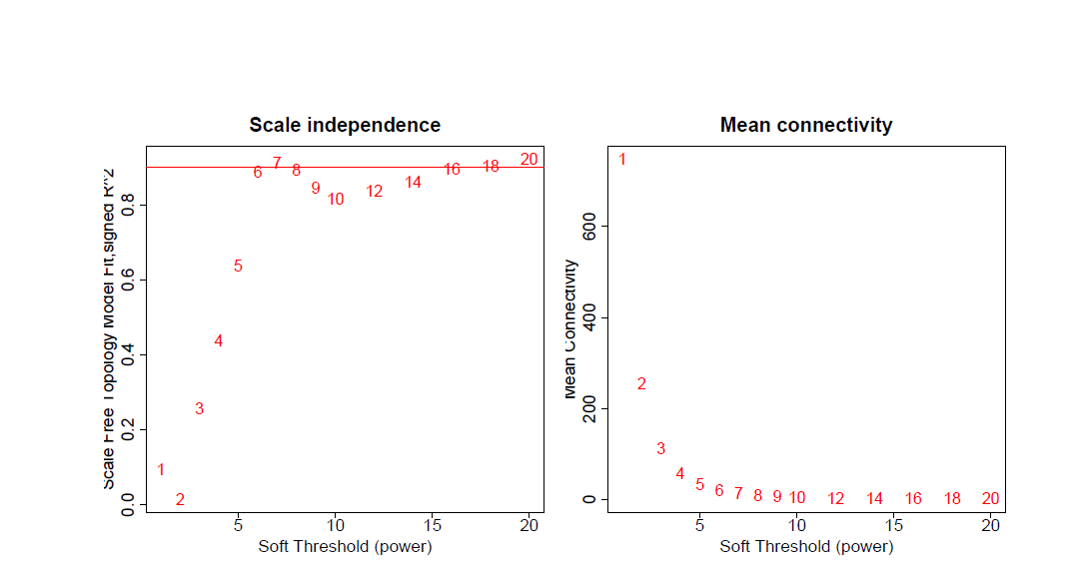
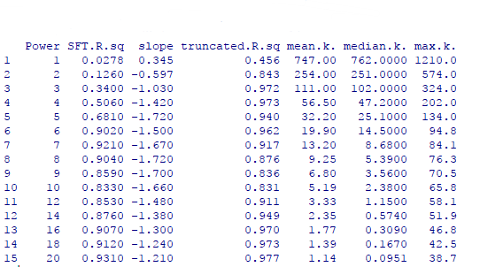
β R²
^{回归线斜率 连通性}
Female liver
Notes:
1、中文表头

Slide 11
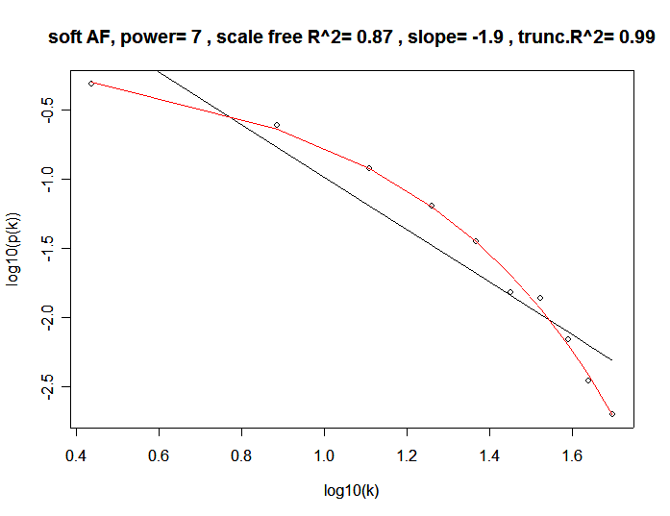
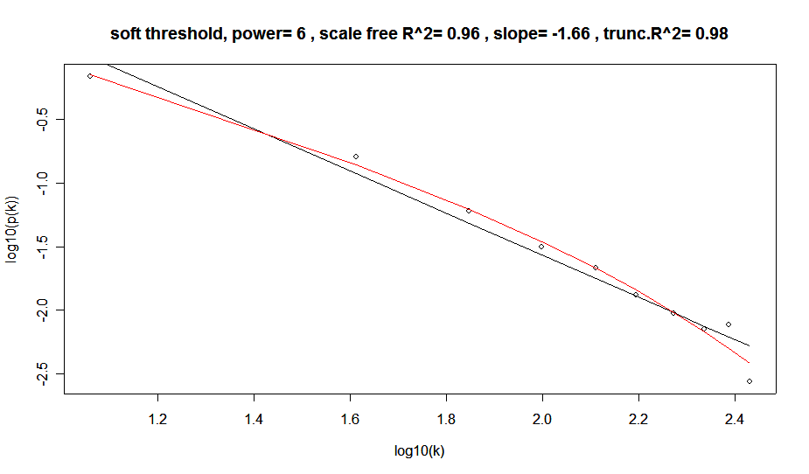
7
6
yeast

Slide 12



WGCNA原理（建立基因模块流程）:
Topological Overlap Matrix
3、TOM
基因i、j 都存在连接的节点的邻接系数乘积和
引入第三方中间节点

Slide 13

WGCNA原理（建立基因模块流程）:
Topological Overlap Matrix
3、TOM
TOM-based dissimilarity
Average linkage hierarchical clustering

Slide 14
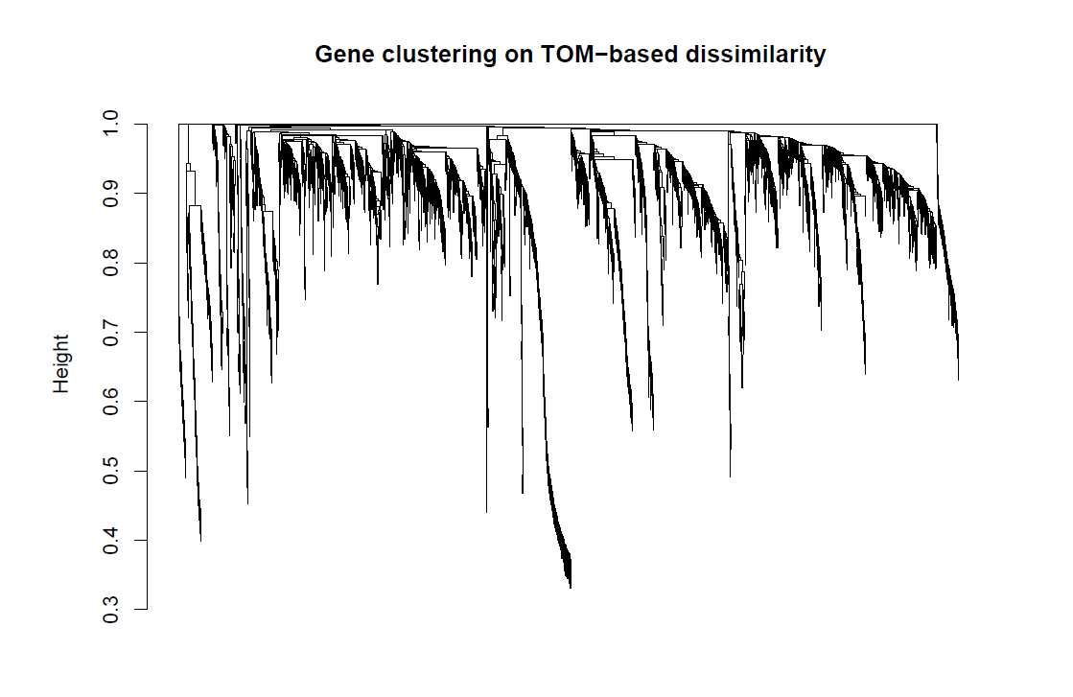
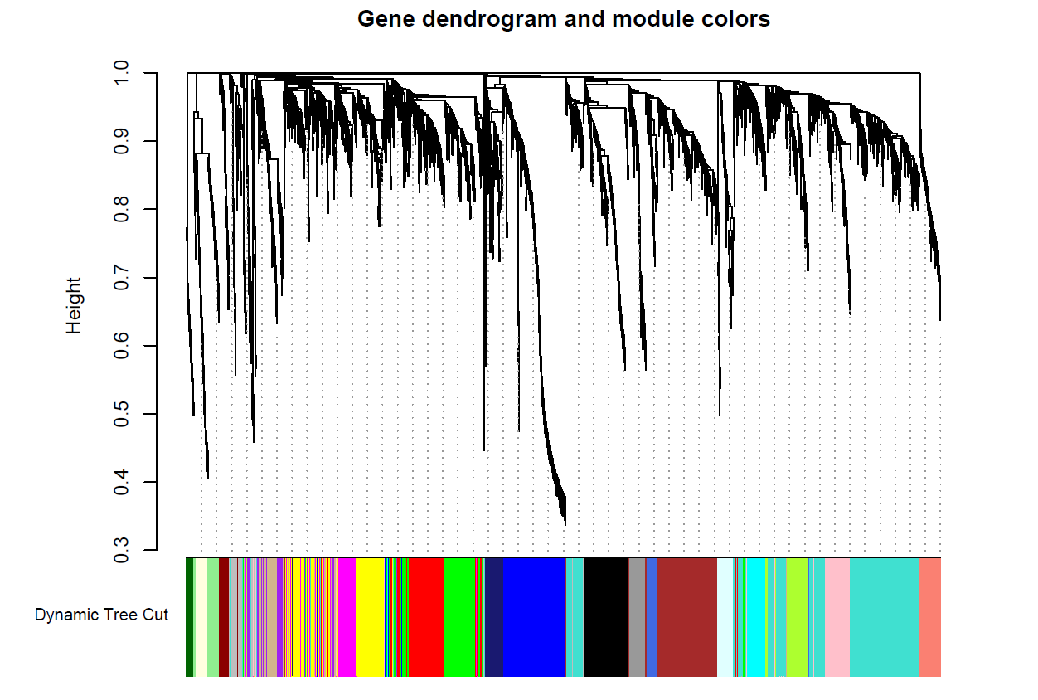
WGCNA原理（建立基因模块流程）:
4、 Identifying Gene Modules
dynamic tree cut
Female liver

Slide 15
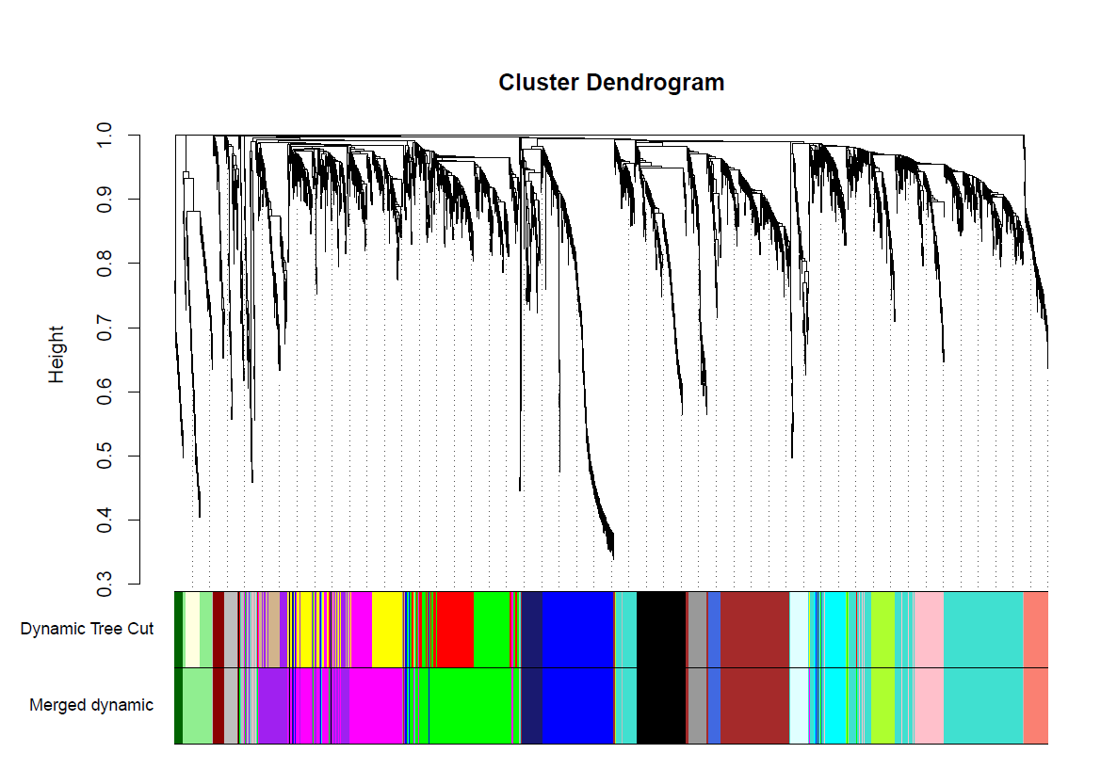
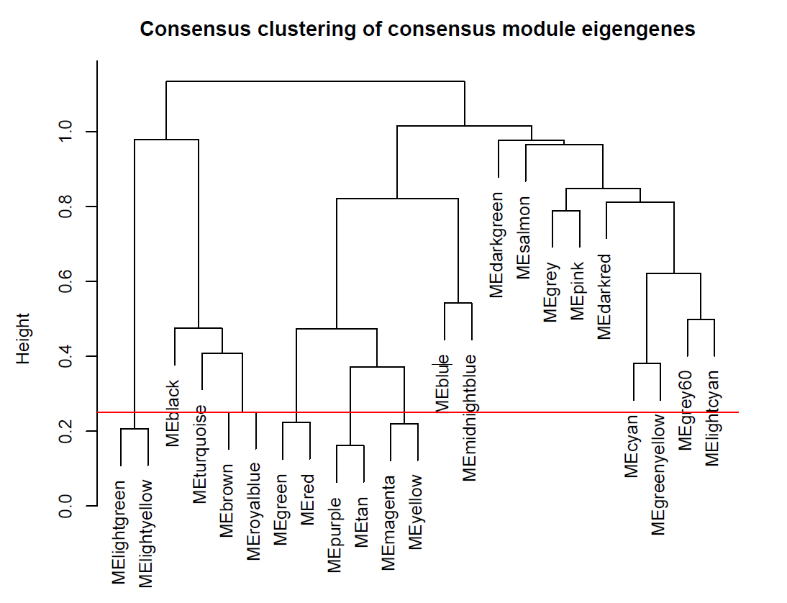
WGCNA原理（建立基因模块流程）:
a height cut of 0.25
4、 Identifying Gene Modules
correlation of 0.75
Merge
Female liver

Slide 16
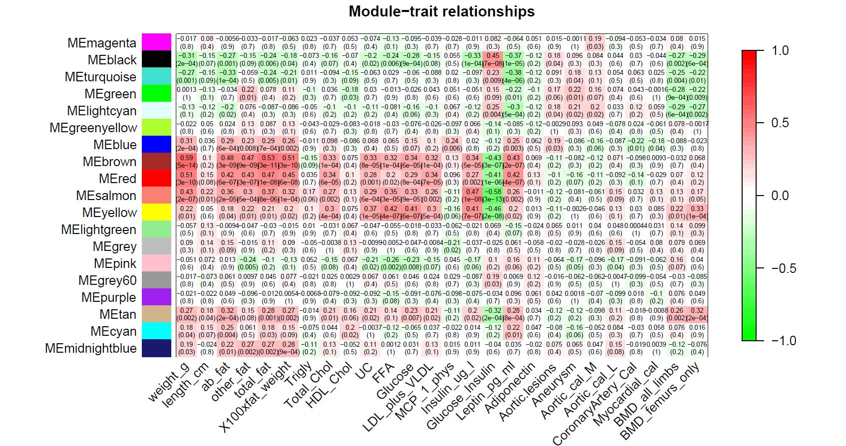
Female liver

Slide 17
Gene Signicance (GS)
Quantify associations of individual genes with our trait of interest
the correlation between the gene and the trait
Module Membership (MM)
For each module, define a quantitative measure of module membership MM
As the correlation of the module eigengenes and the gene expression profile

Slide 18
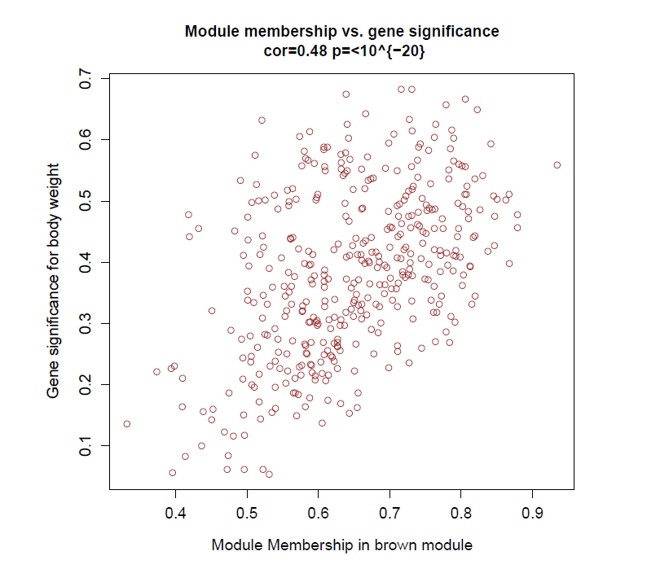
In the brown module trait: weight
GS vs MM
GS and MM are highly correlated.
Genes highly signicantly associated with a trait are often also the most important (central) elements of modules associated with the trait.

Slide 19
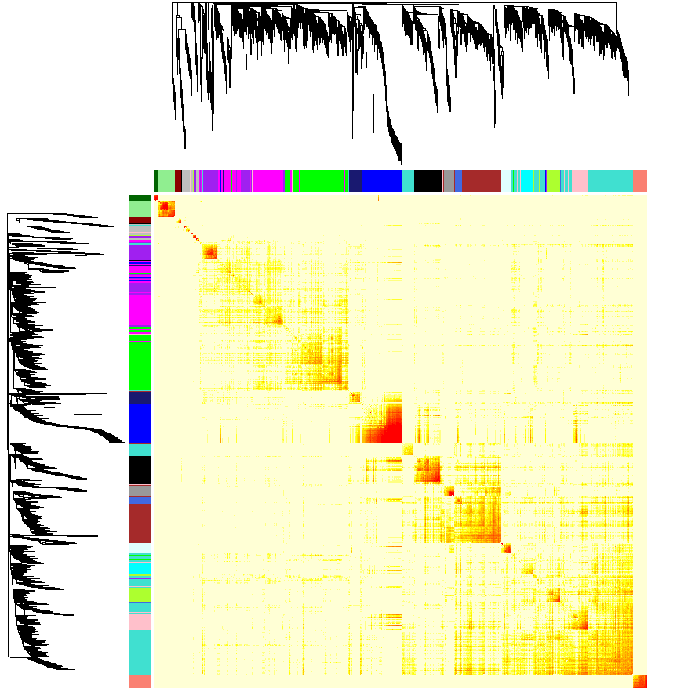
Hierarchical clustering
dendrogram
TOM matrix
Module:
Correspond
to branches
Notes:
1、热图对称

Slide 20
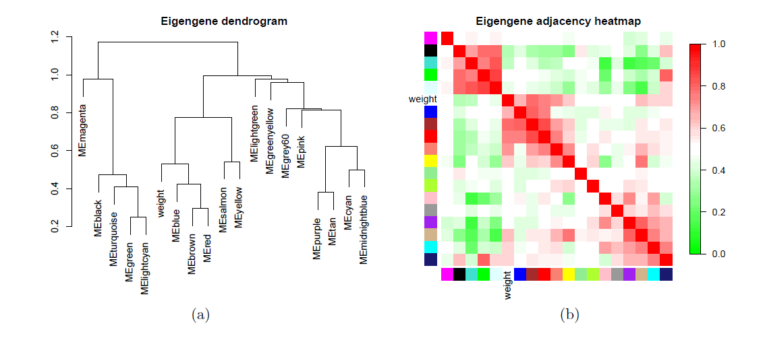

Slide 21
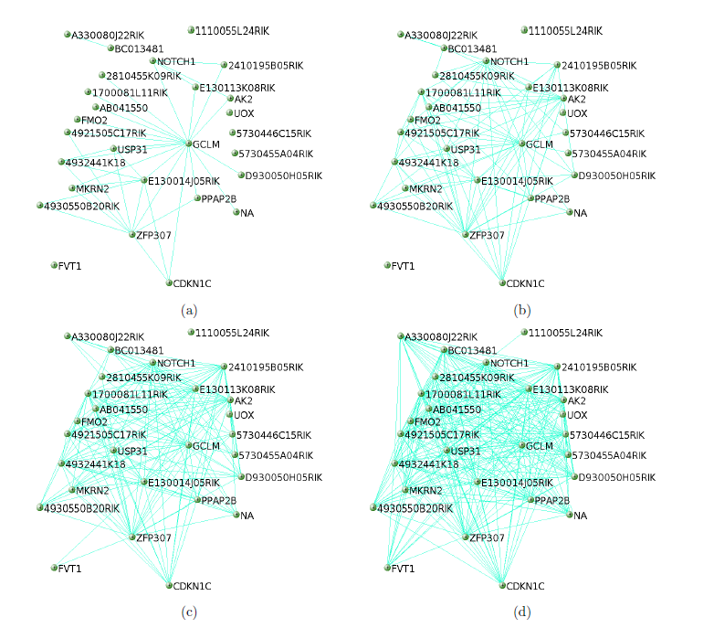
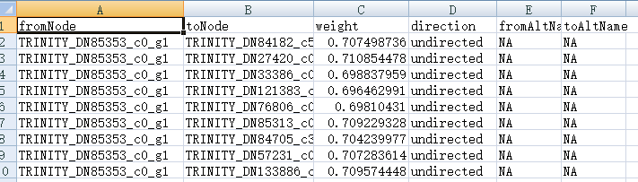
Different threshold value

Slide 22
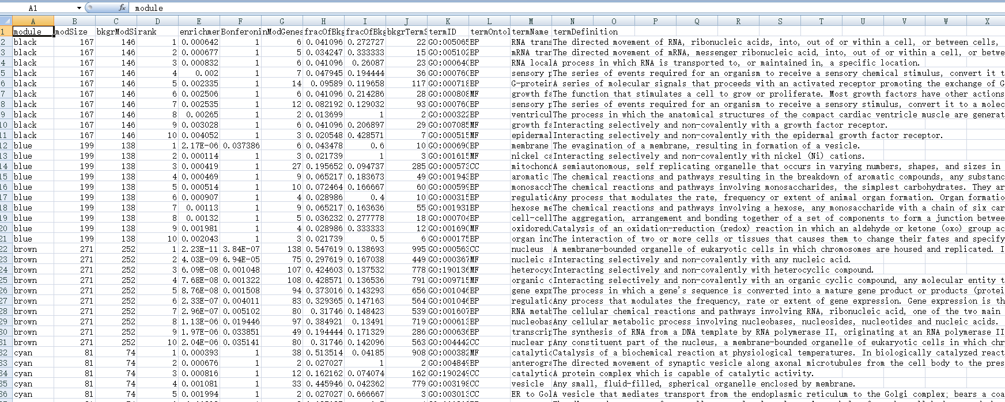
GO，KEGG
Modulle, hub, or interest

