Slide 1
Driving Factors of COVID-19 Protective Behaviours in Australia
Based on Deep Learning
JIAJUN LI

Slide 2
BACKGROUND
Importance
Protective behaviours, especially mask wearing, were important in reducing COVID 19 transmission, understanding their drivers is important for public health policy.
Existing Research
-Multiple Factors Shape Behaviour
Protective behaviours are influenced by demographic, psychological, and policy factors, and may also change with vaccination and COVID-19 case numbers [1].
-Mask mandates and protective behaviour drivers in Australia
Protective behaviours are not fixed, Ryan et al. [2] showed the role of face mask mandates in influencing the drivers of protective behaviours in Australia.
-Deep learning has shown potential in structured data
MLP(Multi-Layer Perceptron)s can achieve competitive or even stronger performance on structured data when appropriate regularization and parameter tuning are applied. [3]
[1]Wismans et al. (2022), DOI: 10.1186/s12889-022-13632-9.
[2]Ryan, Matthew, et al. (2025) , DOI:10.1098/rsos.241941.
[3]Bagheri, Sajjad, et al. (2023) , DOI: 10.3389/fpsyt.2023.1283095.

Slide 3
BACKGROUND
Research gap & Liminations of Existing Studies
-Ryan et al. [1] provided important evidence on the relationship between mask mandates and protective behaviours in Australia. However, some key factors have not been considered. For example, the introduction of vaccination and COVID-19 case numbers may alter individuals’ risk perception and behavioural responses.
-Although tree based models often perform strongly on tabular data, they may still be limited in fully capturing complex interactions, particularly when multiple factors are involved [2].
Research Questions
-How do vaccination rates and COVID-19 case numbers influence the protective behaviours in Australia?
-How does the performance of deep learning models compare to traditional models in predicting protective behaviours?
[1] Ryan, Matthew, et al. (2025) , DOI:10.1098/rsos.241941.
[2] Rana, Pratham Singh, et al. (2023), DOI: 10.1109/ICACCTech61146.2023.00044.

Slide 4
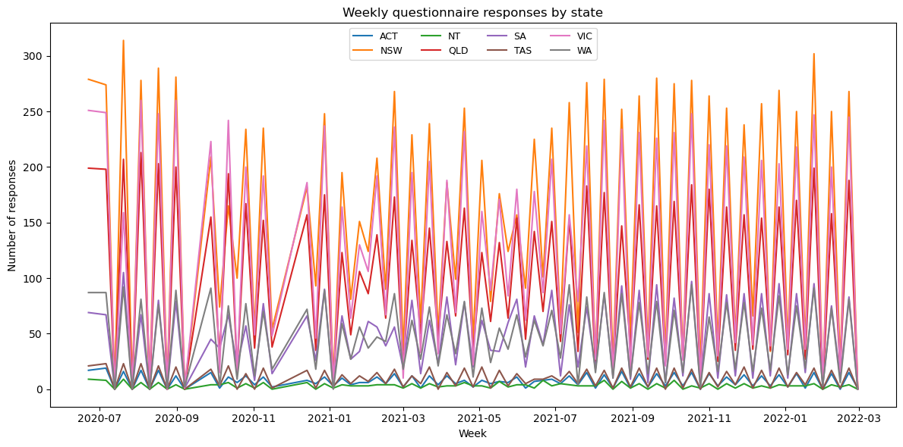
DATA
METHODS
1.YouGov COVID-19 Behaviour Tracker
Individual-level behavioural data

Slide 5
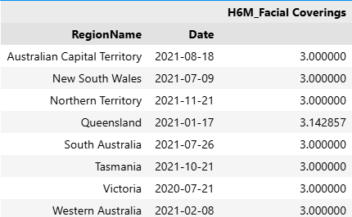
DATA
METHODS
2.OxCGRT COVID-19 Government Response Tracker
Mask policy (H6)

Slide 6
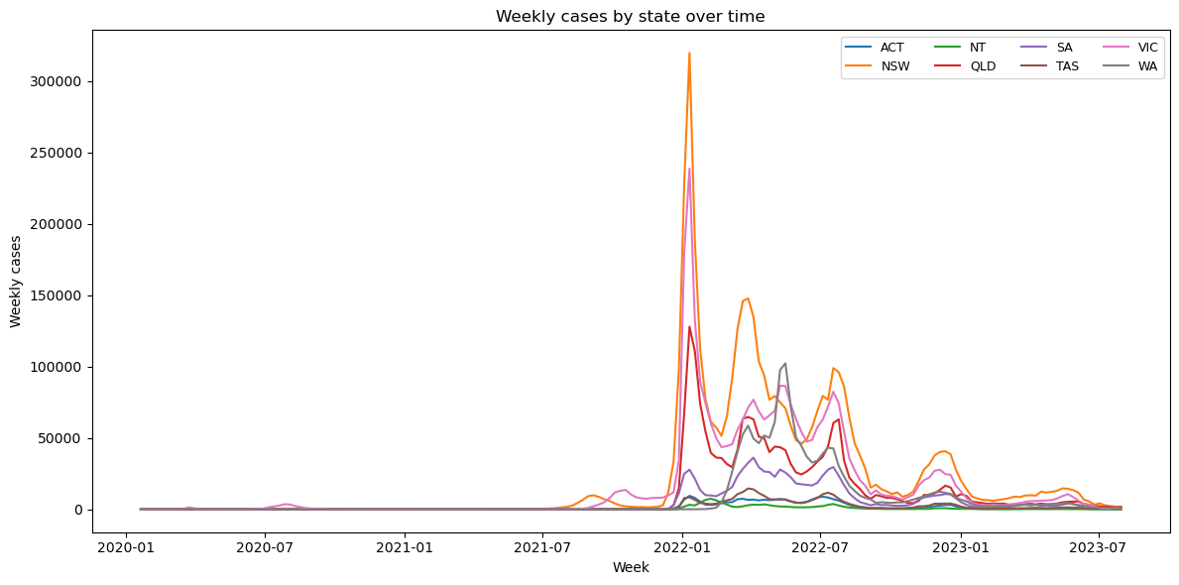
DATA
METHODS
3.COVID-19 case data
Since the Australian government has not released detailed case number data for each state on a weekly basis, this study relies on a vaccine dataset compiled by a third-party team
COVID19DATA.COM.AU. (2023). STATES AND TERRITORIES, COVID-19 IN AUSTRALIA. VIEWED 25 MARCH 2026, HTTPS://WWW.COVID19DATA.COM. AU/STATES-AND-TERRITORIES.

Slide 7
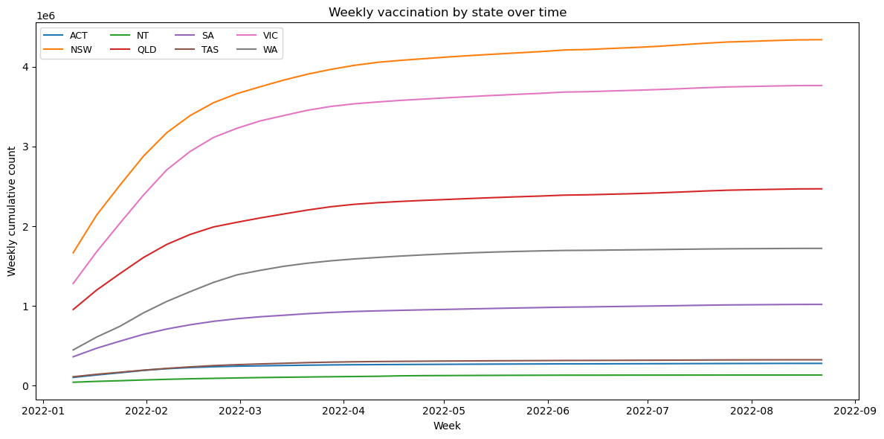
DATA
METHODS
4.Vaccination data
Since the Australian government has not released detailed vaccination number data for each state on a weekly basis, this study relies on a vaccine dataset compiled by a third-party team
COVID19DATA.COM.AU. (2023). VACCINES, COVID-19 IN AUSTRALIA. VIEWED 25 MARCH 2026, HTTPS://WWW.COVID19DATA.COM.AU/VACCINES.

Slide 8
MODELS
METHODS
Baseline Models
-Logistic Regression
A simple statistical model that estimates the probability of the outcome.
Easy to interpret and helps show whether more complex models provide improvement.
-Decision Trees
A tree based model that splits the data into groups using a series of decision rules.
Can capture some nonlinear relationships and provides a more flexible baseline than Logistic Regression.
XGBOOST
-An ensemble tree model that builds trees together to improve prediction step by step.
-Has already shown strong performance in structured data
-Training:
5 fold cross validation on the training set
-Evaluation:
F1 score and ROC AUC on the testing set
-Interpretation:
SHAP values for the two best performing models

Slide 9
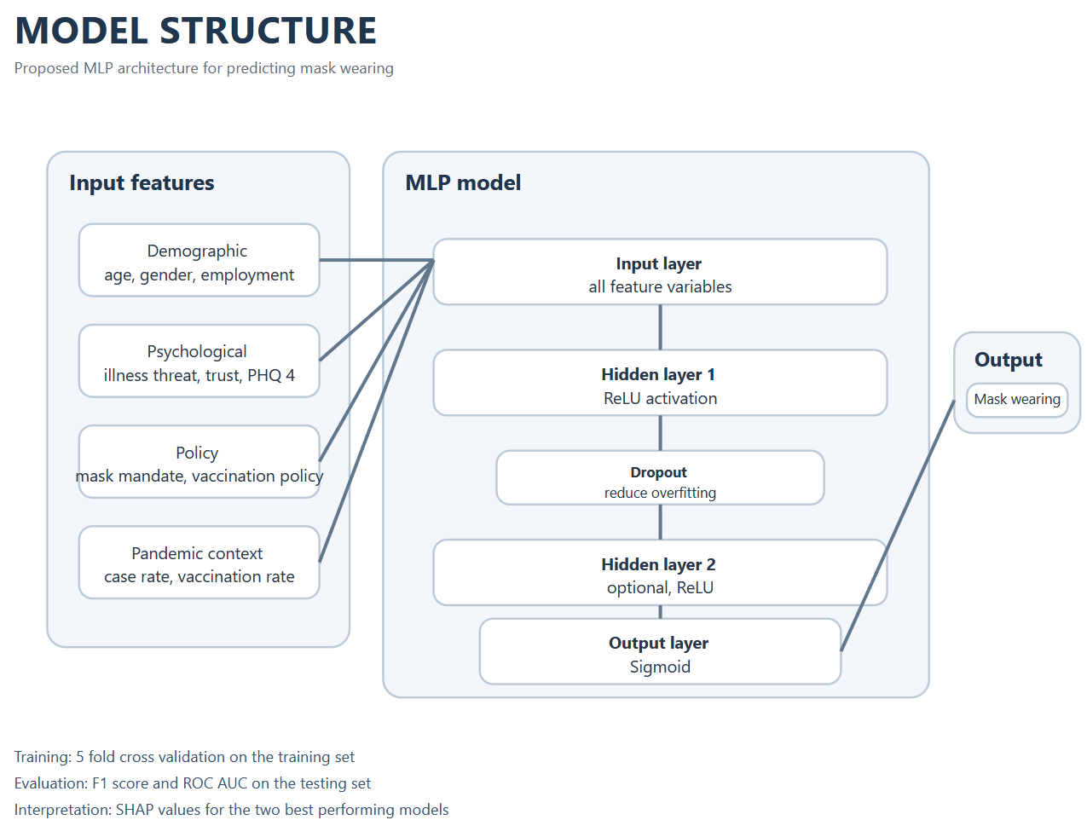
MODELS
METHODS
MLP Model
-Training:
5 fold cross validation on the training set
-Evaluation:
F1 score and ROC AUC on the testing set
-Interpretation:
SHAP values for the two best performing models

Slide 10
SUMMARY
What I did:
Reproduce part
-Determining the mandate timing for each state based on the OxCGRT COVID-19 Government Response Tracker data
-Cleaning, preprocessing, and splitting of the YouGov COVID-19 Behaviour Tracker data.
Data work for the extend part
-Integrating COVID-19 case numbers, vaccination data, and the YouGov COVID-19 Behaviour Tracker data into a single dataset.

Slide 11
FUTURE
Extend the original framework (Term2)
-Cleaning and preprocessing (w2-3)
Still cleaning...
-Model tuning (w3-6)
Fit four models：Logistic Regression, Classification Trees, XGBoost, and MLPs.
For the tree based models, hyperparameters will be tuned using Optuna with 5-fold cross validation on the training data, with AUC as the optimisation metric.
-Model comparison (w6-7)
Compare the four models using AUC, Precision, Recall, Accuracy, and F1 score. The best models will be selected based on predictive performance.
-Interpretation (w7-9/10)
Investigate the stable important features by SHAP values on the two best performing models.

