Slide 1
CATG
Ansible Introduction

Slide 2
I. Introduction

Slide 3
DevOps. General concept and ideas.
Collaboration as a problem to solve.
Provisioning and management of „infrastructure” vs software production speed.
General idea of DevOps a.k.a. „The Phoenix Project”.
No more siloses – „one click” deployment.
Myths behind DevOps.

Slide 4
Infrastructure as a code.
Infrastructure, platform and environment.
Installation vs provisioning systems.
Configuration management.
Immutability.
Context is everything.

Slide 5
Application & Configuration
Environment
Platform
Infrastructure
„Hardware & Network”
Operating system and 3rd party.

Slide 6
CONTEXT
Environment
Platform
Infrastructure
Environment
Platform
Infrastructure
Environment
Platform
Infrastructure
Environment
Platform
Infrastructure
Environment
Platform
Infrastructure

Slide 7
Environment
Platform
Infrastructure
Environment
Platform
Infrastructure
Context sharing & switching
Environment
Platform
Infrastructure
Environment
Platform
Infrastructure
Environment
Platform
Infrastructure
Environment
Platform
Infrastructure
Environment
Platform
Infrastructure
Environment
Platform
Infrastructure
Environment
Platform
Infrastructure
Environment
Platform
Infrastructure
Environment
Platform
Infrastructure

Slide 8
II. Ansible

Slide 9
What exactly „Ansible” is.
Provisioning system.
Orchestration system (almost).
Immutability keeper.

Slide 10
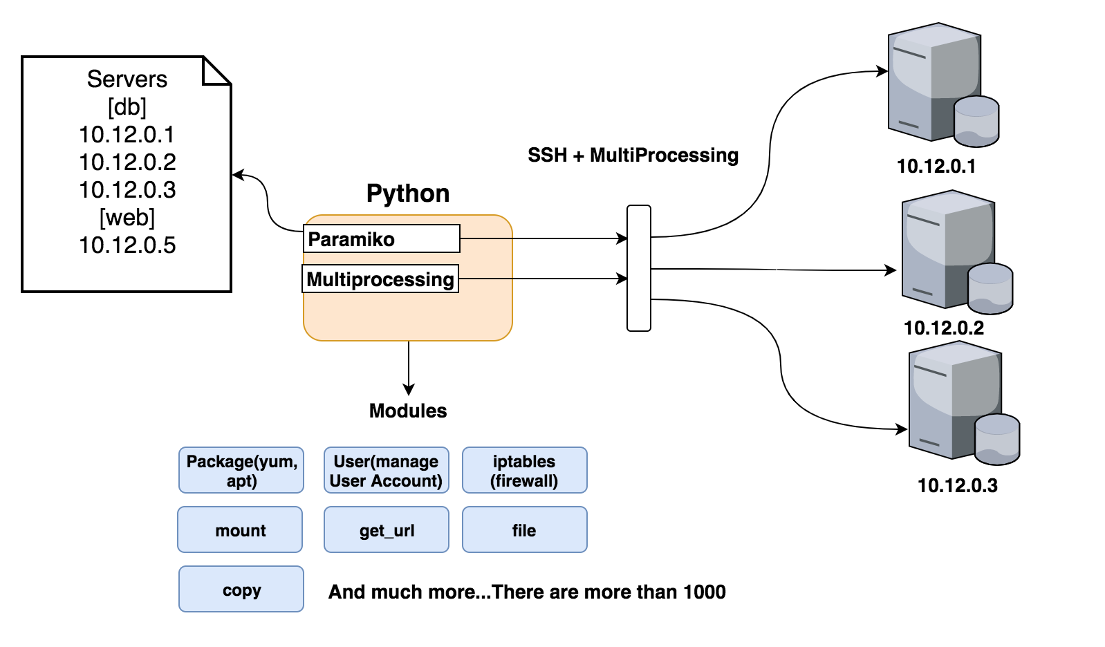
How Ansible works...

Slide 11
Ansible configuration.
Ansible config files.
Inheritance and shadowing of config files.
ANSIBLE_CONFIG (an environment variable)
ansible.cfg (in the current directory)
.ansible.cfg (in the user’s home directory)
/etc/ansible/ansible.cfg
Connections with target hosts.

Slide 12
YAML, Python and jinja2.
YAML syntax.
https://docs.ansible.com/ansible/latest/reference_appendices/YAMLSyntax.html
https://yaml.org/start.html
Jinja2 syntax.
http://jinja.pocoo.org/

Slide 13
Inventory concept
Address book.
Data storage.

Slide 14
Vault and encryption
ansible-vault https://docs.ansible.com/ansible/latest/user_guide/vault.html
encrypt string

Slide 15
Data structures used in Ansible.
Variables.
„Magic” variables.
Facts.
Lists.
Dictionaries.

Slide 16
Ansible command line and debugging.
Basic ansible commands.
Call arguments a.k.a. extra vars.
Verbose output.
Limiting scope.

Slide 17
III. Ansible project structure

Slide 18
Roles.
Structure and directory layout.
ansible-galaxy init <ROLE_NAME>
Why roles are important.
Calling and executing roles.

Slide 19
Tasks.
Syntax.
Conditionals (changed_when, failed_when, when)
Common usages.
Pre and post tasks.

Slide 20
Handlers.
Notify.

Slide 21
Templates.
What are templates.
When to use templates.
Examples.

Slide 22
Playbooks.
Basic structure.
Some examples.

Slide 23
Inventory once again.
Inventory layout.
Group and host vars directories.
Designing proper inventory structure.

Slide 24
IV. Ansible developer’s toolset

Slide 25
Testing Ansible code.
Catching output of tasks.
Catching stdout, stderr from tasks.
Blocks
Error handling (rescue, always)

Slide 26
Versioning Ansible code.
Why it’s important to keep Ansible code versioned.
Some examples and traps.

Slide 27
Ansible code reviews.
What is code review?
Why Ansible code should be reviewed?
How to perform review?
Pull request and review example.

Slide 28
Ansible documentation.
https://docs.ansible.com/

Slide 29
V. Helpers, cheatsheets and scripts
https://www.digitalocean.com/community/tutorials/how-to-use-ansible-cheat-sheet-guide
https://www.edureka.co/blog/cheatsheets/ansible-cheat-sheet-guide/
https://gist.github.com/andreicristianpetcu/b892338de279af9dac067891579cad7d
https://lzone.de/cheat-sheet/Ansible
https://cheat.readthedocs.io/en/latest/ansible/

Slide 30
VI. Q&A

