Slide 1
Compact Representations of Human Interception Movements
Low-dimensional models for representing and generating human interception movement
Seman Libbiss & Paz Flashner
Research supervision: Prof. Jason Friedman | Course advisor: Moni Shahar
Workshop on Deep Learning, Tel Aviv University

Slide 2
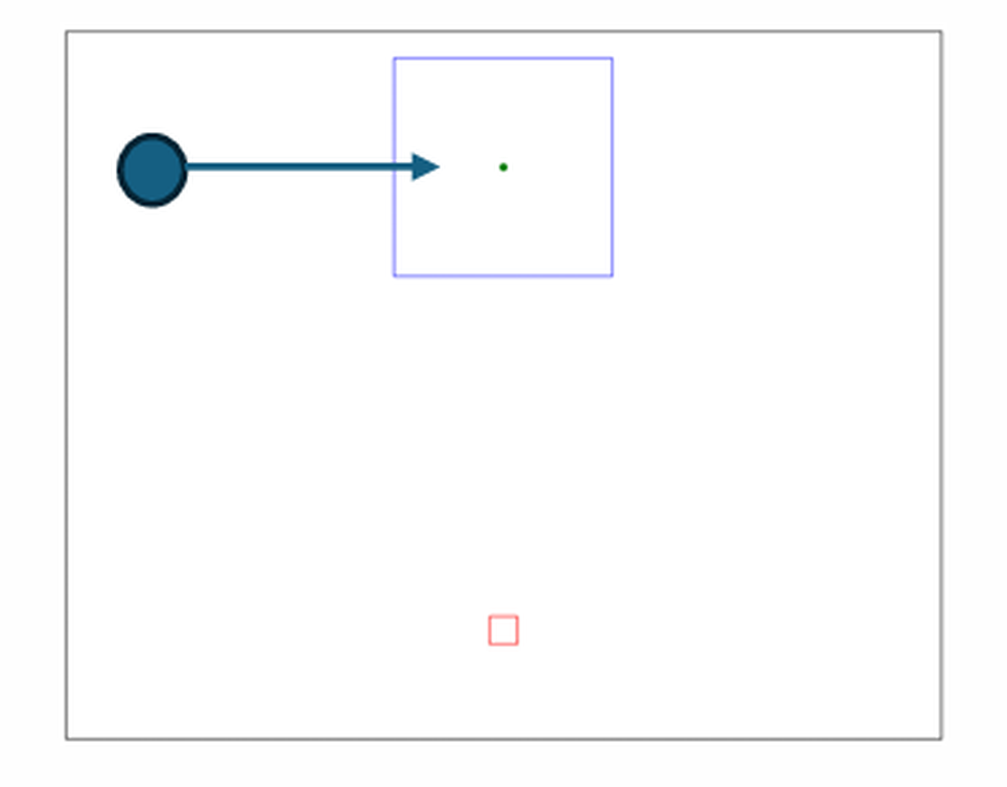
The experimental task and the data structure
2/11
The experimental task
• Participant's task: move the finger from the lower start zone into the upper interception square exactly as the ball passes through it.
• Conditions: the free eye-movement condition is analysed. Six target start locations (3 right, 3 left) over a continuous speed range.
• Sample: 4,732 valid trials from 28 participants, measured in 3D at 240 Hz with a Polhemus system.
A strict split that prevents information leakage
Four fixed folds: 17 training participants, 4 validation and 7 test. Every participant appears in a test fold exactly once.
Notes:
Planned: 45 seconds. Slide 2 of 11.

Slide 3
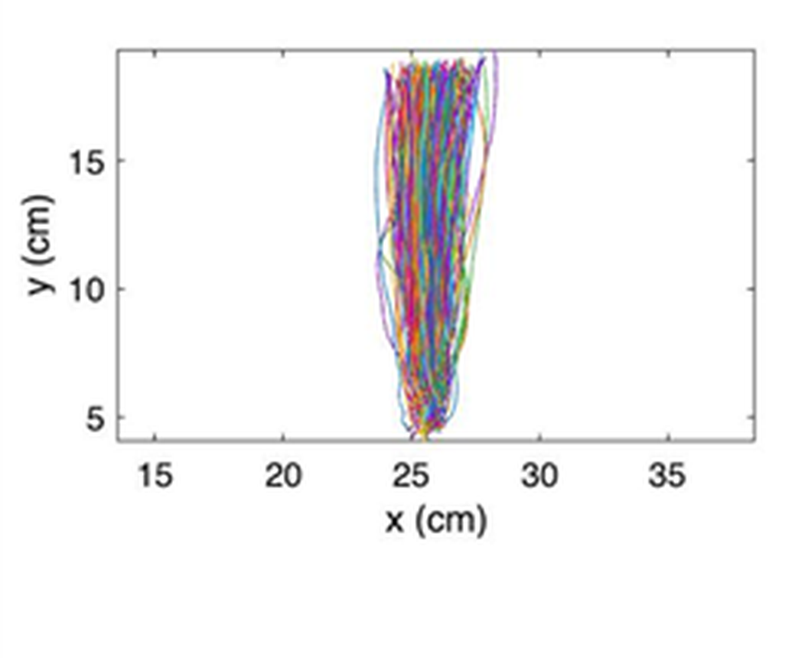
What we set out to answer
3/11
The core question
Human movement is stochastic: perception and motor control vary from trial to trial. One participant, one target - and every trial takes a different path.
Can a compact fingerprint capture that spread?
Compress 200 numbers - the 100 × 2 path - into a 3-to-8 dimensional fingerprint of an individual's movement distribution.
100 × 2 coordinates ———> n = 3 or 8 latent numbers (durations predicted)
What would count as success, evaluated on participants the model never trained on
SUCCESS TEST 1
SUCCESS TEST 2
SUCCESS TEST 3
Reconstruct
Generate
Stay personal
Rebuild specific recorded trajectories from the compressed code.
Sample new trajectories matching that person's stochastic distribution.
The fit must come from that person's own fingerprint, not a generic one.
Notes:
Planned: 40 seconds. Slide 3 of 11.

Slide 4
Trajectory processing and the compression architectures
4/11
Stage in the model | Spline + PCA (linear baseline) | Neural models (VAE / CVAE / CAE)
Primary input | The same 100 × 2 normalised trajectory | The same 100 × 2 trajectory; CVAE and CAE add 5 task conditions
Where standardisation happens | On the 18 spline coefficients, after fitting | On the 200 coordinates, with train-set constants
Encoder / compression | Cubic B-spline with 5 knots fit, 9 coefficients per axis -> PCA to n latents | Two fully connected 256-unit ReLU layers -> latent n
Decoder / reconstruction | Inverse PCA -> multiply by the spline basis for the full path | Two 256-unit ReLU layers -> separate heads for 200 coordinates and 2 durations
Timing prediction | Separate Ridge regression on the PCA scores + conditions | Dedicated head predicting initiation and movement time
Three neural variants, one architecture
VAE - Variational Autoencoder, trained on the trajectory alone. CVAE - Conditional Variational Autoencoder, which also receives the task conditions. CAE - Conditional Autoencoder, the same network without the variational latent.
All are compared at identical latent dimensions, n = 3 (extreme compression) and n = 8 (extended capacity).
Notes:
Planned: 65 seconds. Slide 4 of 11.

Slide 5
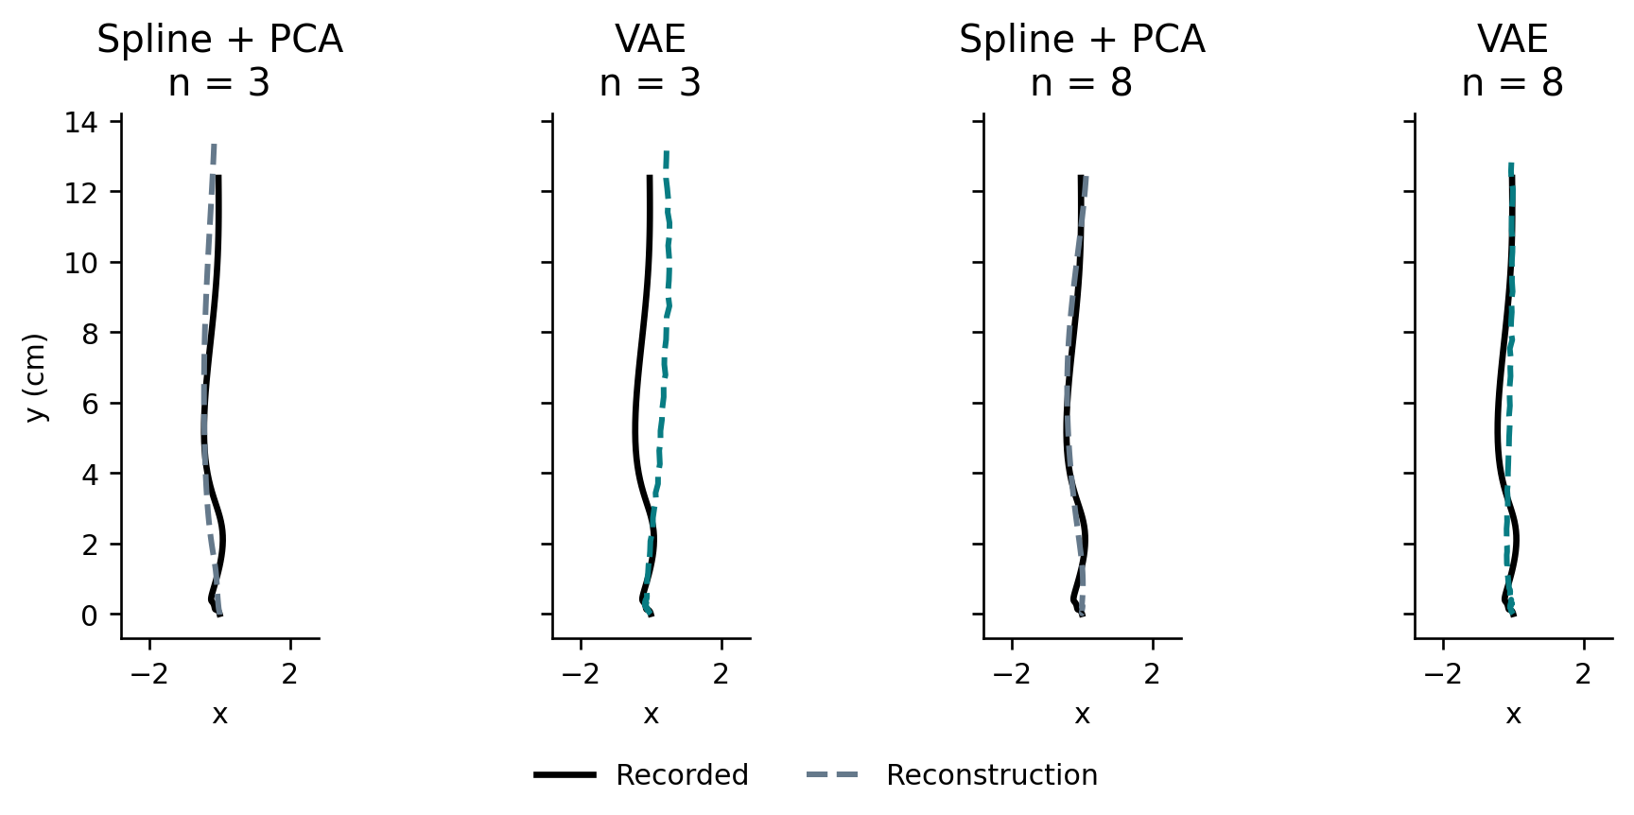
Task 1: Trajectory Reconstruction
5/11
Trajectory reconstruction error (MSE, cm²)
Model | MSE n=3 | MSE n=8
Spline + PCA | 0.0972 | 0.0228
VAE (Unconditional) | 0.1483 | 0.0335
Conditional AE (CAE) | 0.1697 | 0.0260
CVAE | 0.1770 | 0.0325
Condition-only Ridge (Floor) | 1.2338 | 1.2338
Key insight on pointwise reconstruction
PCA wins at reconstructing a single trajectory.
One median-duration trial. Black: recorded; dashed: reconstructed. Both axes in cm at equal scale.
As a linear projection, PCA is analytically optimal for minimising squared error among all linear methods. VAEs trade off pointwise accuracy to obtain a continuous and samplable latent space.
Notes:
Planned: 55 seconds. Slide 5 of 11.

Slide 6
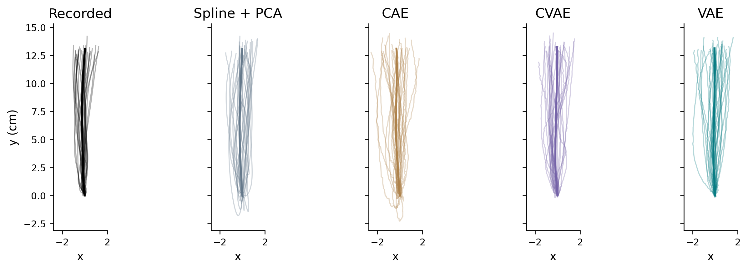
Task 2: generating a personal movement distribution
6/11
How do we generate movements from a fingerprint?
• Enrollment: earlier context trials of the participant, whose mean defines the personal fingerprint centre.
fingerprint centre: θ_s = (1 / |C_s|) Σ c_i
• Stochastic sampling: draw 120 latent vectors around that centre using a shared covariance learned from training data.
one generated movement: z ∼ N ( θ_s , Σ_train )
• Unseen movements: query trials are held aside to evaluate the distribution and are never exposed to the model.
c_i is the trial's code: the encoder mean μ_i for the neural families, the PCA scores for spline + PCA.
Below, n = 8. Thin: first 30 draws. Thick: their mean. Equal x/y scale, cm.
Notes:
Planned: 45 seconds. Slide 6 of 11.

Slide 7
How we score a generated distribution
7/11
WHAT WE MEASURE
HOW WE COMPARE
11 kinematic features
Marginal Feature Matching
Initiation and movement time, peak speed, time to peak, path length, straight-line distance, curvature, maximum lateral deviation and the three endpoint coordinates.
One KS test per feature, averaged over the 11 features into Mean KS. Lower is better.
Notes:
Planned: 40 seconds. Slide 7 of 11.

Slide 8
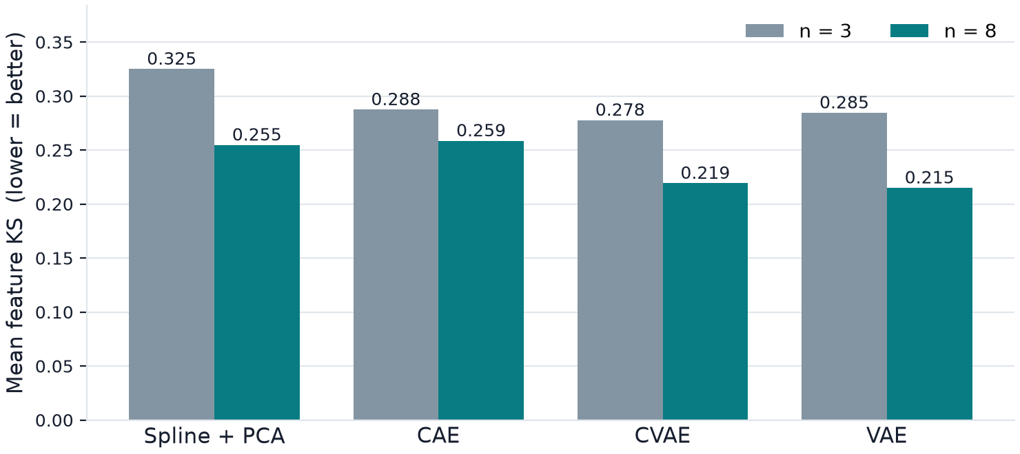
Generation results: VAE leads on movement distributions
8/11
A reversal in the ranking: VAE wins at generation
Although Spline + PCA won pointwise reconstruction, VAE and CVAE achieve much better distribution matching (corrected p < 0.001 under BH and Holm). VAE at n = 8 was set as the dashboard default.
Notes:
Planned: 55 seconds. Slide 8 of 11.

Slide 9
Validating the personal fingerprint (Control Test)
9/11
Does the personal fingerprint really matter?
To verify that the model is not merely producing a generic average movement, we replaced the fingerprint while the decoder, the noise and the conditions stayed completely frozen:
27 / 28
Injected fingerprint centre | CVAE n=8 (Mean KS) | VAE n=8 (Mean KS)
The participant's own centroid | 0.2194 | 0.2151
Training-population mean | 0.2896 | 0.2841
Another test participant | 0.3172 | 0.3144
participants improved markedly
Using the personal fingerprint improved distribution matching against generic attribution (p < 1.5 x 10^-6).
Notes:
Planned: 45 seconds. Slide 9 of 11.

Slide 10
Recommended summary: the trade-off between reconstruction and generation
10/11
To reconstruct known trajectories
For generation and simulation
Spline + PCA
VAE (n = 8)
Recommended when the goal is compact compression and the most accurate pointwise reconstruction of a measured trajectory (MSE = 0.0228).
Recommended for simulating a participant's future movements. Produces the kinematic distributions closest to reality (MMD squared = 0.0639).
! Key caveat
Direct measurement from the participant's own context data still beats latent regressions at predicting pointwise summary measures. The compact representation is meant to generate whole trajectories, not a single number.
Notes:
Planned: 45 seconds. Slide 10 of 11.

Slide 11
The applied product: an interactive dashboard
11/11
1
2
3
Model and dimension
Fingerprint selection
Distribution sampling
Supports CAE, CVAE, VAE and Spline + PCA at dimensions 2, 3, 4 and 8.
Slider control over the latent coordinates and real-time simulation of the resulting trajectory.
Generate 25 to 500 trajectories and compare them against the participant's real data.
Run locally in a terminal:
Streamlit App
python -m streamlit run src/confirmatory_dashboard.py --server.port 8510
Notes:
Planned: 80 seconds. Slide 11 of 11.

Slide 12
Backup: resampling and the two time windows
BACKUP
Model input: target motion to final tracker sample.
Feature input: detected finger onset to end.
A phase of 0.5 means half the selected time interval, not half the path length.
100 samples are a common representation, not 100 independent observations.
Notes:
We start with a regularized 240 Hz grid, smooth using a fourth-order 10 Hz forward-backward Butterworth filter and select the modeled window. We fit a cubic interpolant through the existing filtered points and evaluate it at j/99. This interpolation is different from fitting the later five-knot compression model. Subtracting the first position aligns starts, but does not scale amplitude or rotate paths. We retain initiation and movement seconds as separate targets. Early movement after target motion remains; the earlier appearance interval is outside the modeled window. Source: src/preprocessing.py, src/trajectory_view.py; appendix A1.

Slide 13
Backup: what becomes the PCA matrix?
BACKUP
Object | Dimensions | One row / one column means
Sampled trial | 100 × 2 | Time point / x or y
Spline basis B | 100 x 9 | Time point / basis function
Trial coefficient vector | 18 | Nine x coefficients followed by nine y
Training coefficient matrix | N training x 18 | Trial / coefficient
PCA directions V | 18 x n | Coefficient / retained component
Training latent codes | N training x n | Trial / latent coordinate
Five interior knots + degree 3 + 1 = nine coefficients per axis.
Notes:
Moni asked what we feed into PCA. It is a matrix where each row is one trial's eighteen spline coefficients. We first fit a spline separately to x and y of each trial. Nine x and nine y coefficients give eighteen numbers. We stack training trials and PCA learns n directions in that eighteen-dimensional space. Neither test trials nor validation trials train those PCA directions. The number of knots and the number of latent coordinates are different controls. Source: src/baseline_spline.py, CompactSplineRepresentation; appendix A2.

Slide 14
Backup: fitting and decoding spline + PCA
BACKUP
Fit the two coordinate coefficient vectors by least squares.
Validation selects raw or standardized coefficients.
Inverse PCA gives coefficients; multiplying by B restores the path.
m and d combine centering/scaling; V contains retained PCA directions. Raw PCA uses d = 1.
Notes:
There are two compression steps: sampled path into smooth coefficients, then coefficients into a smaller PCA code. Fit B c_x to x and B c_y to y. The code z is obtained by centering/scaling the coefficient vector and projecting onto retained axes. To decode, apply inverse PCA and inverse scaling, split the eighteen coefficients into two blocks and multiply both by the basis B. Raw PCA still centers columns. PCA optimizes variance in coefficient space and does not guarantee the best trajectory MSE against all methods. Sources: src/baseline_spline.py; appendix A2. The on-slide equation matches the effective forward and inverse transformations.

Slide 15
Backup: predicting physical timing
BACKUP
Stage | Spline + PCA | Neural models
Predictors | n PCA scores + 5 conditions | Latent code + conditions where enabled
Targets | Two standardized log(t + .001) values | Same two standardized targets
Predictor | Ridge, alpha selected on validation | Separate decoder output head
Inverse | Undo scaling, exponentiate, subtract .001 | Same inverse transform
Observed timing never enters the trajectory encoder. Reconstruction-time timing prediction sees the observed shape.
Notes:
The coordinate path is on normalized phase, so the model must predict seconds separately. Initiation is time from target motion to finger onset, movement time is onset to end. We take log(t+.001) to accommodate zeros, standardize training targets, and reverse these transformations after prediction. Spline Ridge receives the code and five conditions, with training input standardization and alpha from .01, .1, 1, 10, 100 selected using validation error on standardized log targets. Neural models have a two-value timing head. Huge positive timing errors were not upper-clipped out of the main scores. Source: src/confirmatory_spline.py, TimingRidge; src/vae_model.py; appendix A3.

Slide 16
Backup: the neural training objective
BACKUP
Coordinate error sums 200 squared differences.
Timing error sums two squared differences and receives weight 20.
KL sums across latent dimensions; the batch averages the total.
Replacing both summed terms by separate MSE means would change the effective timing weight.
Notes:
The actual code uses reduction=none, then sum across output coordinates and mean across trials. We must not simply write MSE plus 20 MSE because one output has two hundred coordinates and the other has two. KL measures how far the encoder's Gaussian posterior is from the standard normal. Beta warms from zero to one over fifty epochs, while checkpoint validation uses the final beta-one objective. Adam learning rate .001, batch size 64, gradient norm clipping at five, patience 25, maximum 150 epochs, three seeds. Source: src/vae_model.py vae_loss; src/train.py; appendix A3.

Slide 17
Backup: VAE, CVAE and CAE
BACKUP
Property | VAE | CVAE | CAE
Trajectory encoder | Two hidden layers | Two hidden layers | Two hidden layers
Task inputs | Masked to zero | Encoder and decoder | Encoder and decoder
Latent training code | Gaussian sample | Gaussian sample | Deterministic
KL penalty | Yes | Yes | No
Reconstruction code | Posterior mean | Posterior mean | Deterministic code
A nonsignificant conditional-model advantage does not mean the experimental conditions are irrelevant.
Notes:
Our VAE is an unconditional ablation in the same code framework. It does not receive meaningful conditions because we zero them at both ends. CVAE uses actual conditions. CAE uses actual conditions but suppresses probabilistic sampling and KL. The condition vector is three one-hot category entries, a side value (left zero, right one), and normalized executed speed. We checked input routes and shuffled conditions. The routes are active, but these results cannot settle whether another architecture or training regime would use conditions better. Source: src/vae_model.py encode_condition/encode_trial_condition; src/train.py; audit records.

Slide 18
Backup: where the generated variation comes from
BACKUP
The personal center averages context codes.
Training residuals estimate within-person latent variation.
Variational models also add average posterior variance.
One shared covariance for every participant; 120 draws around each personal center.
Notes:
For each training person, subtract that person's mean code from each trial code. Pool these residuals and estimate their covariance. Add the mean encoder posterior variance on the diagonal for VAE/CVAE and add a tiny identity regularizer for numerical stability. CAE and spline have no posterior variance term. We do not fit a separate covariance to a new participant's context trials. Generation draws a multivariate normal around their context center and uses the shared decoder. A nonlinear decoder can still produce different visible spread at different centers. Source: src/context_query.py and src/confirmatory_spline.py; appendix A4.

Slide 19
Backup: leakage and held-out evaluation
BACKUP
Information | Training | Validation | Test context | Test query
Fit network/PCA/scalers | Yes | No | No | No
Select checkpoint/settings | No | Yes | No | No
Personal center | No | No | Yes | No
Reconstruction input | No | No | No | Observed path
Generation task mixture | No | No | No | Metadata only
Generation scoring | No | No | No | Paths and timings
Population model fitting and participant enrollment are separate stages.
Notes:
A test person is new to model fitting, but provides context recordings. Query recordings only provide the targets for generation scores, with task metadata allowed for a matched-condition mixture. Reconstruction deliberately reads the query path because that task is compression. None of the test data changes fitted PCA axes, learned neural parameters, training covariance or normalization. This prevents a common misunderstanding: test context is not retraining. Model selection for the final dashboard still used the evaluated cohort, so independent post-selection validation remains future work. Source: participant_folds.json, context_query.py; appendices A1/A4.

Slide 20
Backup: what the eleven features measure
BACKUP
Group | Features
Timing | Initiation time; movement time; relative time to peak speed
Speed | Peak speed; heuristic speed-peak count
Geometry | Path length; straight-line distance; curvature ratio; maximum lateral deviation
Endpoint | Final x; final y
Generated feature computation uses predicted timing and an onset-based movement crop.
Notes:
For observed data we use the onset-to-end movement segment. For generated data we use the predicted initiation fraction to crop the go-to-end path, capped at .98, and floor movement duration at one millisecond. Both movement segments become one hundred phase points and are filtered with cutoff min(10 Hz, .45 times sample rate). Sample rate is 99 over movement seconds. Gradients give speed. Peak count uses prominence ten percent of maximum and roughly fifty milliseconds separation, with at least one reported peak. This is distinct from minimum-jerk component fitting. Source: src/features.py; appendix A5.

Slide 21
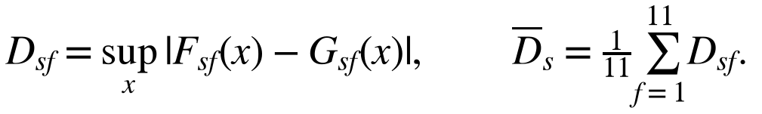
Backup: KS and joint distribution distances
BACKUP
KS: largest gap between two empirical cumulative curves.
Mean KS: average of eleven feature statistics.
Energy and MMD: compare whole vectors and account for joint structure.
KS statistics are not p-values. Correlated features can affect joint geometry.
Notes:
If a recorded feature has seventy percent of trials below a value and the generated feature has forty percent, the empirical CDF gap there is .3. KS takes the largest gap over all thresholds. Its output is a discrepancy. We average discrepancies across features, not significance tests. Energy and MMD use complete feature vectors and can notice dependence between features that separate marginal KS statistics may miss. Standardization comes from training. Correlated features do not mean we should remove whichever feature makes a p-value improve; removal defines a new endpoint. Sources: src/context_query.py; appendix A5/A6; Gretton et al. JMLR 2012.

Slide 22

Backup: energy discrepancy and mean collapse
BACKUP
Energy compares cross-set distances with within-set distances.
A generator needs plausible variation as well as a good center.
Example reference | Mean-path RMSE | Path energy
VAE n=8 | 0.1604 | 0.0548
Repeated context mean | 0.1146 | 0.4621
Lower is better. The mean-only output has a closer mean but a much worse distribution.
Notes:
Average error against all recorded paths can favor a collapsed output near the center. Energy subtracts within-generated and within-recorded distances from twice the cross average, addressing the distributions rather than only their centers. Our energy estimator includes within-sample diagonal zeros and is not square-rooted afterward. The mean-only reference is actual analysis output, not a hypothetical numerical illustration. Source: src/trajectory_distribution.py; trajectory_distribution summary CSV; Szekely and Rizzo 2013; appendix A6/A8.

Slide 23
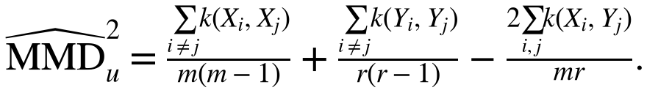
Backup: Gaussian-kernel MMD
BACKUP
Kernel: exp(-gamma x squared Euclidean distance).
Gamma comes from the median positive training pair distance.
Within-set diagonals are excluded in the unbiased estimator.
Finite-sample unbiased MMD squared may be slightly negative. It is not an accuracy percentage.
Notes:
The kernel gives high similarity to close vectors and low similarity to distant vectors. MMD compares average within-recorded and within-generated similarity with cross similarity. The within terms omit identical-element pairs and divide by m(m-1) or r(r-1); cross divides by mr. We estimate gamma once from at most 512 deterministic training trials in each representation and use it for all models in the rotation. Whole paths and feature vectors have different units and scales, so their absolute MMD values are not interchangeable. Source: src/trajectory_distribution.py; src/context_query.py; Gretton et al., A Kernel Two-Sample Test, JMLR 13 (2012).

Slide 24
Backup: 28 paired scores, not thousands of independent trials
BACKUP
First average neural seeds within each participant.
Then compare paired participant scores using two-sided Pratt Wilcoxon.
Round differences to 12 decimals before ranking.
Correction family | Tests
Original seven endpoints x ten pairs x two dimensions | 140
New two path endpoints x ten pairs x two dimensions x two geometries | 80
VAE replacement controls | 6
CVAE replacement controls | 12
BH controls false discoveries under its assumptions. Holm is a familywise-error sensitivity. Nonsignificance is not equivalence.
Notes:
Each participant supplies one score per model for the paired comparison. Three seeds are repeated model fits, not three independent people. Wilcoxon ranks the absolute paired differences and uses their signs. Pratt keeps zeros in ranking but omits their signed contribution. The usual location interpretation assumes a symmetric difference distribution. BH adjusts the complete declared family, not only the comparisons we liked. We additionally show Holm. Training folds overlap, so these remain exploratory comparisons, and a fresh cohort is still needed for replication. No formal three-versus-eight or resampling-reference test was added. Source: src/statistical_tests.py, all_pairs_140.csv, paired_comparisons.csv; appendix A6.

Slide 25
Backup: the boundaries of the conclusion
BACKUP
Useful same-session personal centers do not establish stable traits.
Direct context summaries beat latent linear probes on all 14 tested targets.
Condition routes work, but their value depends on the task and model.
Minimum-jerk decomposition remains a separate investigation.
The 31-page laboratory report retains the extended results and Jason's open questions.
Notes:
We should volunteer the relevant limitation instead of defending every result as a success. Direct context means and standard deviations were more accurate than our latent linear probes, and many probe R-squared values were negative. Matched minimum-jerk component comparisons did not establish corrected model differences. Timing and event assumptions remain important, including the tracker endpoint arriving on average 26 ms before the MATLAB arrival marker. More data might help, but we did not run a learning curve that proves sample count caused the failures. Source: frozen report pp.16-28, production/all_models_direct_context_summary.csv; course Discussion and appendix A10.

Slide 26
Backup: launch and source navigation
BACKUP
Repository terminal:
python -m streamlit run src/confirmatory_dashboard.py --server.port 8510
Browser: http://127.0.0.1:8510
Stop: Ctrl+C in that terminal
The standalone dashboard archive contains launch instructions for use without the full research checkout.
Notes:
Full PowerShell path: cd "D:\oneDrive_Main\OneDrive\Desktop_onedrive\uni2024\Third Year\semester B\Workshop in AI\interception-movements-dl". Then use the command shown, adding --server.address 127.0.0.1 --browser.gatherUsageStats false if desired. On the authoring computer Python is C:\Python313\python.exe. Source navigation: src/vae_model.py and src/train.py for neural models; src/baseline_spline.py and src/confirmatory_spline.py for spline/PCA/Ridge; src/context_query.py and src/features.py for generation/metrics; src/trajectory_distribution.py for full paths; production/audit_2026_09_08 for original result CSVs; production/trajectory_distribution_2026_09_13 for new results. Keep the terminal running during the demo.

