Slide 1
Compact Representations of Human Interception Movements
Low-dimensional models for representing and generating human interception movement
Seman Libbiss & Paz Flashner
Research supervisor: Prof. Jason Friedman | Course advisor: Shimon Shahar
Course lecturer: Prof. Nadav Cohen | Teaching assistant: Yonatan Slutzky
Workshop on Deep Learning | 03683538 | Tel Aviv University
10-minute presentation and live demo

Slide 2
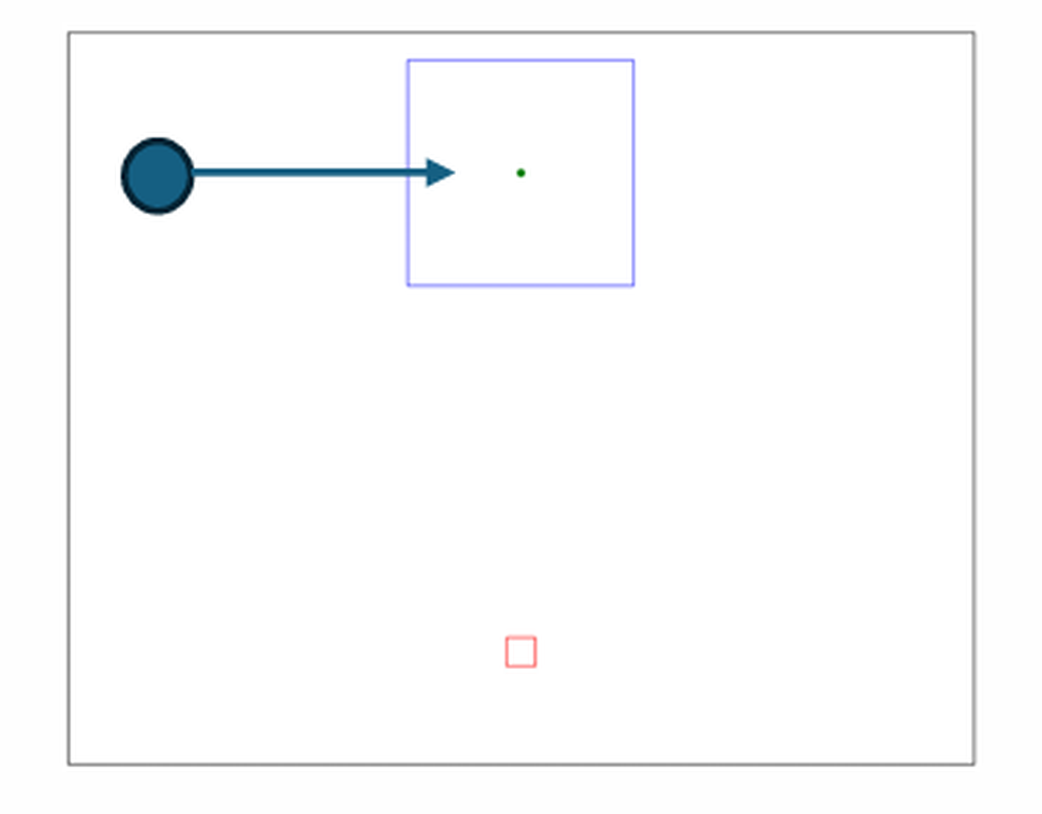
The experimental task and the data structure
50 s | 2/11
The experimental task
• Participant's task: move the finger from the lower start zone into the upper interception square exactly as the ball passes through it.
• Conditions: the free eye-movement condition is analysed. Six target start locations (3 right, 3 left) over a continuous speed range.
• Sample: 4,732 valid trials from 28 participants, measured in 3D at 240 Hz with a Polhemus system.
A strict split that prevents information leakage
Four fixed folds: 17 training participants, 4 validation and 7 test. Every participant appears in a test fold exactly once.
Notes:
Planned: 50 seconds. Slide 2 of 11.

Slide 3
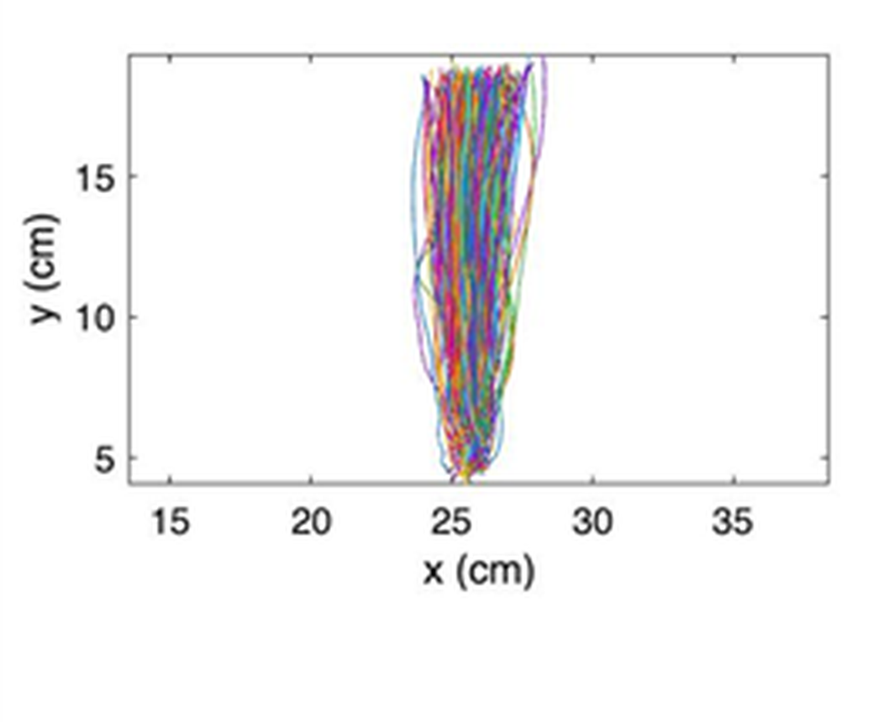
What we set out to answer
40 s | 3/11
The core question
Human movement is stochastic: perception and motor control vary from trial to trial. One participant, one target - and every trial takes a different path.
Can a compact fingerprint capture that spread?
Compress 200 numbers - the 100 × 2 path - into a 3-to-8 dimensional fingerprint of an individual's movement distribution.
100 × 2 coordinates ———> n = 3 or 8 latent numbers (durations predicted)
What would count as success, evaluated on participants the model never trained on
SUCCESS TEST 1
SUCCESS TEST 2
SUCCESS TEST 3
Reconstruct
Generate
Stay personal
Rebuild specific recorded trajectories from the compressed code.
Sample new trajectories matching that person's stochastic distribution.
The fit must come from that person's own fingerprint, not a generic one.
Notes:
Planned: 40 seconds. Slide 3 of 11.

Slide 4
Trajectory processing and the compression architectures
65 s | 4/11
Stage in the model | Spline + PCA (linear baseline) | Neural models (VAE / CVAE / CAE)
Primary input | The same 100 × 2 normalised trajectory | The same 100 × 2 trajectory; CVAE and CAE add 5 task conditions
Where standardisation happens | On the 18 spline coefficients, after fitting | On the 200 coordinates, with train-set constants
Encoder / compression | Cubic B-spline fit, 9 coefficients per axis -> PCA to n latents | Two fully connected 256-unit ReLU layers -> latent n
Decoder / reconstruction | Inverse PCA -> multiply by the spline basis for the full path | Two 256-unit ReLU layers -> separate heads for 200 coordinates and 2 durations
Timing prediction | Separate Ridge regression on the PCA scores + conditions | Dedicated head predicting initiation and movement time
Three neural variants, one architecture
VAE - variational autoencoder, trained on the trajectory alone. CVAE - conditional variational autoencoder, which also receives the task conditions. CAE - conditional autoencoder, the same network without the variational latent.
All are compared at identical latent dimensions, n = 3 (extreme compression) and n = 8 (extended capacity).
Notes:
Planned: 65 seconds. Slide 4 of 11.

Slide 5
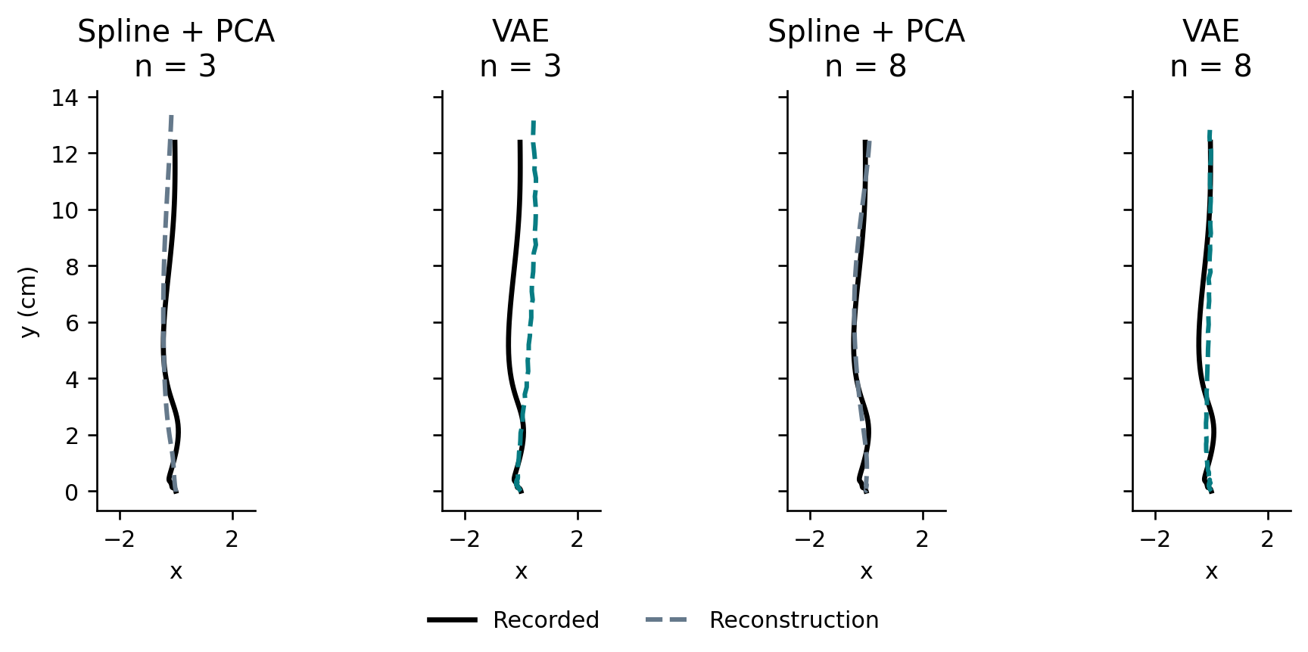
Task 1: Trajectory Reconstruction
45 s | 5/11
Trajectory reconstruction error (MSE, cm²)
Model | MSE n=3 | MSE n=8
Spline + PCA | 0.0972 | 0.0228
VAE (Unconditional) | 0.1483 | 0.0335
Conditional AE (CAE) | 0.1697 | 0.0260
CVAE | 0.1770 | 0.0325
Condition-only Ridge (Floor) | 1.2338 | 1.2338
Key insight on pointwise reconstruction
PCA wins at reconstructing a single trajectory.
One median-duration trial. Black: recorded; dashed: reconstructed. Both axes in cm at equal scale.
As a linear projection, PCA is analytically optimal for minimising squared error among all linear methods. VAEs trade off pointwise accuracy to obtain a continuous and samplable latent space.
Notes:
Planned: 45 seconds. Slide 5 of 11.

Slide 6
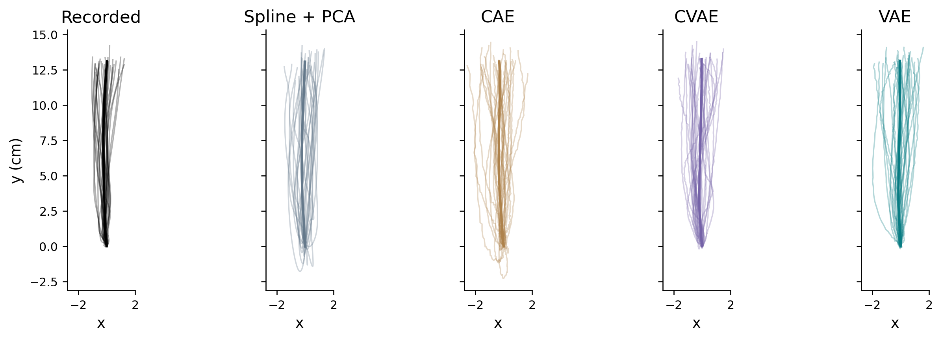
Task 2: generating a personal movement distribution
60 s | 6/11
How do we generate movements from a fingerprint?
• Enrollment: earlier context trials of the participant, whose mean defines the personal fingerprint centre.
fingerprint centre: θ_s = (1 / |C_s|) Σ c_i
• Stochastic sampling: draw 120 latent vectors around that centre using a shared covariance learned from training data.
one generated movement: z ∼ N ( θ_s , Σ_train )
• Unseen movements: query trials are held aside to evaluate the distribution and are never exposed to the model.
c_i is the trial's code: the encoder mean μ_i for the neural families, the PCA scores for spline + PCA.
Below, n = 8. Thin: first 30 draws. Thick: their mean. Equal x/y scale, cm.
Notes:
Planned: 60 seconds. Slide 6 of 11.

Slide 7
How we score a generated distribution
30 s | 7/11
WHAT WE MEASURE
HOW WE COMPARE
11 kinematic features
Two views of the distribution
Initiation and movement time, peak speed, time to peak, path length, straight-line distance, curvature, maximum lateral deviation and the three endpoint coordinates.
One KS test per feature, averaged over the 11 into Mean KS. Energy discrepancy and MMD squared judge the joint structure of all 11 at once. Lower is better throughout.
One fixed yardstick for every model
Feature scales and the RBF bandwidth are fitted on training participants only and then frozen, so every model is measured against the same geometry rather than one tuned to its own output.
Notes:
Planned: 30 seconds. Slide 7 of 11.

Slide 8
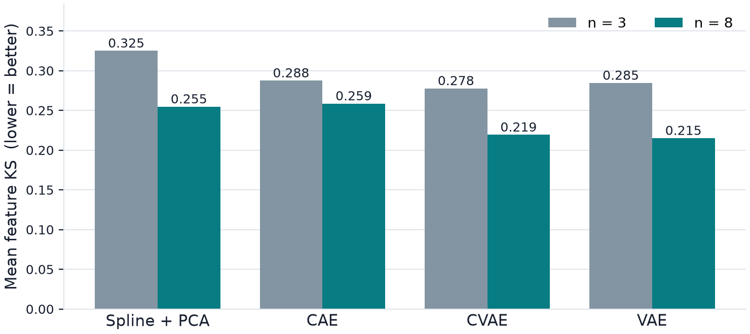
Generation results: VAE leads on movement distributions
55 s | 8/11
A reversal in the ranking: VAE wins at generation
Although Spline + PCA won pointwise reconstruction, VAE and CVAE achieve much better distribution matching (corrected p < 0.001 under BH and Holm). VAE at n = 8 was set as the dashboard default.
The two joint measures agree: at n = 8, VAE reaches energy 0.4110 and MMD squared 0.0639, against 0.7347 and 0.1153 for Spline + PCA.
Notes:
Planned: 55 seconds. Slide 8 of 11.

Slide 9
Full-trajectory generation
9/11
Do generated paths match the held-out set of complete trajectories?
Energy and MMD² compare between-set differences with within-set variability. Lower is better.
Full-path energy (cm)
Full-path MMD squared
Vs spline, same n: * BH + Holm < .05 † BH only ns neither | 28 participants; paired tests, 80 comparisons
At n=8, VAE and CVAE outperform spline + PCA on both distances
The finding also survives balancing the x/y axes. VAE and CVAE are not significantly different; n=3 evidence is mixed.
Notes:
This is our new central analysis. We flatten each whole phase-normalized path and divide by square root of 200. Euclidean distance then means RMS coordinate difference. Energy and MMD compare the generated set with the held-out set and also account for within-set variation. At eight dimensions both variational models improve on spline, and this survives both multiple-testing corrections and equalizing the training variation of the two axes. Their difference from each other is not significant. At three dimensions, raw MMD favors them over spline, but raw energy does not, and balanced-axis MMD no longer passes BH. This is why the eight-dimensional conclusion is stronger. These are phase-path results, not a validation of physical timing. Source: production/trajectory_distribution_2026_09_13/summary.csv, paired_comparisons.csv and protocol.json. Bars show participant-balanced means after seed averaging. Markers compare each bar with the reference named above the chart, using the saved adjusted paired tests. In model-comparison charts, * means BH and Holm both pass .05; dagger means BH only; ns means neither. The personal-center chart uses its original BH-corrected control family. There are no error bars, and no p-value has been converted into an uncertainty interval.
Explain: each generated path and each recorded query path is a 200-coordinate vector. This is a set-to-set comparison, not pairing trial 1 with trial 1. Each participant contributes one score per model after averaging training seeds. The bars give equal weight to each of the 28 participants. A significance marker indicates a difference, not automatically an improvement; lower bars are better. Three-dimensional CAE energy is significantly worse under BH only. Exact values and adjusted p-values are in the source course_slides.json and the trajectory_distribution_2026_09_13 CSVs. The selected plot uses raw RMS coordinates, so energy has units cm and MMD² is dimensionless. A smaller distance does not by itself prove absolute physiological realism.

Slide 10
Personal context improves generation
10/11
Replace only the fingerprint center; keep the decoder, noise and conditions fixed.
Mean feature KS (lower is better)
27 / 28
participants had lower mean KS
Own center vs population center
VAE, n=8
* Different from own center: BH-adjusted p < .05
The correct personal center improves the generated feature distributions
Both n=8 models improve on population and other-person centers. This supports useful personal information within the session.
Notes:
This is the direct check that the personal center helps the generator. Replacing it by a population center or another person’s center makes the feature distributions worse. We keep random draws and other inputs fixed, so the center is what changes. This supports useful information about this participant’s session. It does not give a name to each latent axis or show the same fingerprint would remain stable on another day. The control uses feature endpoints; we have not repeated it on the new full-trajectory endpoints. Source: frozen laboratory report section on personal fingerprints; course report Figure 3 and appendix A4. Bars show participant-balanced means after seed averaging. Markers compare each bar with the reference named above the chart, using the saved adjusted paired tests. In model-comparison charts, * means BH and Holm both pass .05; dagger means BH only; ns means neither. The personal-center chart uses its original BH-corrected control family. There are no error bars, and no p-value has been converted into an uncertainty interval.
The 27/28 count is specifically VAE n=8 mean feature KS, own center versus population center. It is not an identification accuracy and not a claim of individual significance for 27 people. Mean KS: CVAE8 own .219404, population .289636, wrong .317203; VAE8 own .215121, population .284126, wrong .314405. CVAE mean-KS control BH q: population 3.397464752e-7, wrong 2.086162567e-7. VAE both 2.980232239e-8. Each wrong-person result averages alternative test-person centers. CVAE adjustment family has 12 contrasts; VAE n=8 has 6. Sources: studies/review_corrected_evaluation/results/review_controls/fingerprint_paired.csv and production/audit_2026_09_08/uvae8_fingerprint_paired.csv.

Slide 11
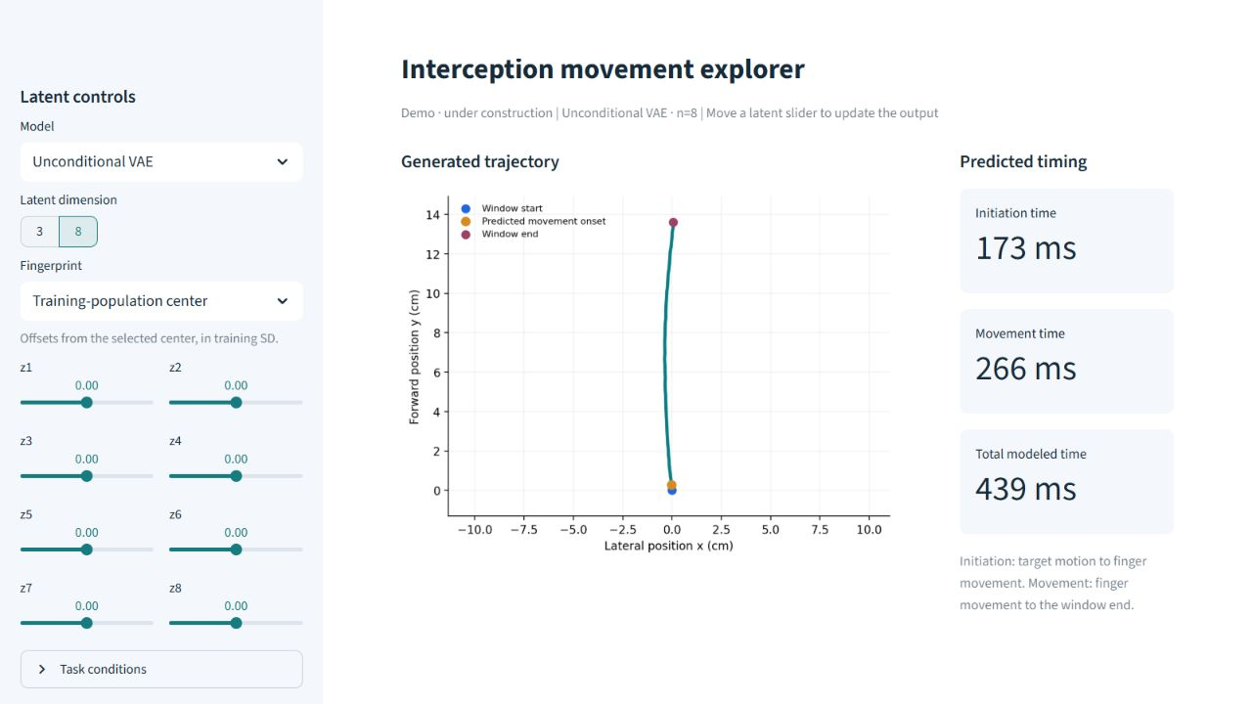
An interactive dashboard
11/11
Explore a latent representation and see its generated trajectory and predicted timing.
Notes:
Live demo, under construction. Double-click demo/START_DEMO.cmd to open Chrome. The original research dashboard is unchanged. Start with VAE n=8, move a latent offset, then optionally switch to n=3 or another model. Each move decodes one latent vector and separately predicts movement and initiation times. It does not sample a distribution or predict one particular future trial. The selected center is the training-population center or a saved context fingerprint. Offsets are measured in training-latent standard deviations; latent axes do not have established psychological meanings. VAE ignores task-condition controls; spline + PCA uses conditions for timing only. All live references are fold 0, seed 42 for neural models. Source: demo/app.py; src/confirmatory_dashboard.py decode; src/dashboard_models.py. Screenshot: the actual locally running demo.

