Slide 1
Modeling interception movement distributions
Seman Libbiss and Paz Flashner
Workshop on Deep Learning, Tel Aviv University
Jason Friedman and Moni Shahar
A compact personal representation for stochastic movement generation
1 / 10
Notes:
Our goal is to model the variability of interception movements using a compact representation of a participant. We compare neural models with spline plus PCA and implement them in a dashboard. The principal result concerns generation at eight dimensions. Three numbers were our original compact target, so we keep that comparison visible. Say distribution, rather than promising an exact prediction of the next trial. Sources: course report Abstract and Introduction.
Suggested duration: 25 seconds. Design reference: Paz Flashner's production/presentation_styled.pdf. Content: course report and evidence tables.

Slide 2
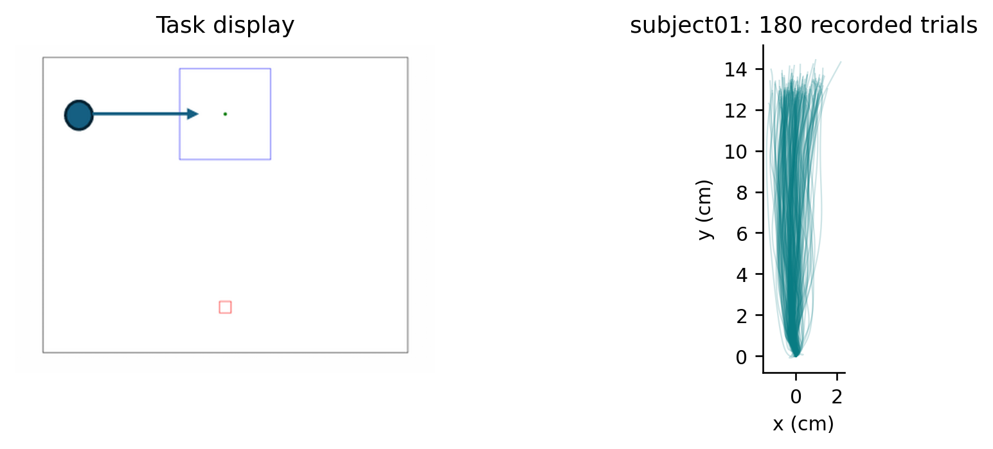
The task and the evaluation split
4,732 trials from 28 participants
Four rotations: 17 train / 4 validation / 7 test
Free eye movement. All 180 trajectories from the first participant by identifier. Median retained trials: 179.5.
2 / 10
Notes:
The participant moves a finger from the lower starting region to the upper interception region as the target arrives. There are three starting categories on each side, with a related speed range. We excluded four trials without an arrival and 27 very late arrivals. The two low-count participants mostly had fewer files available, not extensive exclusions. Population training excludes the seven test people. We then use some recordings from each test person as context and reserve the other recordings as query. Source: course report section 2; src/data_loading.py, src/preprocessing.py; production/cohort_trial_counts.csv. Task image: production/presentation_assets/task_schematic.png, inherited from Paz’s supplied presentation. Data were collected by Beatris Giterman in Jason Friedman’s laboratory. Spatial coordinates are cm; nominal starting positions are mm from screen center.
Suggested duration: 50 seconds. Design reference: Paz Flashner's production/presentation_styled.pdf. Content: course report and evidence tables.

Slide 3
The compression pipelines
Every trajectory becomes 100 x 2 positions on normalized time.
Stage | Spline + PCA | Neural models
Input | 100 x 2 positions | 200 standardized coordinates
Encoder | 9 coefficients per axis; PCA on N x 18 matrix | Two 256-unit layers; n-value code
Decoder | Inverse PCA; two spline basis products | Two 256-unit layers; 200 coordinates
Timing output | Ridge on code + 5 conditions | Separate two-duration head
VAE: variational autoencoder. CVAE adds task conditions; CAE uses a deterministic code. Matched n = 3 and 8.
3 / 10
Notes:
First we resample a filtered go-to-end recording onto 100 equally spaced phases. This keeps relative waiting but removes seconds from the coordinate input. In spline plus PCA, one trial gives nine x and nine y spline coefficients. We stack training trials as rows, giving N by 18, and fit PCA on that matrix. The neural model receives the 200 coordinate values directly after training-derived standardization. CVAE and VAE have mean and variance heads and a KL penalty. CAE is deterministic and has no KL penalty. CVAE/CAE receive conditions at encoder and decoder; VAE zeros them. The timing targets are never encoder inputs. The separate methods explanation PDF explains the actual objective and inverse matrices. Sources: src/baseline_spline.py, src/confirmatory_spline.py, src/vae_model.py, src/train.py. Five interior knots plus cubic degree three plus one give nine basis coefficients per axis. Timing uses log(t + 0.001) to accommodate zero and compress its scale, then training standardization.
Suggested duration: 65 seconds. Design reference: Paz Flashner's production/presentation_styled.pdf. Content: course report and evidence tables.

Slide 4
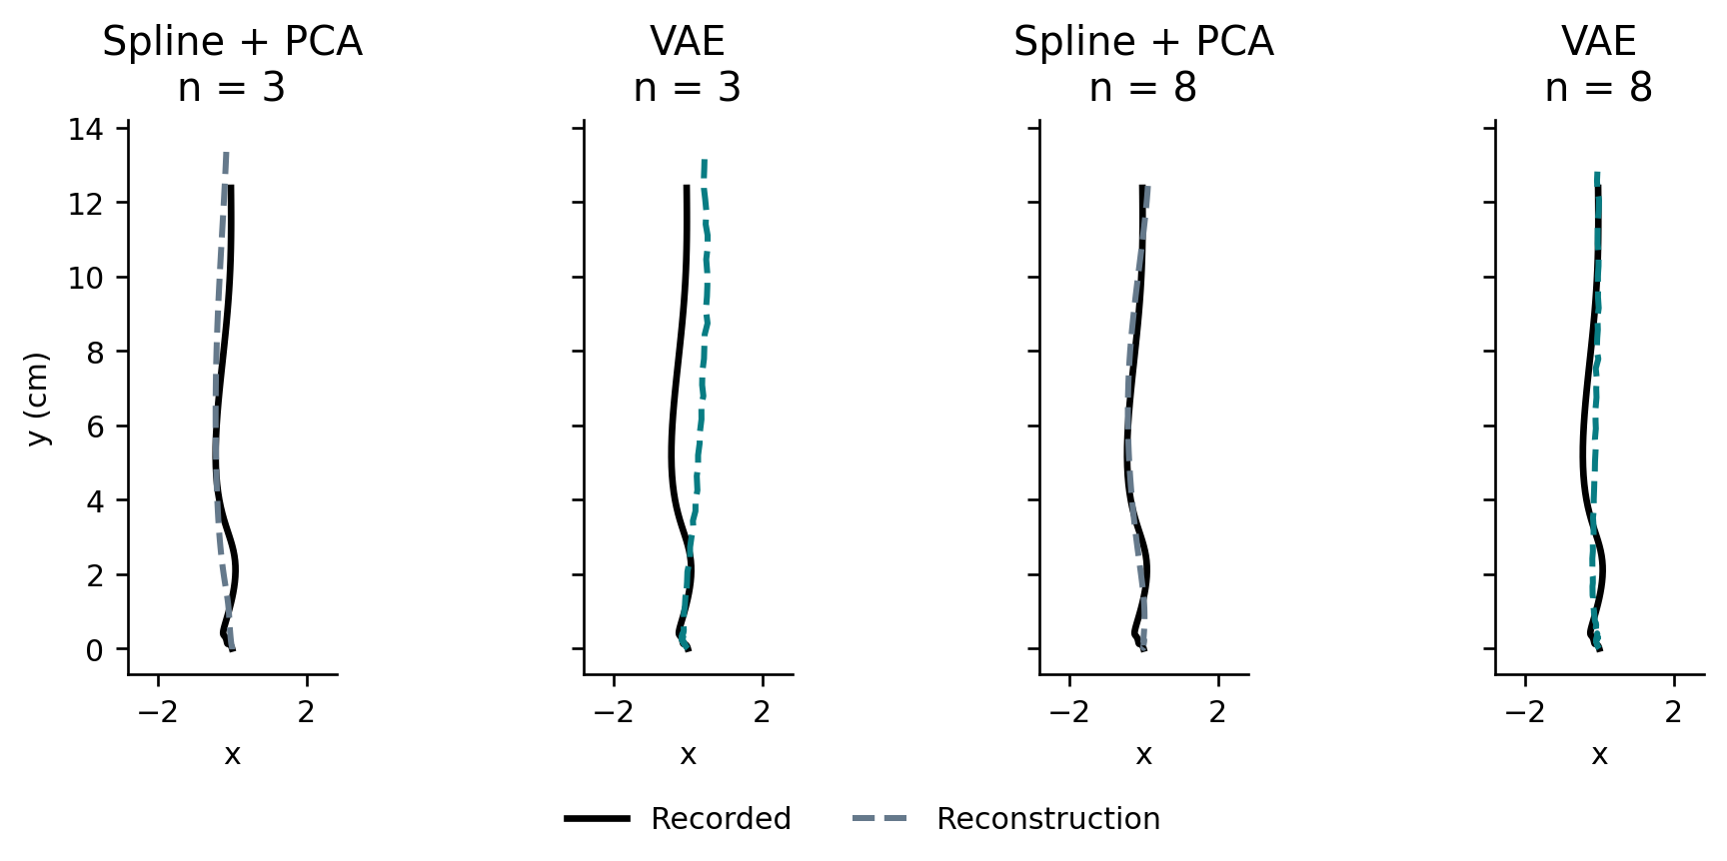
Reconstruction favors spline + PCA
The encoder receives the observed test trajectory.
Reconstruction MSE (cm²)
Black: recorded; dashed: reconstructed. One median-duration trial. Lower MSE is better. Spline beats each neural model under BH-140; spline vs CAE n=8 does not survive Holm.
4 / 10
Notes:
Reconstruction means compressing and decoding the same observed trajectory. We compare the resulting 200 coordinates with the original and average squared errors. Thus it measures information retained by the representation; it is not a prediction without seeing the trial. Scores first average within person and across neural seeds, then equally across 28 people. Spline has the lowest mean at both capacities. The six spline-versus-neural comparisons pass BH, but the spline-versus-CAE eight-dimensional difference has Holm p=0.106. The other five survive Holm. VAE wins the neural reconstruction comparison at three dimensions under BH; CAE is best at eight. Source: production/audit_2026_09_08/all_model_means.csv and all_pairs_140.csv.
Suggested duration: 45 seconds. Design reference: Paz Flashner's production/presentation_styled.pdf. Content: course report and evidence tables.

Slide 5
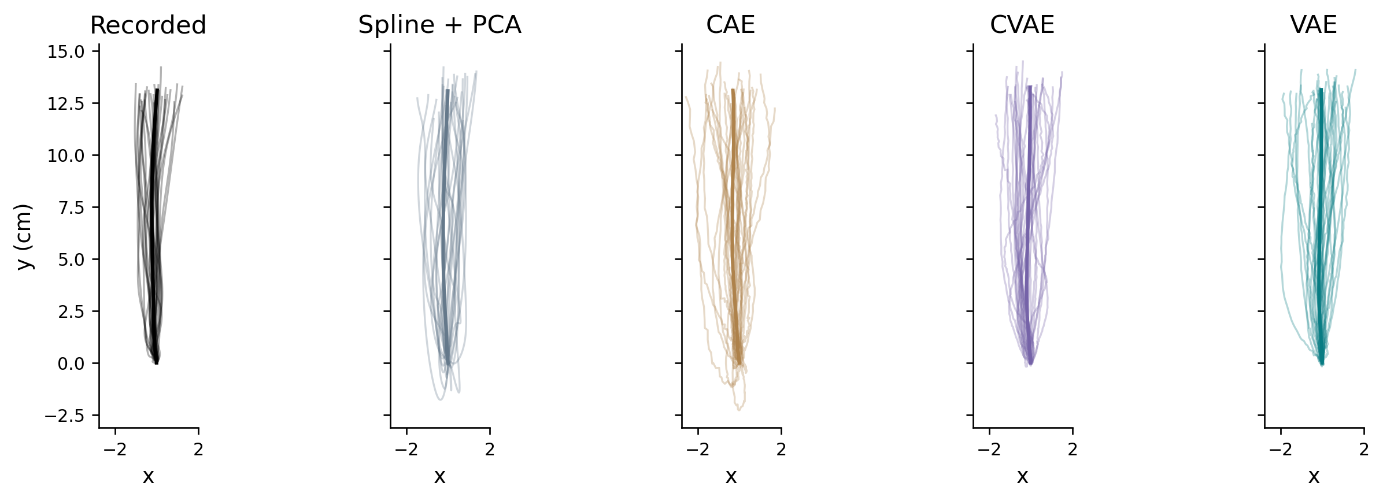
Generation uses separate context trials
Context codes establish a personal center. We decode 120 draws around it using shared training covariance.
Same participant, separate query recordings. n=8, all models. Both capacities appear in the report. Thin: first 30 paths. Thick: mean of all paths. Equal x/y scale in cm.
5 / 10
Notes:
A fingerprint is the average of the encoded context means. We then add training-derived latent noise to that center and decode 120 movements. All participants share the covariance, but their centers differ. VAE generation here is not simply drawing from the standard-normal training prior. For CVAE the query-condition mixture supplies conditions, but the decoder never receives the actual query paths or their durations. The comparison is between two sets of trials, so there is no correct one-to-one pairing of a generated path with an observed trial. Source: src/context_query.py, src/confirmatory_spline.py, scripts/run_review_controls.py; appendix A4.
Suggested duration: 60 seconds. Design reference: Paz Flashner's production/presentation_styled.pdf. Content: course report and evidence tables.

Slide 6
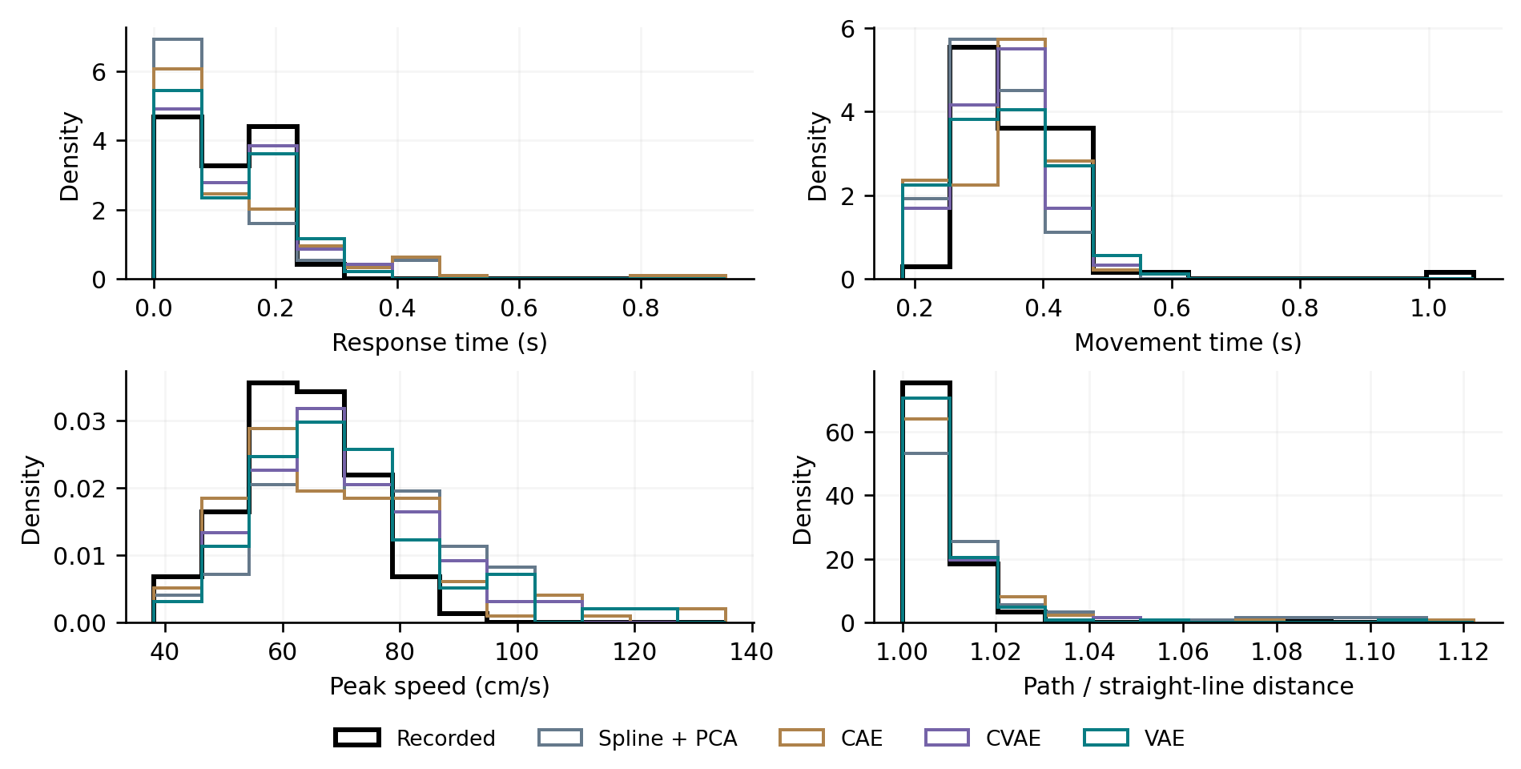
Generated kinematic-feature distributions
Histograms show timing, speed and curvature. KS summarizes agreement across eleven features.
Mean feature KS
Illustration: subject01, n=8. VAE/CVAE beat spline on all three feature metrics at both capacities (BH and Holm-140). VAE and CVAE give comparable results.
6 / 10
Notes:
KS measures the largest gap between empirical cumulative curves for one feature. We average eleven KS statistics, not eleven p-values. Energy and MMD instead compare the joint eleven-feature vectors after training standardization. VAE eight has mean KS 0.2151, energy 0.4110 and MMD squared 0.0639. CVAE is close. VAE versus CVAE eight has BH q=.0257 for energy, .137 for KS and .0518 for MMD; none survives Holm. We can select VAE as a practical default but cannot claim it significantly wins every endpoint. Features depend on predicted durations as well as shape. Sources: course report Table 2; audited means and 140-test CSV. The figure uses density histograms with twelve shared bins per feature and the same stored samples. Histograms are illustrations; KS still uses the original empirical cumulative distributions without binning.
Suggested duration: 55 seconds. Design reference: Paz Flashner's production/presentation_styled.pdf. Content: course report and evidence tables.

Slide 7
Full-trajectory generation supports VAE and CVAE
Energy and MMD compare complete sets of ordered paths, including their variability.
Full-path energy (cm)
Full-path MMD squared
Lower is better. At n=8, both VAE/CVAE beat spline (BH and Holm-80), also with balanced axes. VAE vs CVAE: q=.672 and 1.000. At n=3, results depend on metric and scaling.
7 / 10
Notes:
This is our new central analysis. We flatten each whole phase-normalized path and divide by square root of 200. Euclidean distance then means RMS coordinate difference. Energy and MMD compare the generated set with the held-out set and also account for within-set variation. At eight dimensions both variational models improve on spline, and this survives both multiple-testing corrections and equalizing the training variation of the two axes. Their difference from each other is not significant. At three dimensions, raw MMD favors them over spline, but raw energy does not, and balanced-axis MMD no longer passes BH. This is why the eight-dimensional conclusion is stronger. These are phase-path results, not a validation of physical timing. Source: production/trajectory_distribution_2026_09_13/summary.csv, paired_comparisons.csv and protocol.json.
Suggested duration: 70 seconds. Design reference: Paz Flashner's production/presentation_styled.pdf. Content: course report and evidence tables.

Slide 8
The participant’s own center improves generation
We change the center while holding decoder, noise and task draws fixed.
Mean feature KS after replacing the center
Mean feature KS; lower is better. All VAE control comparisons: BH q < 1.6×10⁻⁶ (6 tests). All CVAE comparisons: q < .000382 (12 tests).
8 / 10
Notes:
This is the direct check that the personal center helps the generator. Replacing it by a population center or another person’s center makes the feature distributions worse. We keep random draws and other inputs fixed, so the center is what changes. This supports useful information about this participant’s session. It does not give a name to each latent axis or show the same fingerprint would remain stable on another day. The control uses feature endpoints; we have not repeated it on the new full-trajectory endpoints. Source: frozen laboratory report section on personal fingerprints; course report Figure 3 and appendix A4.
Suggested duration: 45 seconds. Design reference: Paz Flashner's production/presentation_styled.pdf. Content: course report and evidence tables.

Slide 9
What the compact model achieves
Stored context resampling has lower mean path discrepancy.
It retains complete paths, while the compact models retain a personal center.
Raw path reference | Energy (cm) | MMD²
VAE n=8 | 0.0548 | 0.0238
Resample stored context | 0.0328 | 0.0054
Repeat context mean | 0.4621 | 0.2452
Descriptive reference means. Resampling retains all context paths; repeating their mean loses movement variability.
9 / 10
Notes:
Our main conclusion is useful compact generation, not that deep learning beats every possible baseline. Keeping the entire context paths and resampling them yields lower mean discrepancies. That uses more participant memory and cannot be summarized as an eight-number fingerprint. Repeating only the context mean is much worse as a distribution despite having a good mean-path error. Direct context behavioral summaries also beat our latent linear probes. These observations describe what compression loses and motivate a richer model. Default selection used this cohort and needs independent confirmation. Sources: full-path summary CSV; production/all_models_direct_context_summary.csv; course Discussion. The new nine-feature sensitivity is covered in Appendix A11. Both variational models retain their corrected advantage over spline, but VAE versus CVAE does not pass BH on any reduced-feature metric.
Suggested duration: 45 seconds. Design reference: Paz Flashner's production/presentation_styled.pdf. Content: course report and evidence tables.

Slide 10
Dashboard demonstration
VAE n=8 is the default. Explore n=3, CVAE, CAE and spline + PCA alongside the cohort results.
Explore recorded and generated paths, feature distributions and model benchmarks for the same session.
10 / 10
Notes:
Open the dashboard already running in a browser. Explain that generated curves are samples, not predictions paired with particular recorded trials. Show the VAE eight default, then three dimensions and an alternative model. Do not interpret a single chosen plot as the significance test. VAE does not respond to condition controls because it ignores conditions. Spline condition changes affect only timing; CVAE/CAE use conditions for shape and timing. Finish with Benchmarks. If live launch fails, the slide contains recorded and generated examples from a fixed subject, chosen by identifier. Launch from the repository: python -m streamlit run src/confirmatory_dashboard.py --server.port 8510 --server.address 127.0.0.1 --browser.gatherUsageStats false. Open http://127.0.0.1:8510. Ctrl+C stops the terminal server. Source: production/MULTIMODEL_UPDATE.md; src/confirmatory_dashboard.py; generated-array figure provenance in course_figures.py.
Suggested duration: 80 seconds. Design reference: Paz Flashner's production/presentation_styled.pdf. Content: course report and evidence tables.

