Slide 1
Affinity Propagation Clustering
Unsupervised Machine Learning Approach

Slide 2
Introduction
• Clustering is an unsupervised ML technique.
• Affinity Propagation does not require number of clusters in advance.
• It works by finding exemplars (cluster centers).

Slide 3
Algorithm Concept
• Exchanges messages between sample pairs.
• Chooses exemplars (cluster centers) automatically.
• Preference values determine number of clusters.

Slide 4
Code Snippet: Model Training
from sklearn.cluster import AffinityPropagation
ap = AffinityPropagation()
labels = ap.fit_predict(x)
cluster_centers = ap.cluster_centers_

Slide 5
Code Snippet: Visualization
plt.scatter(x[:, 0], x[:, 1], c=labels, cmap='rainbow', s=30)
plt.scatter(cluster_centers[:, 0], cluster_centers[:, 1],
color='black', marker='X', s=200, label='Centers')
plt.title('Affinity Propagation Clustering')
plt.legend()
plt.show()

Slide 6
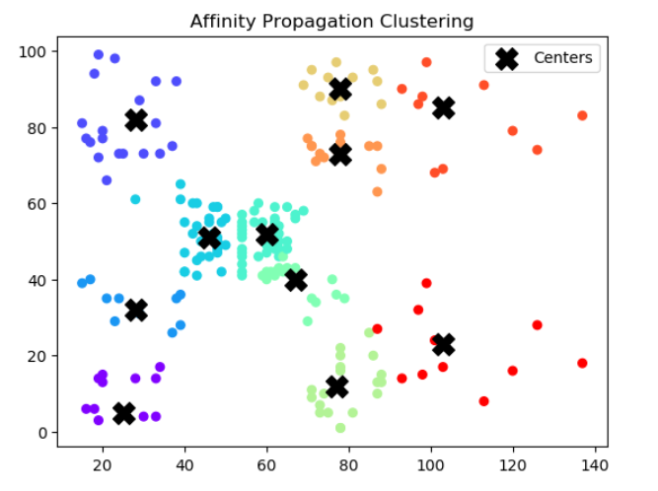
Visualization Output
Clusters discovered using Affinity Propagation

Slide 7
Advantages
✓ No need to pre-specify cluster count
✓ Automatically discovers clusters
✓ Works well for small to medium datasets

Slide 8
Limitations
⚠ Computationally expensive for large datasets
⚠ Sensitive to preference parameter
⚠ May take longer time for convergence

Slide 9
Conclusion
• Affinity Propagation is a powerful alternative to K-Means.
• Finds number of clusters automatically.
• Good for exploratory data analysis.

