Slide 1
EMPLOYEE MANAGEMENT SYSTEM
MINI PROJECT
BY
PAZHANISAMY.K
(REG.NO: A20MCS08 )
UNDER THE ABLE GUIDANCE
OF
Dr. A. VICTORIA ANAND MARY M.C.A., M.Phil., B.Ed., SET, Ph.D.,
Assistant. Professor
PG and Research Department of Computer Science
St. Joseph's College of Arts and Science (Autonomous), Cuddalore-1

Slide 2

The mini project titled “Employee Management System” is designed to computerized the employee details of an organization or a company.
The project is developed with “PHP” as the front end and “MYSQL” as the backend.
The text editor Subline Text Editor is used with coding language PHP.
The Employee Management System will automate the operations performed over the information about the employee.
This computerization will help in many instances and reduce the workload of company as most of the manual work is reduced.
The project will store the personal and official details of an employee like employee name, employee id, contact details, address, salary, project details and leave.

Slide 3



PERIPHERAL | SPECIFIACTION
PROCESSOR | AMD PRO
RAM | 1 GB OR MORE
MONITOR | 17” MONITOR
KEYBOARD AND MOUSE | NORMAL
COMPONENT | TOOLS OR APPLICATION
FRONTEND | HTML 5, CSS 3
SERVER SIDE SCRIPTING | PHP 8.0.2
CLIENT SIDE SCRIPTING | JAVASCRIPT, AJAX
BACKEND | MYSQL 5.0.4
IMAGE & VIDEO | PICSART 18.3.2, KINEMASTER 5.2.2
DESIGNING TOOLS | SUBLIME TEXT EDITOR 3.0
EXECUTION SERVER | XAMPP SERVER 8.0.2

Slide 4
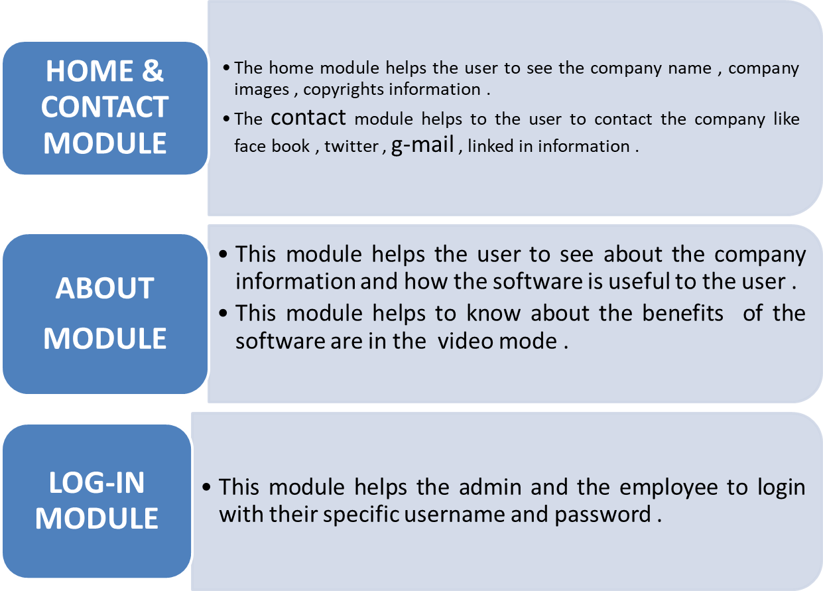

MODULE DESCRIPTION (GENERAL )

Slide 5
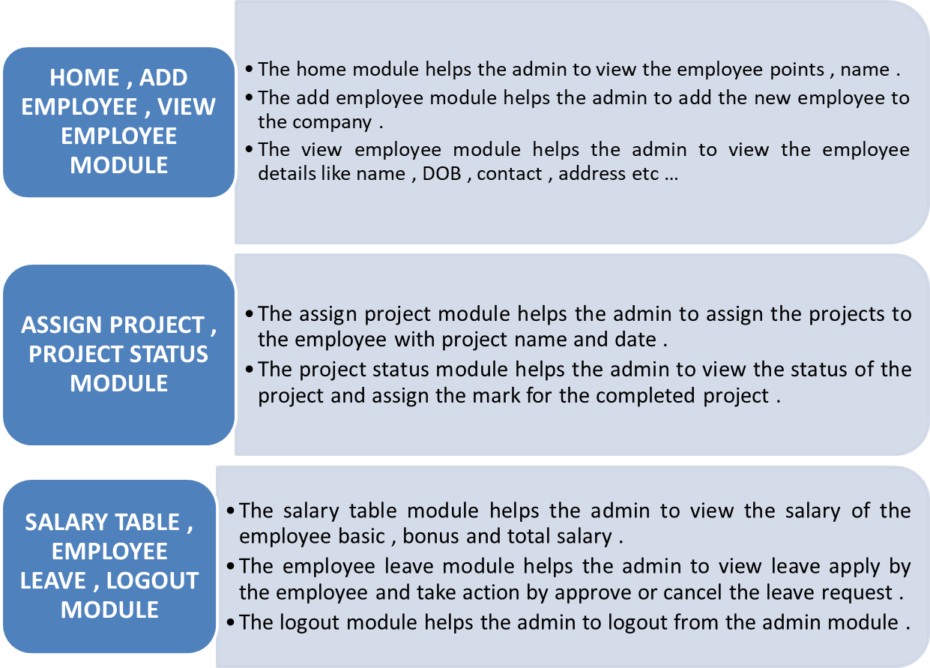
MODULE DESCRIPTION (ADMIN )

Slide 6
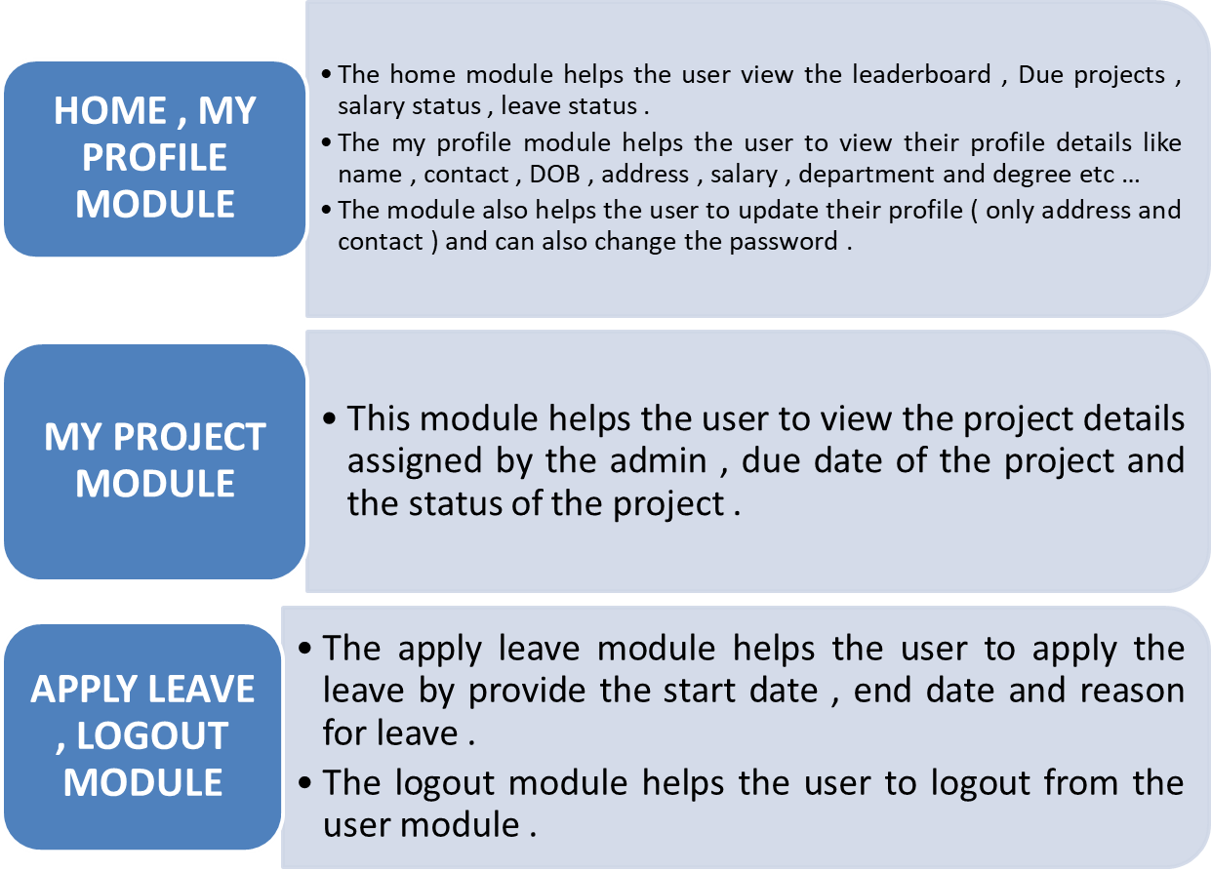
MODULE DESCRIPTION ( USER )

Slide 7
DATABASE DESCRIPTION
DATABASE NAME | EMS
TABLE NAME | ALOGIN
FILED NAME | DATATYPE
Id | integer
Email | varchar
password | varchar

Slide 8
DATABASE DESCRIPTION
DATABASE NAME | EMS
TABLE NAME | EMPLOYEE
FILED NAME | DATATYPE
Id | integer
Firstname | varchar
Lastname | varchar
email | varchar
Password | Text
Birthday | Date
Gender | Varchar
Contact | Integer
Address | Varchar
Degree | Varchar

Slide 9
DATABASE DESCRIPTION
DATABASE NAME | EMS
TABLE NAME | SALARY
FILED NAME | DATATYPE
Id | Integer
Base | Integer
Bonus | Integer
Total | Integer

Slide 10
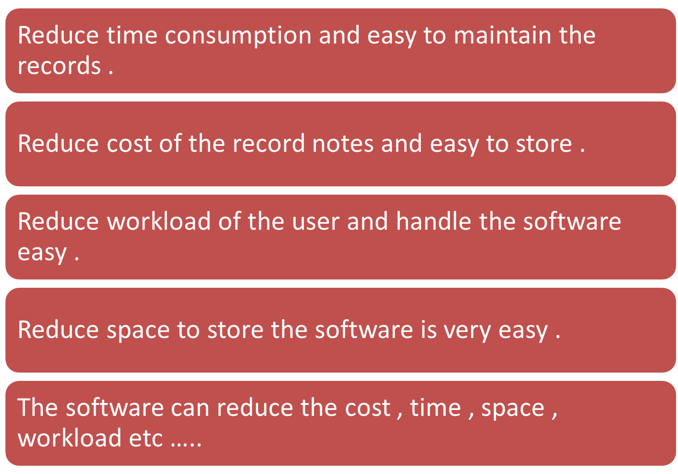
ADVANTAGES OF THE PROJECT

Slide 11
EMPLOYEE MANAGEMENT SYSTEM
MINI PROJECT WORK
BY
PAZHANISAMY.K
(REG.NO: A20MCS08 )
THANK YOU

