Slide 1
Project Maze
Short Introduction
Made by: Pázmányi Sándor

Slide 2
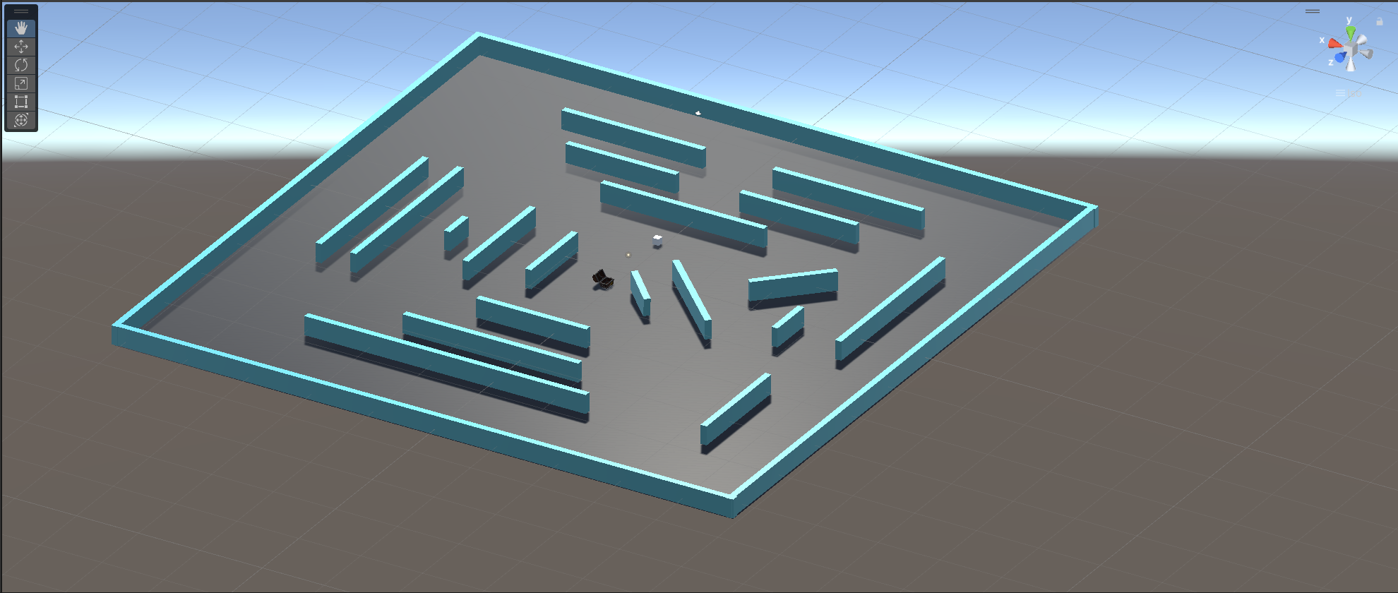
The Maze
Treasure
Agent
Walls and Obstacles

Slide 3
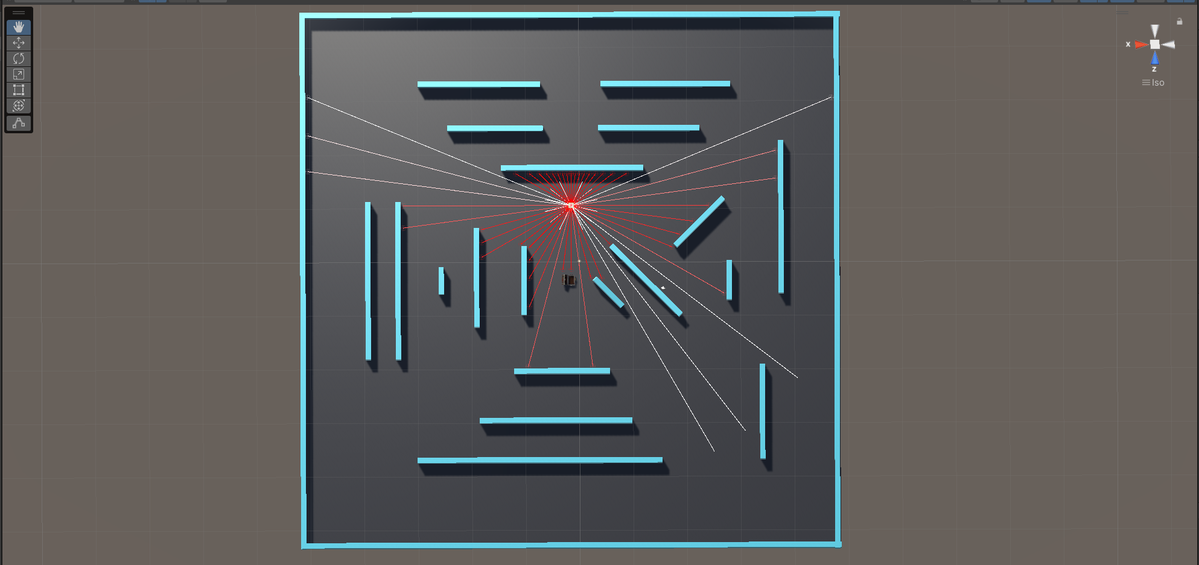
The Sensors of the Agent
Detecting closer Obstacles
Short range
Detecting the Treasure
Long range

Slide 4
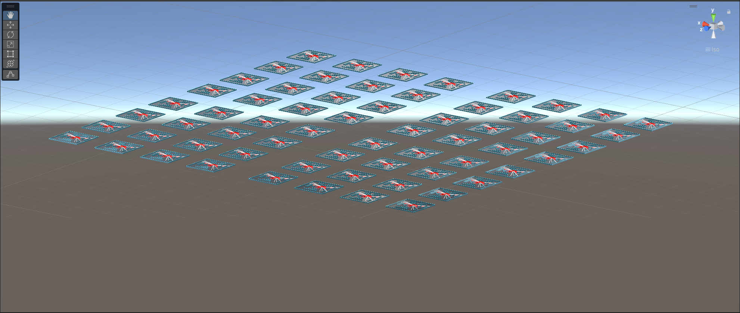
The Testbed Scene, used to traing the Agent

Slide 5
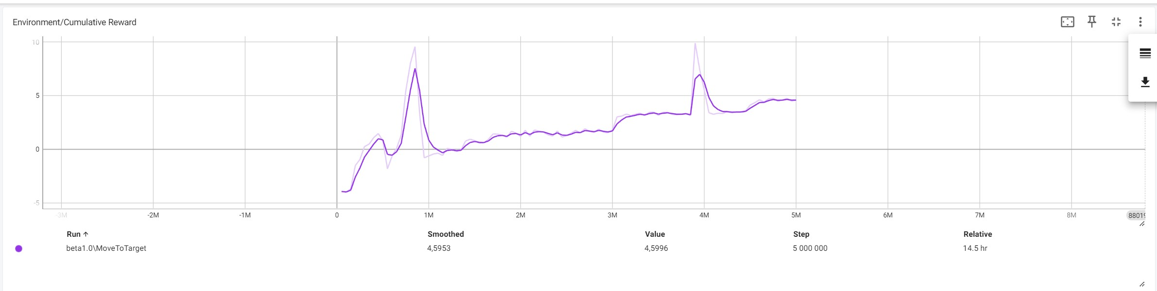
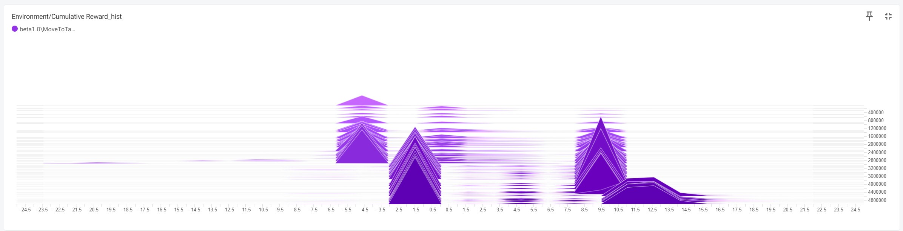
The Agent started to use Sensors
The Environment’s rotation started
Uprades:
Fine-tuning settings
Added the 2. Sensor
Moving Agent towards the centre if idle
Punishment for being idle
Fine-tuning rewarding system
Added more Environments
Last fine-tunings

