Slide 1
Ship Bunker Prices Web Scraper
Web scraping application, running in the background as a Windows Service
By Kosmas Stamos

Slide 2
Legal Notice
This work is not in any legal grey or red zone since:
It doesn’t infringe, use, publish any kind of personal data in the broader sense (in accordance with the GDPR law framework)
The data acquired is public and factual information
No copyright infringement took place, since no website elements ( in the case of Screen Scraping* ) were gathered in the process, just raw data.
The work in not intended for commercial use or reproduction, republish as my own work, and it’s results won’t be used as a source for further research or conclusions
No commercial use of any kind is planned or depends on the gathered data
The work is thus protected by article 3 and 4 of the Digital Services Act, which aims to bring all EU countries under Digital Single Market(DSM) sharing same regulations. According to Article 3 and 4 of this regulation, “reproduction of publicly available content” is not illegal.
The DSM Directive permits text and data mining, which means:
“any automated analytical technique aimed at analyzing text and data in digital form in order to generate information which includes,
but is not limited to, patterns, trends and correlations.”

Slide 3
Web scraping , what is it?
Static Web Scraping
Static web scraping involves the gathering of static elements of a website, like tables or plain text. It is a the most basic form of web scraping, since the elements do not change with user activity or events and popups.
It involves all the same procedures as any other form of w.s:
First, we fetch a website through its URL
Second, we load it into an Html Document, which is an appropriate form for the scraping to take place
We select via Xpath signature, the particular element we want to gather data from
Perform the scraping and gathering of the data into an appropriate data structure (e.g. List)
Export the results of the process, formatted or not, into a file format of your choice (e.g a Csv file) or a database.
Web scraping(w.s) is a data scraping technique used for extracting data from websites. Web scraping software may directly access one or multiple websites to gather valuable information (publicly available) for commercial or research purposes. It is a form of copying in which specific data is gathered and copied from the web, typically into a central local database or spreadsheet, for later retrieval or analysis.
Scraping a web page involves fetching it and extracting from it. Fetching is the downloading of a page (which a browser does when a user views a page). Web scrapers typically take something out of a page, to make use of it for another purpose somewhere else. There are 3 main scraping methods:
Screen scraping
Dynamic Scraping
Static scraping → this case

Slide 4
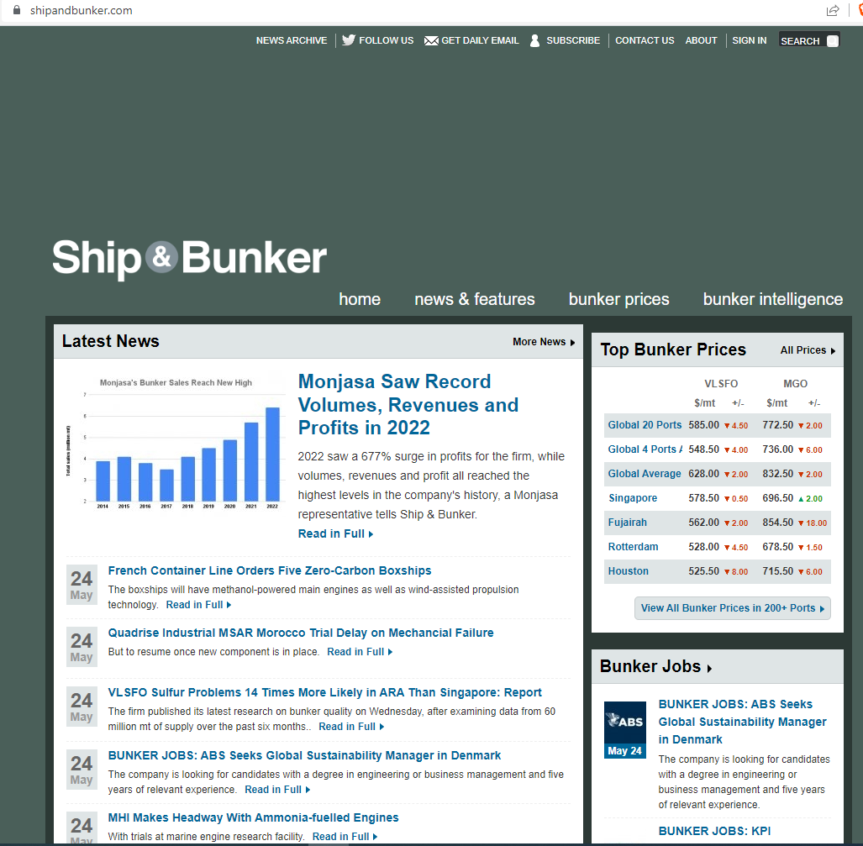
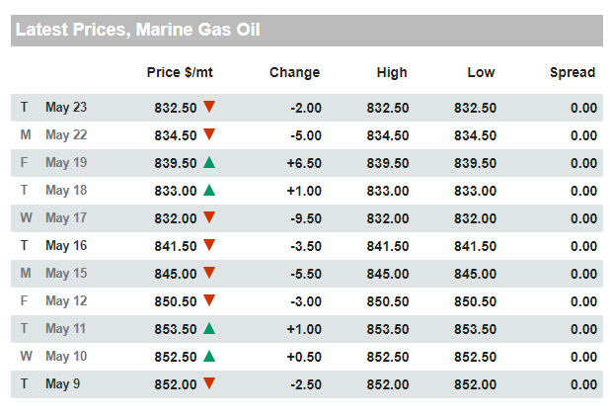
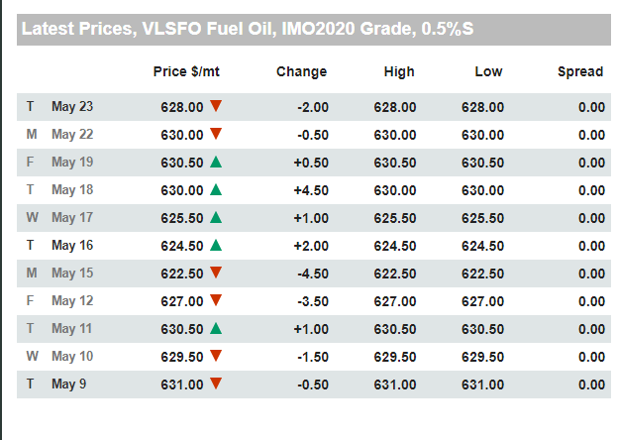
ShipBunkerWindowsService project
(Left)The website I chose to collect data from is called shipandbunker.com and provides financial
Info about oil and bunkering prices in ports, all around the world.
Specifically, I scraped 2 tables from the Global Average section(right), that presented the price, change, high and low and spread.
The first table has data about Marine Gas Oil and the second about VLSFO Fuel Oil.
The columns of interest in this case were the ones that had the date, the price $/mt and High Low. The red and green symbols were not scraped.

Slide 5
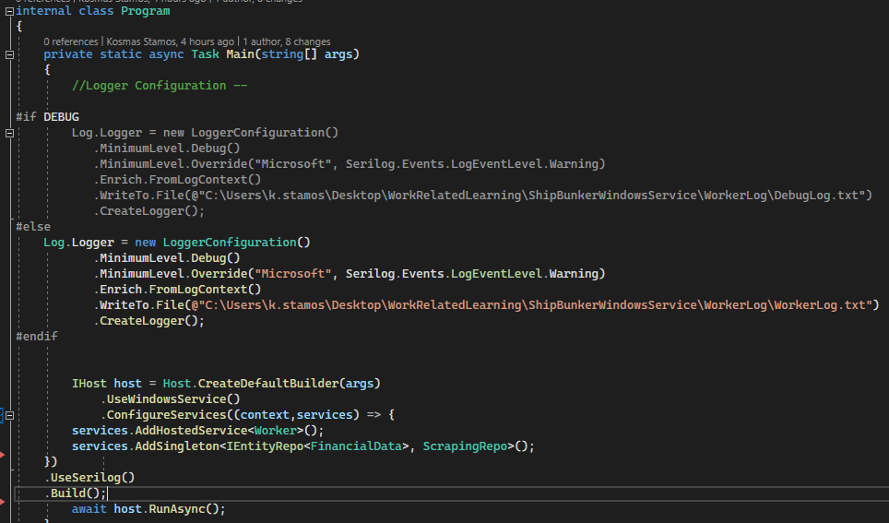
Worker Service and Logging
The project was accomplished with the use of a worker service (from Visual Studio template files), because it has the perfect environment for a long running background service, since it inherits the BackgroundService class. An asynchronous timer ( in the form of Task.Delay() command is present to enforce the running interval of the service and its continuous running is ensured with a continuous while loop.
After confirming its correct running, through testing in the Debug Environment, I then proceeded into publishing the project in a local folder.
Then, after registering the project as a windows service, I had it running continuously as a background service through the Windows “Services” capability.
For logging purposes Serilog and its complimentary packages were used, bypassing the default Visual Studio console logging capacities. The Logger, exports its messages into a simple “.txt” file and it ensures better debugging and understanding of the progress of the process. Below is the setup of the Logger, in the 2 environments, DEBUG and RELEASE.

Slide 6
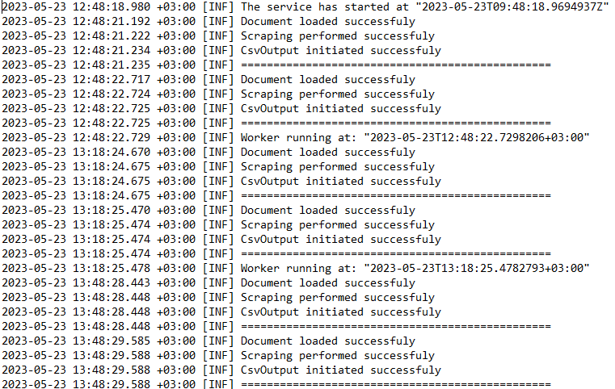
WorkerLog.txt Capture

