Slide 1
Ship Bunker Prices Web Scraper
Web scraping application, running in the background as a Windows Service
By Kosmas Stamos

Slide 2
Legal Notice
This work is not in any legal grey or red zone since:
It doesn’t infringe, use, publish any kind of personal data in the broader sense (in accordance with the GDPR law framework)
The data acquired is public and factual information
No copyright infringement took place, since no website elements ( in the case of Screen Scraping* ) were gathered in the process, just raw data.
The work in not intended for commercial use or reproduction, republish as my own work, and it’s results won’t be used as a source for further research or conclusions
No commercial use of any kind is planned or depends on the gathered data
The work is thus protected by article 3 and 4 of the Digital Services Act, which aims to bring all EU countries under Digital Single Market(DSM) sharing same regulations. According to Article 3 and 4 of this regulation, “reproduction of publicly available content” is not illegal.
The DSM Directive permits text and data mining, which means:
“any automated analytical technique aimed at analyzing text and data in digital form in order to generate information which includes,
but is not limited to, patterns, trends and correlations.”

Slide 3
Web scraping , what is it?
Static Web Scraping
Static web scraping involves the gathering of static elements of a website, like tables or plain text. It is a the most basic form of web scraping, since the elements do not change with user activity or events and popups.
It involves all the same procedures as any other form of w.s:
First, we fetch a website through its URL
Second, we load it into an Html Document, which is an appropriate form for the scraping to take place
We select via Xpath signature, the particular element we want to gather data from
Perform the scraping and gathering of the data into an appropriate data structure (e.g. List)
Export the results of the process, formatted or not, into a file format of your choice (e.g a Csv file) or a database.
Web scraping(w.s) is a data gathering technique used for extracting information from websites. Web scraping software may directly access one or multiple websites to gather valuable, publicly available information for commercial or research purposes. It is a form of copying in which specific data is gathered and copied from the web, typically into a central local database or spreadsheet, for later retrieval or analysis.
Web scrapers typically take something out of a page, to make use of it for another purpose somewhere else. There are 3 main scraping methods:
Screen scraping
Dynamic Scraping
Static scraping → our case

Slide 4
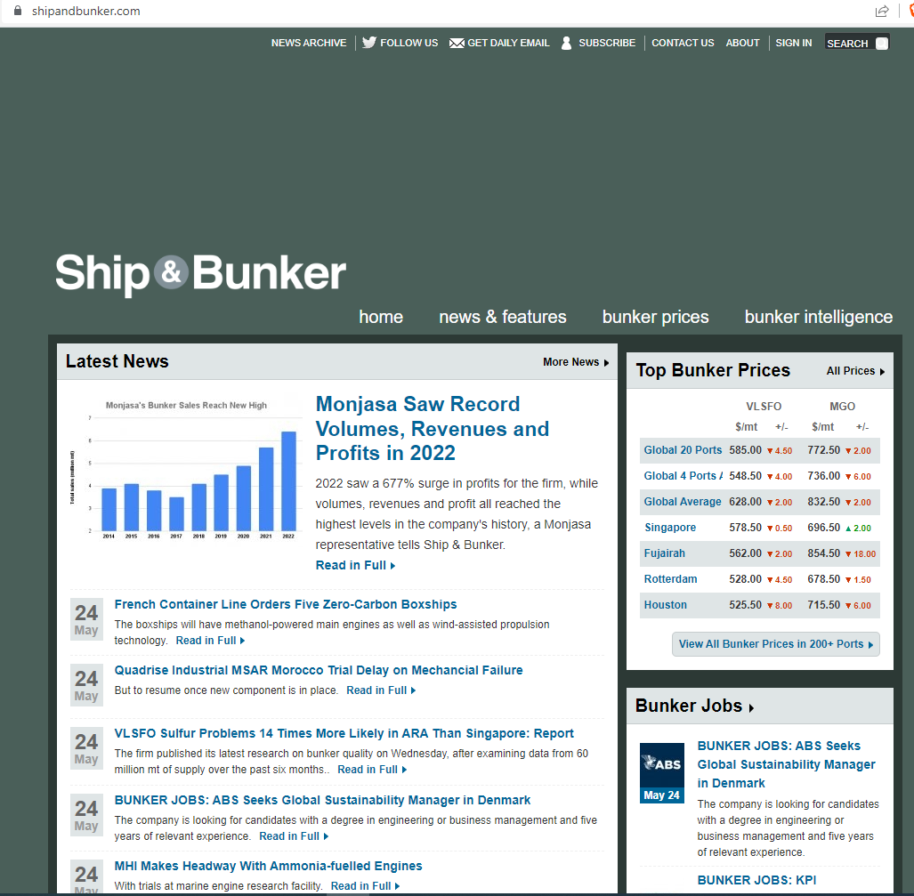
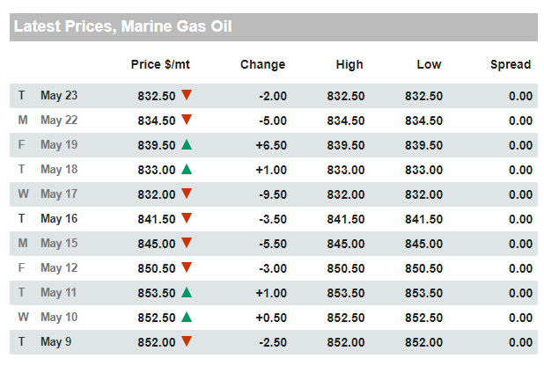
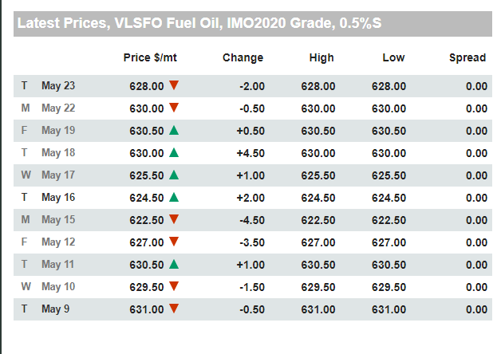
ShipBunkerWindowsService project
(Left)The website I chose to collect data from is called shipandbunker.com and provides financial
Info about oil and bunkering prices in ports, all around the world.
Specifically, I scraped 2 tables from the Global Average section(right), that presented the price, change, high and low and spread.
The first table has data about Marine Gas Oil and the second about VLSFO Fuel Oil.
The columns of interest in this case were the ones that had the date, the price $/mt and High Low. The red and green symbols were not scraped.

Slide 5
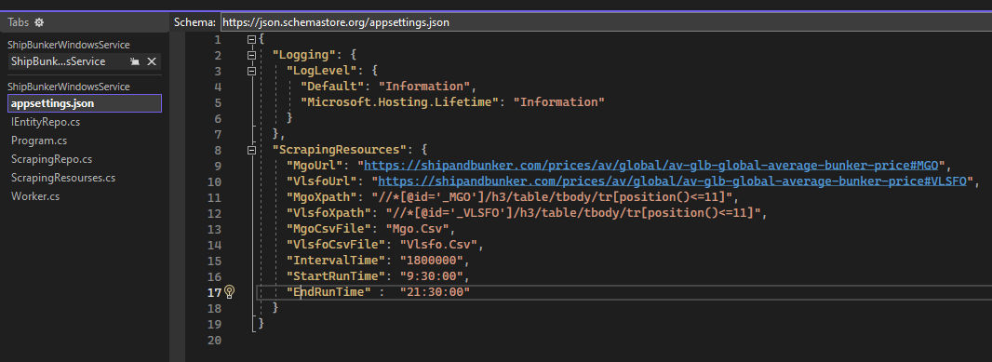
Data Inputs
The vast majority of the data inputs required for the implementation of the service is handled and passed through the appsettings.json file of the project.
In this json format, our data gets passed on as configurations in the initial stages of the process, matched with corresponding variables of the same name and then used to perform the tasks that require their use.
This way, if we wanted to perform changes in our Windows Service, or have it run in multiple instances with different business requirements, we only have to change those settings, instead of modifying the code extensively.

Slide 6
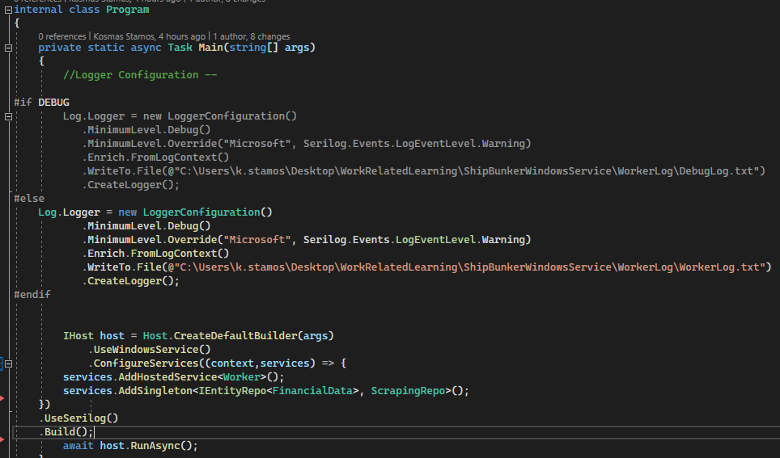
Worker Service and Logging
The project was accomplished with the use of a worker service (from Visual Studio template files). A timer is present to enforce the running interval of the service and it runs continuously in the background. After confirming its correct running, through testing, the service was published in a local folder.
Then, after registering the project as a windows service, I had it running continuously as a background service through the Windows “Services” capability.
For logging purposes, Serilog and its complimentary packages were used, bypassing the default Visual Studio console logging capacities. The Logger, exports its messages into a simple “.txt” file and it ensures better debugging and understanding of the progress of the service. To the right, is the setup of the Logger, in 2 environments, DEBUG and RELEASE.

Slide 7
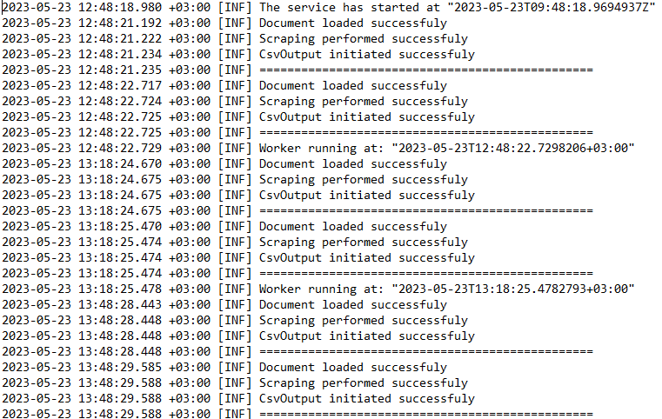
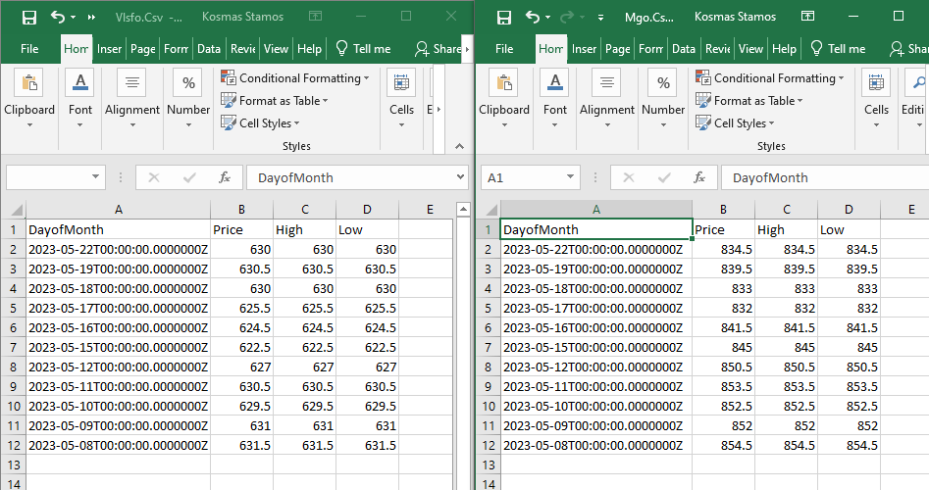
CSV outputs
The other 2 output files that the app produces are 2 separate .csv files in the current working directory, titled “Mgo.csv” and “Vlsfo.csv”. They contain the scraped data that we gathered and are updated every time the worker service running interval is reached. Below is a snippet from both of the files.
WorkerLog.txt example

Slide 8
Business Requirements
The business requirements for this project are stated below.
The app. must have the capacity to run in the background as a Windows Service .
It should be collecting and refreshing when changes happen, the 2 aforementioned MGO and VLSFO global average prices from the shipandbunker.com website.
It should be scraping the columns “Date, Price $/mt, High, Low” from those tables and store the data in the form of 2 separate csv files.
The “Date” column’s data must be formatted to be exhibited in the ISO time Format.
The scraping should be happening in a 30 minute interval between the allotted time span.
The running period of the service should be between 9:30 and 21:30 in UTC time format, from Monday to Friday.

Slide 9
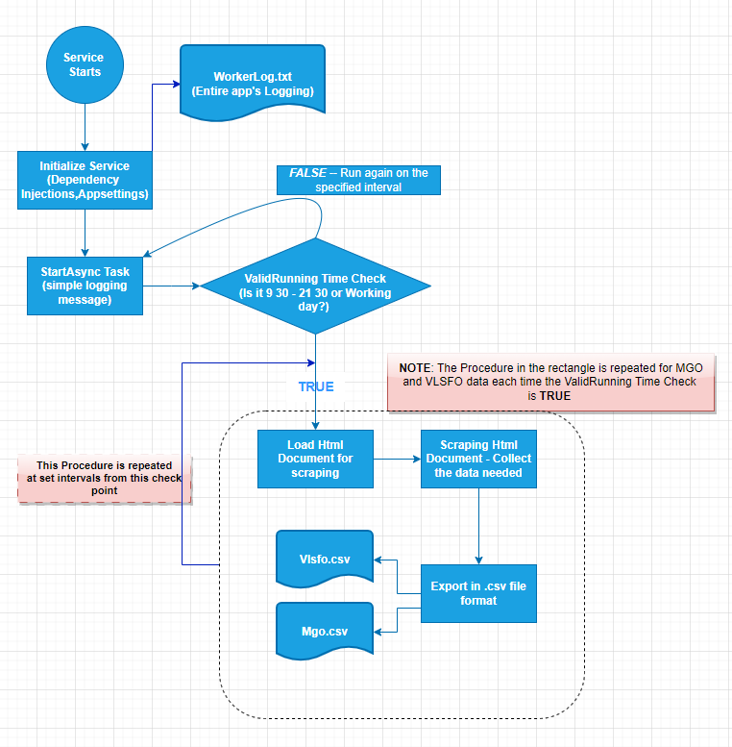
Flow chart of the process
Points of interest
The ValidRunning Time condition for running the process
The 3 processes in the rectangle that handle the scraping operation
The 3 output documents

Slide 10
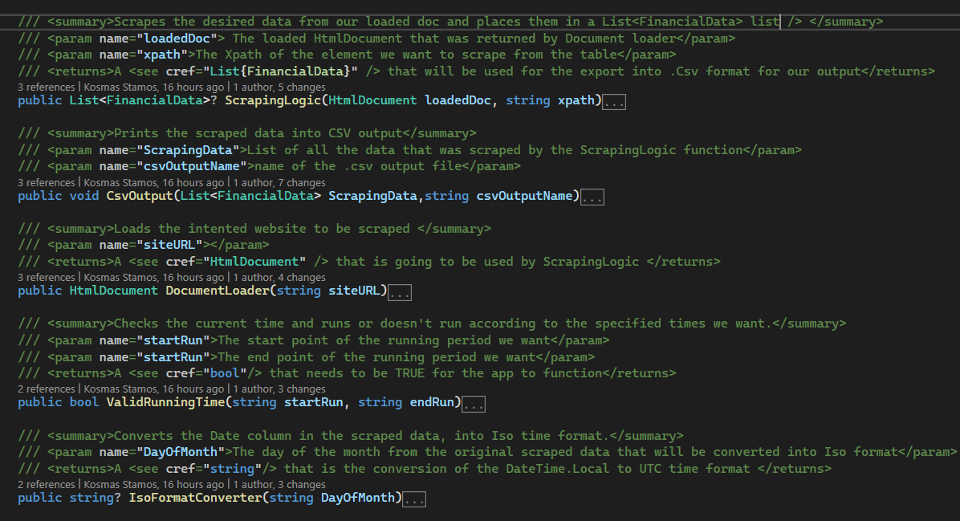
The 5 functions that handle the logic and most of the business requirements of the Service
ValidRunningTime
IsoFormatConverter
DocumentLoader
ScrapingLogic
CsvOutput

Slide 11
Our functions in some detail
ValidRunningTime: Handles the important condition about the running times/days of the service. It is used frequently to ensure the adherence to our business requirements
IsoFormatConverter: Converts the date column that we scraped, into ISO time format
DocumentLoader: Loads the website about to be scraped into HTML Document through the site’s URL
ScrapingLogic: Handles the scraping of the data from the loaded Html Document and places them into a List
CsvOutput: Exports the scraped data into a csv file, with the desired format.

Slide 12
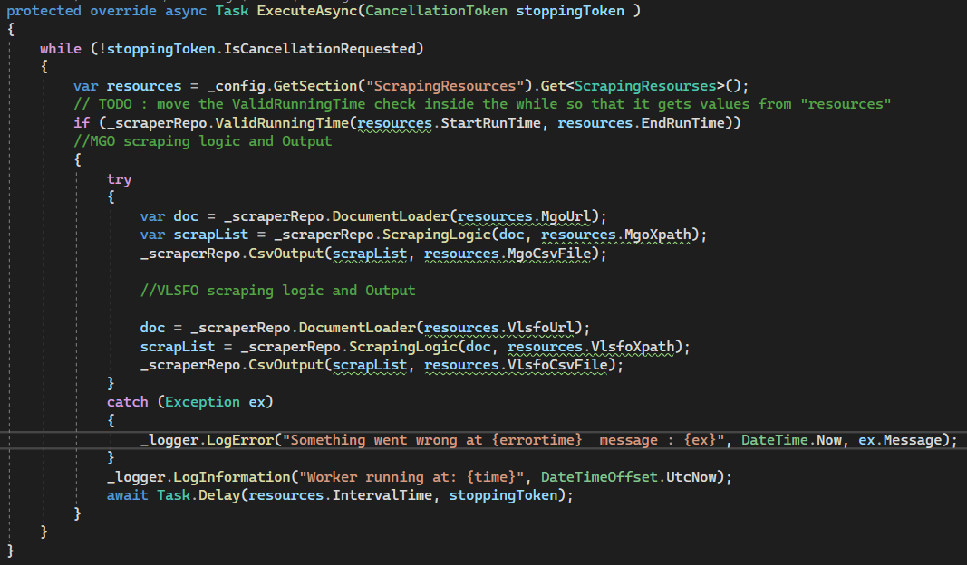
Worker file
Most of the work of the application happens in the Worker file, especially in the ExecuteAsync task function and most of the logic is implemented here.
The continuous operation of the service is ensured with the While loop.
The decision to perform the procedure or not based on time/day criteria is handled
with an if statement
Lastly, the time interval that our service will be performing is implemented with the last line, Task.Delay()

Slide 13
Thank you for your time

